Slide 1

VOLA
Guide for Using Vola Event Management
and
Timing Software for Season 2026

Slide 2

IMPORTANT NOTICE
Procedures which impact your event operations and programs must be relayed to all event officials, Team Captains, and competitors.
The procedures must – without question – be respected and observed.

Slide 3
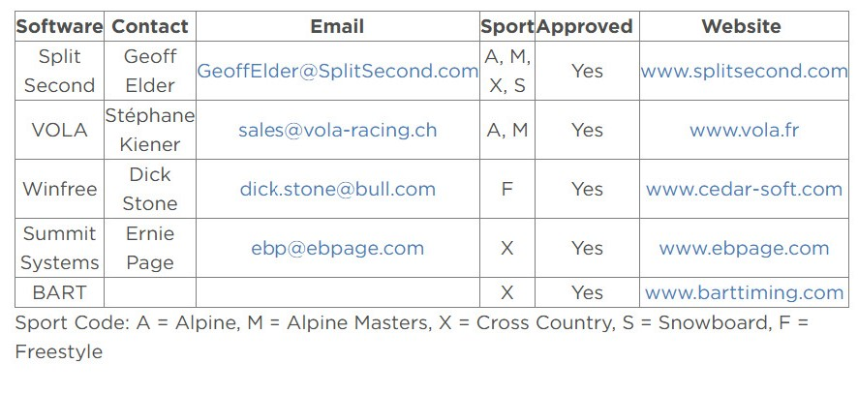
Race Results Software usskiandsnowboard.org/sport-development/officials-development/timing-race-administration vola.fr/en/timing/logiciels/suite-skialp /skialp-pro

Slide 4
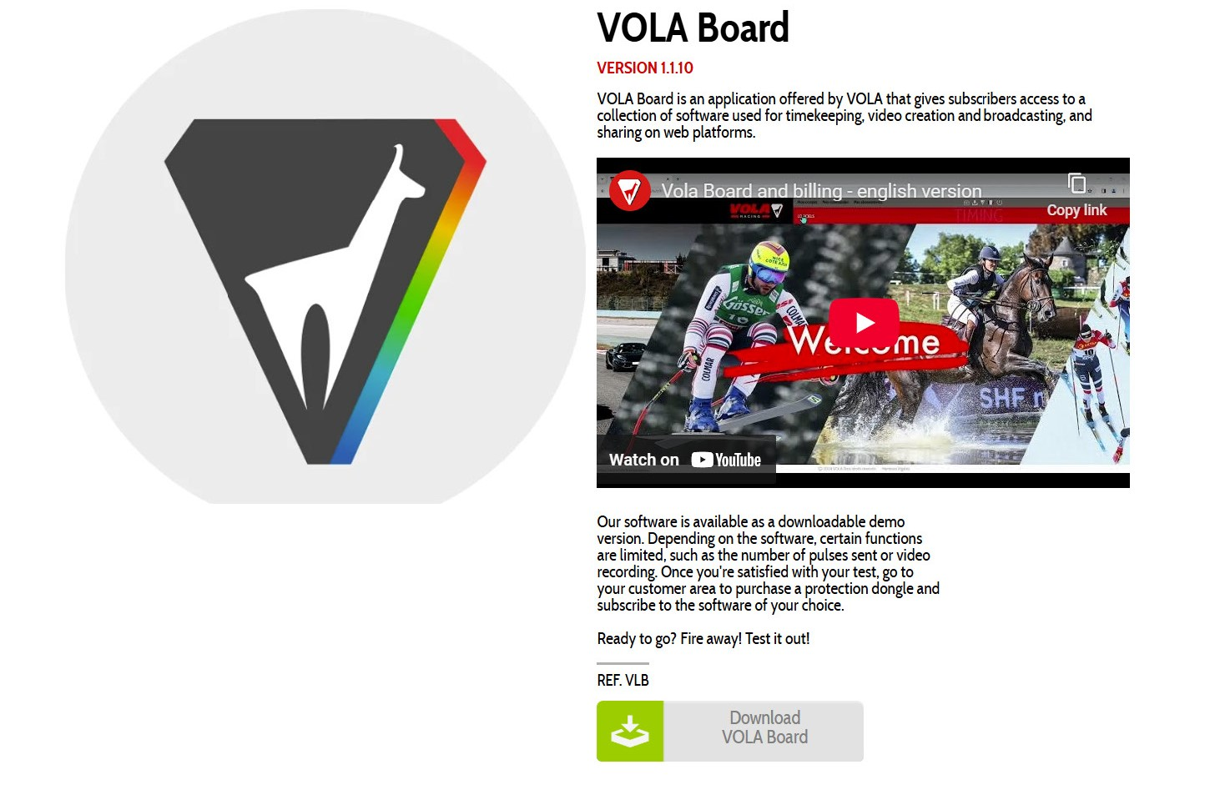
Downloading Vola Board
Access the Vola Website.
Click on Vola Board download icon and install
You will be asked to create an account and verify via email

Slide 5
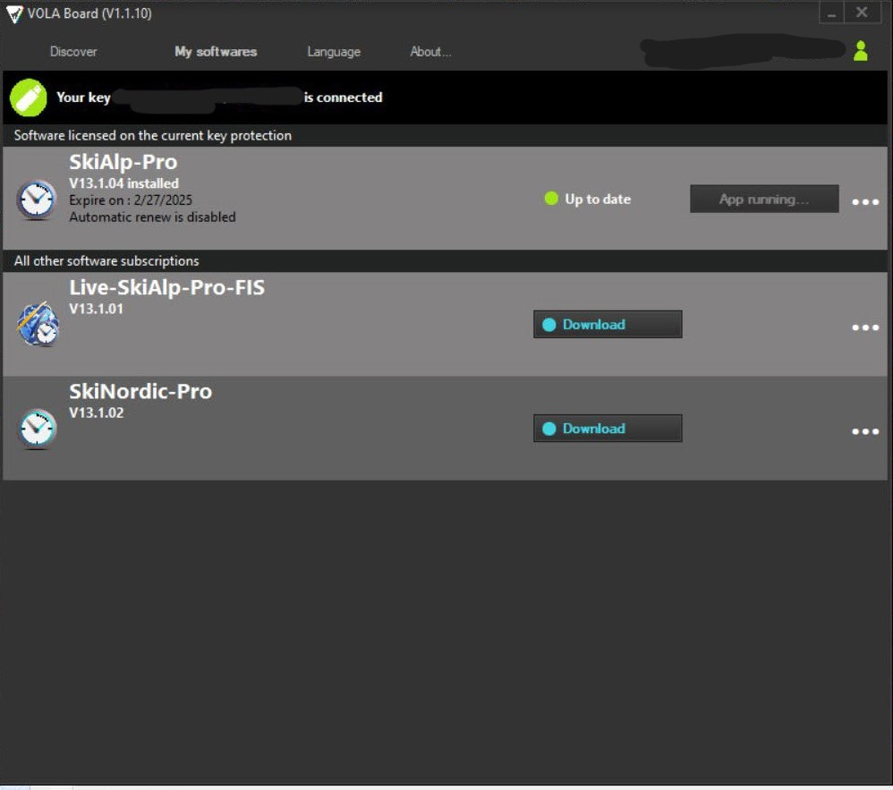
Downloading SkiAlp-Pro
From the Vola Board App on your desktop, you will now be able to download SkiAlp-Pro

Slide 6
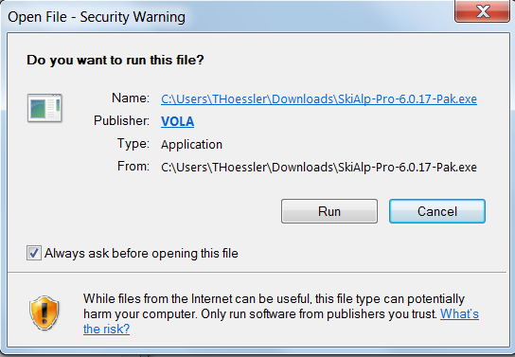
Select ‘Run’
NOTE: You will be asked if you wish to allow this program to make changes to your computer. In order to continue installation, you must answer: YES

Slide 7
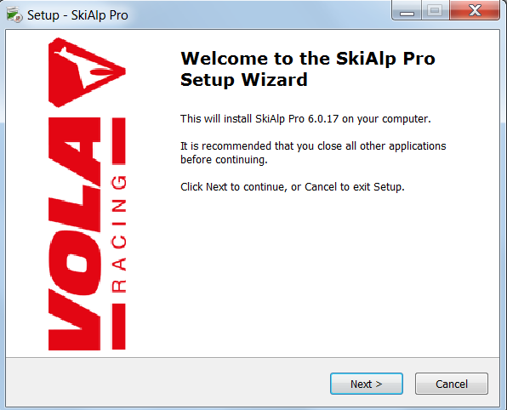
Select ‘Next’ and Begin Installation

Slide 8
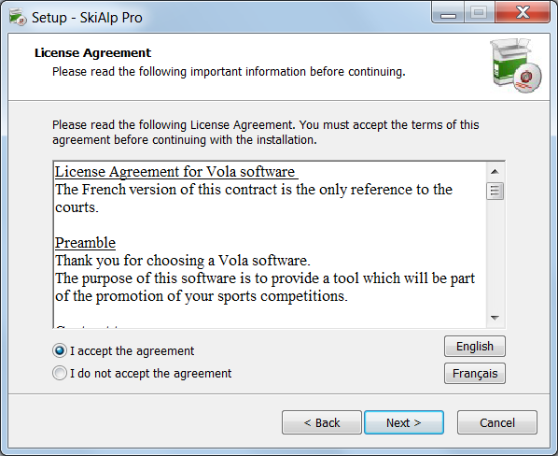
Accept and Select Next

Slide 9
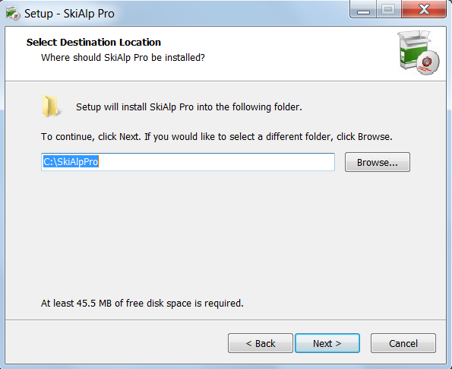
Select Next

Slide 10
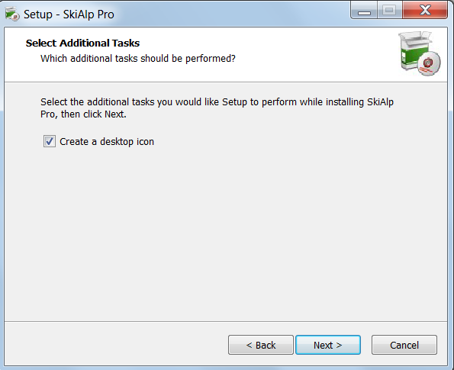
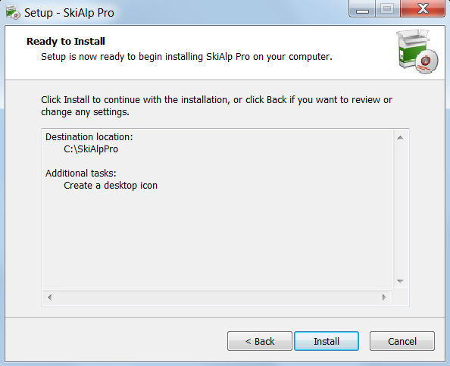
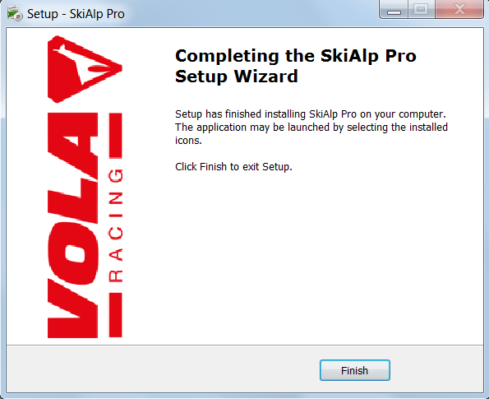

FINAL STEPS:
1. Create Icon/NEXT
2. Verify/INSTALL
3. FINISH
Click on created desktop icon to start the software.

Slide 11
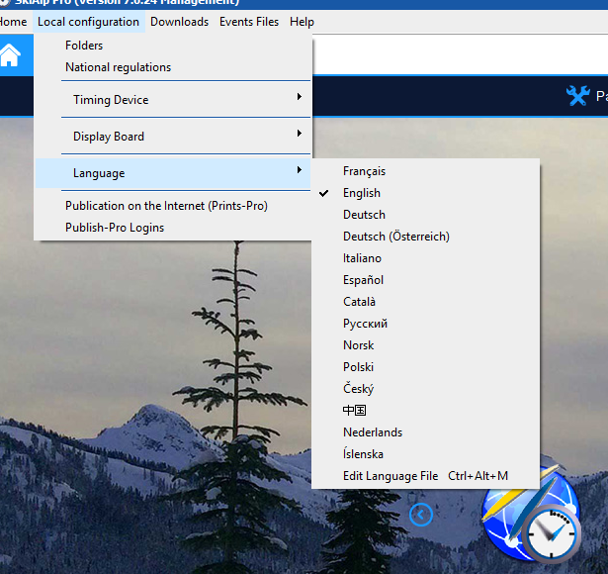
Local Configurations
Choose Local Configurations
Choose National Regulations
Choose Language:
‘English’

Slide 12
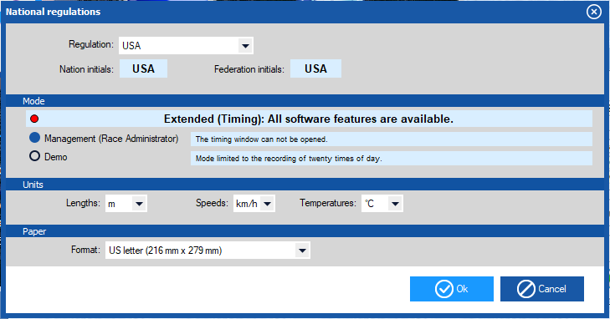
National Regulations
This sets your
- Nation
- Lengths
- Speeds
- Temperature - Management
mode for Race
Administrators

Slide 13
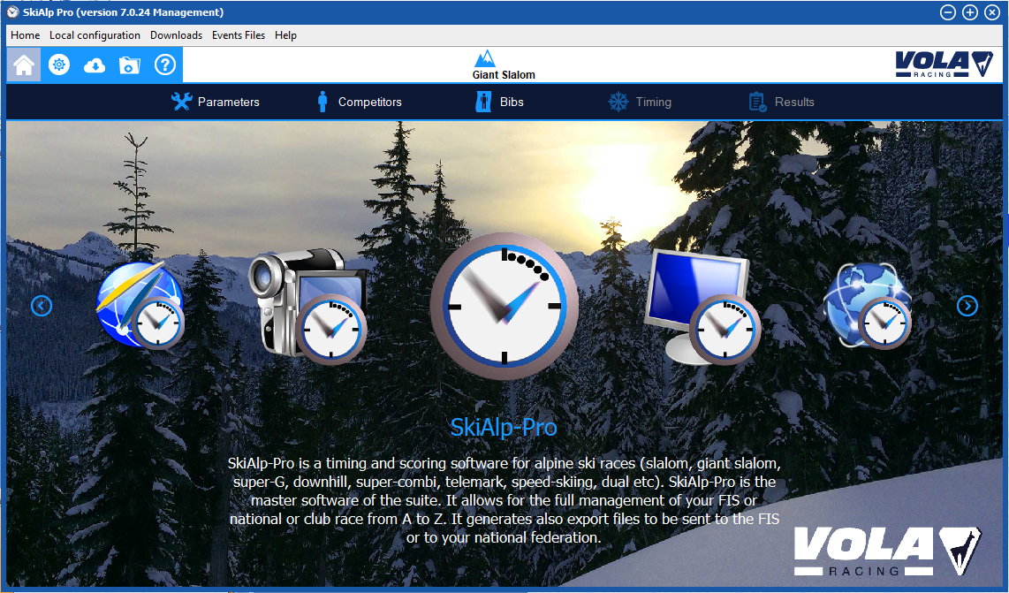
OPENING SCREEN
Time to verify your dongle and create an event.

Slide 14
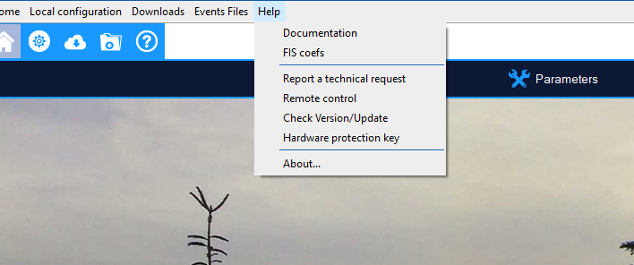
Verify your dongle
Select Help
Choose Hardware Protection Key

Slide 15
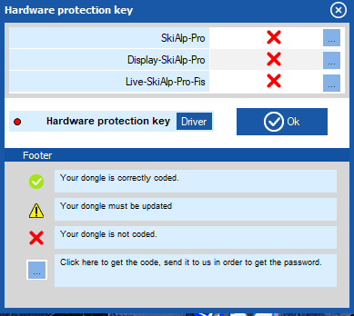
Dongle Driver and Confirmation
Install Driver: Follow the directions carefully
Red confirms the dongle is NOT working properly.

Slide 16
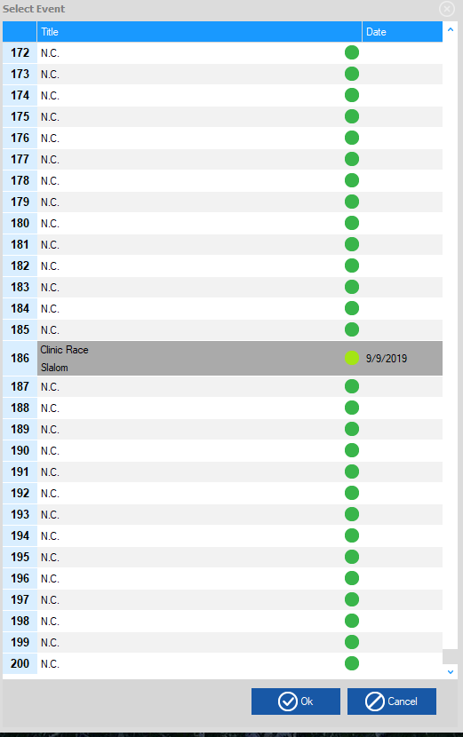
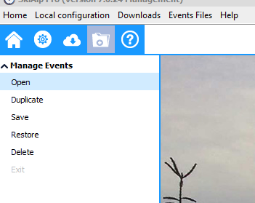
Creating an Event
Click on Folder Icon to open ‘Select Event’ Window.
Choose Manage Events
Choose a previous event or Choose N.C. to create a ‘New Event’
Will hold up to 200 events
NOTE: A ‘dongle’ is not required in order to create or administer an event. It is only required for timing functions.

Slide 17
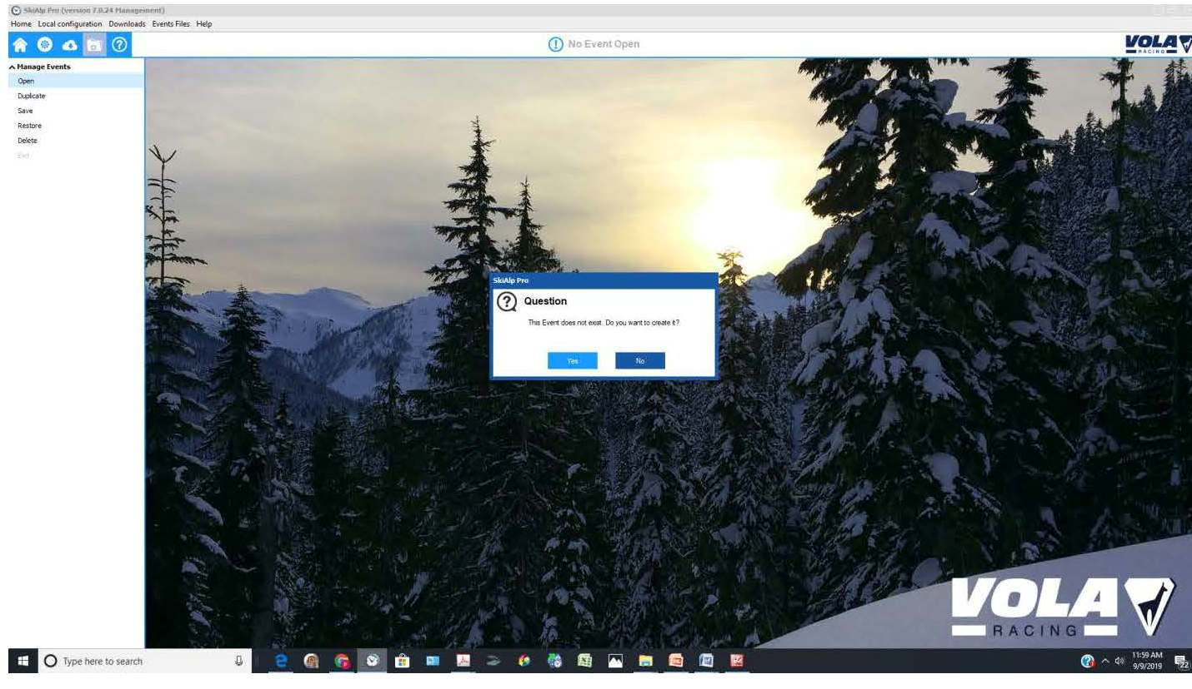
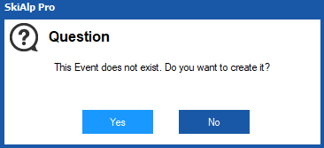
New Event Selected

Slide 18
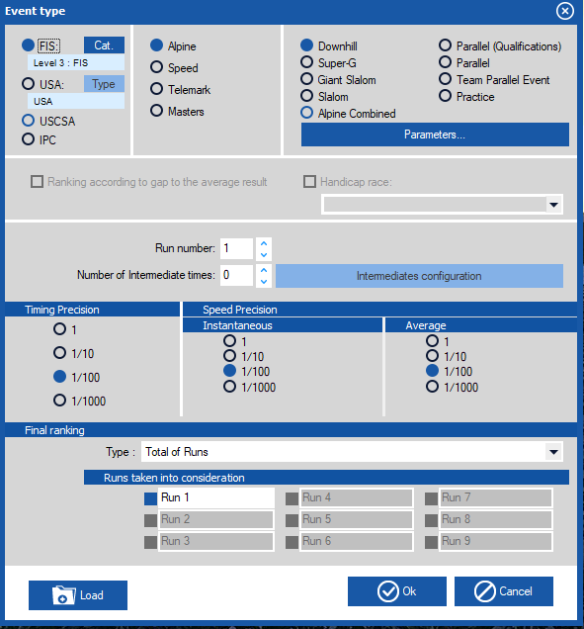
Event Type
Use the radio buttons to complete the data for your event: - U.S. Ski & Snowboard/FIS - Discipline/Event:
DH.SG.GS.SL.AC.PL
- # of intermediate times - # of runs in the event - Timing Precisions as
reported on results

Slide 19
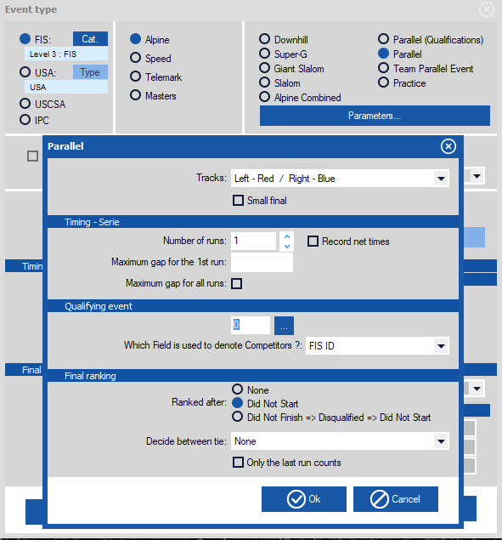
PARALLEL: Set your “Parameters”

Slide 20
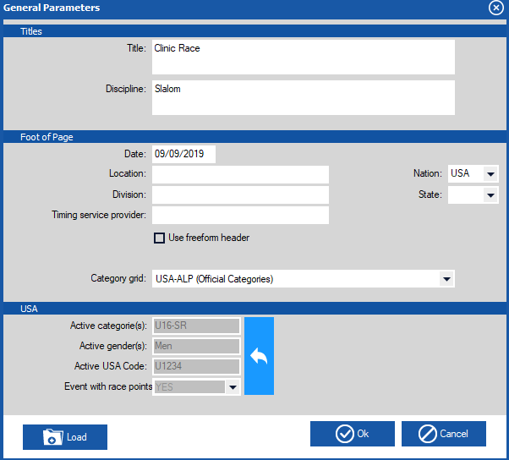
General Parameters
- Event Title
- Discipline/Event
- Date
- Location
- Division
Timing Service Provider
Category grid

Slide 21

Codex and Gender – U. S. Ski & Snowboard Races
Click on to add gender, age class & codex

Slide 22
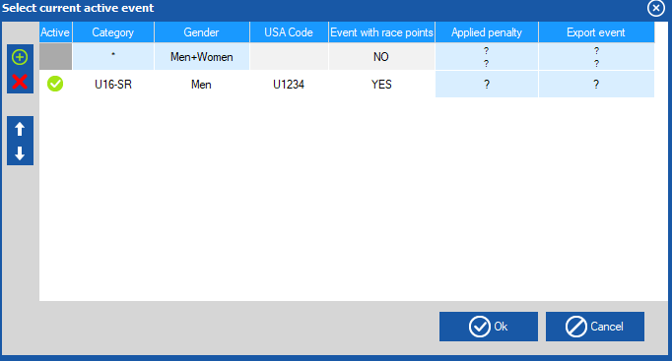
Codex and Gender – U. S. Ski & Snowboard Races
Choose + ,
then double click on Category = Age Class Gender = Men/Women Codex = USA code Event scored = yes/no
This example will only show one gender per event file.

Slide 23
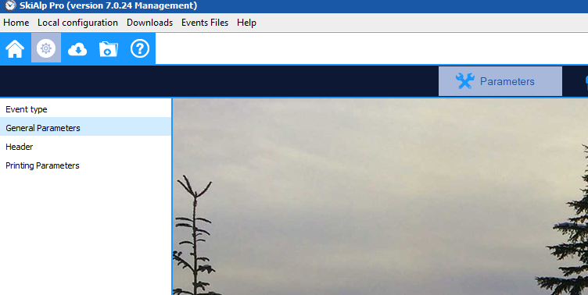
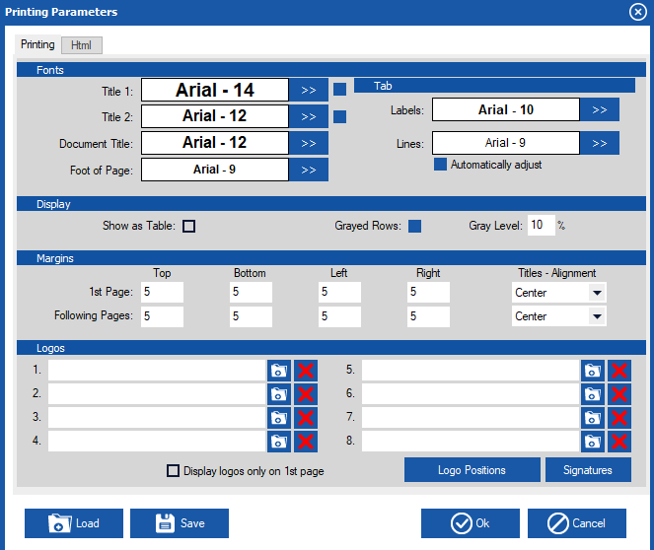
Printing Parameters
OC can choose from different Fonts, Font Size, Logos, Watermarks, General layout Can be saved for future use

Slide 24
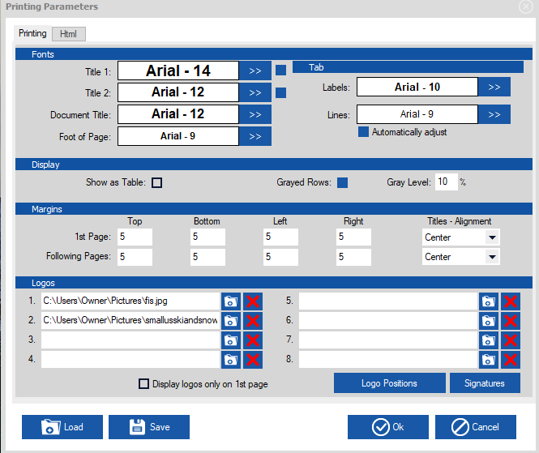
Printing Parameters Adding logos
Logo set ups can be ‘Saved’ to
your ‘config’ folder
Your logo set up can then be loaded into a new event folder
by using the ‘Load’ button.
Logo layout can be accessed by selecting logo positions

Slide 25
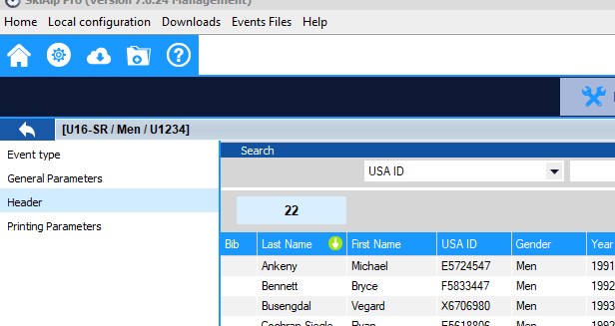
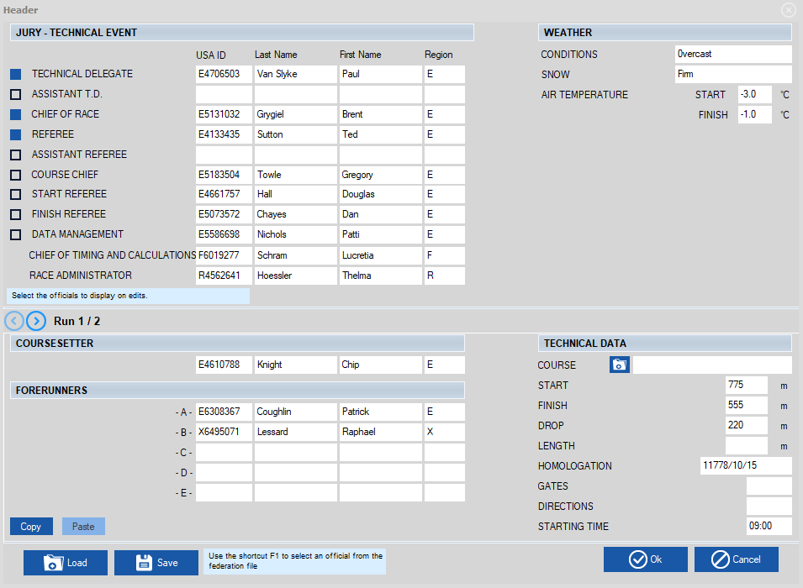
Parameters Header – Officials
Choose the Jury you need printed on results.
Place your cursor in the desired field and choose F1 to pull up valid officials.

Slide 26
Parameters Header Forerunners-Technical Data
Enter Weather Data
Choose the folder next to ‘Course’ to download FIS homologation information. Must verify accuracy on FIS website.
Course Setter and Forerunners can be entered by using F1

Slide 27
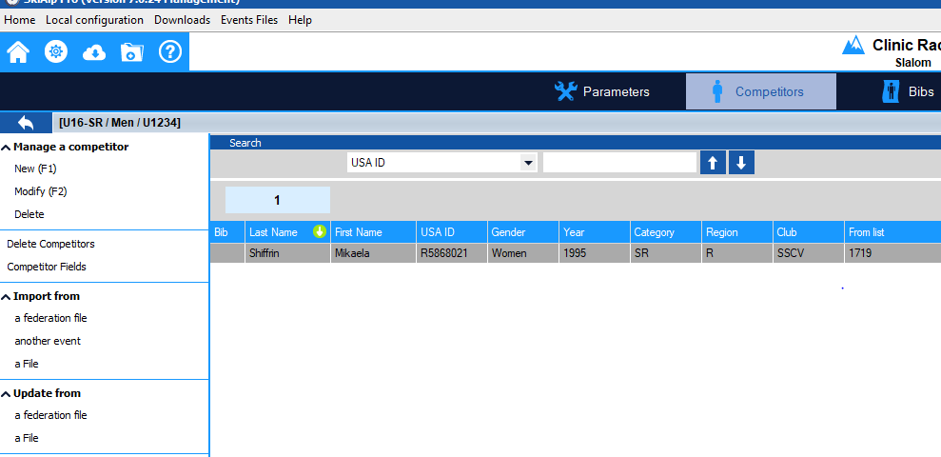
Competitor Page
Select Competitors at top of the page.

Slide 28
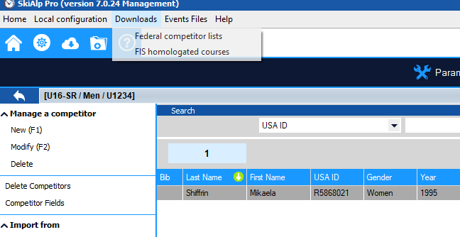
Downloading a Points List
Choose the ‘Downloads’ tab from top and choose ‘Federal competitor lists.’
Choose FIS homologated courses to download a database
of information to use in headers. This only needs to be done once
or twice a season.

Slide 29
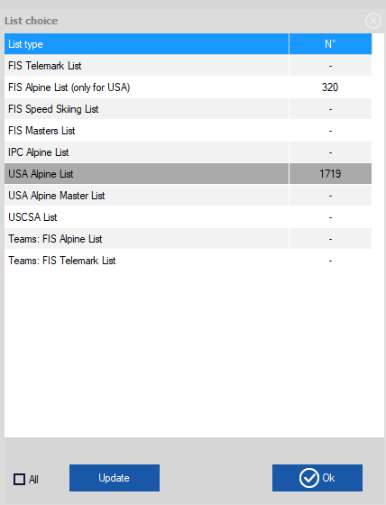
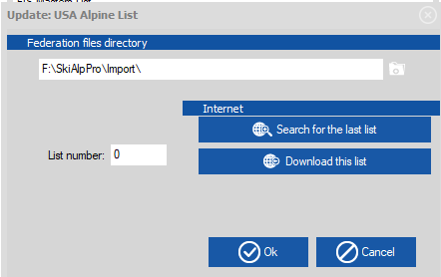
“DOWNLOAD” Points List
Select List
Choose Update
Enter List # or ‘Search for the last list’.
‘Download this list’ followed by Ok to import the list and the athlete list will open.
Complete for U.S. Ski & Snowboard and FIS (alpine for U.S. Ski & Snowboard only)

Slide 30
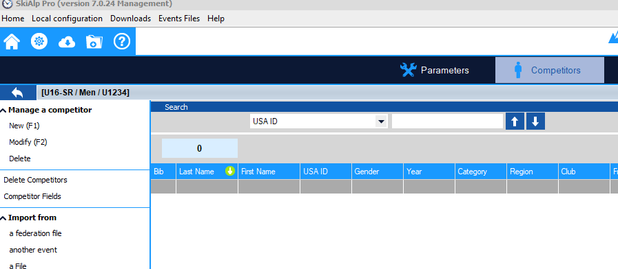
Points List – Entering Individual Athletes
In Competitor screen, select Import from a federation file. Then select the list USA Alpine or FIS

Slide 31
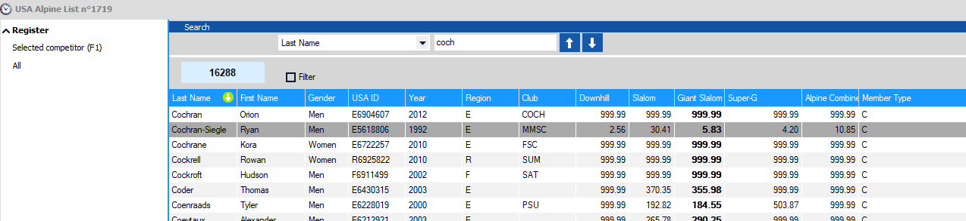
Points List – Entering Individual Athletes
Enter ‘Last Name’ of the athlete.
Once highlighted, double click, or hit F1, to enter athlete into the event file. Filters can be set up to enter blocks of athletes.

Slide 32
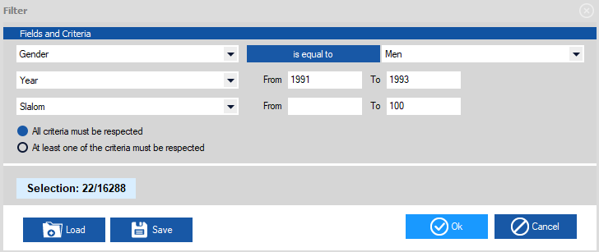
Entering Athletes using Filters
To enter a group of athletes you can apply a filter. Filters are available for: Gender, Year of Birth, Event, Club, Division, Etc. To access the filter screen select the filter box on the points list
In this example: 22 athletes meet the criteria of Men, YOB 91-93 with SL Points between 0 and 100

Slide 33
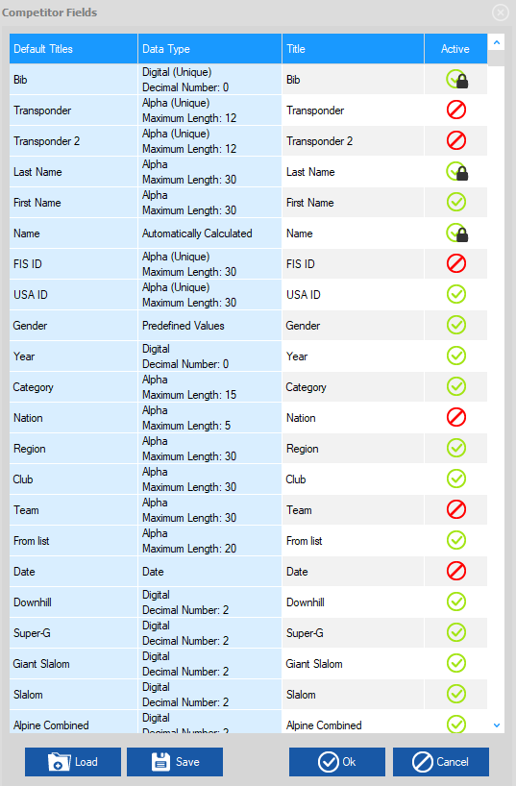
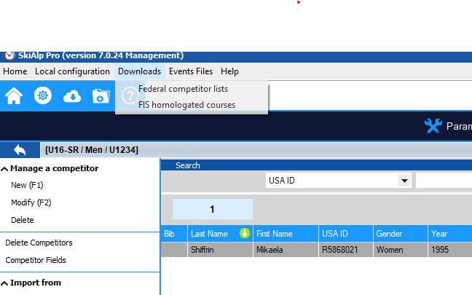
Competitor Fields
Define your competitor fields prior to importing competitors from excel.
Choose: ‘Competitor Fields’
(Make Category active if you want to see age classes.)
Double click to make item active
or inactive, notated by green and red  symbols

Slide 34
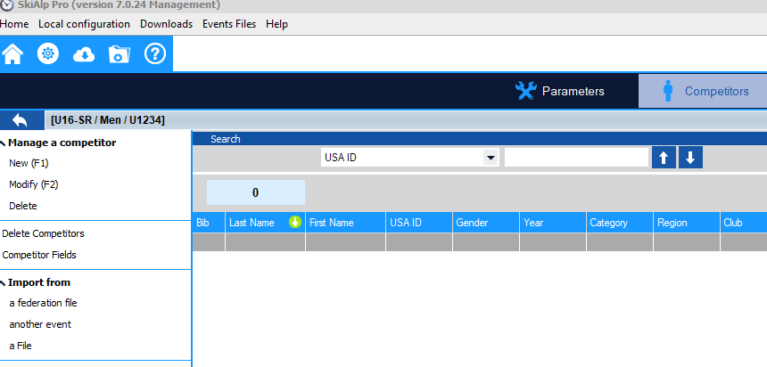
Importing Athletes via Excel
Choose: ‘Import from a File.’

Slide 35
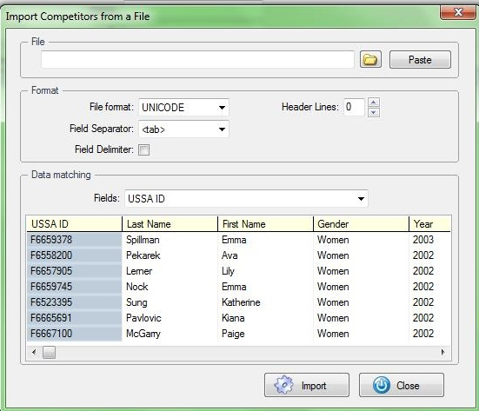
Importing Athletes via Excel = Paste
‘Copy’ fields needed from your open excel file
import competitors from a file
‘Paste’ and athletes populate in the ‘Data Matching’ window

Slide 36
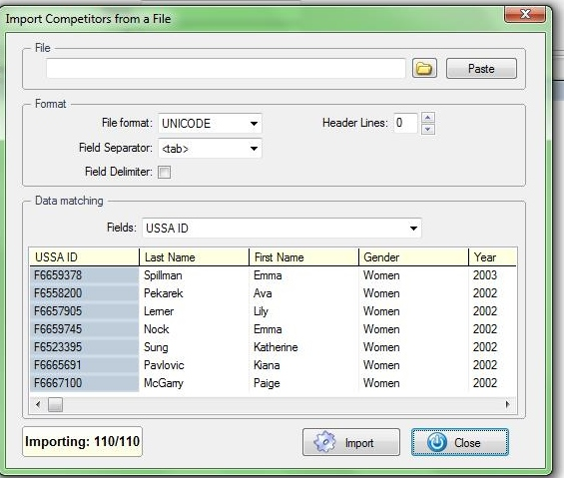
Verify Import Numbers Match
110 in the excel, 110 imported into the race file

Slide 37
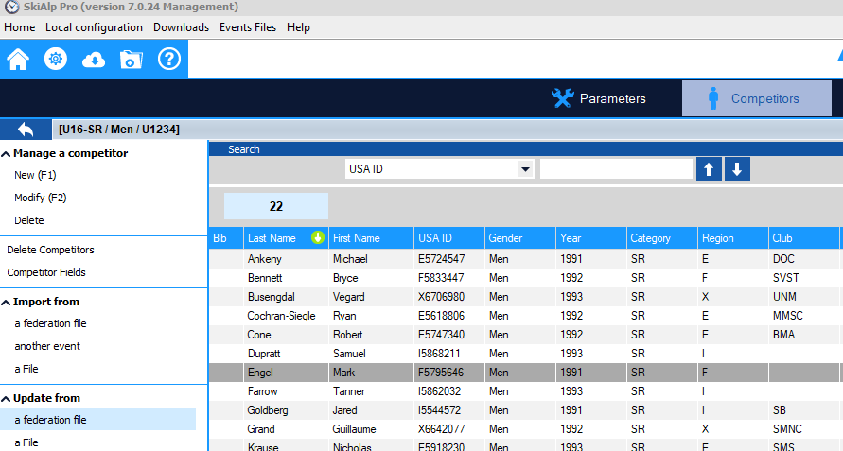
Updating Points After Excel Import
Choose
‘Update from a
Federation File.’
Choose OK on next screen
Names may be spelled differently on each site: U.S.: O’Henry; FIS: O Henry.
Use data source applicable to type of event to eliminate autoscore rejection.

Slide 38
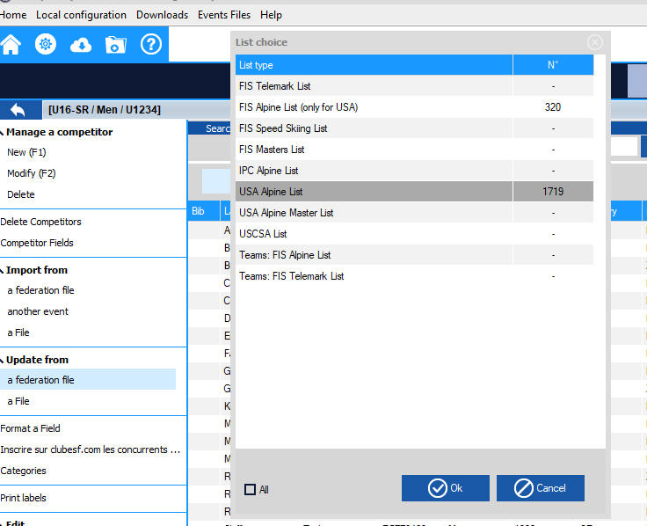
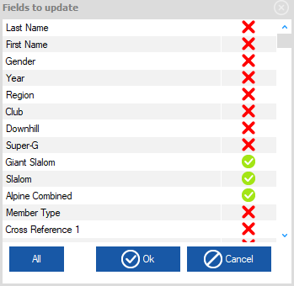
Updating Points
Select Update:
Select Source
Confirm event(s)
(Double Click to select or deselect update fields)
Click ‘OK’
Reminder: always verify points after import

Slide 39
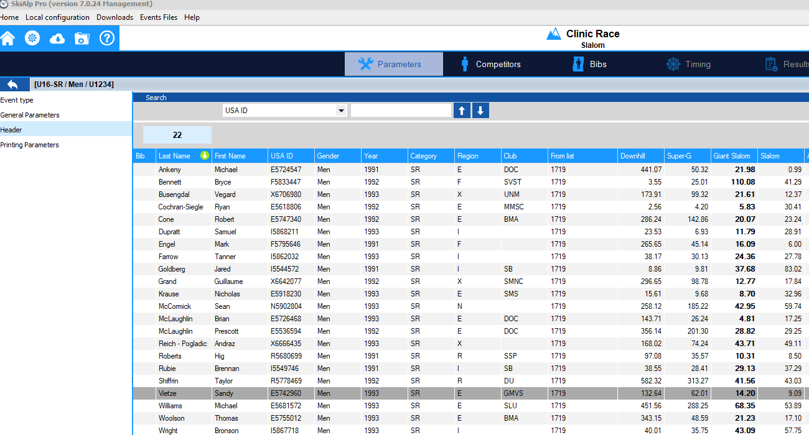
Quick Sort: Function can also be used in an Event File
Green arrow signals the column you are currently sorted by.
Double click on column header to change the sort .

Slide 40
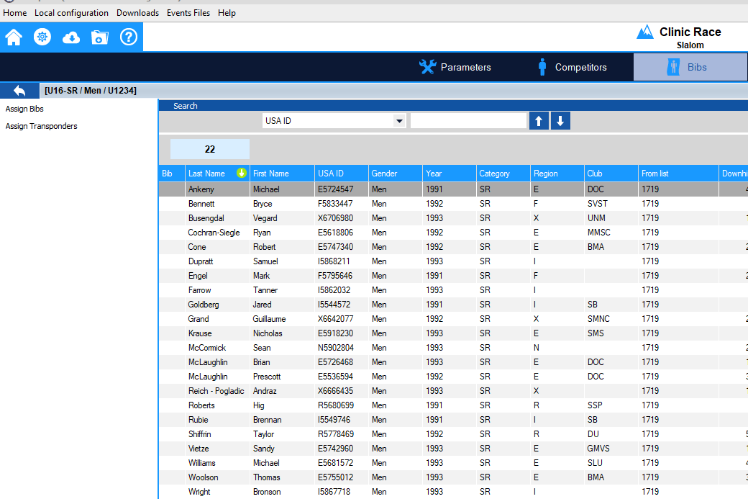
Assign Bibs
Select ‘Bibs’
Click on ‘Assign Bibs’

Slide 41
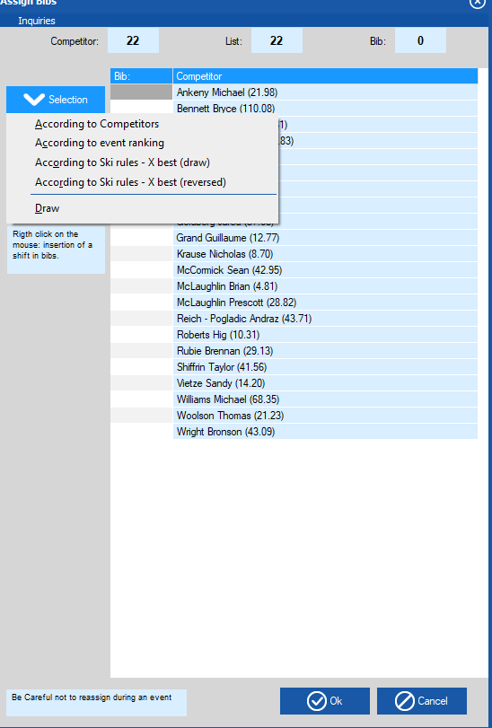
Draw and Assigning Bibs
According to Ski Rules – X Best(draw)
This will Randomize the top 15 and the 999.99

Slide 42
ASSIGNING AN OUT-OF-SEQUENCE BIB NUMBER
VOLA:
interprets the “start number” to be the “bib number”
breaks a tie in time by defaulting to the athlete’s “bib number”
When assigning an out-of-sequence bib number to insert an athlete or to replace a missing bib:
Assigning Bib 106 to Start 6
May affect VOLA’s tie breaking capability should a tie in time occur
Example:
St. Bib Time
Start 6 Bib 106 1:05.10
Start 20 Bib 20 1:05.10
Bib 106 will be ranked before Bib 20 regardless of the earlier start
617.3.3 If two or more competitors have the same time or the same number of points, the competitor with the higher start number must be listed first on the official list of results.

Slide 43
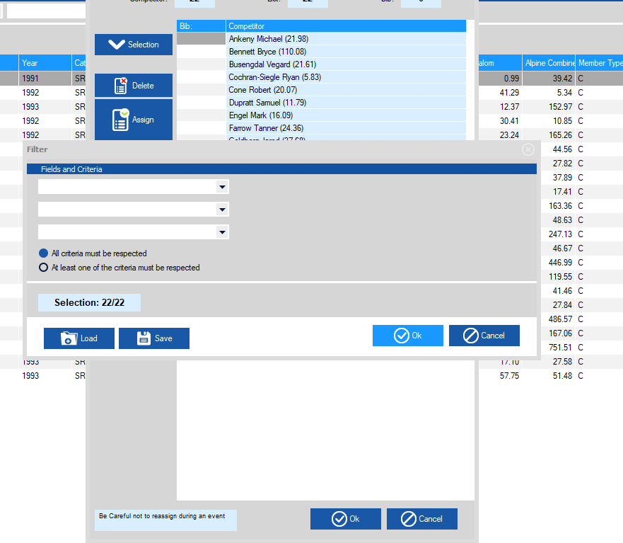
Draw and Assigning Bibs
No filter needed in a regular Scored Event Choose ‘OK’

Slide 44
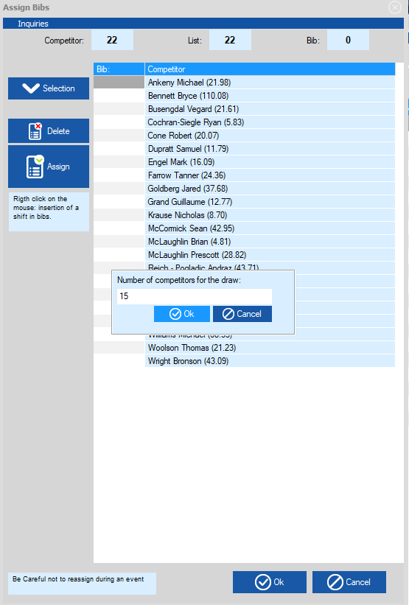
Draw and Assigning Bibs
Choose ‘Number of Competitors for Draw’
(Defaults to 15)
Choose ‘OK’ and randomization will occur. Scroll and Review accuracy of process.

Slide 45
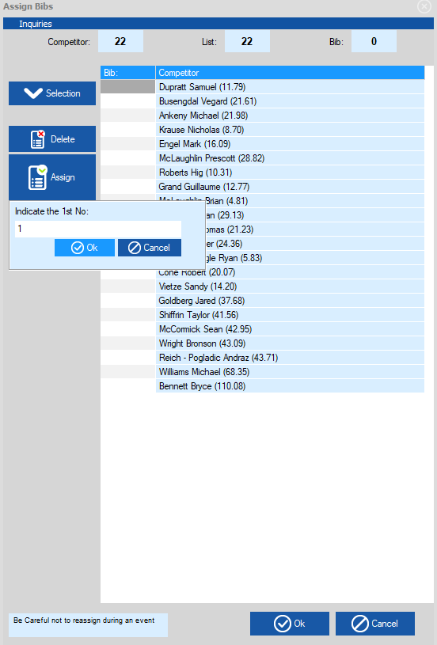
Draw and Assigning Bibs
Choose ‘Assign’ Enter starting bib number Choose ‘OK’
Click ‘OK’ again to load into the
‘ Competitors page’

Slide 46
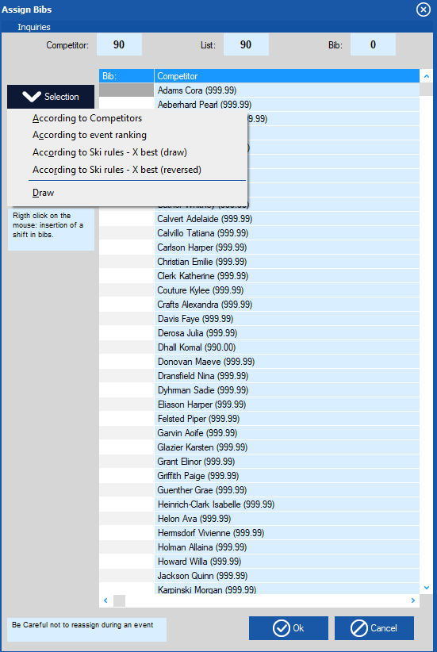
Draw and Assigning Bibs Non-Scored
Non-Scored Steps Assign Bibs Selection Draw

Slide 47

Draw and Assigning Bibs Non-Scored
Choose ‘OK’ on Filter List Window Random by of full field will take place if filter is not applied Proceed to Assigning Bibs OR Apply a filter here and random will take place within each category

Slide 48

Missing bib – ‘shift in numbering’
When a bib is missing in the order, right click in the ‘shift’ column where you need to note you are missing a bib.
You are not entering a bib #. You are entering the spot where a bib is missing; e.g., spot 1, spot 2, etc.
Notes:
Start at position 1 and work your way down. You are not noting the Bib # that is missing, you are marking the “spot” where a bib is missing.

Slide 49

Creating a Start List
Choose ‘Timing’
Choose ‘Start List’
Make sure you are in Run 1

Slide 50


Creating a Start List
Choose ‘Options’
Choose ‘Prepare with Bibs’

Slide 51

Creating a Start List
Click on ‘Add’ to load the start list
Choose ‘Close’ to complete the task

Slide 52

Clearing a Start List
To get rid of this start list Click on
‘Delete this List’

Slide 53

Run(Print) a Start List
Make sure timing is selected
Choose ‘Run a Start List
Select Run 1
Select Ok

Slide 54

Run(Print) a Start List
From the ‘run start list’ box, you can create ‘custom’ start list and save the settings,
or click on ‘Preview’ to review and ‘Print’.

Slide 55

1st Run Start List

Slide 56

Condensed Start List
With or without the header
Choose 2 Columns

Slide 57


Snow Seed
Choose Start List
Choose Options
Choose Snow Seed from the list
Choose how many from last 20% are to be applied to the Snow Seed (rule is 6)
Choose ‘OK’

Slide 58

Snow Seed
Choose ‘Apply the Snow Seed’
To apply the Snow Seed
To un-apply the snow seed, uncheck the box

Slide 59

Snow Seed – Start List
Note Starred Athletes are drawn for the Snow Seed

Slide 60

Inserting a Late Racer/Entry Step 1
Click on
‘Start List’
Click on
the green
+ to add a line
Double click on the bib square to add bib #.
Please note there are multiple ways to enter a late athlete. This ppt addresses only one method.

Slide 61

Inserting a Late Racer/Entry Step 2
Return to ‘Competitors’ at the top of the page
Choose ‘Import from a federation file’ on the left of the page to open the ‘List Choice’ field

Slide 62

Inserting a Late Racer/Entry Step 3
Type in athlete
‘Last Name’
Double Clicking on the athlete will enter them into competitor list

Slide 63

Inserting a Late Racer/Entry Step 4
Double click on added athlete. Opens the ‘Modify’ box Add the assigned bib Add Nation and Club

Slide 64

Inserting a Late Racer/Entry Step 5
Return to ‘Timing’
Open ‘Start List’
Click above athlete, hold and drag to their start location

Slide 65

Timing Device
Choose Local Configuration
Timing Device 1
NOTE: Access to timing functions is limited if Hardware Protection Key (dongle) not correctly coded or updated.

Slide 66

Timing- Test Device
Select Timing Device
And type of connection (USB, ComPort. IP)
Test timing device

Slide 67

Timing Screen
Choose ‘Timing’
Click on ‘Timing’ to open the timing screen

Slide 68

Timing - Sync
Start List is loaded
Sync: Impulse to the Primary Time Base starts the clock in the software
Shows impulse received for sync

Slide 69

Timing
Unlock Start and Finish: Click on the green circle icon (green light), or double click on red dot to turn it green

Slide 70

Timing - Forerunners
Double click on bib 1 and Enter 901 as the first Forerunner.
This # can be changed under Options; Software Parameters, Forerunner numbers

Slide 71

Timing – Run in Progress
Double click green button to create the ‘unactive passage.’
Starts
Finishes
Records
Ranking Box
Double click on radio buttons to allow start and finishes to be ‘open’

Slide 72

Timing – Windows of Options
To select DNF, etc. -right click on athlete bib # to open the window of options and select Status: Did not Finish or highlight the Bib number and Choose the DNF Icon at top

Slide 73
Timing – DNS
Highlight bib in Start Box Choose DNS Icon at top or right click and choose ‘status: Did not Start’

Slide 74

Timing – First Run Complete
Confirm Data

Slide 75

DSQ
Choose ‘Modify Data’
Type in bib
Status = Disqualified
Enter Gate # or Rule #

Slide 76
NPS
Choose ‘Modify Data’
Type in bib
Status = Not Permitted to Start
Enter Rule #

Slide 77

1st Run Report by the Referee
Select Results at top of Page
Choose ‘USA Referee Report’
Choose ‘Run 1’
Click on ‘OK’
Preview or Print in the next screen
(Repeat steps for Run 2)

Slide 78

Report by the Referee Sample
DNS & DNF data entered by Timing personnel during the timing of the event.
NPS & DSQ data entered by Timing personnel using the “Modify Data” option.

Slide 79

1st Run Results
Select Results at top of Page
Choose ‘Ranking After Run’ Choose ‘Run 1’ Click on ‘OK’ Preview or Print in the next screen

Slide 80

2nd Run Start List
Click on arrow to ‘Run 2’
Click on ‘Start List’ button
Click on ‘Options’ button
Choose ‘Prepare From Ranking of
Another Run’
This allows the option to include 1st run DNF and DSQ’s on the start list

Slide 81

Creating 2nd Run Start List
Insert ‘Bibbo’
Choose ‘Add’ Start list will load in background, Click on ‘Close’

Slide 82

Run(Print) 2nd Run Start List
Click on ‘Run Start List’ Choose ‘Run 2’
Click ‘OK’
The next step, printing/running of the start list, is the same process as run 1.

Slide 83

Results
Choose ‘Final Ranking’ to load overall results.
Final Ranking box will open, preview or print results.

Slide 84
Penalty Calculation
Choose ‘Penalty Calculation’ to load choose and calculate applicable Penalty (FIS or USSS).

Slide 85

Penalty Calculation
Check that the correct F Value and Maximum Points for the Discipline are displayed. Enter Category adder and Applied Penalty by clicking on arrows. When Finished click ‘OK’ and Print Box will open

Slide 86

Reading the Results
Jury
Weather Data
1st run Data
2nd run Data
Points list
Race Code
Software
version
Time and Date Report Printed

Slide 87

Transmitting Results - XML
On the Results page
Choose ‘Export Event’

Slide 88
Confirm Penalty
Penalty Calculation Box will open
Review For Errors, Confirm by ‘OK’

Slide 89


Transmitting Results - XML
Where did my file save to?
Review For Errors
Log in and upload xml result file to: race-results@usskiandsnowboard.org
NOTE: The sanctioning club’s login or a previously-approved login for individuals who do not have access to the club login is required.
If unable to log in, contact Competition Services for assistance.

Slide 90

Saving and Transferring File
Close event Choose ‘File’ Choose ‘Manage Events’ Choose ‘Save’ Choose the event to save

Slide 91

Saving and Transferring File
Name the Event Click on ‘Save’
Note file extension .spro and SkiAlpPro Default Folder location

Slide 92

Restoring a File
Choose ‘File’ Choose ‘Manage Events’ Choose ‘Restore an Event’ Select the correct .spro file, based on where you have saved this file.

Slide 93

Exporting Data
Click on ‘Export’ Choose ‘Copy for Excel’
Open an excel file and paste

Slide 94
CRITICAL NOTE
EXPORTING and IMPORTING COMPETITORS’ TIMES and DATA
The event data is being managed with SplitSecond, but your Chief of Timing & Calculations is timing with VOLA:
it is possible to transfer data between the systems
It is recommended that only bib #’s and times be exported from VOLA timing to SplitSecond data
If athletes’ names are exported from VOLA and imported to the SplitSecond file, please verify that any athletes who have double last names: e.g., “VAN HORN, Eric”
transfer back from VOLA in the original format: VAN HORN, Eric and
not VAN, HORN Eric
The misplaced comma will result in FIS and U.S. Ski & Snowboard autoscore systems rejecting the XML file.

Slide 95
SUGGESTIONS
Prior to your first event:
Review both sections of the Race Administration Study Guide
Review all software options
Practice all race-related software procedures
Establish contact with an experienced RA who will take the time to help you solve issues that may occur!

Slide 96
For further videos and educational items please review at
vola.fr/en/timing/logiciels/suite-skialp For assistance from U.S. Ski & Snowboard please visit:
usskiandsnowboard.org/sport-development/officials-development/timing-race-administration Thank you for your time and
best wishes on your upcoming season!

