Slide 1

SEASON 2026
CALCULATE A REPLACEMENT TIME a/k/a
EQUIVALENT ELECTRONIC TIME (EET)

Slide 2

IMPORTANT NOTICE
Procedures that impact your event operations and programs must be relayed to all event officials, Team Captains, and competitors.
The procedures must – without question – be respected and observed.

Slide 3
ALPINE OFFICIALS’ RESOURCE MATERIALS
Alpine Officials’ resource materials are prepared to be accurate and in compliance with current rules and procedures while maintaining a nationwide outlook.
The content of the material is reviewed by senior Alpine Officials prior to being submitted for acceptance by appropriate U.S. Ski & Snowboard authorities.
If an item included in the resource materials appears to be in conflict with current rules and procedures, please contact U.S. Ski & Snowboard Competition Services for clarification and/or interpretation.

Slide 4
What is a “Replacement Time”?
The purpose of a "Replacement Time (EET)" is to calculate and replace the missing time-of-day (ToD) impulse - either start or finish
In the case of the failure of the System A (primary) electronic timing system, the results of the electronic System B (secondary/backup system) will be valid as per the requirements for calculating a correction
In the case of the failure of both the primary and secondary systems, Manual (hand) times may be used in the official results after a correction has been calculated
NOTE: Calculations must be done using full precision displayed by System A and System B. In this presentation, manual watches that were used only displayed to 1/100 (0.00) precision and required adjustment with the addition of zeros in order to reach full precision. Hand (manual) timekeeping is required for all levels of competition.

Slide 5
CALCULATION OF THE CORRECTION
Calculate the difference between the electronic System A ToD and the System B ToD or hand timing for the 10 competitors who started before the missing ToD.
If there are not 10 times before the missed time, complete the calculation with the remaining times after the missed time.
(A Forerunner is not a competitor!)
Divide the sum of the 10 time differences by 10 and round, if required, to give the correction.
Apply the correction to the System B impulse – or the hand time – for the competitor without an impulse from System A.
HINT - When calculating the difference, ask the following:
What do I have to do to the System B ToD or Hand ToD to make it equal the System A ToD? Do I have to add (+) or subtract (-)?

Slide 6
RULES OF ROUNDING
If the next digit in your calculation is less than 5, truncate to the hundredth
e.g., 0.921 = 0.92
If the next digit in your calculation is 5 or more, round the previous digit up and truncate to the hundredth
e.g., 0.256 = 0.26

Slide 7
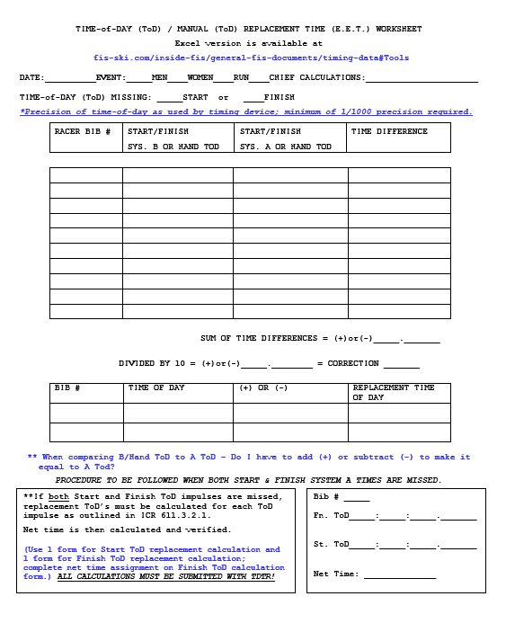
CALCULATION FORM
The following presentation is an aid to help you understand the basics of the calculation.
If System A time of day is missed, calculation must be based on System B ToD
If both System A time of day and System B time of day are missed, calculation must be based on manual (hand) ToD
This exercise is based on a failure of SYSTEM A FINISH

Slide 8
REQUIRED DOCUMENTS:
Timing Tapes (A and B) or verified
“Electronic ToD Recording Form”
Start or Finish Timekeeper Recording Form *
* If both System A and System B Start or Finish are missed, manual (hand) timing must be used

Slide 9
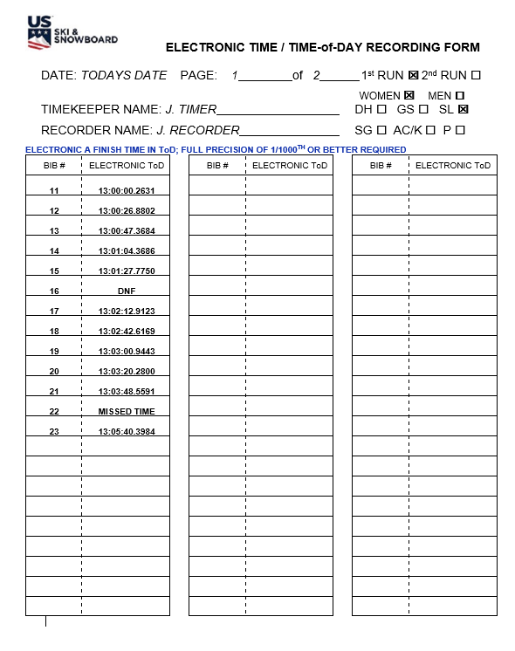
ELECTRONIC ToD RECORDING FORM

Slide 10
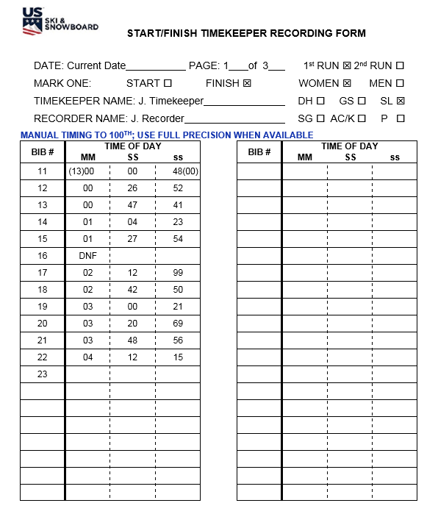
MANUAL/HAND ToD RECORDING FORM

Slide 11

TIME OF DAY (ToD)TIMES FOR MISSING TIMES
Insert the Missing ToD from the Correct Recording Forms
This example is based off of a missing finish ToD
using HT to complete the calculation
ToD taken from Finish HT Recording form.

Slide 12
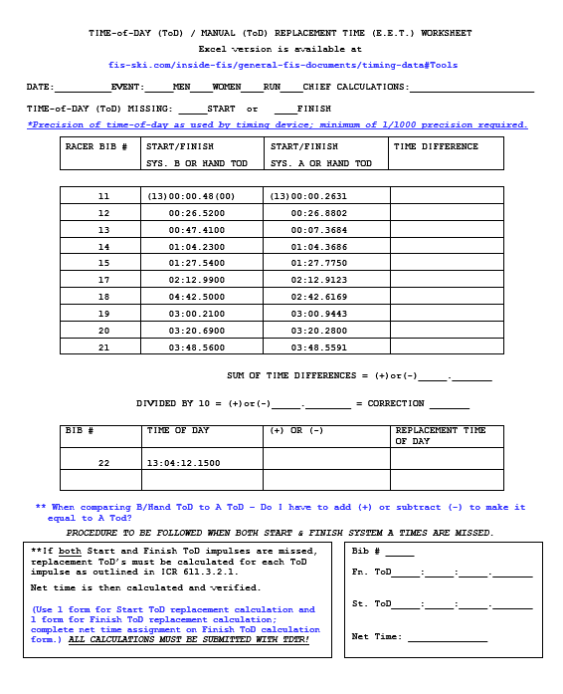
COMPLETE DATA FOR 10 BEFORE
From:
System B Timing Tape,
Electronic ToD Form or
Start/Finish Timekeeper Form
From Timing Tape

Slide 13
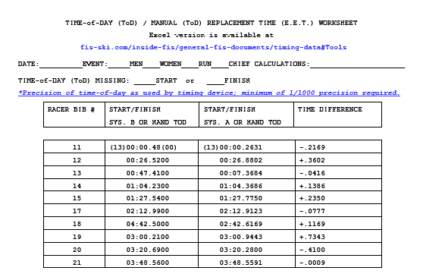
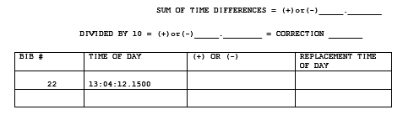
DO THE MATH & ADJUST THE ToD

Slide 14
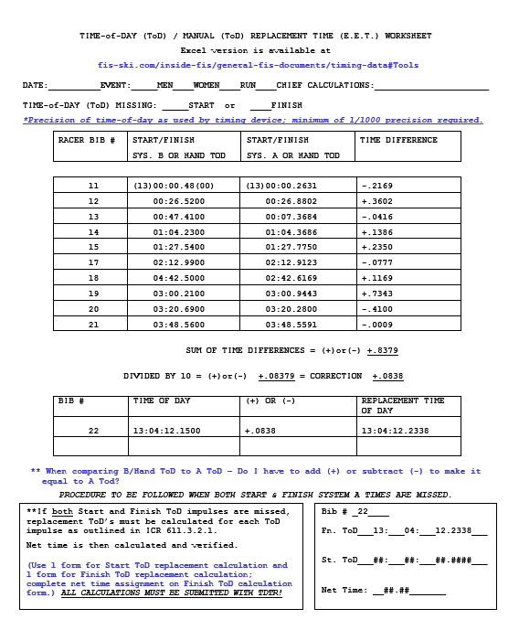
NO START or FINISH IMPULSE!
If both the Start impulse and the Finish impulse from system A are missed,
replacement ToD’s must be calculated for each impulse as outlined in ICR 611.3.2.1.
Net time is then calculated & verified as applied.
(Use one form for Start ToD impulse and one form for Finish ToD impulse.)

Slide 15
Application of ToD
Return to Software
Enter equivalent Finish ToD for athlete
3) Verify the applied Net Time

Slide 16
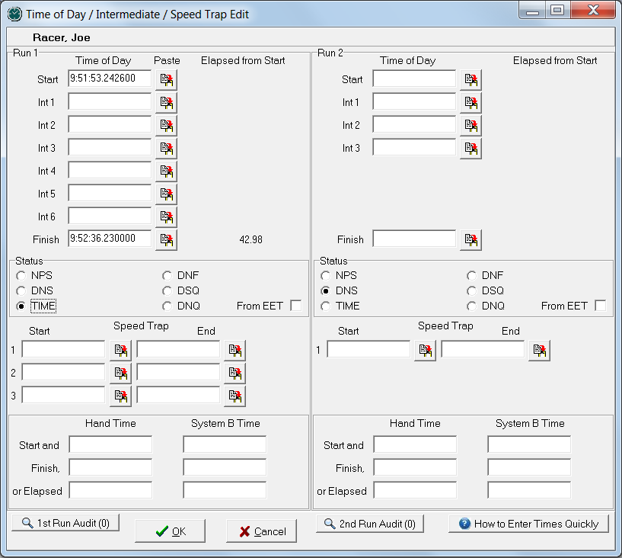
Application of ToD
ToD as received from A system
Applied ToD from calculated EET
(52:36.230000)
Time not displayed?
-confirm you have selected the ‘Time’ radio button

Slide 17
VALUE OF A REPLACEMENT TIME
A Replacement Time that is calculated in accordance with the rules is a valid time!
Accuracy of a hand-calculated replacement time must be verified.
ACR/ICR 611.3.2 and 611.3.2.1

Slide 18
ALTERNATIVE CALCULATION METHODS:
Excel spreadsheet in MPF
Excel calculator on FIS website (Timing & Data: Tools)
SplitSecond & Vola both have options that allow for calculation of replacement time(s)
HINTS:
      Do NOT use Forerunners’ times
      When missed times are in close proximity, systems may allow for calculation of multiple replacement times
      Calculation(s) may require a dedicated computer
      Electronic timekeeping equipment operator should not be responsible for these calculations; they are the responsibility of the Chief of T&C
      Regardless of the system you prefer, do not wait until race day to learn how to use it!

Slide 19
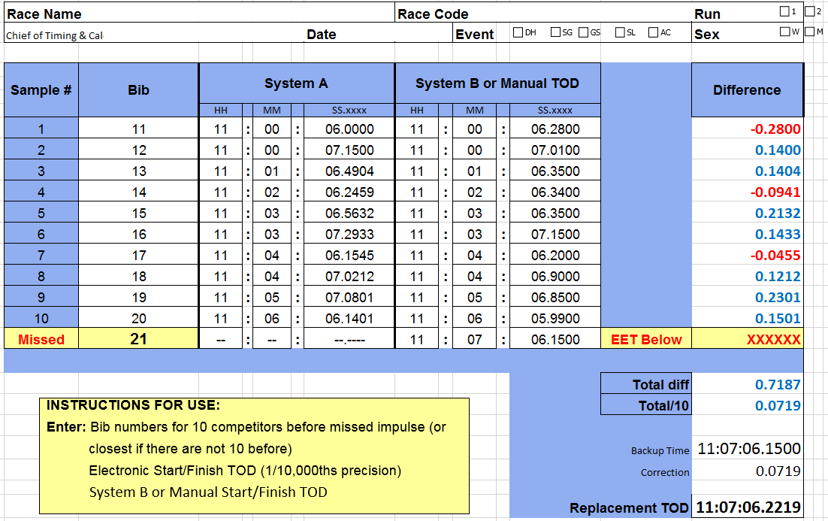
CALCULATION: USING A SPREADSHEET
(Both systems timed to 1000th precision)

Slide 20
CALCULATION: USING YOUR SOFTWARE
Refer to SPLIT SECOND 101 ppt and VOLA ppt for updated information.
Become familiar with the software’s procedure prior to race day!

Slide 21
COMPUTER-CALCULATED
REPLACEMENT TIMES
Just because a replacement time is calculated by a computer doesn’t mean it is correct.
Accuracy of a computer-calculated replacement time must be verified!

Slide 22
CALCULATIONS: Submittal Requirements
ALL EVENTS – non-FIS or FIS: Copies of all calculations of any Replacement Times (EET’s) must be included in the PDF “Event Document Packet” submitted to U.S. Ski & Snowboard.
Copies of all calculations must also be included with the XML copy of the Timing & Data Technical Report (TDTR) submitted to tdtr@usskiandsnowbord.org.
Regions/Divisions may have additional submittal and/or review requirements.
FIS EVENTS ONLY: Copies of all calculations must be submitted as attachments to the Timing & Data Technical Report (TDTR).

Slide 23
SUGGESTIONS
Take the time to verify manual devices are still synchronized. A countdown over the radio and a request for the display reading can be done prior to the start. Another option is requesting the manual time for the first forerunner. You will need the manual time for the first athlete, but verification prior to the start of Bib 1 allows time to address any issues.
If electronic systems fail, immediately verify manual times are available for the racer for whom an electronic time is not available. This immediate action will indicate whether or not manual timekeeping has validity so you will either be able to calculate a replacement time or authorize a rerun.
Two suggestions: Neither one will take much effort, but they may be the difference between a race result or a disappointed athlete for whom no time is available.

