Slide 1

SEASON 2026
CHIEF OF RACE
“Clean Hill Initiative,” “Clean Hill Initiative Revisited,” “Courses,” and “B-Net” are a mandatory part of this clinic.
Also available is:
“MINUTES: A Guide for the Preparation of Jury Minutes and Team Captains’ Meeting Minutes”
Notes:
PowerPoint Presentations are to be inserted at clinic instructor(s) discretion.

Slide 2

IMPORTANT NOTICE
Procedures that impact your event operations and programs must be relayed to all event officials, Team Captains, and competitors.
The procedures must – without question – be respected and observed.

Slide 3
ALPINE OFFICIALS’ RESOURCE MATERIALS
Alpine Officials’ resource materials are prepared to be accurate and in compliance with current rules and procedures while maintaining a nationwide outlook.
The content of the material is reviewed by senior Alpine Officials prior to being submitted for acceptance by appropriate U.S. Ski & Snowboard authorities.
If an item included in the resource materials appears to be in conflict with current rules and procedures, please contact U.S. Ski & Snowboard Competition Services for clarification and/or interpretation.

Slide 4
OFFICIALS’ RESPONSIBILITY
It is the responsibility of every official, coach and competitor to know, understand, and abide by the rules for the sport. These rules include, but are not limited to, current editions and “Precisions” of:
U.S. Ski & Snowboard ACR
FIS ICR
Supplemental rules, such as Equipment Specifications, Rules of the FIS Points, Rules for the Alpine Continental Cups, etc.
Coaches, Program Directors, and other club officers are encouraged to provide the time and opportunity to instruct their athletes on the rules for the sport.

Slide 5
APPLICATION OF RULES
For all events scheduled as non-FIS events, applicable U.S. Ski & Snowboard rules must be considered and applied (ACR)
For all events scheduled as FIS events, applicable rules of the FIS must be considered and applied (ICR)
In cases that are not addressed by the ACR or by the ICR, [601.4.7] or in cases where the rules must be interpreted, the authority for making such decisions will rest with the Competition Jury – all decisions must be documented!
NOTE: 601.4.9.4 further states the TD decides on questions not covered or insufficiently covered by the rules in so far as these have not already been decided by the Jury and “do not fall within the scope of other authorities.”
If an issue arises that is not covered or is insufficiently covered by the ACR but is covered by other rules books that apply to our sport, defer to the “other authority”. e.g., FIS ICR, Equipment Rules, Rules of the Points.
Notes:
NOTE: Legal review may include to what extent rules/accepted procedures were followed, deviated from, or ignored.

Slide 6
MINOR ATHLETE ABUSE PREVENTION POLICY (MAAPP)
SAFESPORT CODE
The following slides referring to MAAPP and SafeSport are:
Only a brief summary of information found in many documents
Documents will be updated as required
Please refer to links posted on the U.S. Ski & Snowboard website for access to complete and current information.
usskiandsnowboard.org/safesport-athlete-safety/safesport-resources

Slide 7
MINOR ATHLETE ABUSE PREVENTION POLICY (MAAPP)
MAAPP applies to “In-Program Contact” within the Olympic & Paralympic movement.
Its implementation is required for the U.S. Olympic & Paralympic Committee IUSOPC), National Governing Bodies (NGB), Member Clubs (also known as Local Affiliated Organizations or LAO), and Paralympic Sport Organizations (PSO)
MAAPP applies to all U.S. Ski & Snowboard employees, contractors, athletes, officials, and members
It also applies to participating non-members, e.g., foreign officials, timing companies, volunteers, and any adult participants. MAAPP has three primary components:
- Education & Training
- Required Prevention Policies
- Recommended Prevention Policies
MAAPP should be implemented alongside the SafeSport Code.

Slide 8
SAFESPORT CODE
U.S. Federal Law requires that adults who have frequent contact with, or who are in positions of authority over athletes, must receive consistent education on prevention and reporting of all allegations of sexual misconduct, bullying, hazing, and abuse of all forms
This impacts all U.S. Ski & Snowboard member clubs, coaches, officials, and Club Volunteer members
All members turning 18 years of age and older during the season are required to complete SafeSport training through the U.S. Center for SafeSport (substitutions are not permitted)
U.S. Ski & Snowboard membership status for members who fail to complete required SafeSport Training will be noted as “PENDING”. They must not be issued any venue access that would allow competition arena access until their membership is complete.

Slide 9
ADMINISTRATION PER MAAPP & SAFESPORT: LOCAL ORGANIZING COMMITTEE (LOC)
The Local Organizing Committee (LOC), as well as other individuals and entities as set out in the MAAPP and the SafeSport Code, are responsible for monitoring and enforcing all requirements. These requirements include, but are not limited to:
Events: Any U.S. Ski & Snowboard member club hosting a U.S. Ski & Snowboard sanctioned event must follow the Competition Administration Summary available at usskiandsnowboard.org/safesport-athlete-safety/safesport-resources
to ensure compliance with required athlete safety at at event. There are additional
athlete safety event resources available on this webpage.
Memberships: Using the U.S. Ski & Snowboard website, the Race Administrator must verify that all Jury members, Jury Advisors (Start and Finish Referees), Chief of Course, Course Setters, Coaches, Competitors, Forerunners, Chief of Timing & Calculations, Race Administrator, and medical staff have current and applicable U.S. Ski & Snowboard memberships.
Individuals whose memberships are “pending,” or whose names appear either on the Centralized Disciplinary Database or the Pending Membership List must not be issued any venue access that would allow competition arena access.

Slide 10
ADMINISTRATION PER MAAPP & SAFESPORT: LOCAL ORGANIZING COMMITTEE (LOC)
Alpine Official Certification Status: Using the U.S. Ski & Snowboard website, the Race Administrator must verify that all Jury members, Jury Advisors, Chief of Course, Course Setters, Chief of Timing & Calculations, and Race Administrator have appropriate certification as required by their position
Alpine Official Continuing Education (Update) Status: Using the U.S. Ski & Snowboard website, the Race Administrator must verify that the Chief of Race, Referee, Assistant Referee (if required), Chief of Course, Course Setters, and Chief of Timing & Calculations have attended a yearly Continuing Education Clinic (Update & Review)
Unless excused, Technical Delegates and Race Administrators are required to attend a yearly certification-specific Workshop

Slide 11
ADMINISTRATION PER MAAPP & SAFESPORT: LOCAL ORGANIZING COMMITTEE (LOC)
In addition to the above verifications, using the U.S. Ski & Snowboard website, the Race Administrator must review the following:
Pending Membership List: Competition entry and venue access not allowed
YOB 2007 and 2008 athletes who have not completed background screening requirements:
Any athlete who is 18 at the time of membership application (YOB 2007), must complete background screening prior to membership being activated
Any athlete who turns 18 years of age during the competition season (YOB 2008), will receive notice of requirement for background screening. They will be given 45 days after their birthday to finalize screening; membership will be inactivated on the 46th day.
Athletes must not be allowed to compete or forerun until background screening is successfully completed and active membership status restored.

Slide 12
ADDITIONAL REQUIREMENTS
Centralized Disciplinary Database:
List of individuals subject to temporary or permanent restrictions pending investigation of violation of SafeSport Code.
Presence not allowed.
Site allows filtering to sport. However, an individual may not be listed under one sport but may be listed under another; searching by name is the best practice.
If you have a name match and cannot verify if it is the individual attending the event, please reach out to Member Services.

Slide 13
ADDITIONAL REQUIREMENTS
Volunteer Competition Worker Registration: Completion of a current “Volunteer Competition Worker Registration” is required for any workers/volunteers who are over the age of 18, are not U.S. Ski & Snowboard members, properly credentialed FIS officials, coaches and trainers, or regular employees of Organizer or of Ski Area/Landowner acting within the scope of their employment.
“Blocks” of coaches’ tickets must not be made available.
Practice does not allow the OC to make their best effort to comply with SafeSport requirements
Due to circumstances, it may be necessary to allow one coach to pick up all of a team’s coach credentials/lift tickets
In this case, the coach must list all the names to whom the credentials/lift tickets will be issued.
Race Administrator must verify membership status, non-presence on pending lists, and non-presence on Centralized Disciplinary Database for all recipients
Coach must sign for receipt of credentials/lift tickets, thereby confirming recipients’ identity
In order to ensure compliance, all of the above requirements, verifications must be continually monitored and completed for same-day participants, and they must be informed of the SafeSport Code and MAAPP. This can be accomplished by posting the QR Code at registration and asking the same-day participants to scan and read the disclosure.

Slide 14
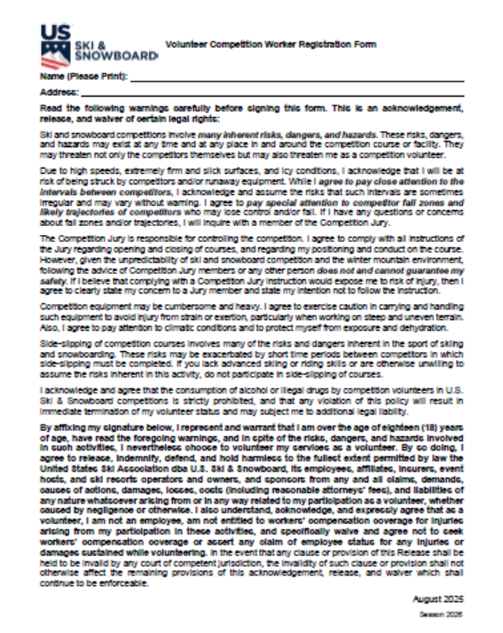
VOLUNTEER COMPETITION WORKER REGISTRATION
Updated form is in the MPF
Must be 18 years of age

Slide 15
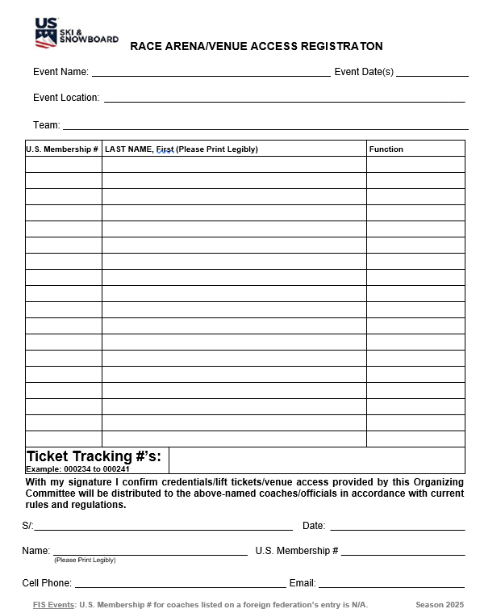
RACE ARENA/VENUE ACCESS REGISTRATION
Form is in the MPF
Retain form in OC’s file
Notes:
Using this form 1) Allows RA to have contact with only one coach per team, and 2) allows for due diligence to only provide venue access to members who have completed all SafeSport requirements.

Slide 16
Please Note:
The responsibility for communication and enforcement of SafeSport and MAAPP policies is:
The responsibility of the Local Organizing Committee as well as other individuals and entities as set out in the Competition Administration Summary, the MAAPP and the SafeSport Code.
All information is available on the U.S. Ski & Snowboard website at usskiandsnowboard.org/safesport-athlete-safety/safesport-resources
The Jury is only responsible for technical matters within the closed competition areas. [601.4]
The closed competition areas are defined as the “race arena” which is accepted as being those areas which the Jury inspects and accepts as being suitable for competitors’ presence:
- start arena
- race course
- finish arena

Slide 17
Please Note:
In addition to stating for “actions within and without the competition area,”
sanctions can be applied and
a penalty can be imposed
223.2.1 includes “conduct within any location connected with the competition.”
These locations include, but are not limited to the following areas that are required for the orderly conduct of an event:
Team Captains’ Meetings,
Jury meeting areas,
timing building,
equipment control area
Neither the “closed competition areas” (within or without the fencing) nor “any location connected with the competition” include lift lines, cafeterias, parking lots, warmup areas, warmup courses, etc., unless rules state otherwise; e.g., U14 regulation which prohibits waxing application on ski resort property.

Slide 18
CHIEF OF RACE

Slide 19
CHIEF OF RACE:
Qualifications & Responsibilities
Chief of Race at all U.S. Ski & Snowboard-sanctioned events must hold a current U.S. Ski & Snowboard Official membership and be currently certified in one of the following categories:
Chief of Race
Referee
Technical Delegate
Chief of Race must also attend a yearly U.S. Ski & Snowboard-approved Continuing Education Clinic (Update & Review) prior to events.
Chief of Race is responsible for staffing the race and should choose the most qualified, experienced and properly certified person available for each position.
Chief of Race should give some consideration to the development of new officials. This may include informal shadow assignments or the use of a mentor for key positions.

Slide 20
ORGANIZING COMMITTEE
Organizing Committee (OC) consists of those members (physical or legal) who are delegated by the Organizer. It carries out the rights, duties, and obligations of the Organizer.
The Organizing Committee is responsible for orderly preparation and conduct of the event
Chief of Race is a member of the Organizing Committee and serves a s a liaison between the OC and event-related areas
Additional membership is dependent on type and level of event
Upon appointment, the following are members of the Organizing Committee:
Technical Delegate
Referee
Assistant Referee (speed events only)
Forerunners

Slide 21
WHAT IS A “SHADOW ASSIGNMENT?”
Referee certification requires completion of a Referee-specific shadow assignment. Similar requirements are in place for other certification areas.
A “shadow assignment” is more than just showing up on race day. Any individual who is fulfilling their shadow assignment requirements should be prepared to participate in all of the duties and responsibilities related to:
Pre-race
Race day
Post-race
In addition, pre-event communication with mentor(s) is strongly recommended.

Slide 22
CHIEF OF RACE & EARLY PLANNING
Well before the event, the Chief of Race should address these items:
Is the organizing ski club a member club of U.S. Ski & Snowboard?
What runs will be available?
Does ski area have special requirements or issues, e.g., liability waiver, other events, any procedures that could affect the event?
Are the runs homologated?
Downhill & Super G (Valid only for 5 years)
    Giant Slalom & Slalom (Valid only for 10 years)
If runs are not homologated, are there other options?
What on-hill competitor security measures are required? Is the material available? Is there a source for additional supplies if required by the Jury?

Slide 23
COURSE HOMOLOGATION VERIFICATION
Paper copies of homologations may have a valid date but be outdated due to:
- natural or artificial changes in terrain
- changes in regulations
- changes in technical requirements
The only accurate sources for course homologation data verification are U.S. Ski & Snowboard and FIS websites:
media.usskiandsnowboard.org/CompServices/Homologation/
(Login is required: User ID = homologation; Password = Allout2022!)
fis-ski.com/DB/alpine-skiing/homologations.html
(Maps, photos, reports, etc., not accessible at this site.)
NOTE: U650.1.2 A new inspection of an existing course (FIS or National) voids the previous homologation of an existing course.
Notes:
NOTE: FIS course homologation supersedes U.S. Ski & Snowboard course approval unless major changes have occurred or the FIS homologation is not current.

Slide 24
U.S. SKI & SNOWBOARD COURSE APPROVAL INVENTORY
U.S. Ski & Snowboard Course Approval (Inventory available on U.S. Ski & Snowboard /FIS websites) is:
Required for all U.S. Ski & Snowboard Downhill (DH), Super G (SG), Giant Slalom (GS), Slalom (SL), and Parallel (P) events, both scored and non-scored
Required for U.S. Ski & Snowboard Masters events
Course setting needs to conform to the inspection report and U.S. Ski & Snowboard/FIS requirements
Current FIS course homologations supersede existing U.S. Ski & Snowboard course approvals, provided no major changes have taken place on the racecourse and re-inspection is current.
FIS course homologations supersede U.S. Ski & Snowboard course approvals. If a FIS course homologation is declared void, any existing U.S. Ski & Snowboard course approval is also void.

Slide 25
CHIEF OF RACE & EARLY PLANNING
Will proposed race date fit into schedule? Is time available for planning?
Could poor course conditions change event? If so, what are the options?
Snow hardening agents: Availability and restrictions?
What lift facilities are available to the race? Can they be dedicated to ONLY the race and officials or will a competitors’, officials’ and workers’ lane be available?
Are adequate housing and meal facilities available for competitors/officials?
Can entire race hill be closed to recreational skiers?
Crossings: How many? How controlled? Communication?
Are special grooming preparations required? Will area provide these services?
Communication/cooperation between ski area and the Organizing Committee?
Medical Plan: Required for all events; does it meet requirements of competition?
Are both area management and Ski Patrol fully aware of areas that fall under Jury’s jurisdiction? Are they prepared to deal with issues outside of these areas?
Will area management and Ski Patrol be able to provide a location for controlled warmup?
Are trained officials, appropriately certified officials, Forerunners, other personnel available?
Are all members of the Local Organizing Committee aware of MAAPP and SafeSport Code requirements?

Slide 26
CHIEF OF RACE & EARLY PLANNING
Financial considerations? Sponsors? Is there a written budget?
Is the necessary equipment available, e.g., poles, panels, fencing, bibs, timing equipment, and radios as required by level of event?
Will on-site U.S. Ski & Snowboard competitor membership applications (for competitors 17 and under prior to December 31) be accepted? Competitors 18 years of age and older must complete SafeSport Training and background screening; membership are “pending” until requirements are met; athletes must not be allowed to compete or forerun until they are “active."
Will online race entry system be used? Will late entries be allowed? Late entry fee?
Is adequate internet connectivity available?
Are U.S. Ski & Snowboard memberships and officials’ certifications for Chief of Race, Chief of Course, Chief of Timing & Calculations, Race Administrator (Race Secretary), Start Referee and Finish Referee, current? Have they completed their yearly update requirement?
Will a freeskiing session on the race hill be available?
Where is Race Headquarters? Where will the Team Captain’s, Gate Judge’s, and volunteer’s meetings take place?
What is the available daylight on race day?
Does a race arena dismantling procedure need to be put in place?

Slide 27
PRELIMINARY DOCUMENTS
Schedule (Sanction) Agreement:
Processed online (club log-in required)
Lists event types, schedules, etc.
Upon approval, U.S. Ski & Snowboard will assign event transmittal (codex) numbers and post them on the website section for event lookup
Without a properly executed/signed Schedule Agreement (signed by OC, Ski Area/Land Owner), U.S. Ski & Snowboard, event liability insurance is not in effect!

Slide 28
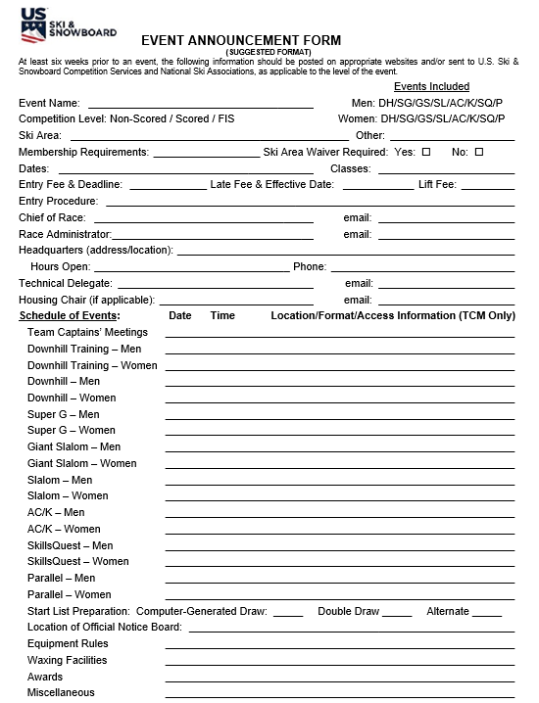
PRELIMINARY DOCUMENTS
Event Announcement:
Available at least 4 weeks before event
Should include any special requirements, e.g., area waiver
Must include breakdown of fees: actual entry fee and lift fee
If TCM will be online, must include all platform and login information.
If required, copy of waiver should be attached
If required, Venue Access form should be attached

Slide 29
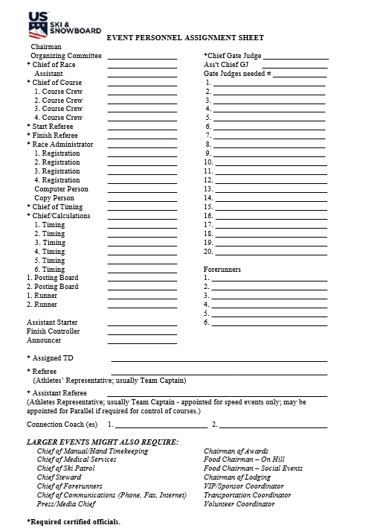
PRELIMINARY DOCUMENTS
Personnel Assignment:
Responsibility of CR
Most qualified, experienced, appropriately certified officials available (where required)
Use a mentoring system in key positions in order to develop new officials
CR is “responsible” for staffing – however, an Assistant may actually do the “staffing”

Slide 30
MEMBERSHIP REQUIREMENTS: NON-FIS EVENTS
Chief of Race, Referee, Assistant Referee, Jury Advisors (Start & Finish Referees), Chief of Course, Course Setters, and Chief of TC are required to be current, appropriately certified U.S. Ski & Snowboard members. They must have also attended a yearly Continuing Education Clinic (Update & Review) in order to serve in the respective position.
Technical Delegate and Race Administrator must attend a yearly certification-specific Workshop
Competitors are required to have an appropriate and current competitor’s U.S. Ski & Snowboard membership
Forerunners must have appropriate and current U.S. Ski & Snowboard membership: e.g., Competitor, Coach, Official, Volunteer, General, Master w/requirements, Non-Scored Athlete, or Short-Term Athlete
Qualified members of foreign federations recognized by FIS must hold a current, appropriate U.S. Ski & Snowboard membership in order to be granted venue access and take part in any capacity at U.S. Ski & Snowboard sanctioned non-FIS events.
NOTE: Forerunning may not be included in the duties outlined in a coach’s club employment contract.
Regardless of the type of membership, an event’s equipment and vertical drop regulations apply to all forerunners.

Slide 31
MEMBERSHIP REQUIREMENTS: FIS EVENTS
Jury members, Jury Advisors (Start & Finish Referees), Chief of Course, Course Setters, and Chief of TC are required to be current, appropriately certified Coach or Official U.S. Ski & Snowboard members who have attended a yearly Continuing Education Clinic (Update & Review) prior to serving in the respective position, or must be qualified members of foreign federations recognized by FIS
If a foreign FIS Federation lists a foreign coach on their entry form, the Federation is certifying that the coach has the knowledge and ability to fulfill the duties of a Team Captain: e.g., serve as a Jury member or set a course; this satisfies the “qualified member of foreign federation” requirement for FIS events
Competitors are required to be FIS inscribed and must be “Active." Allowing a competitor without a FIS inscription to compete will invalidate the liability insurance
Age-eligible, current U.S. Ski & Snowboard members who are not FIS inscribed and who are serving as forerunners must sign the “FIS Athlete’s Declaration”

Slide 32
“PENDING” MEMBERSHIPS: Coaches & Officials
If a U.S. Ski & Snowboard Coach or Official member’s membership status on the U.S. Ski & Snowboard website is “PENDING“, this is an indication that the member has not completed membership requirements, e.g., required background screening, Introduction to Avalanches Course, SafeSport training and/or Coaching Fundamentals Course, and they must not be appointed to serve as:
- Jury members
- Jury Advisors
- Chief of Course
- Course Setter(s)
In addition, Coaches without current coach/official membership must not be granted race arena/venue access.

Slide 33
“PENDING” MEMBERSHIPS: Competitors
Competitors 18 years of age or older noted as “PENDING." This is an indication that the member has not completed membership requirements, e.g., required background screening or SafeSport training
“Pending” athletes must not be allowed to start or
Competitors who turn 18 years of age (YOB 2007 & YOB 2008), during the competition season will be notified of background screening requirement.
U.S. Ski & Snowboard must receive a screening determination within 45 days from the member’s birthday
If process not complete, membership will be deactivated on the 46th day, and they must not be allowed to start or forerun until membership is reactivated

Slide 34
OTHER OFFICIALS
Officials’ Certification is not required for all officials; however, the following are often certified Competition Officials.
Starter: Is a member of the timing crew and should have experience
Assistant Timekeepers: Start & Finish manual/hand timekeeper/Start & Finish recorder
Electronic timekeeping equipment operator(s): Generally a ski area employee; however, knowledgeable volunteers may also be used
Electronic time recorder(s)
Runner(s) needed to move supplies and documents
Scoreboard poster: Posts competitors’ unofficial times on a posting sheet
Announcer: Depends on events’ specific set of circumstances
Finish Controller and/or Finish Spotter. At lower-level races, the Finish Referee assumes the responsibilities of this official; requirements are in place for Finish Referee.
Gate Judges: As required, estimate 2-3 gates per person; for DH, 1 gate per person is preferred

Slide 35
GATE JUDGES
The Jury along with the support of the Organizing Committee may opt to not use Gate Judges for:
Downhill
Downhill Training
Super G
Super G Training
Giant Slalom
Measures MUST be taken to cover the entire course with sufficient:
Jury members
Jury Advisors
Eyes of the Jury
Connection Coaches [U669.3]
Slalom requires regular assignment of Gate Judges.
* NOTE: This is a non-FIS rule; FIS rules require that Gate Judges be in place for all events.
Notes:
Depending on terrain/course set, the Jury may opt to assign Gate Judges for other non-FIS events.

Slide 36
EVENT STAFFING
Start staffing at least 3 weeks ahead - even sooner for larger races
Verify availability of key officials first: Chief of Course, Race Administrator, Chief of Timing & Calculations, Chief Gate Judge, Jury Advisors (Start and Finish Referee)
Start recruiting Gate Judges early, if required
Use race personnel assignment sheet to make sure no position is overlooked
Co-ordinate with area concerning course access for race officials
Verify Chief Gate Judge is aware of differences in procedures for hiking and completing clear passage of missed gates in non-FIS Slalom as well as restrictions against hiking and definition of “clear passage” for Downhill, Super G, Giant Slalom, and FIS Slalom
Co-ordinate nourishment provisions for Gate Judges and other race workers, if being provided
Create a plan for worker registration area/procedures. Verify the availability of adequate staff to help with check-in and check-out in the afternoon. Verify availability and location of your registration area

Slide 37
VOLUNTEER REGISTRATION
Volunteers must complete this form unless they are:
U.S. Ski & Snowboard members
The ski area landowners
Ski area employees acting within the regular scope of their employment.
Must be 18 years of age or older in order to complete this form.

Slide 38
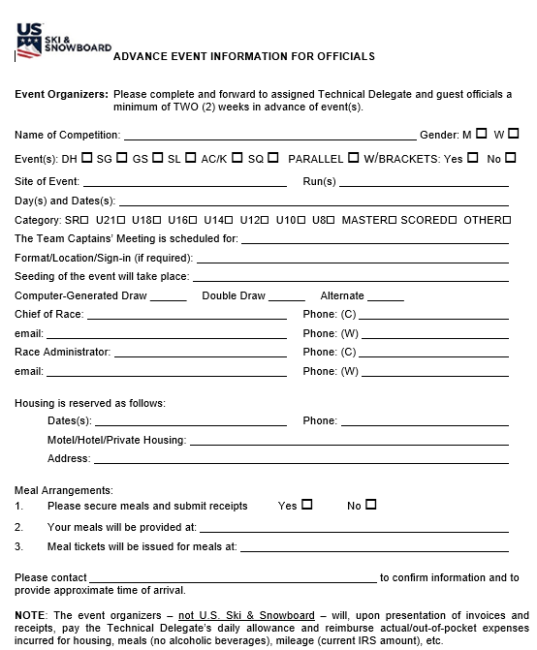
ESTABLISH CONTACT WITH KEY OFFICIALS
Initial contact with TD should be made a minimum of 4 weeks before the event; continued contact is important
Non-FIS TD should arrive 24 hours prior to Draw for GS/SL and 48 hours prior to Draw for DH/SG
FIS TD must arrive 24 hours prior to Draw for GS/SL and 48 hours prior to Draw for DH/SG
Other key officials arrive per agreement with OC
All Key Officials should be available for attendance at Team Captains’ Meetings: e.g., Jury Advisors and “Chiefs”

Slide 39
PROGRAM – Race Day Schedule
The development of a draft, race day schedule is a critical planning item. U.S. Ski & Snowboard and FIS forms provide useful templates. These are items that may be included:
  Course Setting start times for each run
  Jury Inspection time
  Competitor Inspection opening and closing times
  Course entry closure for all participants; e.g., coaches, media, Gate Judges
  Forerunner/Competitor start intervals
  Start time for Forerunners / Start time for 1st racer for each run (if 2-run event)
The construction of a schedule will require the following information:
  Type of event “technical” or “speed” and projected start interval(s)
  Field Size, Start Intervals, Competitor’s projected time on course
  Lift opening time
  Inspection window for each run
  Projected time for course setting
  Projected time for Jury course inspection
  Time needed for final course preparation after inspection
  Lift closing time
  Other items may include Award Ceremonies & next

Slide 40
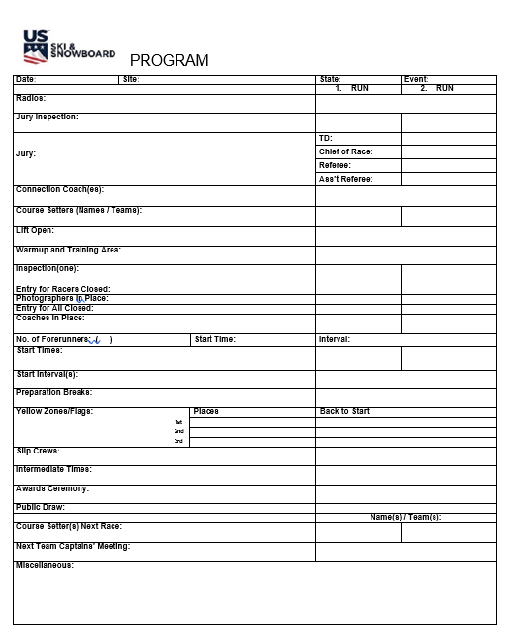
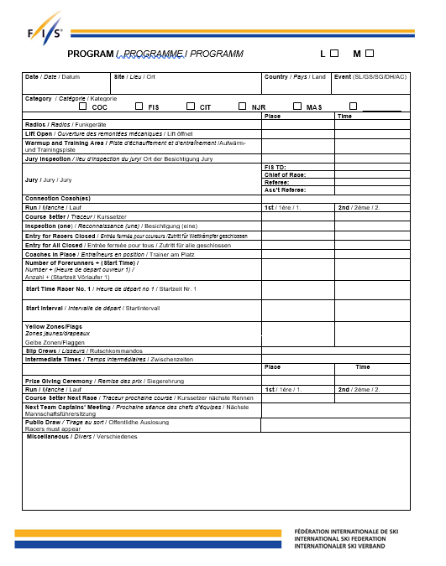
PROGRAM TEMPLATES: Non-FIS & FIS
Templates are also available in the MPF for both Non-FIS and FIS Parallel events.

Slide 41
WHAT IS “FORCE MAJEURE”?
In Alpine competitions, "force majeure" describes those uncontrollable/unexpected events (such as extreme weather, extreme surface conditions) that are not the fault of any party and that make it difficult or impossible to carry out an event.
An unexpected weather occurrence that requires a program/course/assignment change
A last-minute ski area management decree
Force majeure is “uncontrollable and unexpected”; force majeure is not “planned”.

Slide 42
Resources and References
FIS
ICR
Precisions
fis-ski.com
Rules of FIS Points
WC & COC rules
FIS Equipment Specifications
Calendar & bylaws
U.S. Ski & Snowboard
Competition Guide & ACR
U.S. Ski & Snowboard Equipment Rules
usskiandsnowboard.org
Region/Division Links
Region/Division Handbooks
AO Manual

Slide 43
COMPOSITION OF THE JURY
The Jury for a technical event is comprised of the following officials:
Technical Delegate
Referee
Chief of Race
The Jury for a speed event is comprised of:
Technical Delegate
Referee
Assistant Referee
Chief of Race
NOTE: A technical event Assistant Referee may be appointed for training purposes. They are not Jury members, so their names must not appear on official documents; they have neither voice nor vote in Jury decisions. One may also be appointed for Parallel events if required in order to control both courses.

Slide 44
JURY APPOINTMENT, MEETINGS & TENURE
Appointment of the Jury
The FIS Office appoints the Jury for World Championships and Olympic Winter Games [ICR 601.4.1]
Division/Region representatives appoint the Technical Delegate for other FIS and Non-FIS and FIS events [601.2, 601.2.3]. Upon appointment, the TD becomes a member of Organizing Committee (OC)
The Technical Delegate appoints the Referee* and Assistant Referee* (speed events). Upon their appointment, they become members of the Organizing Committee (OC)
* These officials are the athletes’ representatives and should be appointed from among the coaches present for the event & with athletes in the field.
Tenure of the Jury [601.4.4]
  When does the Jury begin their duties? [601.4.4.1]
  How long is the Jury active? [601.4.4.1, 601.4.4.2]
  When does the Jury meet?
  Prior to the all Team Captains’ Meeting
After course inspections
After each run
End of race or in case of race halt
To rule on Protests when appropriate [601.4.6.3, 646.1]

Slide 45
JURY & THE COMPETITION VENUE
The “competition venue” is defined as the “ski resort property”
The “competition venue” is the responsibility of ski area management and the ski patrol
The “competition venue” is not the responsibility of the Jury
Prior to the event, the Chief of Race should establish contact with ski area management and Ski Patrol and clarify those areas for which the Jury will assume responsibility.

Slide 46
JURY & THE RACE ARENA
The Jury is responsible for technical matters within the closed competition areas. [601.4]
The closed competition areas are defined as the “race arena” which is accepted as being
within (the side-to-side fencing) and
without (start area and finish arena) the confines of the competition area and
any location connected with the competition [223.2.1]
PLEASE NOTE: Warmup slopes are not under the control of the Jury and are not governed by the ICR. [614.1.3]
The Chief of Race should work with ski area management and the Ski Patrol to identify a controlled location for training courses.

Slide 47
Please Note:
In addition to stating for “actions within and without the competition area,”
sanctions can be applied and
a penalty can be imposed
223.2.1 includes “conduct within “any location connected with the competition.”
These locations include, but are not limited to the following areas that are required for the orderly conduct of an event:
Team Captains’ Meetings,
Jury meeting areas,
timing building,
equipment control area
Neither the “closed competition areas” (within or without the fencing) nor “any location connected with the competition” include lift lines, cafeterias, parking lots, warmup areas, warmup courses, etc.

Slide 48
RACE ARENA versus RACE VENUE
A simplified way of defining which parts of the ski area property are under the jurisdiction of the Jury is to ask yourself what the Jury inspects and accepts as being suitable for competitors’ presence.
The Jury does inspect/accept:
the start and finish areas as well as ingress and egress to these areas
the racecourse
the type and placement of the on-hill competitor security
In upper-level events, the Jury may also inspect ingress/egress to areas where media meets with athletes, coaches, etc.
The Jury does not inspect/accept:
lift areas
parking lots
cafeterias
terrain parks,
public trails
Team meeting rooms
Therefore, the Jury does not have jurisdiction over these areas and should not assume the liability for their being acceptable for competitors’ presence.

Slide 49
DUTIES OF THE JURY
  Duties of the Jury are varied and basically cover 3 areas:
  Technical Standpoint [601.4.6.1]:* Preparation for the actual event; e.g., course condition, checking course set, course inspection, debriefing Forerunners.
  Organizational Standpoint [601.4.6.2]: Ranking competitors, granting reruns, shortening course, termination of an even.
  Disciplinary Standpoint [601.4.6.3]: If necessary, excluding competitors, deciding on protests; imposing sanctions, etc.
  *Care should be taken to avoid situations that go beyond the inherent risks of the sport. Presence of timing equipment, terrain, weather, gate panels, gates, ability (or lack thereof) etc., are considered “inherent risks;” shovels, rakes, drills, tents, bamboo, poorly placed personnel are not.

Slide 50
DUE PROCESS – ACR/ICR Art. 224.7
Prior to the imposition of a penalty (except in cases of verbal reprimands and withdrawal of accreditation), the person accused of an offense shall be given the opportunity to present a defense at a hearing, verbally or in writing.
Defense may include, but is not limited to the following:
Calling witnesses – including athlete, coach, Gate Judges, etc.
Questioning witnesses – including athlete and coach – upon whose testimony the Jury relies
e.g., considering information from a witness who is unavailable for questioning by the accused would create a serious issue.

Slide 51
DUE PROCESS – Policy
The Jury must adhere to this policy:
    Consider infraction
    Hear and consider all testimony and evidence
    Allow accused person the opportunity to present a defense and review all evidence (question witnesses, etc.)
    Deliberate
    Make a fair decision
    Review, vote and sign prepared Minutes of decision
    Notify affected parties

Slide 52
IMPORTANT POINTS TO REMEMBER
Each person who is a witness to an alleged offense is required to testify (224.5)
Person accused of an offense shall be given the opportunity to present a defense at a hearing, orally or in writing (224.7 – due process!)
Jury Minutes related to protest / sanction must contain:
Offense committed
Evidence submitted
Rule(s) violated
Penalty imposed (224.8)
Jury Minutes must not contain opinions (facts not supported by evidence or by the rules).
Protest fees collected at FIS events for protests that are not upheld must be forwarded to your National Federation!
Protest fees collected at non-FIS events for protests that are not upheld remain with the OC.

Slide 53
WHY ARE THESE POINTS IMPORTANT?
Although a Jury may re-evaluate a previous decision, new evidence that relates to the original Jury decision must exist. (640.2)
NOTE: Decisions subject to protest deadlines are not generally subject to the Jury’s re-evaluation.
NOTE: Report of the Referee does not constitute a Jury decision, and its contents are not subject to re-evaluation by the Jury.
PROTEST DEADLINES MUST BE OBSERVED AND RESPECTED! (643)
TENURE OF THE JURY EXPIRES AT THE END OF THE PROTEST PERIOD(s) OR AFTER ALL SUBMITTED PROTEST(S) SETTLED! (601.4.4.2)
If the Jury is no longer empaneled, they may not re-evaluate a previous decision
If the Jury is no longer empaneled, they may not alter an athlete’s status; e.g., assign/unassign DSQ based on previously unavailable video.
Jury decisions are final except those that may be protested (641) or appealed (647)
Jury Minutes must provide an accurate and factual record of the proceedings. If they are not accurate, do not contain a factual record of the proceedings, the decisions could be overturned on appeal.

Slide 54
STUDY THESE SCENARIOS
Athlete is disqualified in the 1st Run for committing a gate fault
- Protest is filed within 15-minute protest period.
- Based on available evidence/testimony, Jury decides to not allow a 2nd Run
- Following Jury’s decision, a video is produced showing clear passage
- “New Evidence” is delivered to the Jury
Status: If Jury is still empaneled, the Jury decision to uphold the DSQ and not allow a 2nd Run can be re-evaluated and 2nd Run start allowed
Athlete is disqualified in the 2nd Run for committing a gate fault
- Protest is filed within 15-minute protest period
- Based on lack of evidence supporting athlete’s claim of clear passage, Jury
decides to uphold disqualification
- While enroute home after event, athlete reviews team video and finds evidence
to support claim of clear passage
Status: Jury is no longer empaneled and cannot re-evaluate a decision (provisions of Art. U 647.1.1, 647.1.1 not met; appeal not possible).
Athlete is disqualified in the 1st Run for committing a gate fault
- No protest is filed prior to expiration of the 15-minute protest period
- Athlete and Team Captain approach Jury with video showing clear passage
Status: No Jury decision was made regarding athlete’s status, so Jury cannot consider “new evidence related to a previous Jury decision." Disqualification stands.

Slide 55
STUDY THIS SCENARIO
Both Women’s and Men’s Slalom courses are set
Due to limited space in the finish area, the last gate is common to both courses.
3 of 5 available Forerunners miss the last gate; they do not report to the Finish Referee
Via radio, the Jury briefly discusses the situation, decides to smooth out the track and start the first competitor
Several first-seed racers miss the last gate
What options are available to the Jury?
How should the situation have been initially addressed?

Slide 56
STUDY THESE SCENARIOS
Competitor in the bracket portion of a non-FIS Parallel Slalom event falls and slides past a gate
What is the competitor’s status?
Do the attending Team Captains have the authority to change the application of the rule?
Would the competitor’s status be different if the event were a regular non-FIS Slalom (non-Parallel)?
Is there a difference in the “stepping-back” rules for the following?
- Qualification of a non-FIS Parallel Slalom
- Qualification or bracket of a FIS Parallel Slalom
- single-pole Giant Slalom gate
- double-pole gate of a single-pole Giant Slalom
Is there a difference in the “stepping-back” rules for non-FIS Slalom and FIS Slalom?

Slide 57
JURY ADVISORS: Start Referee & Finish Referee
“Jury Advisor” is a U.S. Ski & Snowboard distinction used to recognize two officials who have the duty to supervise a necessary portion of the race arena: Start and Finish Referees.
Start and Finish Referee are required to be in position from start of competitors’ course inspection until end of event or, if required, until all Protests settled.
The Start Referee is authorized to allow provisional starts for delayed competitors in cases of force majeure but defers to the Jury in cases of doubt.
The Start and Finish Referee deliver reports regarding competitors’ actions that may result in sanction, but they are not members of the Jury, have no vote and should not be listed as participating Jury members on any official documents
Jury Advisors must be appropriately certified/current members of U.S. Ski & Snowboard and must have attended a yearly Continuing Education Clinic (Update & Review) prior to assignment
With the exception of Olympic Winter Games and World Championships,
Start Referee and Finish Referee are not members of the Jury.
Their names are not be listed as such
They must not vote and/or sign official documents as Jury members.
Indicating “NO” does not mean these officials do not have a vote, it means they did not agree with the decision.

Slide 58
What is a “Connection Coach?”
      One or two are appointed depending on type and level of event
      Serve as liaison between all Team Captains and the Jury
      Serve as on-hill “Eyes of the Jury”
      May supervise yellow flag zones in DH and SG*
      Have voice but no vote in Jury matters/decision
      *Depending on terrain, Jury may also choose to appoint Connection Coach(es) for Giant Slalom events

Slide 59
TC MEETINGS – what & why?
A Team Captains’ Meeting is:
A meeting for Team Captains, Jury, and race officials
An inseparable and mandatory part of the competition
Important for communication of Jury instructions, support of the OC, as well as conveying OC requests and information
A critical element for risk management and liability-related matters

Slide 60
TC MEETINGS – Online
For an online Team Captains’ Meeting:
  Verify availability of internet connectivity with sufficient
  bandwidth
  Choose an online meeting platform and test its functions; e.g.,
  sharing screen
  Include platform, URL, time, and date in Race Announcement
  Follow up with log-in information for registered clubs/Team
  Captains
  Establish procedure for posting required documents; e.g.,
  Medical Plan, Program.
  Establish procedure for acquiring list of attendees
  Accept or assign responsibility for generating Team Captains’
  Meeting Minutes
  It is imperative that all document requirements be met as they may be required for a legal review.
Notes:
It is an accepted fact that not all areas of the nation have adequate internet connectivity/bandwidth, and online meetings are not possible (some areas still have rotary-dial phones in their timing buildings! Really, they do!).

Slide 61
TC MEETINGS – In Person
In-person Team Captains’ Meetings are recommended for:
Areas with poor/limited connectivity
Events with special seeding, e.g., Championships,
Nor-Am Cups, team events.
Meetings may be held:
Night before an event
Morning before an event
After an event in preparation for the next day’s event.
For events with Divisional Quotas: athletes with private coaches should be represented by the Division Team Captain, not their private coach.
Notes:
Depending on the type of event, Team Captains’ Meetings may be held either the night before an event, the morning before the event, or at the end of the day for the next day’s event.
IT IS RECOMMENDED THAT TCM FOR EVENTS WITH SPECIAL SEEDING (Continental Cup, Championships, team events, etc.), BE IN-PERSON MEETINGS.

Slide 62
TC MEETING: The Draw
Draw must be conducted or confirmed at a Team Captains’ Meeting
U.S. Ski & Snowboard states Jury may allow a computer-generated draw*
A signed entry is verification of acceptance of a computer-generated draw* by FIS Team Captains
Electronic Seed Boards should have the capability to simultaneously and legibly display entire competition field
* It is important to remember that computer-generated draws are governed by a ‘random identifier’ and unless this identifier is changed prior to each draw, results of a draw involving the same competitors may only have minimal changes.
Notes:
Only the software writer has access required to change the ‘random identifier’

Slide 63
ATTENDANCE, PROGRAM & MINUTES
For all Team Captains’ Meetings for all U.S. Ski & Snowboard-sanctioned events—both scored and non-scored, and regardless of where and when they occur, an Attendance List must be generated
The Attendance List may be either a list of attendees generated by the online meeting platform or an actual, signed document; it is retained in the OC’s event file
For all events, a Program (daily schedule) must be prepared and available for distribution
Team Captains’ Meeting Minutes must be generated and must be included in the submitted event document packet

Slide 64
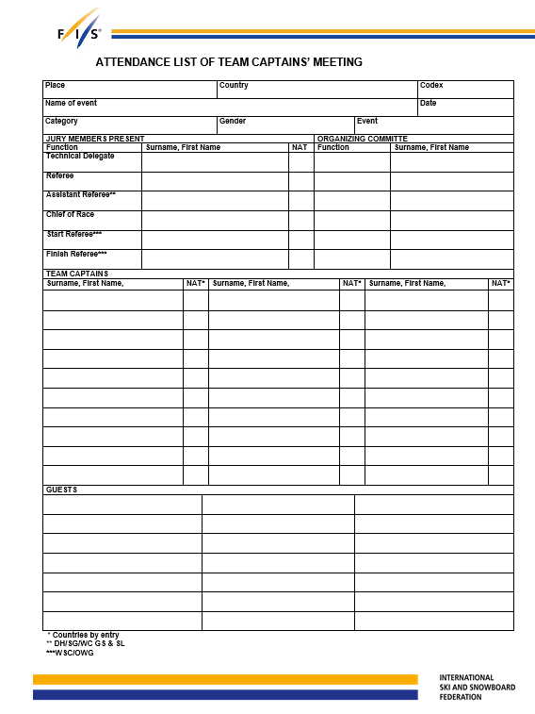
ATTENDANCE (used for an in-person meeting)
Same form used for both non-FIS and FIS events

Slide 65
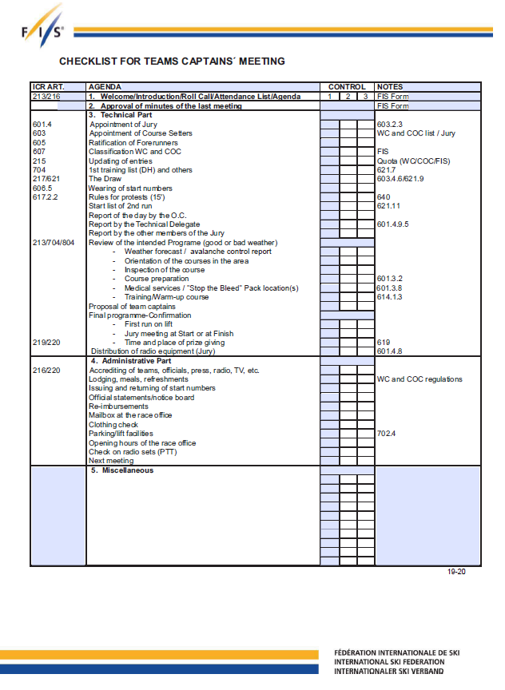
AGENDA
Although not all items may be applicable to your event, following the form will assist you in delivering required information, e.g.,
Jury & Course Setters
Forerunners
Daily Program
Official Notice Board: Actual or online posting
Special Rules/Instructions
Event Medical Plan & availability of “Stop the Bleed” kits
Avalanche Control Report

Slide 66
SCOREBOARD & OFFICIAL NOTICE BOARD
The scoreboard as well as the Official Notice Board are usually located at or near the finish
The OC may opt to only use an online platform for either/both of these items (live-timing, WhatsApp, etc.). Access information must be provided to Team Captains.
An Announcer may also be present and announcing DSQ’s
In each case – actual, verbal, or online – the rules are satisfied, and unofficial results and other documents such as the Report by the Referee are made available for review
System being used must be announced at the Team Captains’ Meeting
Rules do not specify which system – actual, acoustic, or online platform – is preferred.
Notes:
Team Captains must be notified in the Race Announcement as well as at the Team Captains’ meeting as to the type of procedure that will be followed.

Slide 67
INTERNET BASED PLATFORMS (U612.4.1)
Any event that includes U14 and younger athletes is not allowed to post "real-time" results or times on an internet-based timing/result platform during the race.
Competitor lists: e.g., Club entries, Start Lists, Results, Referee Reports may be posted
Standings/times should be updated at the conclusion of the event
Notes:
Team Captains must be notified in the Race Announcement as well as at the Team Captains’ meeting as to the type of procedure that will be followed.

Slide 68
JURY MEETINGS & MINUTES
When Jury is established, meetings will be held to document actual decisions, e.g.,
- acceptance of event medical plan
- acceptance of course set(s)
- acceptance of on-hill competitor security
- confirmation of daily Program
- document Program changes, e.g., lengthy delays, postponements,
terminations or cancellations
- confirm provisional rerun/provisional start
- unusual situations that may require future verification
- document Sanctions as defined by ACR/ICR Art. 223*
Jury Minutes, etc., may be subject to legal review. Prepare and handle them accordingly.

Slide 69
JURY MINUTES: Important Points
Understand the situation:
“Think” – Do not rush
Review all evidence: “Hearing” – Accused has the right to be heard
Review all circumstances: “Facts” – You must have them
Keep an open mind: “Consider” – Discuss all options
Penalty: “Decision”
Make any punishment fit the ‘crime’
Consider mitigating/aggravating circumstances
Consider scope of the penalty
Document: “Written” – With exception of verbal sanctions, decisions must be documented and include:
The offense alleged to have been committed
The evidence of the offense
The rule(s) or Jury directive that have been violated
The penalty imposed
Votes must be indicated, and Minutes must be signed
Notification of Decision: “Deliver” – Athlete/representative, National Association, etc. Depending on the situation, e.g., monetary sanction, etc., FIS Office will address notification requirements. An example of a required on-site notification would be impairment of start position.
Jury Minutes, etc., may be subject to legal review. Prepare and handle them accordingly.

Slide 70
COURSE PREPARATION & SETTING
Co-ordinate course preparation with Chief of Course and area personnel
Grooming: What type of grooming is required? When can it be done?
Snow Hardening Agents to be used, if any? Some areas do not allow the use of salt/chemicals.
Start/Finish Area preparations
Start - [611.2, 613, AOM Chapter VII]
Start Gate specifications/dimensions: [“FIS Timing Booklet”]
Finish - [615.1, 615.2, AOM Chapter VII]
Speed events: no less than 15 m wide
Technical events: no less than 10 m wide
Widths may be decreased by the Jury for technical reasons or because of terrain
Finish line must be dyed horizontally with coloring substance, so it is clearly visible to approaching competitor.
Spectator control
Fencing and competitor security measures [AOM Chapter VII]

Slide 71
BEST PRACTICES
On-hill security/protection installations should follow this creed: ADA
Avoid the obstacle
Deflect a fallen competitor away from an obstacle
Absorb the energy to stop fallen competitor before the competitor reaches the obstacle
Equipment/supplies needed for course preparation/course maintenance

Slide 72
COURSE SETTING
Co-ordinate with Course Setters:
Course setting is not only an ability, it is also an art that can best be learned through experience; there is no Study Guide for Course Setting. Coaches’ Education materials address particulars related to course setting.
Assistance for Course Setters includes:
Transportation to the start
Equipment needed/available
Assistance [614.1.2.1]

Slide 73
COURSE SETTERS & THE HOMOLOGATION REPORT
Course Setters must follow the rules governing course setting for the event being contested. They are obliged to set in accordance with the course protection plan set forth by the Homologation Report, and any additional request from the Jury and Chief of Course.
What is the “Homologation Report?”
The “Homologation Report is a multi-page document containing maps, photos, reports, etc., describing an arena to used for competitive skiing that has been inspected and approved by U.S. Ski & Snowboard and/or FIS.
Counting Gates:
The Start Gate and the Finish Line are not included in actual gate counts! [614.1.2.3]

Slide 74
EVENT COMMUNICATION
Radios – with a reserved Jury channel – must be furnished for:
Jury Members
Jury Advisors (Start & Finish Referees)
Connection Coaches (Eyes of the Jury)
Chief of Course (monitors Jury channel)
The following officials also need the capability to monitor the Jury channel
Chief of Timing & Calculations
Ski Patrol
Chief Gate Judge
Race Administrator

Slide 75
EVENTS
Please refer to current U.S. ACR and FIS ICR and their Precisions for complete details regarding the following events:
Downhill
Slalom
Giant Slalom
Super G
Alpine Combined
Parallel
Kombi
Information for SkillsQuest is available at
usskiandsnowboard.org/index.php/sport-programs/skillsquest

Slide 76
DOWNHILL
Course preparation & Course Setting:
Competition course length must be measured; Measurement is actual gate-to-gate racing line
Gate count must be verified
Competitors’ Course Inspection & Security:
Course inspection prior to first official training run
Carrying their numbers
Yellow flag zones marked
Yellow flags visible during competitors’ course inspection
Official Training:
Entered and drawn in all official training runs
Should start in all training runs
Must participate in at least one timed training run
Start Intervals:
Minimum interval 40 seconds
May be increased as required
Start order must be redrawn daily

Slide 77
DOWNHILL: “Special Training Runs”
Every training run/race must have a U.S. Ski & Snowboard race code (FIS events also require a FIS codex); this is verification event liability insurance is in effect.
If one or more athletes have not participated in at least one timed training run and the Jury wishes to allow them to race, the following procedure must be followed:
U.S. Ski & Snowboard must be contacted; if required, they will contact FIS
Race Transmittal numbers/codex numbers must be assigned
Program must be prepared to allow the staging of an additional training run
ALL athletes must be afforded the opportunity to start in the additional training run
ALL training-day-related documents: XML file, Program, Jury Minutes, etc. must be filed as required

Slide 78
SLALOM
Single-pole Slalom:
Where must both outside pole and turning pole be installed?
What is definition of “gate line” & “clear passage” for double pole installations?
How far does competitor have to hike after missing a double pole installation?
What is the definition of “gate line” & “clear passage” for single pole slalom?
How far does competitor have to hike after missing a single pole gate?
If a competitor interferes with the run of the following competitor or is passed by a competitor, they cannot continue on course
Non-FIS: Number of gates is determined by distance between turning poles. Specific gate types are required e.g., hairpins, verticals, delays.
FIS: Minimum number of gates = those requiring direction change
Inspection of the course:
Jury determines method
May not ski down course or through gates
Start Interval:
Determined by the Jury
Is irregular (non-fixed)
Second run Start Order:
Reverse 30 is the standard bibbo
Decision to reduce to reverse 15 must be announced by the Jury 1 hour prior to start of first run

Slide 79
GIANT SLALOM
Single gate Giant Slalom
Where must both outside gates and turning gates be installed?
What is the definition of “gate line” for single gate slalom?
What is the definition of “clear passage”?
A competitor may not continue on course after missing a gate in GS
After coming to a complete stop a competitor may not step back (hike)
Course Setting:
Non-FIS: Number of gates is determined by distance between successive gates and turning pole to turning pole and level of competition. The course setter setting a course for youth should take particular consideration of the physical ability of the competitors.
FIS: Minimum number of gates = direction changes
Methods of Course Inspection:
Specific methods noted
Violation may result in sanction
Start Intervals: Minimum interval 30 seconds
Second run Start Order:
Reverse 30 standard bibbo
Jury must announce 1 hour prior to start of first run to reduce to 15

Slide 80
SUPER G
In General:
Jumps are allowed
Competition course length must be measured with measuring tape, wheel or GPS
Competition course length is used to calculate racers’ speed on course
Course Setting:
  Non-FIS: Number of gates is determined by distance between successive gates and turning pole to turning pole and level of competition
  FIS: Minimum number of gates = those requiring direction
Event:
Course closed on day of race, if no inspections
Yellow flag zones required with flags in place for competitors’ course inspection
A competitor may not continue on course after missing a gate in SG
After coming to a complete stop a competitor may not step back (hike)
Minimum start intervals 40 seconds
Methods of Course Inspection:
Specific methods noted
Violation may result in sanction 7.
Youth Competitions:
Specific rules are in place for U16 and younger age groups; please refer to current rules for details

Slide 81
ALPINE COMBINED
Alpine Combined event consists of two runs: A Downhill or Super G run, and a single run of Slalom; results are calculated on combined times of both runs
The speed events must be held on courses specifically homologated for DH or SG respectively
Specific speed event rules (DH or SG) are in effect
The Slalom may be held on the same courses; Slalom homologation is not required
If possible, both runs should be held on one day; exceptions can only be decided by the Jury
If the Slalom run takes place before the DH or SG, competitors who DNS, NPS, DNF, or DSQ will start in DH or SG with original bib after the last competitor who qualified in the SL run

Slide 82
PARALLEL
What is Parallel?
Two or more competitors race simultaneously side by side down two courses
Winners may advance into “brackets” and elimination-type finals
Course specifications & course setting:
Uniform course preparation across slope
Set distance between courses
Equally set side-by-side courses
Set distance between gates
Minimum vertical drop
Finish specifications:
Finish areas must be symmetrical
Line into finish must be parallel with line of start posts
Marked with two sets of SL gates
Inside poles placed side by side
Visually separate approaches and separated after finish line

Slide 83
KOMBI
Kombi consists of a mixture of standard turns and gates and meets developmental needs for this age group. There is no minimum or maximum number of turns required. There are two forms of Kombi:
SL / GS – Technical format must be held on courses homologated for Giant Slalom
GS / SG – Speed format must also be held on courses homologated for Giant Slalom.
Important Points:
With the exception of rules related to course setting, rules for the faster portion of a Kombi apply; SL/GS Youth requires adherence to GS rules and GS/SG Kombi requires adherence to SG rules; e.g., start commands, start intervals
The Jury should determine the number of runs by the first Team Captains’ Meeting
Course setting, equipment recommendations, etc. are in place
U1259.10 clarifies Kombi athletes must use helmets designed for GS, SG, or DH. Athletes U14 and older must use helmets that meet FIS standards.

Slide 84
SKILLSQUEST
SkillsQuest represents a quest, or journey, toward success in competitive skiing and snowboarding. It focuses on skills, the critical components that make up a high-performing athlete, and includes activities and competencies for skiing skills, technique and tactics, conditioning, equipment preparation, performance psychology, and athlete management.
SkillsQuest competitions are organized in such a way that athletes can be scored in various areas. This will allow coaches, trainers, and parents the opportunity to assess an athlete’s strengths and weaknesses and prepare a more-balanced, individual training program.
A Sanction Agreement provides event liability insurance
A SkillsQuest Technical Delegate’s Checklist has been added to the Master Packet of Forms
Additional information regarding SkillsQuest is available on the U.S. Ski & Snowboard website:
usskiandsnowboard.org/sport-programs/skillsquest

Slide 85
ADDITIONAL YOUTH SPECIFICATIONS
Slalom, Giant Slalom and Super G events with multiple age groups: Courses must be set only one (1) class above the youngest class competing in the event
U8 age class– although recognized by U.S. Ski & Snowboard – as well as younger age classes, are designations used only for the purpose of awards. Events with U8, U10, U12, U14 competitors must recognize U10 as the youngest class competing in the event, and must follow U12 course setting specifications
Downhill events with multiple age groups: Courses must be set according to course setting specifications for the youngest class competing

Slide 86
PLEASE NOTE:
APPLICATION OF COURSE SETTING SPECIFICATIONS:
MULTIPLE AGE CLASS COMPETITIONS
Published Course Setting specifications:
Only apply to actual course setting specifications
Course Setting specifications do not apply to maximum vertical drop
Example: GS field consists of U16, U14, U12, and U10 athletes:
U12 course setting specification apply
Maximum vertical drop of 250m for U10 athletes must be respected
Although the maximum vertical drop is the same for U10 and U12, it does not allow moving up to U14 vertical drop
Unless an athlete is participating with an approved “Ski Up Agreement”, they are not permitted to participate in events where the vertical drop exceeds the allowance for their age group.

Slide 87
FORERUNNERS
Organizer is obliged to provide minimum of three
Downhill: Should participate in all training runs
Members of the Organizing Committee
U.S. Ski & Snowboard event: Forerunners must hold current U.S. Ski & Snowboard membership; e.g., Competitor, Coach, Official, General, Master w/Requirements, Non-Scored Athlete, or Short-Term Alpine.
FIS event: Forerunners must hold either current U.S. Ski & Snowboard membership and FIS inscription or membership in a foreign federation recognized by FIS.
Current U.S. Ski & Snowboard members without a FIS inscription may forerun after signing the FIS Athlete’s Declaration.
Forerunners are not allowed to start in the competition
Must wear Forerunners’ start numbers (bibs)
Are able to ski course in racing manner
Forerunner times should not be published or announced
Forerunners report to the Jury/Jury Advisor regarding course and its condition. This provides information which may or may not affect the start!

Slide 88
RACE DAY: Start
Verify all officials are familiar with “Start Stop” process
Verify that Referee and Chief Gate Judge have coordinated collection of all Gate Judge Cards, and that the Gate Judges have been informed of the collection plan. Verify where and when you are to meet the Referee and review the cards. It may be more time efficient for more than one person to pick up Gate Judge Cards
If the event used an Alternate Seeding System, verify the Start Referee is aware Team Captains may request an increased interval prior to a competitor’s start. Also verify the Start Referee is aware any increase must be announced over the Jury radio.
Verify that the Chief of Course, Chief of Timing & Calculations, Chief Gate Judge, and Ski Patrol (medical staff) are in place and prepared to start.
NOTE: Ski Patrol assigned to the start should be physically present at the start; not just in the vicinity of the start.
Start Forerunners prior to scheduled race start time.
Start Snow Seed, if required, prior to start #1 but at scheduled race start time.
Be ready to start on time!

Slide 89
RACE DAY: The Race
Chief of Race SHOULD BE PRESENT during the Jury’s course inspection.
Chief of Race SHOULD BE ON THE RACE HILL during the race and positioned according to Technical Delegate's request.

Slide 90
RACE DAY: The Conclusion of Run/Event
At end of first run or the event coordinate and verify:
Course maintenance crew and equipment ready to go?
Course Setter and equipment ready to reset for second run (GS/SL)?
When was the Report by the Referee posted?
If an announcer is present and is announcing competitors’ unofficial times, was DSQ information announced and not posted? Were the Team Captains made aware of the procedure?
If the Report by the Referee is being posted on an online platform, were the Team Captains made aware of the procedure/platform?
Will there be a Jury meeting?
Have timing requirements been met? (TDTR)
Will all officials be ready?
Where will copies of the Second Run Start List be available/posted?
Does the schedule need to be adjusted for the second run?
For scored non-FIS events not using TRS (Butterfly Seeding) , what is the anticipated number of first-run NPS, DNF, and DSQ competitors who will be starting the second run?

Slide 91
MISCELLANEOUS
U.S. Ski & Snowboard Concussion Policy
Any U.S. Ski & Snowboard athlete – this includes those with the Short Term Athlete or General memberships – suspected of having sustained a concussion must be removed immediately from participation in U.S. Ski & Snowboard sporting events (e.g., sanctioned training, practice, camps, competitions, or tryouts), by the Technical Delegate or U.S. Ski & Snowboard member coach overseeing such sporting events.
The athlete will be prohibited from further participation until evaluated and cleared in writing to resume participation in U.S. Ski & Snowboard sporting events by a qualified health care provider trained in the evaluation and management of concussive head injuries.
The health care professional must certify to U.S. Ski & Snowboard in the clearance letter a continuing education course in the evaluation and management of concussive head injuries has been completed within three years of the day on which the written statement is made.

Slide 92
MISCELLANEOUS
U.S. Ski & Snowboard Exceptional Athlete Ski Up Agreement:* At all U.S. Ski & Snowboard events, including training, an athlete who is not “age-eligible” for the vertical drop of the actual course set on the piste may not participate in competition or training as a competitor or forerunner.
The U.S. Ski & Snowboard Ski Up Agreement allows exceptional athletes to ski-up one class and authorizes the athlete to compete in the next older age group, but only in the events in which they are normally eligible and only in the specific competitions authorized by the appropriate Regional staff member (September 2001 ASC executive, as amended).
Ski-Up Agreements must be processed by the Regional Office, approved by the U.S. Ski & Snowboard National Development Director, cannot be applied for onsite, and are not accepted by all U.S. Ski & Snowboard Regions/Divisions. A copy of the approved Ski-Up Agreement must accompany the entry.
FIS does not recognize requests to ski-up in class.
*Some Divisions allow competitors to ski down in class.

Slide 93
SKI UP AGREEMENT: Clarifications
“but only in the events in which they are:
- normally eligible and
- only in the specific competitions authorized by the
U.S. Ski & Snowboard National Development Director.“
What does this mean?
U14 and younger athletes are not “normally eligible” to participate in Downhill, so an actual U12 or younger (by year of birth) athlete skiing up to U14 cannot compete/forerun in a Downhill
U10 and younger athletes are not “normally eligible” to participate in Super G, so an actual U10 or younger (by year of birth) athlete skiing up to U12 cannot compete/forerun in a Super G
National Development Director may limit a Ski Up to a particular event; e.g., may only ski up in Slalom

Slide 94
WHAT IS THE “GOLDEN RULE”?
MISCELLANEOUS
The “Golden Rule” is alternative seeding proposed by the late, Adaptive World Champion, Diana Golden. Its intent is to encourage adaptive competitors’ participation in regular-calendared competitions. Adaptive athletes are allowed to compete using the equipment appropriate to their disability.
1st Run: Seeded in special groups (16-20... 36-40... 56-60), or by National Points, whichever is more favorable. e.g., athletes 1-5 are seeded in group 16-20; athletes 6-10 are seeded in group 36-40.
2nd Run: Seeded in same special groups or by bibbo, whichever is more favorable. In the case of a “flip-30” 2nd run, the special group starts in the 31st position. In the case of a “flip-15” 2nd run, the special group starts in the 16th/31st, etc., position. Adaptive athletes who have requested special seeding and who are shown as DNS, DNF, DSQ, or NPS in the first run can start in the second run with their original bib immediately after the last qualified competitor has completed his run. It is recommended they be run in bib order. Announcement of this procedure should be made at the Team Captains’ Meeting.
The “Golden Rule” is not valid for FIS events!

Slide 95
THE “GOLDEN RULE”
Athletes who have requested Golden Rule seeding may compete using the equipment appropriate to their disability.
Adaptive athletes who are visually impaired will be accompanied by a guide
The guide provides verbal instructions to the athlete and is accorded the same consideration as the athlete
The Start Referee should skip a minimum of one start interval following the start of a visually impaired athlete and their guide

Slide 96
MISCELLANEOUS
What are the rules regarding provisional starts/provisional reruns?
What would make a provisional rerun invalid?
In an event where hiking is allowed, should having to hike any section of the course prior to requesting a provisional rerun have any effect on the Jury’s acceptance of the provisional rerun?
Where should a competitor who has been allowed a provisional start/provisional rerun be inserted in the starting order?
What are the potential ramifications if the “provisional” status of a provisional start or rerun is not stated?
If an Official Video Controller has been appointed by the Jury, is the video evidence reviewed prior to posting a DSQ?
If actual interference occurs and is witnessed by a Jury member, Jury Advisor, or Connection Coach, upon request, what is granted: Rerun or Provisional Rerun?

Slide 97
RULES ABOUT INTERFERENCE
623.2.3
Interference is recognized as the “blocking of the racing line” by any of the following:
        Official, spectator, animal, or other object
        Fallen competitor who does not clear course
        Broken or detached pole caused by the competitor

Slide 98
MISCELLANEOUS: NOT PERMITTED TO START (NPS)
A competitor will not be permitted to start (NPS) in any competition who
Wears obscene names and/or symbols on clothing and equipment or behaves in an unsportsmanlike manner in the start area
Violates rules in regard to Specifications for Competition Equipment
Trains on a course closed for competitors
Has not participated in at least one timed training run in Downhill
Does not wear a crash helmet that conforms to the Specifications for Competition Equipment [606.4], does not have ski brakes [606.3] or has metal baskets on their skis [1.3, Specifications for Alpine Competition Equipment]
Does not wear or carry an official start number* according to the rules [627]
Disqualified (DSQ), did not start (DNS), not permitted to start (NPS), did not finish (DNF) first run. (Exception: Alpine Combined with Slalom as first run
NOTE: Specifications for Competition Equipment [3.1.2.7.1] does not permit use of equipment which “increases the risk to the user or other persons when used for the purpose for which it was intended”; this rule would address a missing basket on a pole.
An “official start number” is any bib issued by the local event organizer; this includes replacement bibs furnished by the Start Referee.

Slide 99
MISCELLANEOUS: COMPETITION EQUIPMENT
“Competition Equipment” encompasses all items of equipment which the competitor uses in competitions & which forms a functional unit
Athletes, and in the case of a minor, their parents or guardians, are responsible for the legality and working condition of their competition equipment
With the exception of specific rules, e.g., presence of helmet cameras or helmet camera mounts, no helmet, missing ski brakes, etc., where a competitor in violation is not allowed to start, the following procedures must be observed:
Equipment may only be measured with:
- FIS-approved testing equipment used by a
- FIS-approved/trained official, and
Notice of equipment control must be provided
- Race Announcement and/or
- Team Captains’ Meeting

Slide 100
EQUIPMENT CONTROL:
U.S. Ski & Snowboard non-FIS Events
Skis must be marked by the manufacture with both the length and the radius. Unmarked skis will be grounds for disqualification
U.S. Ski & Snowboard scored alpine events, competition equipment will be subject to unannounced control
U.S. Ski & Snowboard non-scored technical events (GS and SL), equipment control will be dealt with only on a protest basis. However, the Jury cannot ignore obvious infractions
In the case of all speed events (SG and DH, scored and non-scored) where the Jury has allowed control of equipment at the start for compliance, the athlete will not be allowed to start if their equipment does not meet the current marked specifications
Unless clear violation of equipment rules exists, e.g., no helmet, attached helmet camera, camera mount, missing or broken ski brakes, etc., the Start Referee must not refuse an athlete’s right to start. An athlete in a U.S. Ski & Snowboard non-FIS event is also allowed to personalize their helmet with the application of bling, stickers.
The Start and Finish Referees’ responsibility to monitor equipment and communicate to the Jury is critical in this process and should be reviewed by the TD at each event. TD instructions to these individuals must be clear. It is essential that the Start and Finish Referee communicate with and report their findings to the competition Jury

Slide 101
EQUIPMENT PROTESTS:
  The athlete must compete or intend to compete on the suspect equipment
  The Coach or Team Captain who observes the equipment that is suspect must alert the Start Referee of an intention to protest the equipment being used by that competitor
  The Coach or Team Captain must formalize the protest, at the end of the run, with the written protest and the $100 (one hundred USD) protest fee
  If the athlete has started, the Start Referee alerts the Finish Referee and the Jury, that there is a pending protest against equipment. The equipment must be evaluated or confiscated for evaluation when the competitor arrives in the finish
  Finish Referee should stop the competitor with suspect equipment and confiscate the suspect equipment pending the filing of the formal protest and Jury review. Confiscation should be witnessed and third-party access to the confiscated equipment must be avoided
  Equipment protests cannot be considered or accepted if the suspect equipment has left the finish area

Slide 102
EQUIPMENT PROTESTS/TESTING:
  If approved testing devices are available, or compliance may be confirmed through checking the manufacturer’s marks, the Jury will then evaluate the equipment and render a decision regarding the equipment. The decision of
  the Jury shall be final.
  If approved testing devices are not available, or the Jury is unable to reach a consensus, the Jury must seal and ship the equipment to the U.S. Ski & Snowboard National Office for evaluation. U.S. Ski & Snowboard’s decision shall be final.
  The Jury will use the $100 (one hundred USD) protest fee to cover the initial shipping costs. The losing party will be charged by U.S. Ski & Snowboard for all expenses related to shipping and testing. Reimbursement must be submitted within 10 (ten) working days of notice of U.S. Ski & Snowboard’s decision.
Acceptable equipment control devices for U.S. Ski & Snowboard non-FIS event alpine equipment evaluation include:
Reliable Racing stand height calipers
FIS-approved equipment-testing devices

Slide 103
EQUIPMENT CONTROL: FIS Events
FIS event on-site equipment control may only be conducted by a FIS measurement expert using official FIS measuring tools
Skis must be clearly marked with both the length and the radius. Unmarked skis will be grounds for disqualification
In the case of a speed event (SG & DH) where the jury has allowed inspection of equipment at the start for compliance, the athlete will not be allowed to start if their equipment does not meet the current marked specifications
Unless clear violation of equipment rules exists, e.g., no helmet, attached helmet camera or helmet camera mount, missing or broken ski brakes, metal baskets on ski poles, GS skis in a SG, the Start Referee must not refuse an athlete’s right to start

Slide 104
NEW SPECIFICATIONS: FIS Events Only!
3.5.2.4 Airbags: With the exception of Nor-Am Cup, Far East Cup, and Junior World Championships, where it is strongly recommended, competitors must use an airbag for all FIS Level 0 and Level 1 speed events. (FIS Specifications for Alpine Competition Equipment)
3.5.3.4 Cut-Resistant Undergarment Pants: With a minimum protection level of 3 Stars, cut-resistant undergarment pants are required for all Level 0 and Level 1 events (technical and speed). Use of the undergarment is strongly recommended at other levels of competition. Please note: Cut-resistant undergarment is intended to provide supplementary protection and not infinite cut protection. (FIS Specifications for Alpine Competition Equipment)
3.5.4 Shin Pads (Carbon Shin Shells): No additional rigid parts are allowed to be worn as shin pads inside the boot. To treat medical issues, additional protection pads, as soft padding, can be approved by FIS. Those pads must be made of soft material (e.g., gel, foam) and be flexible in all directions. Additionally, they cannot have a preformed, curved shape adapted to the leg, and their size must not exceed the height and width of the ski boot tongue. (FIS Specifications for Alpine Competition Equipment)

Slide 105
SUSPECT EQUIPMENT/PROTESTS:
FIS Events
If protest is involved, Team Captain must notify Start Referee of intention to file a protest
Start Referee notifies Jury and Finish Referee of protest or, if no protest is filed, of suspect equipment
Protesting Team Captain must file written protest and pay applicable protest fee prior to Jury meeting
Finish Referee confiscates equipment before it leaves finish area
Third-party access to protested/suspect equipment must be avoided
Equipment must be confiscated in front of witnesses and must be shipped (sealed) to FIS
Losing party pays all costs

Slide 106
“START STOP!”
ACR/ICR 705.5
“Start Stop” is called via radio by Jury Member, Eyes of the Jury (a coach positioned at a yellow flag zone) or Jury Advisor when it is necessary to control the departure of the next racer – usually because the preceding racer has fallen and the racer or racer’s equipment is blocking the course. “Start Stop” commands are applicable at all levels of events.
On command, Start Referee closes start
Start Referee states, in concise manner via Jury radio:
Confirmation “Start Stop” was heard/understood
Bib # of last competitor started
Bib # of competitor held at start
Example: “START STOP confirmed,
number 24 on course,
number 25 at the start”
Extra verbiage discouraged; Jury channel must be kept open!

Slide 107
“START STOP YELLOW FLAG”
In order to control the departure of the next racer and stop the competitor(s) already on course – again because the preceding racer may have fallen and the course may be blocked, Jury Member calling
“START STOP”
is responsible for calling:
“START STOP YELLOW FLAG!”
On command, Start Referee immediately closes the start and states, in a concise manner via Jury radio:
Confirmation “Start Stop” was heard/understood
Bib # of last competitor started
Bib # of competitor held at start

Slide 108
“START STOP” or
“START STOP YELLOW FLAG” is called:
Ski Patrol assigned to the event and in radio contact with the Jury, is now on alert that medical assistance may be required.
If Jury Member calls for medical assistance, Ski Patrol assigned to the event first verifies that the course is clear, i.e.: no racer is on course,
Once Ski Patrol assigned to the event has verified that it has a clear course, it responds to the call for medical assistance.
SKI PATROL ASSIGNED TO THE EVENT ARE THE FIRST RESPONDERS - NOT COACHES / TRAINERS / OFFICIALS / PARENTS / other ATHLETES!

Slide 109
REOPENING THE COURSE
The individual (Jury member, eyes of the Jury or Jury Advisor) who called the “START STOP” or “START STOP YELLOW FLAG” is responsible for releasing the course hold.
The course is reopened at the direction of the Jury: either from top to bottom, bottom to top or from the position where the incident requiring the “START STOP” occurred.
Although the Technical Delegate may not be the official leading radio calls, the Technical Delegate is responsible for confirming that all Jury members, Jury Advisors, and Eyes of the Jury have reviewed and are aware of “start stop” and “start stop yellow flag stop” procedures.

Slide 110
RADIO COMMUNICATION PROTOCOL
The following protocol is intended for review and use as a working document to be enhanced and revised in an effort to promote the clearest, most expedited communication for races.
The CR generally leads communication. However, in the case of a less experienced CR, the TD may assume this responsibility and provide the CR with a valuable educational experience.
The TD should communicate with the Organizing Committee (OC) on who is “leading” calls, or if they want the TD to lead.
It is important that the Technical Delegate confer with the Chief of Race and respect area-specific race crew radio protocol; e.g., “Copy," “Acknowledged,” or “Confirmed."
ANY Jury member, Eyes of the Jury, or Jury Advisor MAY call a “Start, Stop” when necessary to address critical situations.
No other official is authorized to call a “Start Stop”!
Failure to comply may result in a “walk over," effectively impairing the Start Referee’s ability to receive the transmission.

Slide 111
RADIO COMMUNICATION PROTOCOL
“START STOP” is the verbiage in the rule.
Depending on circumstances, an area may actually use “START STOP / START STOP” (double command).
It is imperative that all event personnel authorized to call a stop start are made aware of an area’s existing radio protocols.

Slide 112
Radio Protocol Suggestions
Course Clear
Example
Note: “Course Clear” is often controlled by the Chief of Race or Start Referee. This depends on the officials’ level of experience.
    CR - “CR to the eyes of the Jury, clear the hill from the bottom up.”
    FR - “Finish Referee, clear”
    RF - “Referee on coaches’ knoll, clear”
    TD - “TD, clear on Upper Peak”
    SR - “Start Referee, clear”
  CR - “CR to Start and Timing, course is clear, send the first forerunner (or next racer on next interval if this was a long hold). Out”
  A long course hold generally requires a clear from the bottom up; a short one (gate/flag repair) may clear from the “start stop” position

Slide 113
Radio Protocol Suggestions
Start Stop NO YELLOW FLAG
Example (Slalom event)
    TD - “Start Stop”
    SR - “Copy, Start Stop confirmed, number 33 on course, number 34 at the start”
    TD - “ This is the TD, racer 33 is a DNF, equipment blocking the course”
    SR - “Copy”
    TD - “Course clear, Start Start. ( or resume Start) Clear to send #34, out”
    SR - “ Copy, Start Start, racer 34 in gate
    SR - “Racer 34 on course, Out”
Note: Depending on circumstances, a clear from the bottom up should include Timing.
It is not necessary to have the Start Referee announce each bib number in
the gate unless the there is a change to the running order such as a re-run insertion.

Slide 114

Radio Protocol Suggestions
Start Stop YELLOW FLAG
(GS or Speed Event)
Start Stop Yellow Flag
  Review “Who” May Call “Start Stop "or “Start Stop Yellow Flag”
Jury Member/Eyes Jury/Jury Advisor
  Yellow Flag location (s)
  Identify Yellow Flag location(s) and or # (s). If an incident occurs it is important to clearly state the incident position and Yellow flag (location, or #) to avoid “Yellow Flagging "of an athlete below the incident site of the “Start Stop”

Slide 115
Radio Protocol Suggestions
Start Stop YELLOW FLAG
Example (GS or Speed Event) Includes Jury Member/Eyes Jury/Jury Advisor
Jury Member | Radio Communication
Jury Member- | “Start Stop, Start Stop, Yellow Flag, @ ( Identify Flag location, or the assigned Yellow Flag #)!!
Start Referee - | “Copy, Start is stopped. Racer 56 on course, holding 57. Yellow flag 56!”
Eyes of Jury @ Yellow Flag location - | “Yellow Flag out, 56 is stopped. Racer 56 will return to start for a rerun”
If Medical is not required
Jury Member - | “Racer 55 is a DNF. Continue hold for B-net/ course repair”
Start Referee - | “ Copy, holding 57 at start for course repair.

Slide 116
Radio Protocol Suggestions
Start Stop YELLOW FLAG (cont.)
Example (cont.)
Jury Member | Radio Communication
If medical is required | “Medical required at (location).”
Start Referee - | “Medical notified; in route to (location).”
(After athlete is transported and repairs are complete)
Jury Member | “Athlete being transported. Repair is complete. (location) is clear. Resume start.”
Start Referee - | “Confirm (location) is clear. Finish (or nearest exit location) please notify when medical exits the course.”
Finish Referee (or nearest exit location) - | “Medical is clear.”

Slide 117
Radio Protocol Suggestions
Start Stop YELLOW FLAG
Example (cont.)
Jury Member | Radio Communication
Start Referee - | Confirm course is clear. Please clear from the finish up. Timing?” (Each Jury member/Eyes of the Jury/Jury Advisor clears their section moving up the hill).
Start Referee - | “Start is clear, resuming with racer 57 on next interval.”

Slide 118
Other Necessary and Planned Interruptions
Course Maintenance
Most course maintenance issues do not require a Start Stop. An exception is if a broken gate or other material create an interference for the competitor on the course. Otherwise, experienced race crew members can operate within the start interval.
When it is necessary to have a hold for an extended period of time for course maintenance, the Chief of Course or another Jury member can inform the Start Referee to interrupt the race to complete the task.
On fixed interval events it is common to indicate the requested amount of time in terms of number of intervals - “We will need a 4-interval hold for maintenance.”

Slide 119
Timing Hold: Timing hold information is passed along to the Jury and others by the Start Referee by radio to Jury positions along the course and voice communication to those in the start area. ANY Jury member or Jury Advisor may call a Start, Stop when necessary to address critical situations.
Start Interval: The designated start interval for “fixed interval” events GS/SG/DH is the time planned between consecutive competitor starts. The start interval duration should be listed on the program as it is critical for course workers and officials to know when it is clear to work or communicate between racers. Changes to the start interval MUST be communicated over the jury channel by the Start Referee or Timing.
Finish Interval: A finish interval is a decision to start one racer after the completion of the run by the previous racer. The use of a finish interval, though not required, for the last few remaining athletes on the start list may help eliminate unnecessary delays by minimizing the interference of an athlete due to occurring issues on course prior to their start.

Slide 120
START INTERVALS: CHANGES
Start intervals may be longer for the first group in a scored event, and they may also be longer for a pre-determined number of racers at the end of the field. These start intervals, as well as the start intervals for the rest of the field must be published in the race day Program.
The Jury may adjust published start intervals
Force majeure may require changes to start intervals – e.g., events where Start Lists were prepared using random seeding
Team Captains may request that the Start Referee increase the interval between individual competitor’s starts
All changes to start intervals must be communicated via Jury radio, as required; e.g., Jury, timing, Connection Coach(es), course crew.

Slide 121
START STOP: Important Reminders
It is important to remember that “START STOP” is called when necessary to address critical situations by:
ANY Jury member
ANY Eyes of the Jury (Connection Coach, Chief of Course)
ANY Jury Advisor (Start Referee or Finish Referee
No other official is authorized to call a “Start Stop," and failure to comply may result in a “radio walk-over” effectively impairing the Start Referee’s ability to receive the transmission.

Slide 122
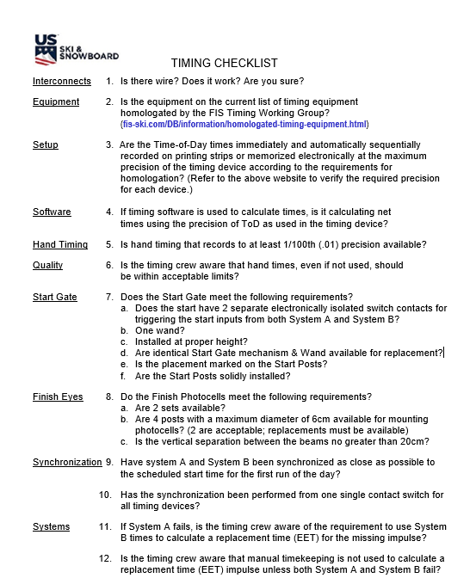
MISCELLANEOUS: TIMING RESPONSIBILITIES
NOTE: Wireless timing has been approved for non-championship events.
If an Organizing Committee wishes to use wireless timing, they must complete an online application. (forms.gle/DsHR5Hi6pvy7w1EG6).

Slide 123
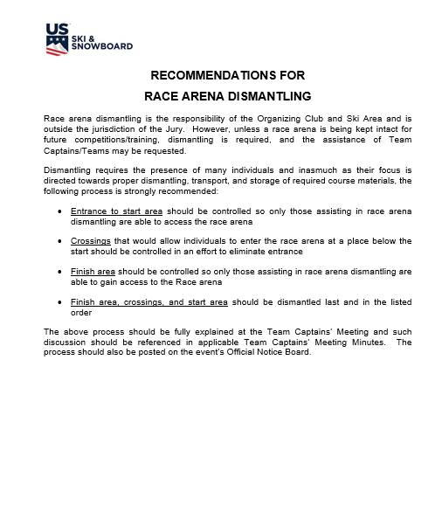
MISCELLANEOUS:
RACE ARENA DISMANTLING

Slide 124
MINUTES – A Review:
Jury Without Protest
Jury With Protest
Team Captains’ Meetings

Slide 125
Verbiage in Jury Minutes:
Using “MUST” means an action is mandatory.
Using “SHOULD” means an action is strongly recommended.
Using “MAY” means an action is optional.
Using “SAFE” means “free from danger” and MUST NOT be used.
“ASSURE, INSURE and ENSURE” must not be used.
Should you use “will” or “shall”?
“Will” implies volition or intention
“Shall” implies necessity or mandatory nature of an action and
can stray into the neighborhood of Must!
In legal documents, “shall” and “will” are commonly used to indicate that an action or obligation is mandatory.

Slide 126
DELAY, POSTPONE, TERMINATE or CANCEL
DELAY – Event will start later on the SAME day
Short delays do not require documentation
A delay that affects the entire Program should be documented
POSTPONE – Event will be rescheduled to ANOTHER day within the same series’ dates
TERMINATE – Event stopped after starting (even if only 1 Forerunner has started!)
CANCEL – Event did not start and cannot be rescheduled within the same series’ dates
Canceling an event cancels event liability insurance and a new Schedule Agreement will be required. Contact U.S. Ski & Snowboard Competition Services for directions!
Notes:
FIS does not recognize “terminate.” If use is required, suggested verbiage is to “terminate the run and cancel the event.”

Slide 127
JURY MINUTES – W/O PROTEST
Jury Minutes are required for all events: non-FIS (scored and non-scored), FIS events, all speed training runs, freeskiing sessions, and SkillsQuest.
(Minutes may be documented sequentially, using only one form per event/day.)
Required:
Prior to Team Captains' Meeting: Medical Plan approval
After course inspection(s) to approve course set and on-hill competitor security and confirm daily Program (schedule)
After termination of a run/race
Documenting a need to apply force majeure
Postponing or canceling an event
Additional meetings as determined by the Jury
Minutes must only contain signatures of voting Jury members; only Jury members may vote on decisions
NOTE: Jury Minutes are required for all runs/events; this includes speed training runs and freeskiing sessions. Any decision involving force majeure must also be documented.

Slide 128
JURY MINUTES – PROTEST/SANCTION
Same form is used for minutes related to protests and Jury-applied sanctions.
Only sanctions related to collective offenses may be documented on the same form; all others require individual forms.
By rule, Minutes of Jury Decisions - Protest must contain the following:
- Offense alleged to have been committed
- The evidence of the offense
- The rule(s) or Jury directives that have been violated
- The penalty imposed
- Minutes must contain records of Jury vote
- Minutes must be signed by Jury members

Slide 129
UNDERSTANDING COLLECTIVE OFFENSES (224.3)
Several persons:
Commit the same offense
At the same time
Under the same circumstances
Jury’s decision as to one offender may be considered binding upon all offenders.
Written decision shall include:
Names of all offenders concerned
Scope of the penalty to be assessed upon each of them
Decision will be delivered to each offender.

Slide 130
COMMENTS REGARDING MINUTES PROTESTS/SANCTIONS
Accused has the right to be heard
Accused has the right to address all testimony and evidence
All facts must be available and presented
Jury should consider/discuss all options
Sanction should fit the “crime”
With the exception of verbal sanctions, the Jury decision must be documented
Minutes must contain signatures of Jury members with record of their vote

Slide 131
FIS EVENT PROTEST FEES &
ON-SITE MONETARY SANCTIONS
Protest fees for a protest that is upheld are returned to the protesting party
Protest fees for protests that are not upheld are to be submitted to U.S. Ski & Snowboard *
This requirement also applies to monetary sanctions that are collected on site
Tendered amount(s) must be identified by event, date, codex and name of applicable party.
Tendered amount(s) will be forwarded to the FIS Office. (644.4).
* NOTE: Protest fees at non-FIS events are retained by the OC.

Slide 132
OTHER COMMENTS
Jury Minutes must only contain facts – not opinions
Jury Minutes should only be written regarding actual decisions. Minutes similar to: “1st Run completed, no issues, no DSQ’s;” “Course set with #/# gates; etc.”
Jury Minutes regarding sanctions must be prepared on separate forms (exception is “Collective Offense”)
With the exception of OWG and WSC, the Start and Finish Referee are not voting members of the Jury; their names must not be included as such on the form. If their presence and testimony is required at a Jury Meeting, it must be noted under section “Others present at the meeting”
Jury Minutes must be signed; votes must be recorded!

Slide 133
TEAM CAPTAINS’ MEETING MINUTES
In accordance with rules, the time and location of the Team Captains’ Meeting must be shown in the Program
If the meeting is being held on an online platform, all access/sign-in instructions must be communicated to all interested parties
A Team Captains’ Meeting is an inseparable part of the competition and is important for communication of Jury instruction, support of the OC, OC requests and information as well as a critical element for risk management and liability-related matters [604.3]
Minutes of all meetings are required, are the responsibility of the Race Secretary (Race Administrator) and must be signed by the Race Secretary.
The Technical Delegate should review their content!

Slide 134
The Chief of Race must have a basic knowledge of all event procedures and rule changes/clarifications.
In order to provide a more comprehensive Update and Review, the following slides contain information relative to other event positions.
Please refer to the original document posted on the U.S. Ski & Snowboard website for complete update and review information.
There may be some repetition of information that has already been addressed. Your patience with our attempts to reinforce this information is greatly appreciated.
SEASON 2026 UPDATE & REVIEW:
CONTINUING EDUCATION FOR ALPINE OFFICIALS

Slide 135

CONTINUING EDUCATION UPDATE
SEASON 2026
U.S. Ski & Snowboard
NON-FIS EVENTS
The following items are only applicable at non-FIS events.

Slide 136
SLALOM POLES
U680.2.1.1
Slalom poles must be contrasting, alternating colors.*
Turning pole must be a flex pole.
For scored U14 events, 72" gates are allowed.
*This change allows an Organizing Committee the flexibility to use colors other than red and blue.
INTERNET-BASED TIMING/RESULT PLATFORMS
U612.4.1
Any event that includes U14 and younger athletes is not allowed to post "real-time" results or times on an internet-based timing/result platform during the race
Competitor lists: e.g., Club entries, Start Lists, Results, Referee Reports, may be posted
Standings/times should be updated at the conclusion of the event.

Slide 137
TD’S DAILY ALLOWANCE & MILEAGE
The amount of the daily allowance for which a Technical Delegate may submit an invoice has been increased to $150 per travel/race arena inspection/training/competition day.
If multiple tasks are completed in one day, e.g., travel and race arena inspection, only 1 daily allowance may be invoiced.
An actual “travel day” is a one-way trip of five or more hours; two one-way trips of less than five hours only equal one day.
Current IRS-approved mileage is $.70 per mile, but it may be adjusted for events January 1; please verify and calculate mileage based on the current IRS-approved amount.
ALPINE OFFICIALS’ CONTINUING EDUCATION (UPDATE & REVIEW)
Certified Alpine Officials are required to attend a yearly Continuing Education Clinic (Update & Review).
Technical Delegates and Race Administrators are required to attend a yearly certification-specific Workshop.
These requirements must be met prior to being appointed to officiate at any U.S. Ski & Snowboard sanctioned event.

Slide 138
CONTINUING EDUCATION UPDATE
SEASON 2026
U.S. SKI & SNOWBOARD
FIS EVENTS
The following items are only applicable at FIS events.

Slide 139
EQUIPMENT SPECIFICATIONS
(FIS Specifications for Alpine Competition Equipment
Airbags: With the exception of Nor-Am Cup, Far East Cup, and Junior World Championships, where it is strongly recommended, competitors must use an airbag for all FIS Level 0 and Level 1 speed events. (3.5.2.4; FIS Specifications for Alpine Competition Equipment)
Cut-Resistant Undergarment Pants: With a minimum protection level of 3 Stars, cut-resistant undergarment pants are required for all Level 0 and Level 1 events (technical and speed).
Use of the undergarment is strongly recommended at other levels of competition.
Please note: “Cut-resistant undergarment is intended to provide supplementary protection and not infinite cut protection.”
(3.5.3.4; FIS Specifications for Alpine Competition Equipment)

Slide 140
Shin Pads (Carbon Shin Shells):
No additional rigid parts are allowed to be worn as shin pads inside the boot.
To treat medical issues, additional protection pads, as soft padding, can be approved by FIS.
Those pads must be made of soft material (e.g., gel, foam) and be flexible in all directions.
Additionally, they cannot have a preformed, curved shape adapted to the leg.
Their size must not exceed the height and width of the ski boot tongue. (3.5.4;FIS Specifications for Alpine Equipment)

Slide 141
COMPETITION EQUIPMENT
Equipment is the responsibility of the athlete and in the case of a minor, their parents or guardians.
Equipment must be maintained and utilized in accordance with manufacturer’s instructions.
Protests against equipment at a U.S. Ski & Snowboard non-FIS event must be handled in accordance with current U.S. Ski & Snowboard Equipment Control/Protest Guidelines.
Protests against equipment at a FIS event must be handled in accordance with current FIS rules.
Equipment violations are subject to disqualification and other sanctions as determined by the Jury. Sanction may be against the individual competitor, or the competitor’s coach if it is determined that the coach was complicit in the use of equipment known to be in violation of the rules.

Slide 142
ADDITIONAL EQUIPMENT NOTES
Competitors are allowed to protect all parts of the body with so-called protectors in all events.
It remains in the athlete's/NSA's discretion and responsibility to individually decide about the use of protectors.
In Downhill, protectors may not be integrated into the competition suit.
In all events these protectors must be worn underneath the conforming competition suit. [3.5 FIS Specifications for Alpine Competition Equipment]
The only exception is forearm protection used in SG, GS and SL and shin protection used in SL.
There is no exception for knee braces; they must be worn underneath the competition suit.

Slide 143
CONTINUING EDUCATION UPDATE
SEASON 2026
U.S. SKI & SNOWBOARD
NON-FIS & FIS EVENTS
The following items are applicable for both non-FIS and FIS events.

Slide 144
TIMING & DATA TECHNICAL REPORT (TDTR)
A Timing Data Technical Report (TDTR) is required for all levels of competition/all events, both non-FIS and FIS
FIS TDTR software is used for preparing and submitting the report.
Software is available for Windows 10, 11, and macOS 10.14+; it is updated as required.
If an event requires calculation of a replacement time (EET), copies of all calculations must be included with the Timing & Data Technical Report (TDTR) submitted to:
results@fis-ski.com or janez.flere@fis-ski.com
tdtr@usskiandsnowboard.org
Copy of the calculation must also be included in the PDF “Event Document Packets.”

Slide 145
HEAD TAX:
CALCULATION/VERIFICATION/PAYMENT
Regardless of whether or not the registration system of choice calculates and submits required Head Tax:
The Organizing Committee is responsible for calculation, verification, and payment of all National, Regional, and Divisional Head Taxes.
Head Tax payments are due within 14 days (2 weeks) after the event.
All late payments to U.S. & Snowboard shall accrue interest at a rate of one and one-half percent (1.5%) per month, or the maximum rate permitted by law, whichever is less, until paid in full.
Organizers who fail to submit head taxes risk loss of Club Certification and the ability to host other competitions until coming into compliance.

Slide 146
REGIONAL DEVELOPMENT TEAMS – Fee Waivers
Named members of the U.S. Regional Development Teams are entitled to waived event fees (entry and lift).
These athletes are exempt from payment of U.S. Ski & Snowboard National Head Tax
Refer to MPF 52: Head Tax Waived Athletes.
- List is current as of September 1, 2025
- If confirmation is required, contact Competition
Services

Slide 147
U.S. SKI & SNOWBOARD FIRST REPORT OF ACCIDENT
Report is required for all injuries involving athletes, coaches, officials, or spectators where an insurance claim may be filed.
Regardless of national federation affiliation
Regardless of whether or not Ski Patrol evacuation was required.
Report should be completed as fully as possible.
Report should only contain facts; speculation should be avoided.
Report must be filed online; instructions and required reporting form may be found under “Participant Accident” at
usskiandsnowboard.org/sport-development/club-development/club-insurance
Copies of the filing instructions as well as a sample of the reporting form are available in the Master Packet of Forms. The sample of the reporting form is intended only for gathering required data prior to online filing.

Slide 148
U.S. SKI & SNOWBOARD FIRST REPORT OF ACCIDENT
Report should, at a minimum, include the following:
- Injured party name
- National ID or member number
- Injury date
- Injury information
- Competition information, as applicable
Injuries/accidents that occur within the competition arena (including Start and Finish areas) should be submitted by the Technical “Director” or an event official.
Injuries/accidents that take place outside of the competition arena must be submitted by a coach, parent, or the respective athlete.
A copy of the submitted report will be emailed to the filing individual; confirmation of approval or denial of the claim will be provided when available.
NOTE: First Report(s) of Injury for named U.S. Ski Team members will be filed by U.S. Ski & Snowboard staff.

Slide 149
U.S. SKI & SNOWBOARD FIRST REPORT OF ACCIDENT:
Report Filing Requirement at FIS Events
FIS Technical Delegates, regardless of their national affiliation:
Are only responsible for the accuracy and submittal of FIS documents.
The accuracy and submittal of any additional documentation that may be required by the NGB are the sole responsibility of the Race Administrator and/or the Organizing Committee; e.g.,
- Results/Penalty based on National Points
- U.S. First Report of Accident (as noted in the filing
instructions)

Slide 150
ELECTRONIC TIMING
Time of day times must be immediately and automatically sequentially recorded on printed strips or memorized electronically. (U611.2.1; 611.2.1 adds “for level 3 and 4, is acceptable.”)
CHIEF TIMEKEEPER
The Chief Timekeeper must publish unofficial times as quickly as possible (on the scoreboard, etc.)
If electric timing fails, the Chief Timekeeper must communicate immediately with the Start Referee and the TD.
The equivalent Electronic Time report must be prepared. The Jury must control and approve it. The report may also be shown to the representative of the nations concerned. (U612.4; 612.4 requires Jury control and approval.)

Slide 151
INTERDICTION TO CONTINUE
If a competitor’s skis come to a complete stop, they must no longer continue through previous or further gates.
If a competitor continues without their skis coming to a complete stop:
- they must not interfere with the run of the next
competitor
- or be passed by the next competitor (614.2.3)

Slide 152
GROUNDS FOR INTERFERENCE
Blocking of the course has been replaced by blocking of the “racing line” in both articles. (623.2.1 and 623.2.2)
Clarification of the intent of Art. 623.2.3: Blocking of the racing line by a broken or detached pole caused by the competitor.
This applies to all non-FIS events as well as FIS Level 1, 2, 3, 4 events.
CANCELLATIONS OR POSTPONEMENT - Clarification
Observing applicable deadlines,
Postponements must always have a future date
Otherwise, the event is considered canceled.

Slide 153
GENERAL REVIEW & CLARIFICATION
SEASON 2026
U.S. SKI & SNOWBOARD
NON-FIS & FIS EVENTS
The following items are applicable for both non-FIS and FIS events.

Slide 154
VERIFICATIONS: MEMBERSHIP, ETC.
The Race Administrator must verify that membership status for all named officials, coaches, forerunners, and competitors is current and not “Pending.”
The Race Administrator must verify the non-presence of all named officials, coaches, and adult forerunners on the Central Disciplinary List.
The Race Administrator must verify the non-presence of all athletes on the Membership Hold List.
These verifications are required prior to granting event credentials and race arena/venue access.

Slide 155
ADDITIONAL COACH REQUIREMENTS
Pursuit of coach certification is required for all coach members.
Effective Season 2026, “Active” coach certification will be required in order to register for a U.S. Ski & Snowboard sanctioned competition and be granted race arena/venue access.
For their first season, new coaches who have never been certified, being “In Progress" towards their Level 100 certification will meet this requirement.
Level 200 Coaches will be required to be a certified Referee.
Sport Education CE (continuing education) completion is separate from required yearly attendance at an Alpine Officials' Continuing Education (Update & Review). Attendance at both is required.
For additional details, contact sporteducation@usskiandsnowboard.org.

Slide 156
FORERUNNERS
U.S. Ski & Snowboard event: Forerunners must hold a current U.S. Ski & Snowboard membership:
- Competitor
- Coach
- Official
- Volunteer
- Master w/Requirements
- Non-Scored Athlete
- Short-Term Athlete
- General
NOTE: Coach, Official, and Volunteer memberships may be accepted in order for an individual to serve as a forerunner. Coaches must take note, however, that forerunning may not be included in the duties outlined in their club employment contract. In addition, regardless of the type of membership, an event’s equipment and vertical drop regulations apply to all forerunners.

Slide 157
FORERUNNERS
FIS events:
Must hold a current U.S. Ski & Snowboard membership
Must hold a current FIS inscription or
Must hold a current membership in a foreign federation recognized by FIS.
In cases of force majeure, where a sufficient number of FIS-inscribed forerunners are not available, an eligible U.S. Ski & Snowboard member may forerun after signing a FIS Athlete’s Declaration. [605.1]
NOTE: FIS Athlete Declaration requires a parent or legal guardian’s signature for an athlete who is not of legal age.

Slide 158
FORERUNNERS
Adult Forerunners – Minor Participants:
Adult (18+) forerunners at events that include minor participants (U18 and younger) are required to be in good standing with a membership that includes SafeSport training and background screening.
The “Alpine Master” and “Short-Term Alpine Master” memberships do not meet this requirement and are not allowed.
Masters Events:
U18 and younger forerunners, including those with General and Short-Term Memberships, at Masters events where competitors may have the “Master” or “Short-Term Alpine Master” memberships that do not include SafeSport Training and background screening must be accompanied by:
- a parent or legal guardian or
- at least two (2) U.S. Ski & Snowboard members with a membership that includes SafeSport training and background screening
(e.g., Coach w/Official, Official, Volunteer, Masters w/requirements).
As with all U18 and younger events, if U18 athletes will be forerunning a Masters event, a communication pertaining to athlete safety policies must be sent to all participants, and the QR code must be posted at the registration area.

Slide 159
LIST OF APPROVED FORERUNNERS
Race Administrator is responsible for verifying Forerunners’ requirements, e.g.:
- membership status: applicable, current, or pending
- within athlete’s vertical drop allowance
- non-presence on Centralized Disciplinary List
A list of approved Forerunners must be provided for the Start Referee – one is generally available on footer of the Start List
Critical if a Condensed Start List is being generated and names of all approved Forerunners are not listed
Critical if the race result software does not provide enough space to list the names of all approved Forerunners
Officials must not allow any individual to start either as a Competitor or a Forerunner if prior approval has not been obtained.

Slide 160
GOLDEN RULE: ALL NON-FIS EVENTS (Golden Rule is not valid for FIS events.)
Athletes who have been granted Golden Rule seeding may compete using the equipment appropriate to their disability.
Adaptive athletes who are visually impaired will be accompanied by a guide.
- The guide provides verbal instructions to the athlete
- The guide is accorded the same consideration as the athlete
Start Referee should skip a minimum of one start interval following the start of a visually impaired athlete and their guide.
Start Referee must notify Jury of any interval changes.

Slide 161
GOLDEN RULE - CLARIFICATION
Events using TRS (Butterfly) Seeding:
Athletes who have been granted Golden Rule Seeding will be seeded 16th+ in all runs or races of the same series unless original start list preparation/flip/butterfly affords them a more favorable (earlier) start position.
Events not using TRS (Butterfly) Seeding:
For all events, First Run U621.3.1: Adaptive athletes will be seeded in special groups with start order: 16-20, 36-40, 56-60, etc., or by seed points, whichever is more favorable. (Placement within groups is by national point ranking.)
Second Run with Flip 30 U621.11.3.2: Adaptive athlete groups will start in the 31st position unless first-run time affords a more favorable (earlier) start position. (Placement within groups will be by the results of the first run.)
Second Run with Flip 15: Adaptive athlete groups will start in the 16th position unless first-run time affords a more favorable (earlier) start position. (Placement within groups will be by the results of the first run.)
Adaptive athletes who are shown as DNS, DNF, DSQ, or NPS in the first run can start in the second run with their original bib immediately after the last qualified competitor has completed their run.

Slide 162
RACE ARENA versus RACE VENUE
The Jury is responsible for technical matters within the closed competition areas. [601.4] The closed competition areas are defined as the “race arena” which is accepted as being those areas which the Jury inspects and accepts as being suitable for competitors’ presence:
within (the side-to-side fencing) and
without (start area and finish arena) the confines of the competition area and
any location connected with the competition [223.2.1]
The Jury does inspect and accept:
the start and finish areas as well as the ingress and egress to these areas
the racecourse
the type and placement of the on-hill competitor security
the ingress and egress to areas where media meets with athletes, coaches (upper-level events)
The Jury does not inspect or accept:
lift areas
parking lots
cafeterias
terrain parks, public trails, team meeting rooms, warmup area, warmup courses, etc.

Slide 163
Please Note:
In addition to stating for “actions within and without the competition area,”
sanctions can be applied and
a penalty can be imposed
223.2.1 includes “conduct within any location connected with the competition.”
These locations include, but are not limited to the following areas that are required for the orderly conduct of an event:
Team Captains’ Meetings,
Jury meeting areas,
timing building,
equipment control area
Neither the “closed competition areas” (within or without the fencing) nor “any location connected with the competition” include lift lines, cafeterias, or parking lots, etc., unless rules state otherwise; e.g., U14 regulation which prohibits waxing application on ski resort property.

Slide 164
SPLIT SECOND / VOLA INTERFACE
If the event data is being managed with Split Second, but your Chief of Timing & Calculations is timing with VOLA:
It is possible to transfer data between the systems.
Itis recommended that only bib #’s and times be imported from VOLA timing to Split Second data.
If athletes’ names are imported, please verify that any athletes who have double last names:
- e.g., “VAN HORN, Eric” transfer back from VOLA in the original format: VAN HORN, Eric not VAN, HORN Eric.
The misplaced comma will result in FIS and U.S. Ski & Snowboard autoscore systems rejecting the XML file.

Slide 165
FIS EVENT ENTRY AUTHORIZATION LETTERS (TRAVEL LETTERS)
Only National Ski Associations (Federations) are entitled to make entries for international competitions.
Some foreign federations may issue an entry authorization (travel) letter which allows foreign athletes training with U.S. Ski & Snowboard clubs or attending USA schools/colleges/universities to be entered by their coaches.
Several nations, e.g., Austria, Canada, Great Britain, and Spain, currently do not issue authorization (travel) letters; entries for competitors from these nations must originate from the respective Federation; cover email should be retained in the Organizing Committee’s event file.
Entries submitted by a foreign Federation must list the names of all personnel accompanying the athlete(s) and for whom race arena/venue access is requested; e.g., coach, trainer, ski technician, physical therapist, medical personnel.

Slide 166
RESULT PROCESSING – XML FILE
Individual event XML race result files are uploaded at
race-results.usskiandsnowboard.org/.
Login for clubs hosting sanctioned events or a previously-approved login for individuals who do not have access to the club login will be required to access the upload platform.
If an official is unable to log in, contact Competition Services for assistance.

Slide 167
RESULT PROCESSING –
EVENT DOCUMENT PACKETS
Following successful uploading of the XML race result file, if the PDF “Event Document Packet” has been completed, it may be uploaded during the same access window as the corresponding XML race result file.
NOTE: An error has been discovered only in the upload process for Event Document Packets. IT is currently working on implementing a patch, but if they are not successful, the above upload option will not be available, and all Event Document Packets will have to be emailed to resultpackets@ussa.org.
If the PDF “Event Document Packet” is:
- not completed until after the XML race result file is uploaded, or
- you are unable to successfully utilize the upload function,
the PDF “Event Document Packet” must be emailed to resultpackets@ussa.org.
The U.S. Ski & Snowboard transmittal number must be used as the email’s subject.

Slide 168
START NUMBER or BIB NUMBER
617.3.3 If two or more competitors have the same time or the same number of points, the competitor with the higher start number must be listed first on the official list of results.
Split Second breaks a tie in time by defaulting to an athlete’s actual “start number.”
VOLA interprets the “start number” to be the “bib number” and breaks a tie in time by defaulting to an athlete’s actual “bib number.”
Refer to these defaults when inserting an athlete in a start order or assigning an out-of-sequence bib:
Split Second: inserting an athlete after the first group and assigning 15A will affect Split Second's tie breaking capability because Split Second will not accept the start number + alpha character.
VOLA: assigning an out-of-sequence high value bib number to replace a missing bib; e.g., Start 6 wearing Bib 106 will affect VOLA’s tie breaking capability should a tie in time occur, for example, between Start 6 Bib 106 and Start 20 Bib 20; (Bib 106 will be ranked before Bib 20 regardless of the earlier start.)

Slide 169
HELMET RULES
Soft ear protection is only permitted for helmets used in Slalom. Soft ear protection is not allowed in Parallel events. [U707, U807, U907, U1007, U1233, Helmet Rules]
U1233: In the case of issues or items not covered in Art. 1220-1233, the rules for Slalom (Art. 800) or Giant Slalom (Art. 900) must be considered.
Reminder: For all events, (FIS, non-FIS scored and non-scored):
- helmet-mounted cameras and/or their mounts are not allowed for use by either competitors or forerunners.
- helmets shall have no spoilers nor protruding parts.

Slide 170
U12 and U14 SUPER G TRAINING RUN
Official training for U12 and U14 Super G must include at least one Super G training run prior to the first competition.
Official training for these age groups is an integral part of the competition, and all athletes are required to participate.
In exceptional cases, a Jury can authorize a controlled freeski run in lieu of an official training run.
The Jury decision must be documented in Jury Minutes.
If racing with U16 athletes, ACR U1256.4 applies, and a training run must be calendared.
All sanctioned speed training runs/camps – Downhill or Super G – require that a full Jury be empaneled.
In addition, they must also carry either liability insurance coverage through the U.S. Ski & Snowboard provider or through the Organizing Committee’s provider.
Notes:
If an OC chooses to use their own provider to provide liability insurance, a transmittal # will not be issued. In addition, U.S. Ski & Snowboard’s secondary insurance will not be available for an injured athlete, coach, official, etc.

Slide 171
RESULT PROCESSING: NON-TIMED TRAINING RUNS
In order to provide a record of participants in a Non-Timed Training Run insured through the U.S. Ski & Snowboard provider and to capture the names of the officials, complete the following:
With all participants’ status classified as DNS, submit an XML result file to race-results.usskiandsnowboard.org/.
Notify Jeff Weinman of any athletes that actually were DNS.
Submit an Event Document Packet containing the documents listed in the MPF “05 Non-FIS Event Document Packets.”

Slide 172
SKILLSQUEST
The Jury members for a sanctioned SkillsQuest Tournament are: Technical Delegate, Referee, and Chief of Race. (The Chief of Race may also be serving as the SkillsQuest Tournament Director.)
A SkillsQuest Technical Delegate’s Checklist for U.S. Ski & Snowboard sanctioned SkillsQuest events is available in the Master Packet of Forms.
A Roster of SkillsQuest Participants and the SkillsQuest Score Card
(usskiandsnowboard.org/index.php/sport-programs/skillsquest)
must be submitted to: jeff.weinman@usskiandsnowboard.org.

Slide 173
WIRELESS TIMING
Wireless timing has been approved for U.S. Ski & Snowboard non-championship events.
FIS further restricts its use to FIS Level 3 and FIS Level 4 only.
An application for the use of wireless timing at U.S. Ski & Snowboard events has been drafted, and a link to the application is available in the Master Packet of Forms (MPF).
Please contact John Jett (jjett@cjtiming.com) or Matt Howard (matt.p1timing@gmail.com) for details.

Slide 174
MANUAL TIMEKEEPING VERIFICATION SUGGESTIONS
Two suggestions: Neither one will take much effort, but they may be the difference between a race result or a disappointed athlete for whom no time is available.
Take the time to verify manual devices are still synchronized. A countdown over the radio and a request for the display reading can be done prior to the start.
Another option is requesting the manual time for the first forerunner.
Completion of the TDTR requires the hand time for the first athlete, but verification prior to the start of Bib 1 allows time to address any issues.
If electronic timekeeping systems fail, immediately verify hand times are available for the racer for whom an electronic time is not available.
This immediate action will indicate whether or not manual timekeeping has validity so you will either be able to calculate a replacement time or authorize a rerun.

Slide 175
SUPPLEMENTARY REPORT or an
ADDITIONAL REPORT OF THE TECHNICAL DELEGATE
A Supplementary Report is filed by the Technical Delegate to document event anomalies. Under some circumstances, the Referee may also be required to file a Supplementary Report.
An Additional Report of the Technical Delegate is used to address issues that may or may not require re-homologation of a racecourse.

Slide 176
DUE PROCESS – ACR/ICR Art. 224.7
Prior to the imposition of a penalty (except in cases of verbal reprimands and withdrawal of accreditation), the person accused of an offense shall be given opportunity to present a defense at a hearing, verbally or in writing.
Defense can include, but is not limited to the following:
Calling witnesses, e.g., Athlete, Coach, Gate Judge
Questioning witnesses upon whose testimony the Jury relies
Considering information from a witness who is unavailable for questioning by the accused would create a serious issue. It is also unwise for Jury members to discuss a situation and consider possible penalties prior to hearing all testimony.

Slide 177
POLICY FOR DUE PROCESS
The Jury must adhere to this policy:
    Consider infraction.
    Hear and consider all testimony and other evidence.
    Allow accused person the opportunity to present a defense and review all evidence (question all witnesses, etc.)
    Deliberate.
    Make a fair decision.
    Review, vote, and sign prepared Jury Minutes documenting the decision.
    Notify affected parties. (FIS Office will address sanctions that involve a monetary sanction.)

Slide 178
NO ADVANTAGE – NO DSQ!
Art. 223 addresses offences for which a sanction – not necessarily a disqualification – may apply.
Art. 223.3.3 states: “Competitors shall only be disqualified if their mistake would result in an advantage for them with regard to the end result; unless the Rules state otherwise in an individual case.”
Rules that address grounds for disqualification are:
Art. 629.2 – jeopardizes the security of persons or property or causes actual injury or damage;
Art. 629.3 – does not pass through a gate correctly in accordance with Art.661.4;
Art. 629.3 – does not start within the time limits defined by Art. 613.7
Please note unsportsmanlike behavior is subject to sanction which may or may not include disqualification. [Art. 223.1.1; Art. 223.3.2]

Slide 179
PROVISIONAL STARTS – IMPORTANT POINTS
An athlete who is granted a provisional start that is later found to be unjustified is subject to “sanction”
Depending on circumstances, the sanction may include DSQ
Prior to imposing DSQ, Jury must decide whether or not the later start provided an unfair advantage, e.g., improved weather conditions.
A competitor shall only be disqualified if his mistake would result in an advantage for him with regard to the end result, unless the Rules state otherwise in an individual case. e.g., gate fault; early/late starts. [223.3.3]
If a provisional start is not approved, the competitor’s status must not be changed to DNS

Slide 180
PROVISIONAL RERUNS
When making a determination on validity of a provisional rerun, Jury must evaluate the following, many of which are included in the very clear provisions of 623:
Did the competitor cross the finish line? Unless the claimed obstruction occurred in close proximity to the finish line and the competitor’s racing speed did not allow sufficient time for the competitor to avoid crossing the finish line, the Jury may consider the run is over.
When interference did not occur in immediate proximity to the finish line, did the competitor stop immediately after the obstruction or interference occurred and report the incident to the nearest Gate Judge, Jury Advisor, or Jury member?
Does the claimed obstruction/interference meet the requirements of 623.1.2 (Technical Failure), 623.1.3 (Yellow Flag) or 623.2 (Grounds for Interference)?
Did a “similar incident” occur that caused significant loss of speed or lengthening of the racing line and consequently affect the competitor’s time? [623.2.6]

Slide 181
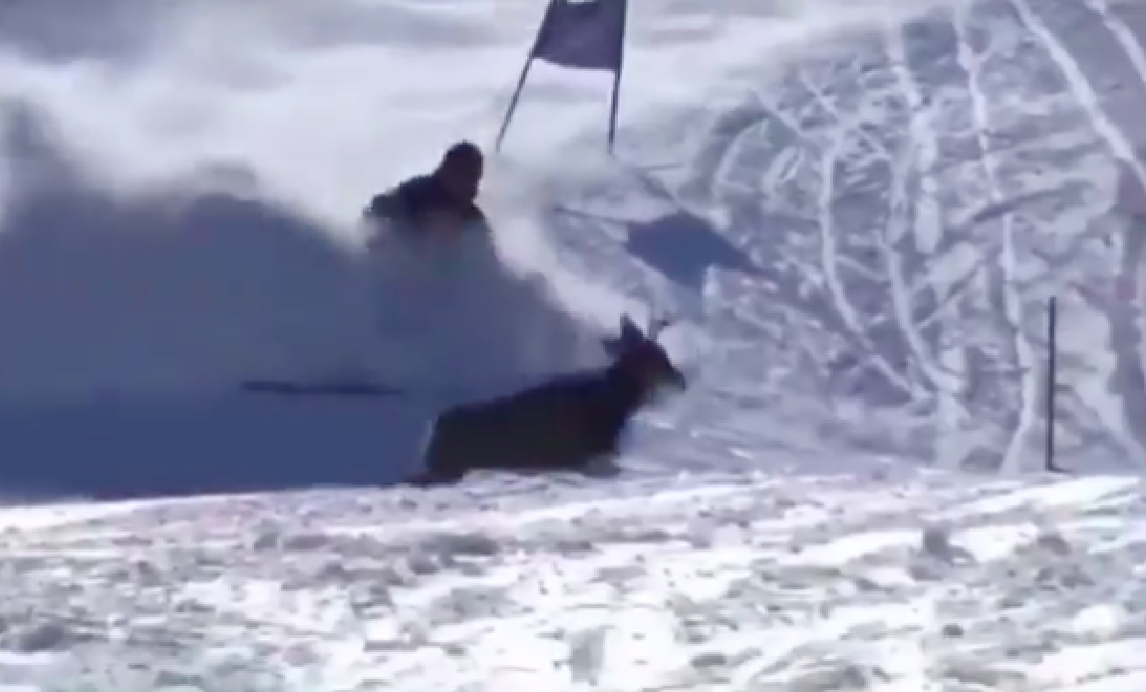
PROVISIONAL or RERUN?
Notes:
Witnessed by the Jury! Do you grant a “provisional” or do you grant an automatic “rerun” which will require no further Jury action?

Slide 182
COLLECTIVE OFFENSES [224.3]
In accordance with Art. 224.3, a “collective offense” occurs when several persons:
Commit the same offense
At the same time
Under the same circumstances
When addressing sanctions related to collective offenses:
Jury’s decision as to one offender may be considered binding upon all offenders
Written decision shall include:
    Names of all offenders concerned
    Scope of the penalty to be assessed upon each of them
Decision will be delivered to each offender.

Slide 183
U12 & U14 AGE GROUP RULES REVIEW
SKIS:
U12 and under competitors are only allowed to use one (1) pair of skis in the race arena (inspections and competition). This mandate is not intended to preclude an athlete using a different pair of skis to freeski while not in the race arena.
Parents, coaches or technicians are not allowed to furnish additional pairs of skis for use during race day inspections or competition.
Non-compliance may result in NPS or depending on circumstance, DSQ (proven violation after start).
SKI PREPARATION:
Wax benches are not allowed in U14 and younger race arenas
Wax application is not allowed at U14 and younger competition venues.
The “competition venue” is defined as the “ski resort property.”

Slide 184
WHAT IS “FORCE MAJEURE?”
In Alpine competitions, "force majeure" describes those uncontrollable/unexpected events (such as extreme weather, extreme surface conditions) that are not the fault of any party and that make it difficult or impossible to carry out an event.
An unexpected weather occurrence that requires a program/course/assignment change.
A last-minute ski area management decree.
Force majeure is “uncontrollable and unexpected”; force majeure is not “planned.”
Jury Minutes are required!
Notes:
Your team playing in the Super Bowl does not constitute force majeure!

Slide 185
TENURE OF THE JURY [601.4.4.2]
The active tenure of the Jury begins with its first meeting and ends, if no protests are submitted, at the expiration of the protest deadlines as noted in Art. 643 (Deadlines for Submittal).
If protests are submitted, the tenure of the Jury ends after settlement of all submitted protests.
A Jury may re-evaluate a previous decision (Art. 640.2) but
- only if their tenure has not ended as outlined in Art. 601.4.4.2
- only if an actual decision has been rendered; e.g., terminating
a competition, not confirming a provisional start or provisional
rerun.

Slide 186
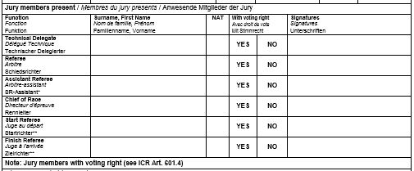
JURY MEMBER SECTION:
TD’s Name
USA
Must be SIGNED!
RF’s Name
USA
Must be SIGNED!
NAME/NAT
Must be SIGNED! DH/SG/WC SL & GS
CR’s Name
USA
Must be SIGNED!
Only OWG, WSC
Only OWG, WSC
Notice that form requests: SURNAME / FIRST NAME
VOTES MUST BE RECORDED!
“YES” or “NO”
PLEASE NOTE: “Jury members with voting right”
Start & Finish Referee are Jury members only for OWG and WSC!
Listing Start & Finish Referee and marking “NO” means the official voted: “NO”; it does not mean the official does not have voting rights.

Slide 187
EVENT RELATED DOCUMENTS
For events with no issues (injuries or accidents), it is recommended all event-related documents be kept on file for one (1) year.
In the case of an event with serious injury/accident as defined by the “Guidelines for Serious Accidents” as posted in the MPF, the Technical Delegate must immediately contact Jeff Weinman, U.S. Ski & Snowboard Competition Services for instructions.

Slide 188
The Chief of Race is responsible for all aspects of an event.
The Chief of Race is responsible for finding staff required to run an event.
A good Chief of Race will assign “Section Chiefs” who will then assign individuals where they best fit.
An event led by a Chief of Race who has the ability to lead by organizing and delegating will be a successful event. The event will be fun, it will be fair, and it will be enjoyed by all participants.
Remember that not all productive officials will be appreciated, but all appreciated officials will be productive.
Be a “Leader” not a “Boss”

