Slide 1

SEASON 2025
SPLIT SECOND 101 –
Data Management of an Alpine Event
Prepared for use in conjunction with:
Race Administration Study Guide Section 1 –
Race Result Software
Notes:
Geoff has reported there are no appreciable changes in Season 2025 software. Changes are internal.
Result XML file must be uploaded at race-results.usskiandsnowboard.org/. This will eliminate the email attachment function but only for U.S. Ski & Snowboard result XML transmissions.

Slide 2

IMPORTANT NOTICE
Procedures which impact your event operations and programs must be relayed to all event officials, Team Captains, and competitors.
The procedures must – without question – be respected and observed.

Slide 3
CHOICE OF SOFTWARE
There are two vendors who provide software capable of producing documents and results for Alpine events in the formats required by U.S. Ski & Snowboard and FIS.
This presentation is for Organizing Committees using:
NATIONAL/FIS Software (Split Second)

Slide 4
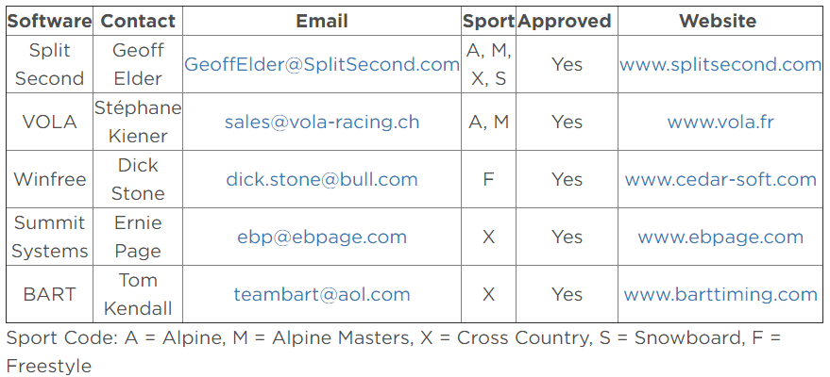
RACE RESULT SOFTWARE
usskiandsnowboard.org/sport-development/officials-development/timing-race-administration
Renewals and timing keys can be purchased at splitsecond.com/order
Key is only required for timing functions.
Split Second offers a 24-hour Online License which temporarily enables timing functions of the software without the necessity of a key.

Slide 5
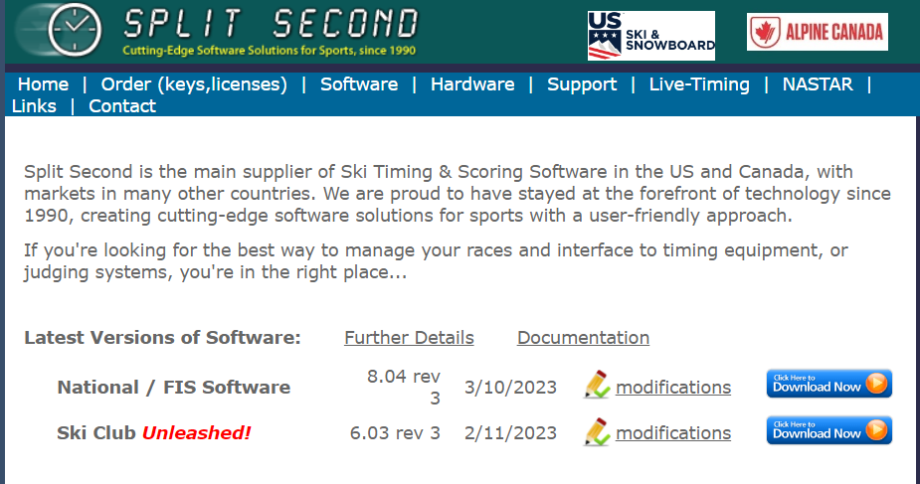
SELECT LINK ON U.S. SKI & SNOWBOARD WEBSITE: usskiandsnowboard.org or at splitsecond.com
Begin download
National/FIS Software can be used for Alpine, Snowboard, Cross Country, & Masters events and is the focus of this presentation.
Ski-Club Unleashed! offers result processing for duals, etc., and is not addressed in this presentation.

Slide 6

INFORMATION & DOWNLOAD, option 1
Begin download
And Monitor download
Note: Installation on a company computer/network may require IT assistance.

Slide 7
SELECT “SOFTWARE”; option 2
Select “Software”:
Review recent
modifications and Download

Slide 8

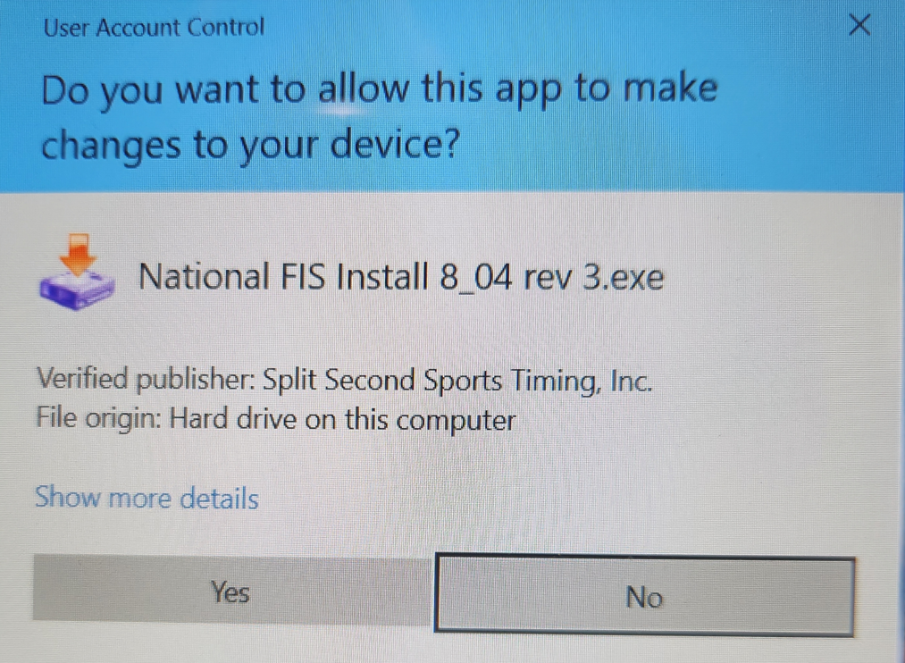
SOFTWARE INSTALLATION
Depending on your storage location for downloaded files, you will find an executable file in a similar format.
Click to begin installation.
Select “Yes” & Begin Installation

Slide 9
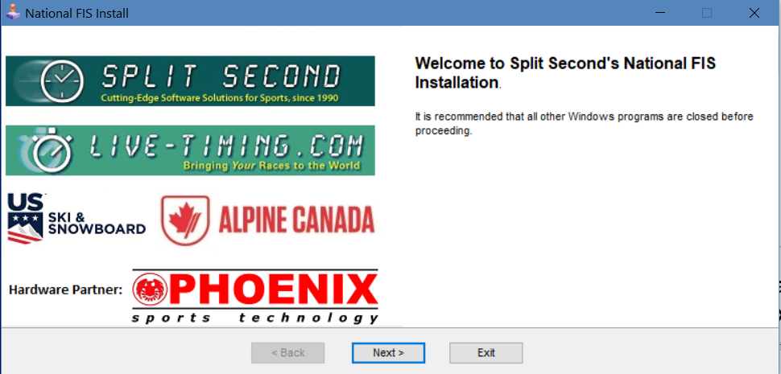
SOFTWARE INSTALLATION
Select “Next” & Begin Installation

Slide 10
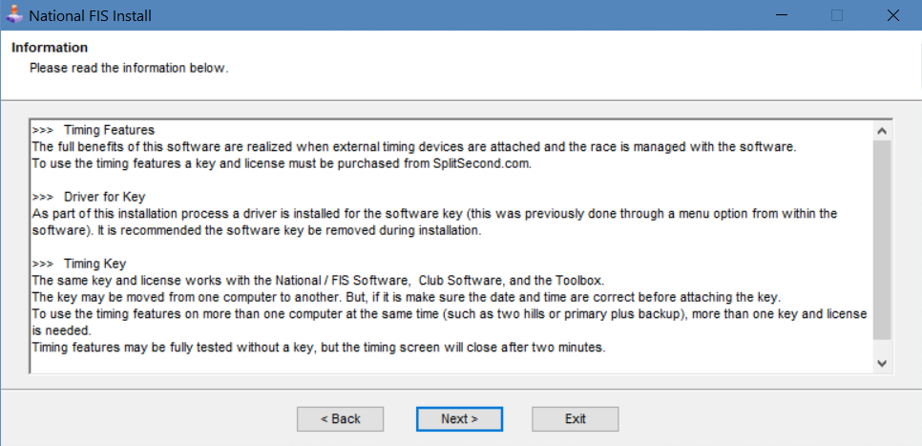
INFORMATION:
Review & Select “NEXT”

Slide 11
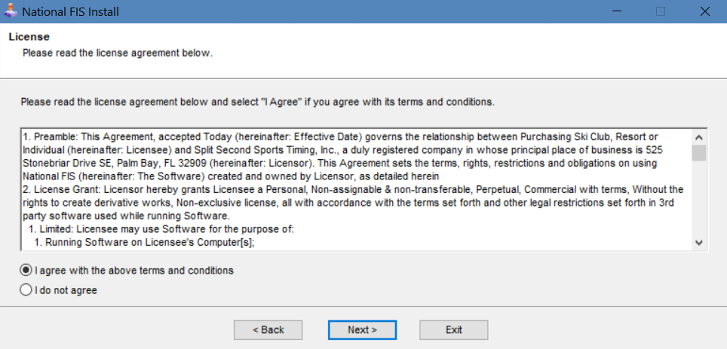
LICENSING AGREEMENT
Agree & Select “NEXT”

Slide 12
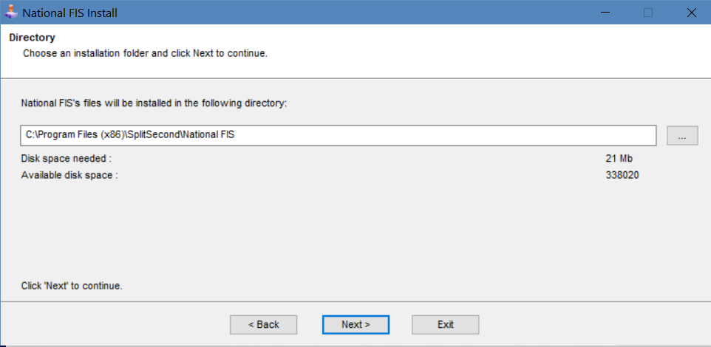
VERIFY or CHANGE STORAGE LOCATION: Select “NEXT”

Slide 13
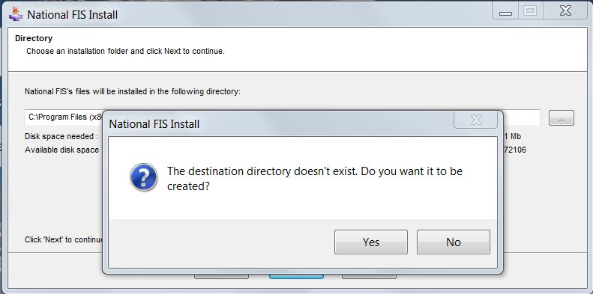
FIRST-TIME INSTALLATION?
Select “YES”

Slide 14
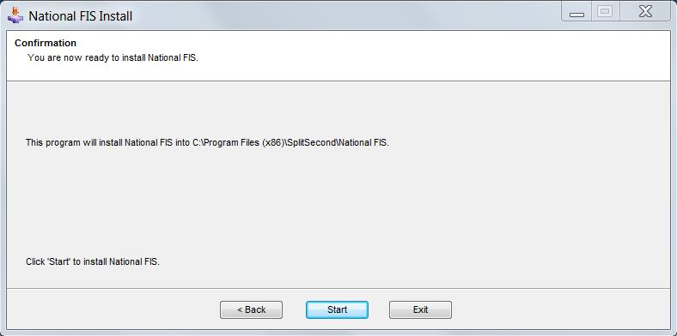
SELECT “START”
TO INSTALL

Slide 15
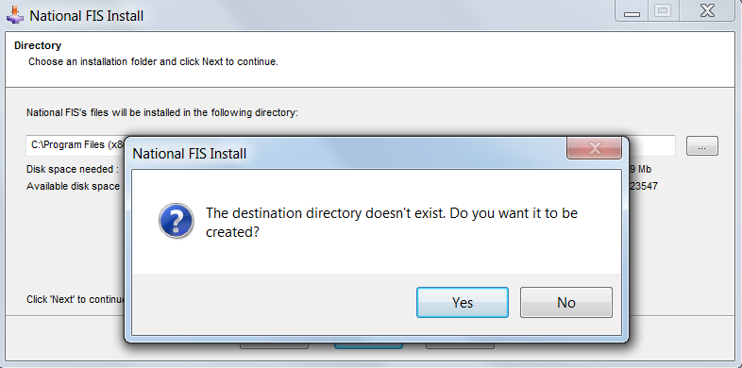
SELECT “YES”
TO CREATE DIRECTORY AND CONTINUE INSTALLATION

Slide 16
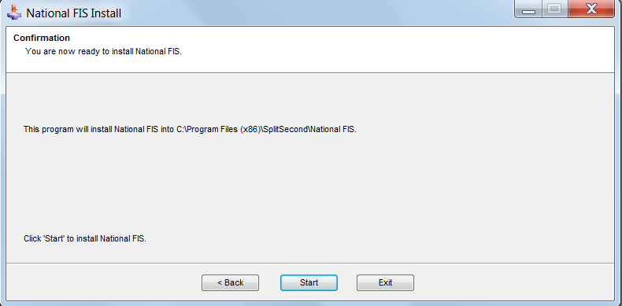
SELECT “START”
TO INSTALL

Slide 17
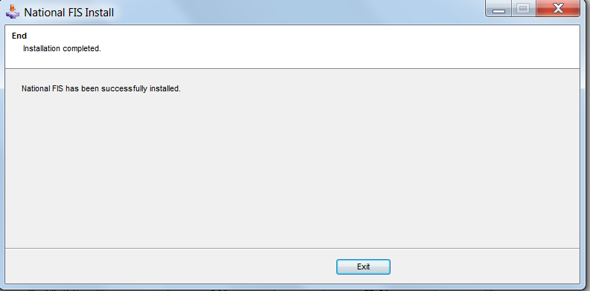
INSTALLATION COMPLETE. SELECT “EXIT” TO CONTINUE

Slide 18
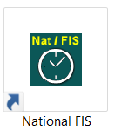
ICON ON YOUR DESKTOP
(Shortcut)
Click icon to start the software.

Slide 19
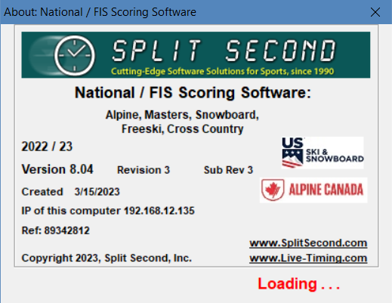
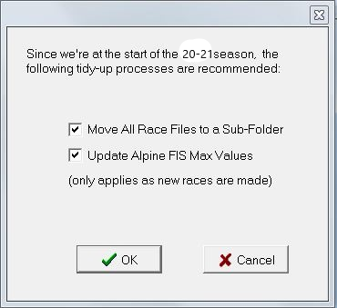
OPENING SCREENS
2023 / 24 is required for current season.
Note Version #, Revision # and creation date.
If current season not used, XML result file will not be accepted by USSS or FIS
Select “OK” and continue

Slide 20
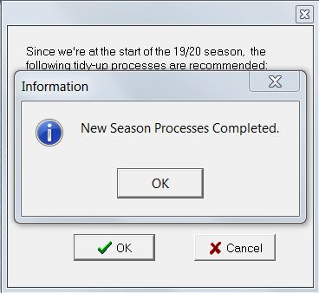
Welcome to Season 2025
Select “OK”

Slide 21
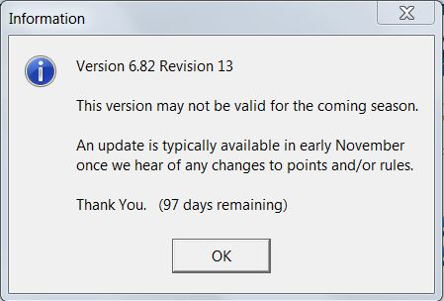
CHANGE NOTICES
This is the screen you will see if you already have Split Second installed on your computer and open the software for use prior to installation of a new season’s version. There is no need to visit the website to verify whether or not a new version is available
During the season, this screen will be used to notify users of version updates.
If a new version is available, changes will be listed and user will be given option to either
accept or reject the download.

Slide 22
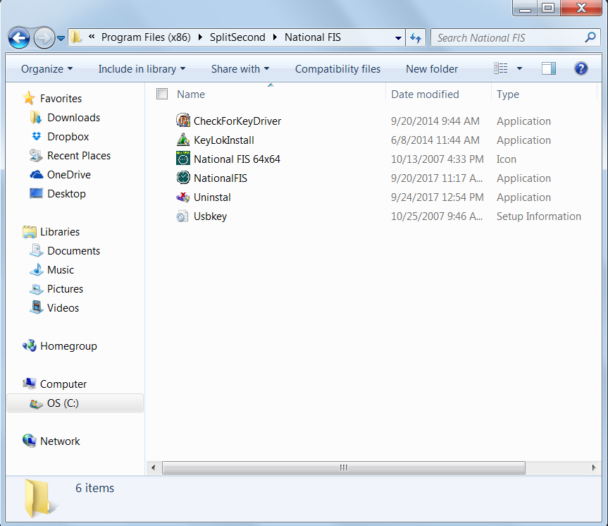
SOFTWARE
Notice actual location of software and related files.
It is different than the location of the “working files."

Slide 23
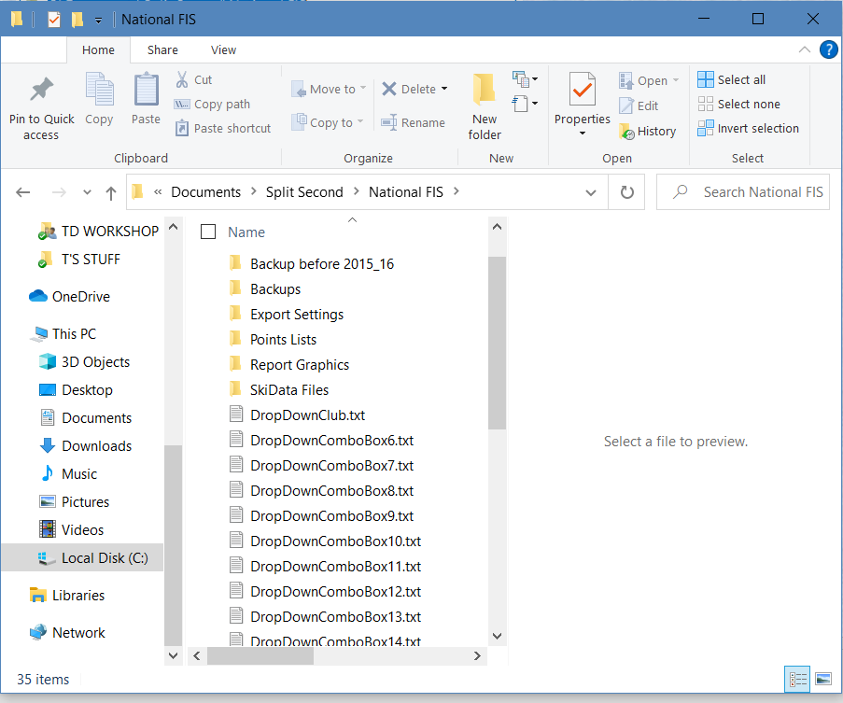
CONTENTS OF SOFTWARE
Notice location of “working files”…it is different than that of the software.
Drop Down Boxes (cache) contain default information; e.g. location, weather, etc. They will be auto-deleted on installation. It is recommended that all Drop Down Boxes be deleted on a regular basis.

Slide 24
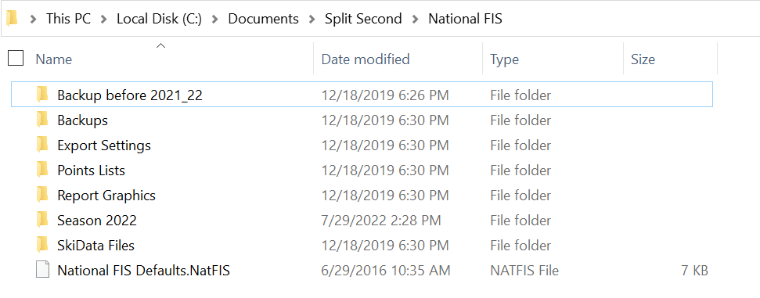
FILE MANAGEMENT
This is a screen shot from an existing installation. It shows some of the folders created by the program.

Slide 25
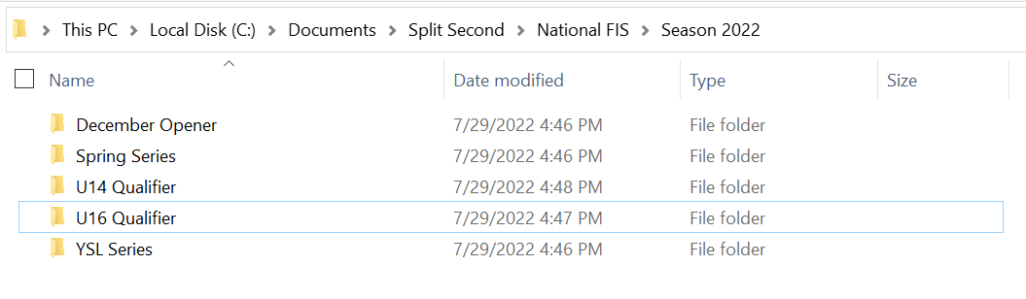
FOLDERS: ORGANIZE YOUR EVENTS

Slide 26
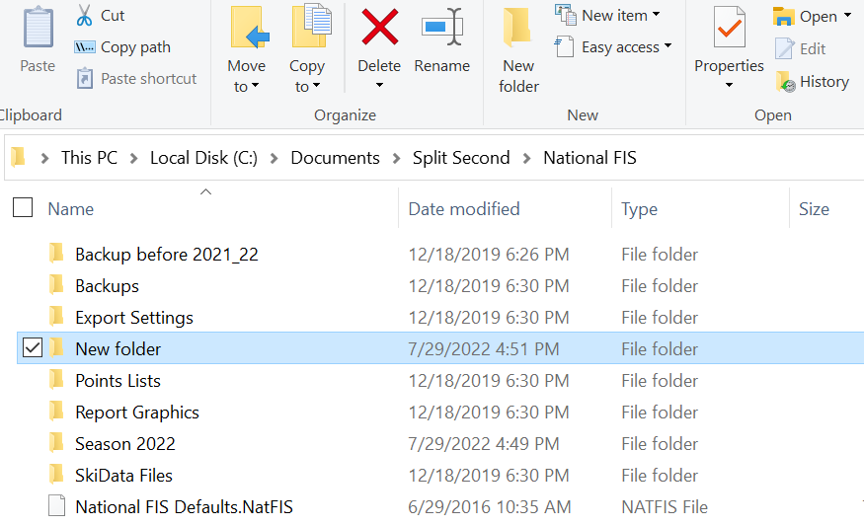
CREATE A NEW FOLDER

Slide 27
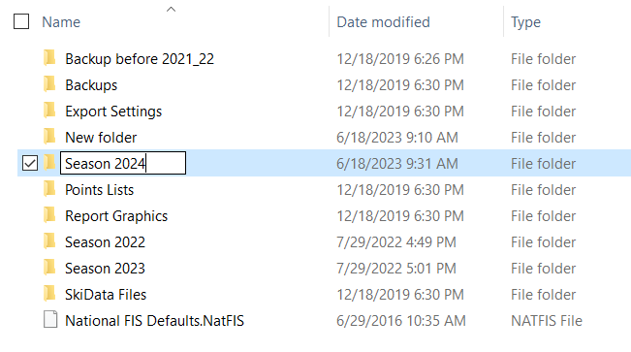
NAME YOUR NEW FOLDER

Slide 28

SUBFOLDER IN SEASON 2025 FOLDER

Slide 29
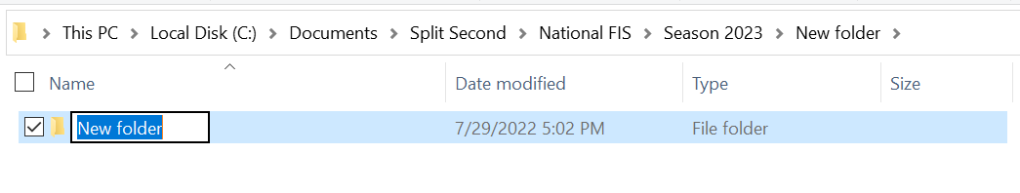
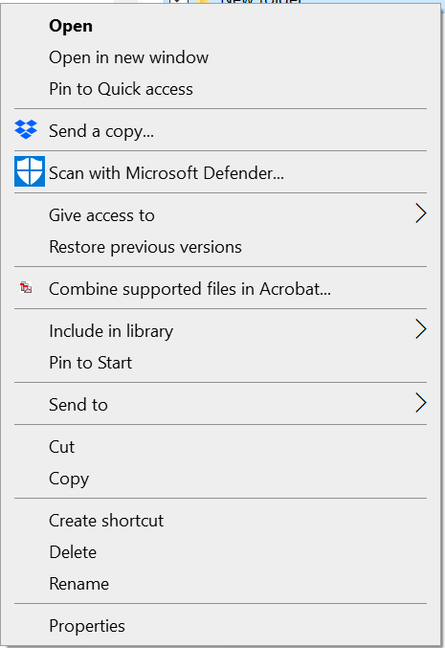
Folder/File Management Menu
Right clicking a folder opens the folder management menu.

Slide 30
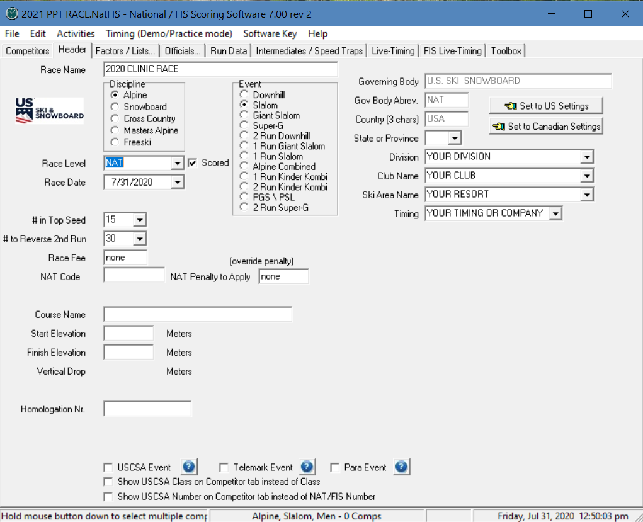

SET YOUR DEFAULTS
Access “Defaults” selecting “EDIT”
Select “DEFAULTS”
Data entered in “Defaults” is used to create ALL future events.

Slide 31
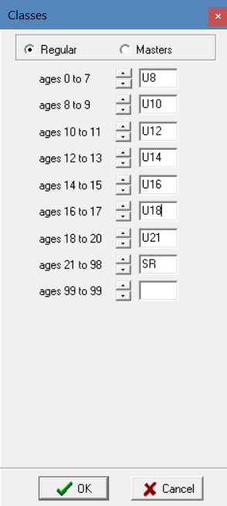
VERIFY YOUR DEFAULTS - Classes
Access “Defaults” selecting “EDIT”
Select “Classes”:
Verify that U19 has been adjusted to U18
Data entered in “Defaults” is used to create ALL future events.

Slide 32
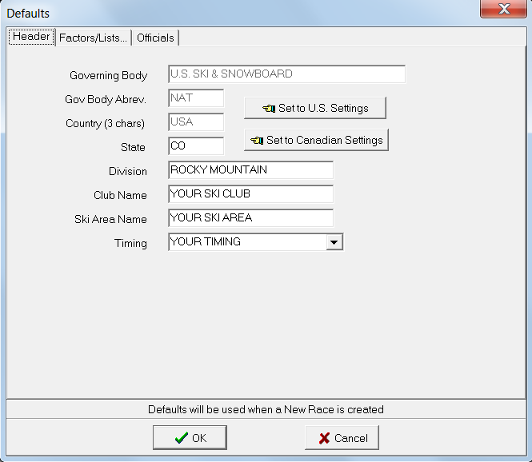
SET “HEADER” DEFAULTS
Only used to change nation where event is staged
State
Division
Club Name
Ski Area Name
Timing Equipment or
Timing Company Name
Select “OK” to continue

Slide 33
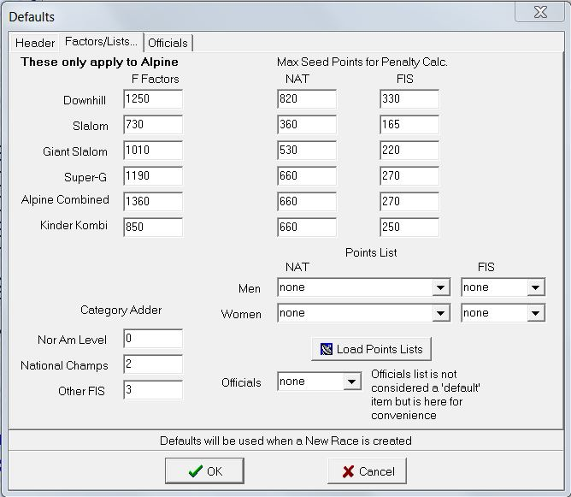
DEFAULTS: “FACTORS/LISTS”
Verify your defaults, e.g. Factors/Max Seed Points at the beginning of every season. Category Adders may change; Points Lists will change.

Slide 34
POINTS LISTS - Defaults
Using the “default” page to load Points Lists.
(Must be online to use this option!)

Slide 35
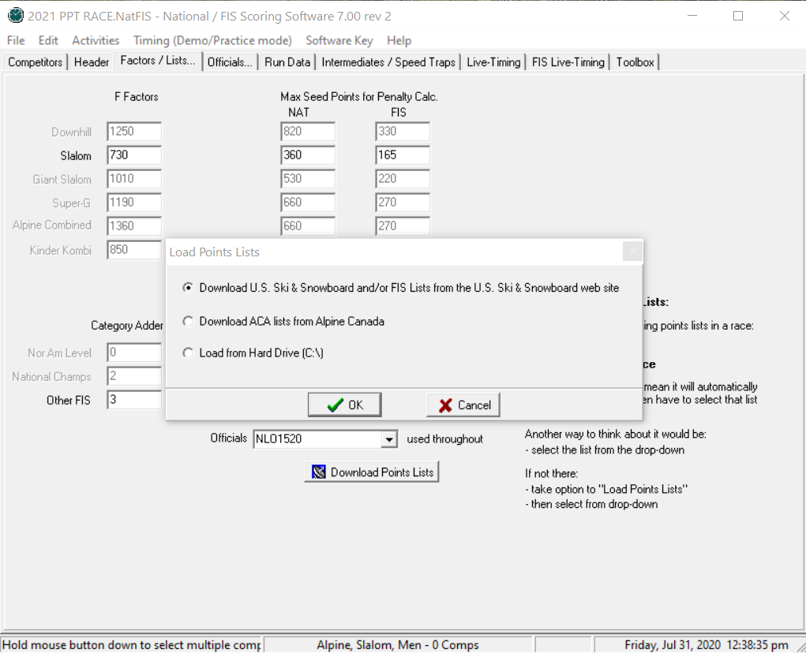
OPTIONS: LOADING POINTS LISTS
U.S. Ski & Snowboard website
Split Second backup location
ACA = Canadian Points for Canadian events
Load lists saved to hard drive
Make selection and click “OK”

Slide 36
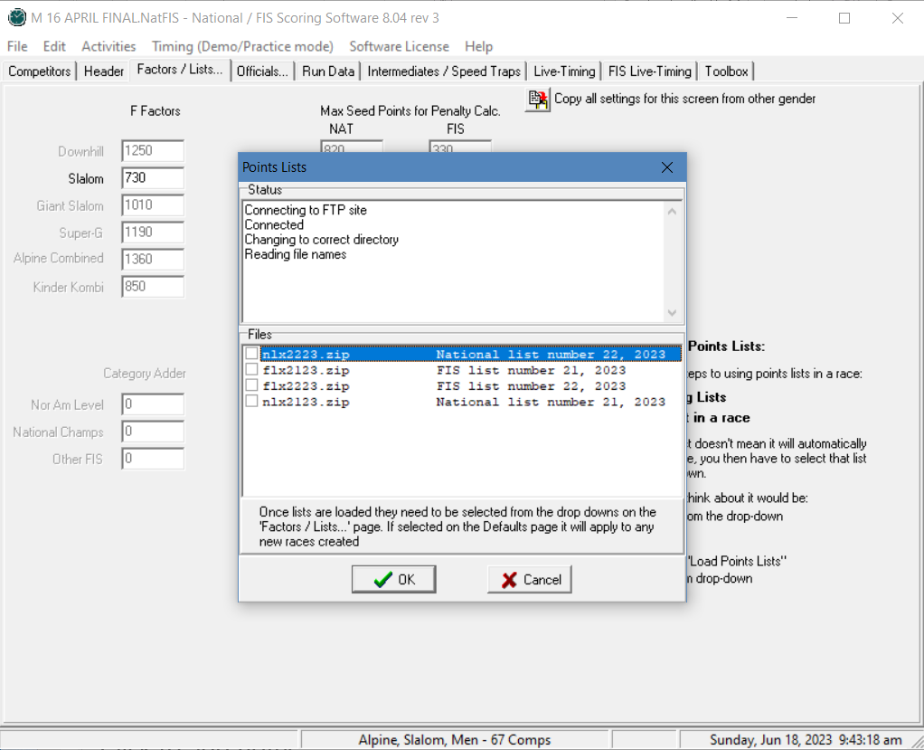
ONLINE OPTION
Software connects to U.S. Ski & Snowboard FTP site for retrieval and download.

Slide 37
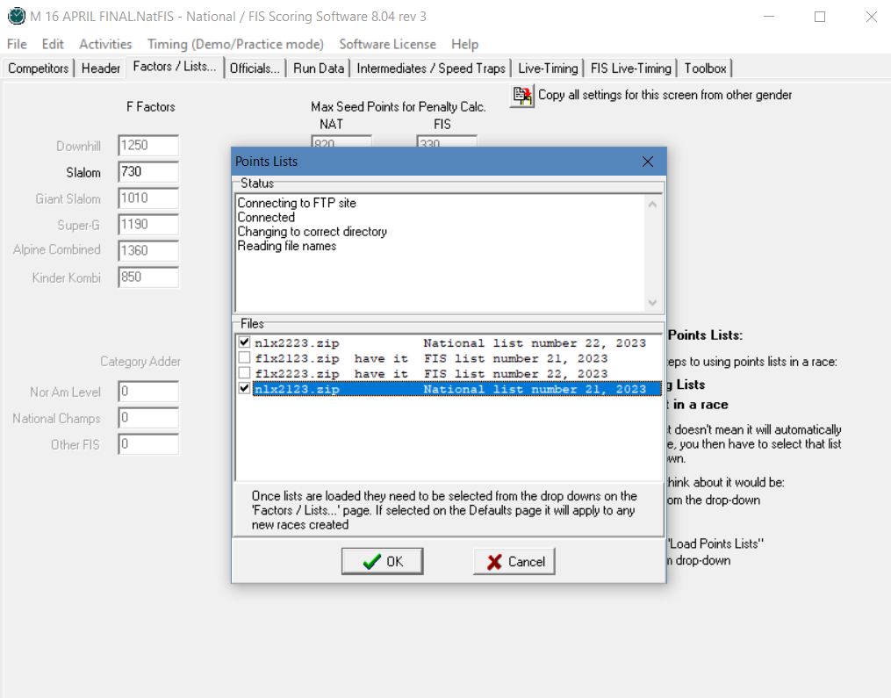
MAKE YOUR SELECTION(S)
(Multiple lists may be selected; “HAVE IT” lists are already loaded!)
Make your selection (multiple selections possible). by clicking the box next to the appropriate list and selecting “OK” to continue.
Points List(s) will be downloaded to a “Points List” folder within Split Second, will be unzipped, and will be ready for you to select and use.

Slide 38
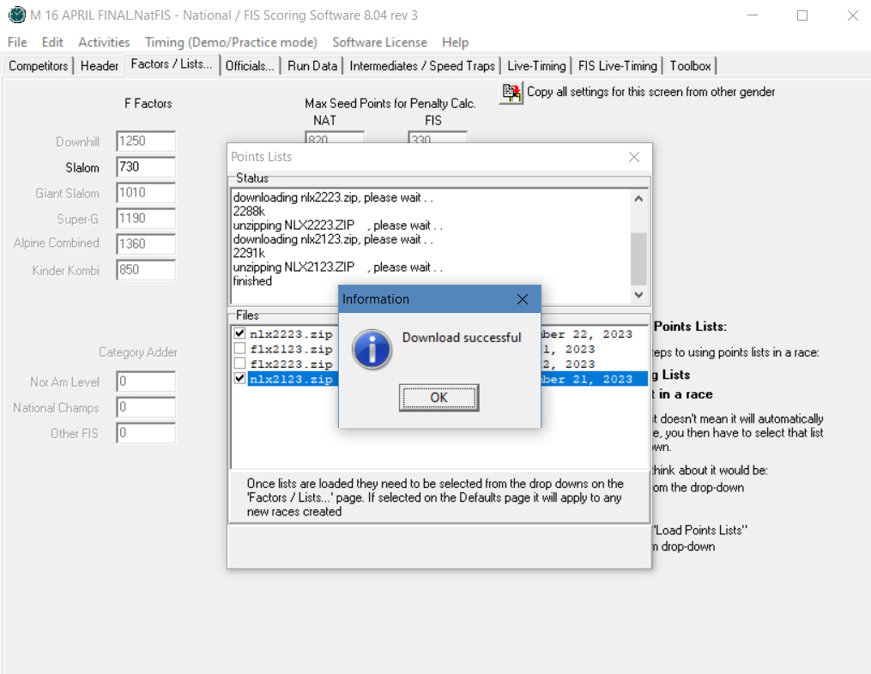
YOU ARE INFORMED OF PROGRESS
Select “OK” & continue.

Slide 39
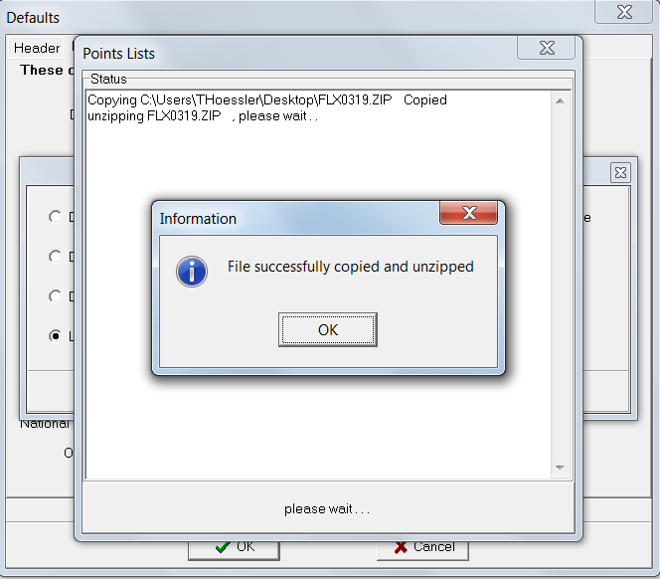
LOAD LISTS FROM HARD DRIVE
Lists available on U.S. Ski & Snowboard website; downloaded to hard drive and then loaded into software.

Slide 40
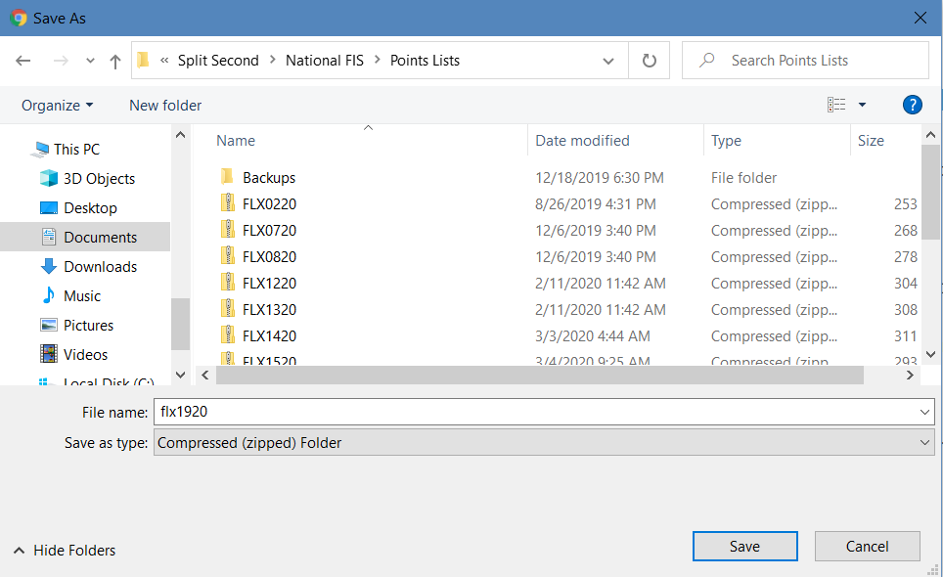
LOAD LISTS FROM HARD DRIVE
If you use this option, you will need to save the list(s) to a destination you can easily locate, e.g.:
1.) External Thumb Drive
2.) Desk Top
3.) Your PC’s “Download” Folder
4.) Directly into Split Second > National FIS > Points List, as follows:

Slide 41
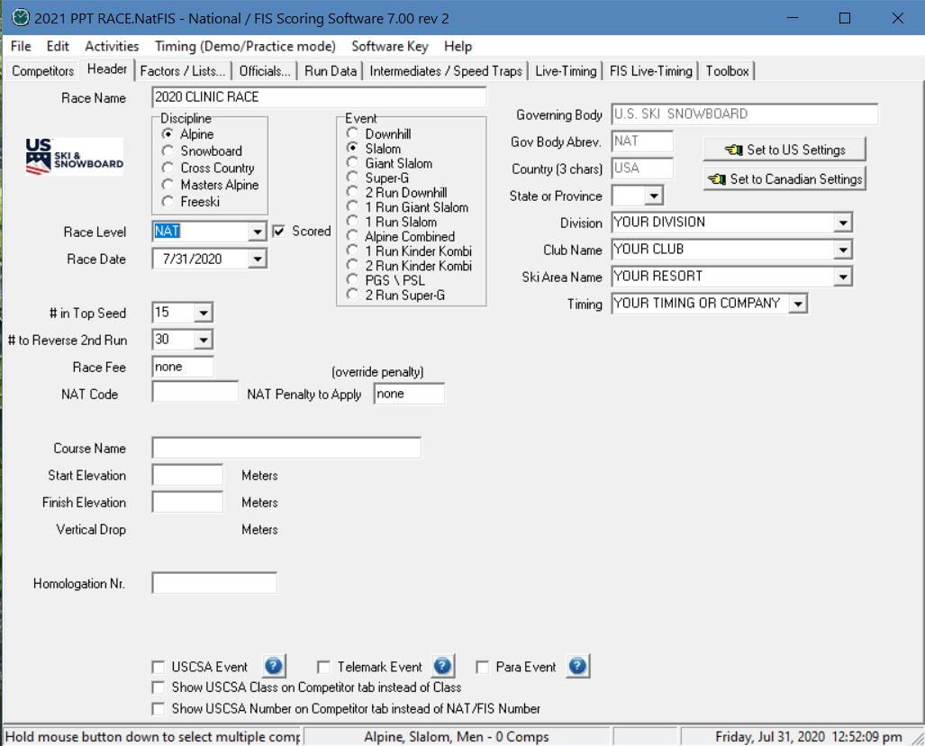
LOAD POINTS LISTS – “Activities”
Points lists can also
be loaded by selecting “Activities”
Process is same as that used by “Defaults”

Slide 42
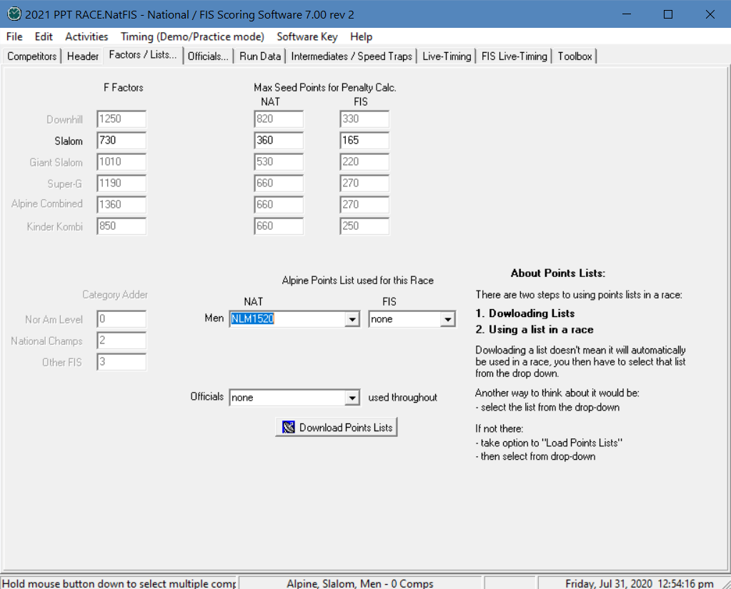
SELECT LISTS YOU NEED
Category Adders required only for FIS events
Listed on cover page of each FIS List.
Use the dropdown menus & select the lists you want to use: NLM = National Men; NLW = National Women; FLM = FIS Men; NLW = National Women; NLO = U.S. Ski & Snowboard member Officials
(NOTE: “NLO” does not verify certification or update status!)

Slide 43
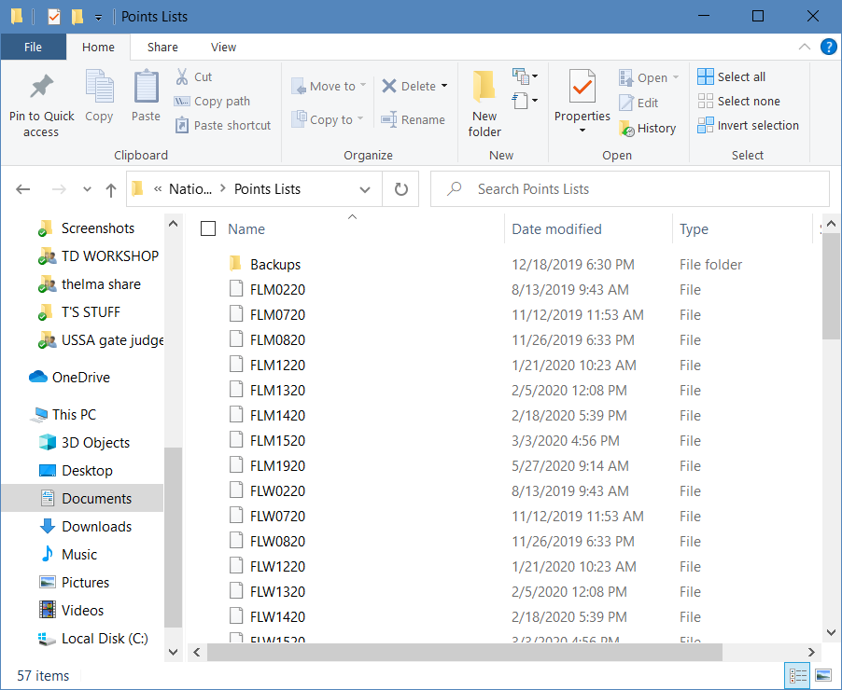
CONTENTS OF POINTS LIST PORTION OF SOFTWARE
Working Files – Points List: If you have to reload a list, delete all copies: M / W / Compressed (zipped) Folder.

Slide 44
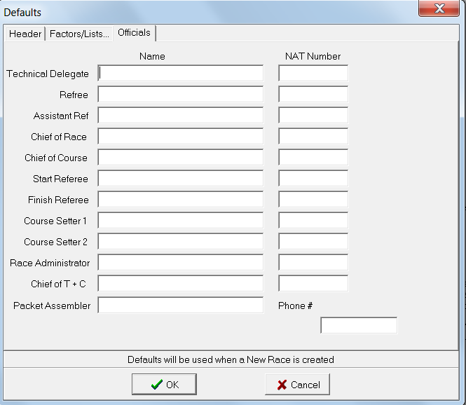
DEFAULTS: OFFICIALS
Use this option when using the same officials for all your events.

Slide 45
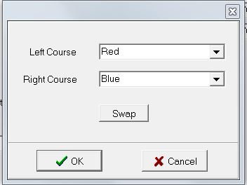
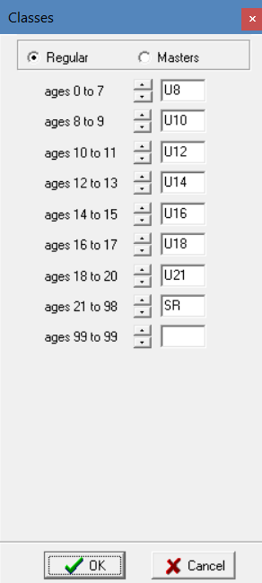
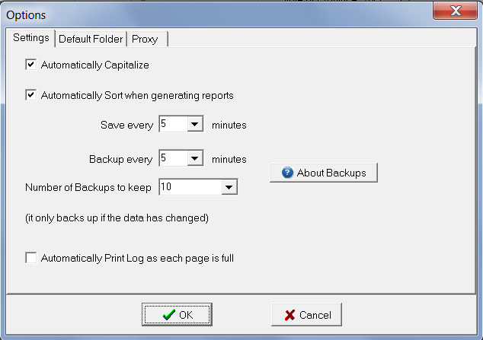
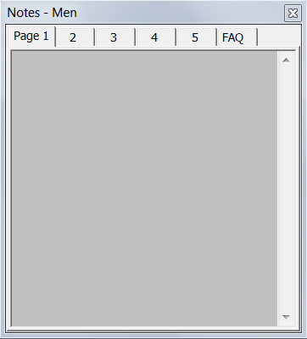

OTHER EDIT OPTIONS:
Season 2025 Change: Verify setting for “ages 16 to 17” =
Verify setting for “ages 18 to 20” =

Slide 46
“EDIT”/”OPTIONS”:
AUTO-SAVE
Set up “auto-save”/”backup” options but also backup your event(s) to an external drive or thumb drive. This should be done after any major data change, e.g. final/verified entries, start/bib # assignments, 1st run time entry, etc.

Slide 47
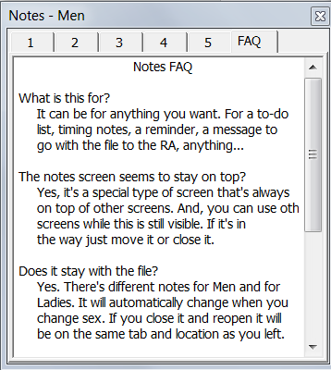
“EDIT” OPTION: NOTES
What is it? What is it for – FAQ?
This is a self-explanatory tool that will provide you with a set location for notes related to your event.

Slide 48
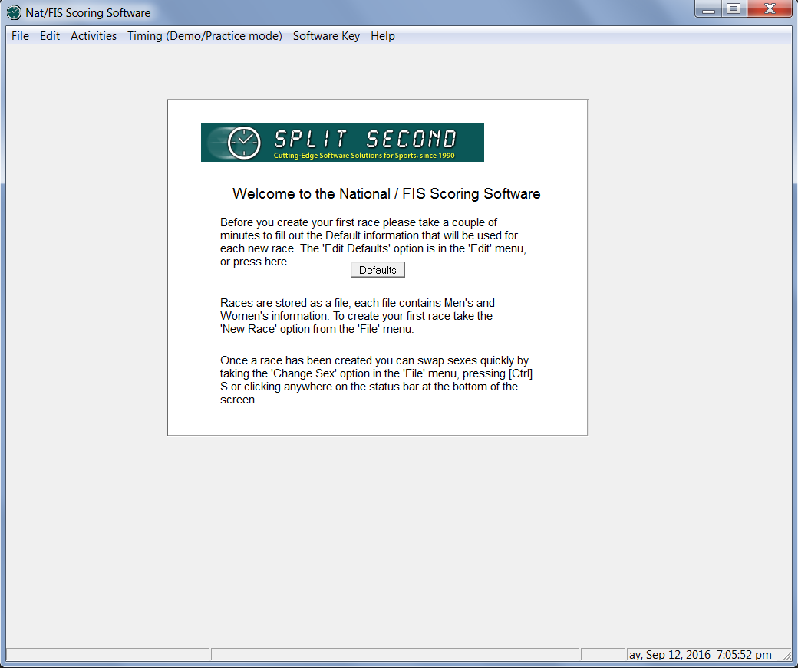
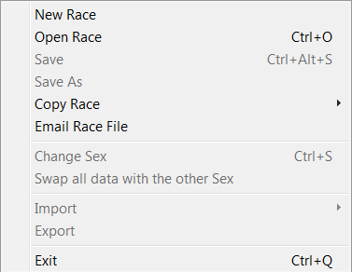
CREATING EVENT
Select “File”
Select “New Race”

Slide 49
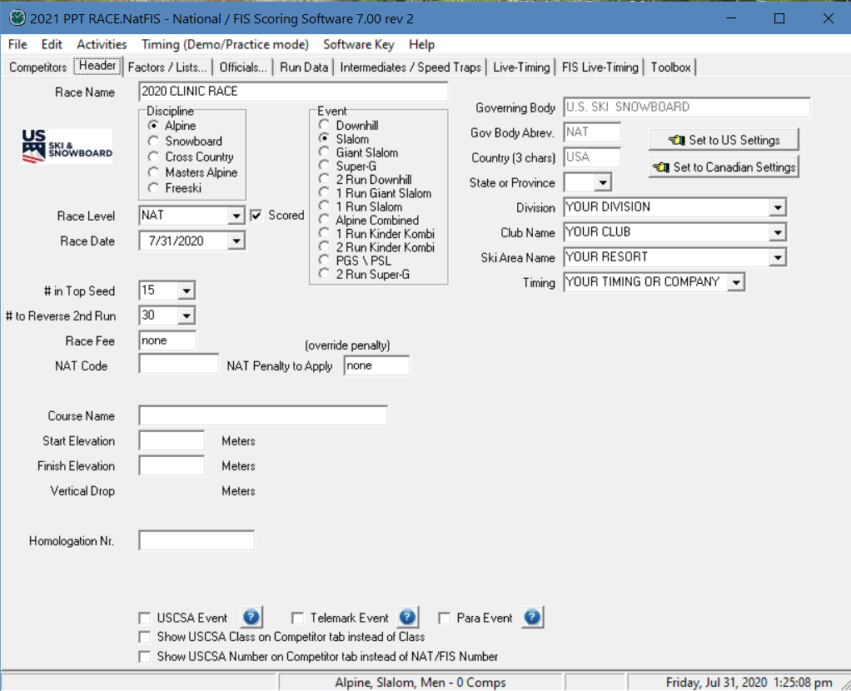
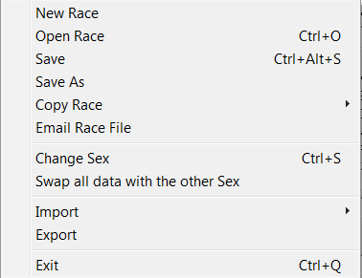
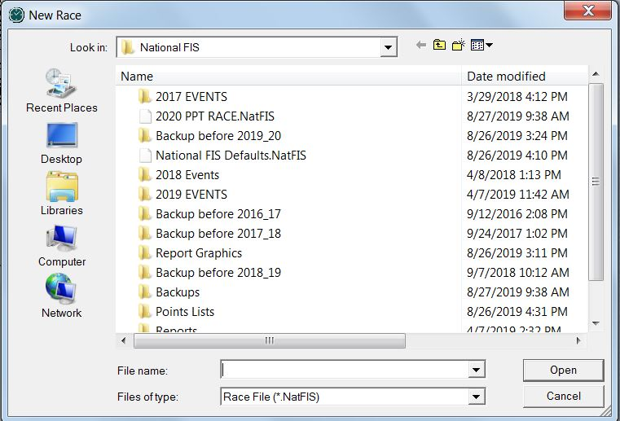
CREATE YOUR EVENT/RACE
Select “File” / “New” or “Open Race”
Create a file name that will be easily identified: e.g., L_SL_31dec
Use same file name for L-T posting!
Notice “NatFIS” extension

Slide 50
DATA VERIFICATION
        All entered data must be verified against the original data source:
        U.S. Ski & Snowboard website for non-FIS event data and
        FIS website for FIS event data
        All computers involved in the timing/scoring/documentation of an event must be running the same software version
        All computers involved in the timing/scoring/documentation of an event must have current Points Lists loaded because transferred race files only contain keyed data; they do not contain accessible copies of the Points Lists.
        Identical data access is required if timing personnel have to make a change in the race file: e.g. insert a competitor, change an official.

Slide 51
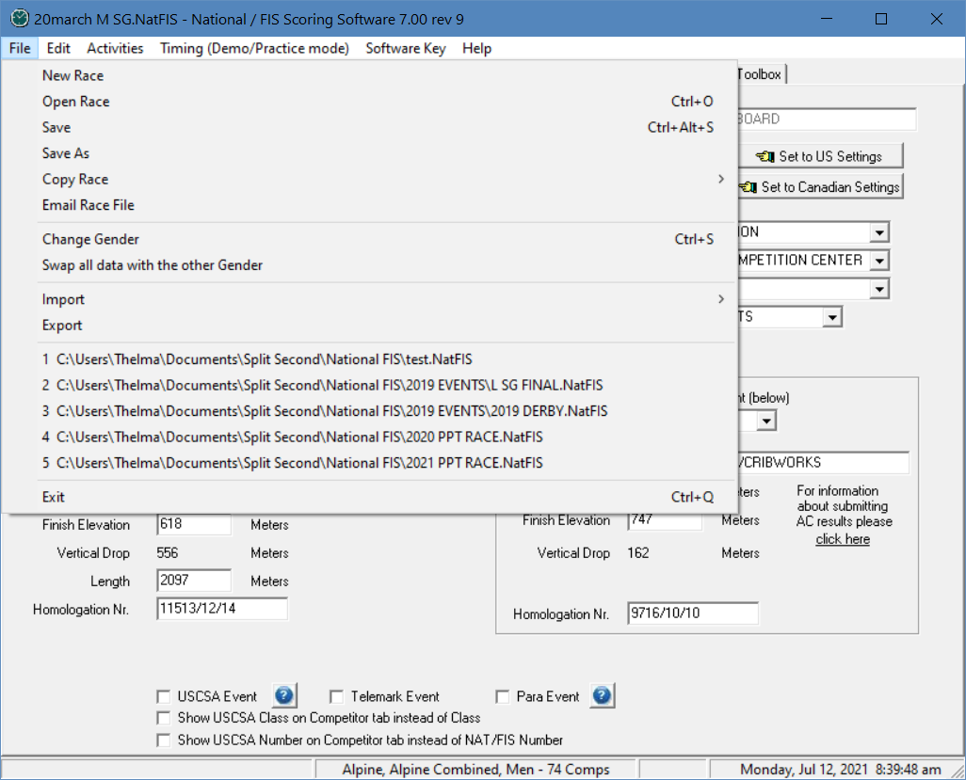
USING IMPORT / EXPORT FUNCTIONS
Select File
Import may be used to import or export a race file from timing
Import may be used to import an event registration file

Slide 52


USING IMPORT FUNCTIONS
Select File
Select Import
Import may be used to import a race date that has been exported from timing
Import may be used to import an event registration file
Importing and exporting race data from timing should be tested prior to race day!

Slide 53

IMPORTING A “CSV” FILE
Select File
Select Import
Locate and open required file

Slide 54

IMPORTING A “CSV” FILE
Step 1: Set format of file being imported
Select duplicate detection method
Select method to address duplicates
Clear to start over, load previously saved settings, or save current settings

Slide 55


IMPORTING A “CSV” FILE
Comparison shows differences:
Step 2: Define use for each column
Column 1 is defined as “Nat Number” but is actually a “Bib”
Use down arrow to right of “Nat Number” to change its use
Scroll bar will open view of available selections
Repeat process for each column until “Used For” is comparable to “Preview”
Notes:
In order to eliminate a messy slide, arrows have not been added. Clinician will need to point out each step.

Slide 56

IMPORTING A “CSV” FILE
“Preview” Columns are now comparable to “Column Used For” screen
Click “OK” to complete “Importing a CSV File”
Remember that imported data must be verified against the original source: National Data – U.S. Ski & Snowboard website &
FIS Data – FIS
website

Slide 57
CRITICAL NOTE WHEN IMPORTING A COMPETITORS’ TIMES
The event data is being managed with SplitSecond, but your Chief of Timing & Calculations is timing with VOLA:
it is possible to transfer data between the systems
it is recommended that only bib #’s and times be imported from VOLA timing to SplitSecond data
If athletes’ names are imported, please verify that any athletes who have double last names: e.g., “VAN HORN, Eric”
transfer back from VOLA in the original format: VAN HORN, Eric and
not VAN, HORN Eric
The misplaced comma will result in FIS and U.S. Ski & Snowboard autoscore systems rejecting the XML file.

Slide 58
USING EXPORT FUNCTIONS
Select File
Select Export
Export may be used to export race date required by timing
Export may be used to create racer data files

Slide 59

USING EXPORT FUNCTIONS
Note “Available Fields”
Select format: Comma or Tab
Select desired field
Use arrows to move desired field
Use arrows to change order of fields
This is “Comma” format. Order of “Fields to Export” agrees with data order in “Preview”

Slide 60

USING EXPORT FUNCTIONS
“Tab” format
Order of “Fields to Export” agrees with “Preview”
Length of data may require editing upon use of file

Slide 61

OPENING HEADER SCREEN:
NON-FIS EVENT
Name of Race as noted on U.S. Ski & Snowboard*
State, Division, Club, Ski Area, Timing Equipment or Timing Co. Name
Non-FIS Race Level:
 = Scored uncheck for
= Non-Scored
Race Date
Course Name & Homologation No. as noted in Homologation Report.
Start & Finish Elevations as verified by the TD.
Use to override calculated Penalty
Non-FIS Code, an alpha+4-digit # for all non-FIS events including speed training as noted on website
When exiting data fields, use “TAB” (not “ENTER”)
* Do not use control character or characters out of the Unicode ranges such as <, >, ," etc. The auto-scoring processor may not accept these characters!

Slide 62

OPENING HEADER SCREEN:
FIS EVENT
Name of Race as noted on FIS & U.S. Ski & Snowboard website
State, Division, Club, Ski Area, Timing Equipment or Timing Co. Name
Select correct FIS Race Level
Race Date
Use to limit 2nd Run (e. g.: NAC)
Course Name & Homologation # as noted in Homologation Report.
Start & Finish Elevations as verified by the TD.
Non-FIS Code: alpha+4-digit # for non-FIS events as noted on U.S. Ski & Snowboard website
FIS Code: 4-digit # for all FIS events as noted on FIS website
Use to override calculated Penalty
When exiting data field, use “TAB” (not “ENTER”)

Slide 63
SELECT YOUR EVENT: Non-FIS or FIS
Your Discipline = ALPINE
Review options and select your event: DH, SL, GS, SG, etc.

Slide 64

FIS RACE LEVELS
After setting to “FIS," select correct “Race Level” as noted on FIS website

Slide 65

# in Top Seed & # Qualify 2nd Run
1.)
3.)*
2.)
1.) How many racers are in the first/top seed (lowest point holders) of scored event;
how many will be sorted in computer-assisted Draw.
2.) How many racers will be reversed for 2nd run (bibbo); 30 is the default; may be
reduced to 15 by Jury decision and announced 1 hour prior to start of First Run.
3.) How many racers will be allowed to start 2nd Run; “DNQ” assigned to all other
competitors.*
*Only applicable for non-FIS Collegiate events and upper-level FIS events.

Slide 66
15 or 30: JURY MAY CHANGE #
How many racers will be reversed in the second run of a scored event.
30 is the default; Jury decision to change to 15 must be announced 1 hour prior to start of event!

Slide 67

TIMING DATA:
EQUIPMENT or TIMING COMPANY NAME
Select equipment being used or
key in name of
Timing Company.

Slide 68

HEADER INFO COMPLETE
This is a completed header for a Men’s event.
Click “Alpine Slalom Men” to change race gender & enter data for Women’s event.

Slide 69
OTHER “CHANGE GENDER” OPTIONS
        In addition to clicking on the event description/competitor count at bottom of screen, you can also change to an alternate gender by:
Keying “CTRL + S," or
Selecting “FILE” / “Change Gender”
Any of these options allows you to establish one file for both genders and quickly move between the two.

Slide 70
MIXED-GENDER U10 / U12 EVENTS
Year-of-Birth (YOB) Seeding
Race File contains all competitors, regardless of gender
Competitors are sorted by YOB, regardless of gender
First-Run Start List is random sort within YOB
Subsequent Start Lists are prepared using TRS system
Results are processed by YOB, regardless of gender
Team Results may be produced
Men/Women Alpine List will be produced for download.

Slide 71
WHAT IS TRS a/k/a “BUTTERFLY”?
TRS or “totally random sort” is used for both scored and non-scored events and is based on the first initial of the last name of the 3 individuals who developed it.
Start Lists are prepared as follows:
First event/run: start order is randomly drawn within each gender, class or group, e.g. Year-of-Birth
Second event/run (may be the same day or the following day): start order of first event/run is reversed within each gender, class or group
Third event/run (may be the same day or the following day): begins with the second half of the first event/run order in each gender, class or group, and continues with the second half of the first event/run order in each gender, class or group
Fourth race (may be the same day or the following day): the start order for the third event/run is reversed within each gender, class or group
NOTE: For individual events/runs, NPS/DNS/DNF/DSQ competitors start subsequent events/runs in their actual start positions.
Example:
Event/Run 1= 1,2,3,4,5,6,7,8,9,10
Event/Run 2= 10,9,8,7,6,5,4,3,2,1
Event/Run 3= 6,7,8,9,10,1,2,3,4,5
Event/Run 4= 5,4,3,2,1,10,9,8,7,6

Slide 72
CREATING AN EVENT DATABASE
There are 2 systems commonly used to create an event database:
1.) Use entry forms and key in competitors’ names to access the
competitors’ data as contained in the points list files:
Team Entry
FIS Entry (FIS events only)
2.) An online race registration system that creates a file for
downloading into software.
Regardless of the entry system you use:
YOU MUST VERIFY ALL COMPETITOR DATA AGAINST THE ORIGINAL SOURCE!

Slide 73
COMPETITORS’ ENTRIES
Entries in a non-FIS event are made by:
- Teams using Team Entry Form
- Online Race Registration Systems
Entries in a FIS event are made by:
- Teams (Nations) using FIS Entry Form
- Online Race Registration Systems*
*(FIS Entry Form still required)
NOTE: U.S. Ski & Snowboard is no longer providing an online registration platform; platforms are available from private vendors.
Notes:
U.S. Ski & Snowboard is no longer providing an online race registration system; OC’s

Slide 74
ONLINE RACE REGISTRATION SYSTEMS
If an OC chooses to use an Online Race Registration System, a file either in TXT or CSV format will be provided. After importing the file into the computer, the DM/RA:
Will be responsible for verifying competitors’ data
Will be responsible for updating points, if required
Will be responsible for updating competitor’s class, if required by Ski Up acceptance (non-FIS only)
Will be responsible for updating X-member (foreign) competitors’/officials’ nations
May have to combine data from individual files in order to create one “Competition Database”

Slide 75

VERIFY YOUR POINTS LISTS DEFAULTS
Select “Competitors”
Select “Factors/Lists”
Category Adder is event specific; required only for FIS events.
(FIS List Cover Page)
Prior to inserting (keying in) competitors, verify that you are using the correct Points Lists for both genders:

Slide 76


IMPORT A RACE REGISTRATION FILE
Select “FILE”
Select “IMPORT”;
Choose your source:
Comma, Tab, etc.
After you make your selection, you will be allowed to select file and download as required.

Slide 77
CREATE YOUR RA CLINIC RACE FILE
If you have correctly installed and selected either a U.S. Ski & Snowboard (Nat) or FIS Points List, you will now be able to create a race file you can use for the rest of this Clinic.
INSERT AT LEAST 20 RACERS
(Your Choice)

Slide 78

COMPETITOR INSERT
1.)
2.)
1.) Select “Competitors” & then
2.) Select “Insert”

Slide 79

INSERTING COMPETITORS

Slide 80

KEY IN FIRST FEW LETTERS OF LAST NAME & SELECT
CORRECT COMPETITOR
Scroll down and select entered competitor
If unable to locate by last name, key in member’s U.S. Ski & Snowboard (NAT) number; for FIS event, key in FIS number
If more than 1 competitor has the same name, use NAT or FIS number to select correct competitor

Slide 81


EDIT or ADD ADDITIONAL COMPETITORS
For “Club” or “Quota”; do not use “Nation” field
“NOTES” used to indicate special info, e.g. entry comped, owes, SL only, etc.
If no information needs to be added, select “INSERT NEXT” for additional entries
Only Edit:
“CLASS” for Ski Up athletes or “NATION” for “X” members”

Slide 82
ADDING A COMPETITOR:
AFTER THE FIRST GROUP & AFTER THE DRAW
SplitSecond breaks a tie in time by defaulting to an athlete’s actual “start number”
Inserting an athlete after the first group and assigning 15A will affect SplitSecond’s tie breaking capability
SplitSecond will not accept the start number + alpha character
617.3.3 If two or more competitors have the same time or the same number of points, the competitor with the higher start number must be listed first on the official list of results.

Slide 83

KEY IN & VERIFY OFFICIALS
Use same selection process – key in first few letters of last name & select correct official
Edit nation for “X members," if required
Click on these icons to copy officials from the other gender’s file
Prior to printing any documents, verify names, membership status, and certification & update status for all officials.
Software (NLO) listing does not verify an officials’ status! This must be verified on the U.S. Ski & Snowboard website.

Slide 84

Enter OFFICIALS
System is the same as for inserting competitors:
Key in a few letters of last name
Make selection from the Dropdown Box.
Only current members* are included in this file!
* You must verify certification and update status!

Slide 85

VERIFY ALPINE OFFICIALS’ CERTIFICATIONS & UPDATE STATUS
Membership data can be accessed through the “Public Tools” option on the U.S. Ski & Snowboard website. Key first few letters of last name, select correct official, verify certification and continuing education status (“Last Clinic Season”).
Must be a current national member, have appropriate certification and attend an Update for Continuing Education biennially!
Officials who are “PENDING” members must not be appointed.
Official’s Certifications
Last Clinic season: 2021*
ONLY SEASON 2024 or SEASON 2025 ARE VALID FOR SEASON 2025
TD & RA require SEASON 2025

Slide 86

KEY IN / VERIFY KNOWN RUN DATA
“RUN DATA” is where you key in 1st and/or 2nd Run information as well as Forerunners’ names:
Key in Last Name, First Name (capitalize first letters) & “TAB” (not “ENTER”). Forerunners’ membership must be verified on website!
USA is the default Nation.
To enter a different nation:
Key Open parenthesis, nation in all caps, close parenthesis, e.g. (CAN) & TAB.
Refer to Computer Input Information:
RA STUDY GUIDE SECTION 1, p.22

Slide 87

SET INTERMEDIATES & SPEED TRAPS
Use drop down menu to select number of Intermediates and Speed Traps
This information is critical for DH TRA, DH, SG, & GS!
Verify this data with timing personnel. If they have the actual race file, they may wish to take responsibility for entering this information.

Slide 88

VERIFY DATA & REGISTER RACE WITH U.S. LIVE-TIMING
Go to these sites to verify accuracy of uploaded data/reports
Follow directions to load event & resort logos already posted
Follow directions t0 load event & resort logos not already posted
Great tool! If timing building does not have internet access, the RA can upload times at the end of each run. Event/area logos can either be selected from available list or uploaded for your selection.

Slide 89




POST, PRINT OR SAVE A REPORT
Select “REPORT”
Select type of Report
Report will automatically upload to live-timing
Option to print with graphics selected

Slide 90

TOP GRAPHIC
First Run Start List with graphics/zebra striping
Inserting Header & Footer Graphics is an option allowing display of Federation, Ski Area, Ski Club, sponsor logos, etc.
BOTTOM CENTER GRAPHIC BOTTOM RIGHT GRAPHIC

Slide 91


REPORT OPTIONS
Make Selections
Generate Report
Print or Save on Preview Screen
Upload to Live-Timing
“Close” to return to software

Slide 92

OTHER L-T OPTIONS
(After race is registered!)
Allows you to upload all competitors, update competitor information, or update times.
Allows you to post Messages:
“Start Delayed," etc.
Also allows you to
Delete posted Reports
Verify accuracy of all postings & deletions!

Slide 93

FIS L-T OPTION
(Posting on FIS L-T Site; please read/follow instructions)

Slide 94



A REPORT OPTION: SEED CARDS
If event requires “seed cards” (scored event), they can be quickly printed using this option.
Select “REPORT”
Select “OTHER”
Select “SEED CARDS”
Select size & data

Slide 95
OTHER OPTIONS
Some of the options available are:
Assigning bib/start numbers
Keying in Time of Day (ToD) information
Keying in elapsed times
Selecting/auto-assigning Snow Seed
Reloading Points List
Calculation of a Replacement Time: “EET”
You will need to access some of these options for your Clinic race.

Slide 96


AVAILABLE REPORTS & OPTIONS
Prior to your event, surf the software and discover the reports and options that are available for use.

Slide 97

NEW REPORT OPTION
You will now be able to upload Race Notice, Event Waiver, Daily Program, etc., to Live-Timing.
If working with a 2-page report, print required pages to PDF, save and post.
Please note: If the OC has opted to post event-related documents to an online forum, this process is acceptable for posting the Report by the Referee.

Slide 98



RELOAD POINTS FROM POINTS LISTS
Required when a new Points List becomes valid between events in a series or between DHT/DH race.
            “RELOAD ALL DATA”: Reloads membership data, membership names, numbers, nations, etc., and will overwrite your additions; e.g. age class, corrected points, club, quota, notes. It will require re-verification of your competition database.
            “RELOAD ONLY POINTS”: Only reloads the applicable Points List and is the preferred option to eliminate overwriting keyed data; e.g. quotas

Slide 99
ENTER 1ST RUN TIMES
In a real race situation, times are electronically transferred from the timing equipment to the result computer and race documents are then either generated by that computer, or the race or timing file is exported to the RA’s result computer via memory stick, email attachment or cloud transfer
However, you are here to learn, so:
Use “Electronic Time Recording Form – 1st Run”:
RA Study Guide Section 1, p. 26, key in 1st run data (times/status)
Use “Report by the Referee – 1st Run”:
RA Study Guide Section 1, p. 28, verify status of DNS/DNF/DSQ
competitors!
How many “options” are available that allow you to enter competitors’ times?
NOTE: p. 26 allows for net time manual entry; p. 27 allows for Time-of-Day manual entry

Slide 100

MANUAL TIME ENTRY
Times can be entered or edited in the 1st or 2nd Run Result field, as required

Slide 101







ADDITIONAL MANUAL ENTRY OPTIONS
“Enter Times (Elapsed)”
Select a run:
Enter your data:
“Enter Time of Day”

Slide 102

Time-Of-Day (TOD) EDIT OPTION

Slide 103

“FILE” OPTIONS
“Import” / “Export”: Send/retrieve specific data, e.g. Bib # + Name to T&C or retrieve Bib # + Time from T&C
“Save”: Save file in current location.
“Save As”: Save file with new name e.g. to create a new race where you require a new Live Timing registration.
“Copy Race”: Preferred option for copying a race file to a different location; this
option overwrites database of destination computer.

Slide 104
DATA ENTRY SYSTEMS
(Using Race File)
T&C staff uses “Copy Race” option and saves it to a thumbdrive
RA uses software to open copied race & overwrites original file using “Save As” option
OR
T&C staff attaches correct “NatFis” race file and emails it to RA as an attachment * or use “cloud storage” and transfers the file
RA uses software to open downloaded attachment & overwrites original file using “Save As” option *
* When using company online services (and prior to race day), confirm you will be allowed to upload/download attachments!
You should always backup your race file. However, saving each action (1st Run Start, 2nd Run Start, Results, etc.) for each gender and under different names is strongly discouraged!

Slide 105


“email RACE FILE” OPTION
Please note:
This sends the race file as an attachment that can only be opened with Split Second software
This is NOT the method or format used for sending results to an autoscoring system, e.g. U.S. Ski & Snowboard, ACA, or FIS!

Slide 106

email RACE FILE PROCEDURES
1.) Key in recipient – make
sure to include your email
address for verification
2.) Key in your information
3.) Enter your subject: Race Name
4.) Add your comments, if any
5.) Select “OK (send)”

Slide 107

1-800-GEOFF!
This is the option you use when all else has failed and Geoff Elder (Split Second creator & Master Wizard) needs to HELP!!!
Please respect this option; use only upon request from Geoff.

Slide 108


TRANSFER DATA:
USING EXPORT/IMPORT
In “File”
1.) Select
“Export”
2.) Select
data you
want to
export.
It will be highlighted
Select your format
Use arrows to move selection to “export”;
click “OK” to continue
Import function is a reverse: Select “Import," select
“Fields to Import” & click “OK”

Slide 109

ENTER 1ST RUN DATA
You have to return to this page to key in: Weather and Gate Counts (Temps are “air” temps at start area & finish area at the beginning of the race.
If you are given temps in Fahrenheit, key in ##F and Celsius conversion will be calculated automatically.

Slide 110

EDIT A COMPETITOR: KEY IN DSQ
If a racer is given a provisional 2nd Run Start and 1st Run DSQ is upheld, DSQ must be entered in the run in which it occurred

Slide 111
PROTESTED FIRST RUN DSQ & A PROVISIONAL SECOND RUN START
What procedure is followed if a competitor is disqualified in the first run, files a protest against disqualification, the Jury allows a provisional second run start, but the protest against the disqualification is not upheld?
DSQ data must be entered in the run where disqualification occurred.
Non-FIS event, “DSQ” status will be displayed with first run data. If DNS, DSQ, DNF athletes were allowed a second run, the competitor’s second run time will be displayed with second run data.
FIS event, “DSQ” status will be displayed with first run data. The provisional second run time will not be displayed in the second run data section. (FIS event rules do not provide second runs for first run DNS, DNF, DSQ competitors.)
Editing a second run provisional time to indicate “DSQ”, so the competitor’s second run status agrees with the run in which the DSQ actually occurred does not provide an accurate record of actual occurrences. This action may cause issues if an appeal is filed, upheld, and competitor is reinstated.

Slide 112

ToD EDIT:
Edit Times or Change Status
Competitor’s status can also be changed on this page; however it does not allow for input of infraction data: gate # or rule #.
This information is required on Official Results!

Slide 113

WHAT IS REQUIRED?
Key in GATE # where infraction occurred or RULE # violated
Overwrite assigned
time by keying DSQ
Remember to “TAB” (not “ENTER”) to exit data fields

Slide 114


RECORDING A “NPS” SITUATION:
NON-FIS and FIS EVENTS
Due to rule(s) violation(s), athlete not permitted to start (NPS)…this could apply to either run of a 2-run event
Athlete’s status is recorded by the Start Referee as “Not Permitted to Start” (NPS); reason must be stated
Example: Note suggestion to insert “name”
“NPS” is noted in of Report by the Referee as required
Example:
Applicable rule number must be noted for results (Procedure will be similar as for entering DSQ rule #)
Software allows for “NPS” designation

Slide 115

BLOCK EDIT
Use “shift” key to scroll/select group
“Block Edit” replaces “Edit Comp” on screen
Edits will apply to entire block

Slide 116

BLOCK & SORT
Use “shift” key to scroll/select group
“Sort” is selected (behind menu)
Group can be sorted to your parameters

Slide 117



MOVE
Select athlete
Select “Move”
Note WOOLSON was moved before KELLEY

Slide 118




HIDE / EXPOSE
“Hide” a group of competitors: Block the group you want to hide & select “Hide." They do not show on lists but remain in database
“Expose” the group by selecting “Expose." The following message appears:
Select “OK” to continue. Field can be resorted to place competitors in preferred order

Slide 119
DOCUMENTS AFTER 1ST RUN
After all 1st Run Data has been verified, print the following documents:
1st Run Result
2nd Run Start List: Prior to printing this document make sure that you have selected the correct amount of racers that will be flipped for the second run in a scored event:
15 or 30
Verify whether or not 1st Run NPS, DNS, DNF & DSQ competitors will be allowed to take a 2nd Run. If so, verify they were inserted in accordance with rules/procedures for level of event.
For non-scored events, please verify/default to Region/Division 2nd Run Start Procedures
If you are unsure of any of the procedures, ask for HELP!

Slide 120

ENTER/VERIFY 2ND RUN DATA
Enter 2nd run gate counts
Verify Start Times
Verify weather/course data entered
Refer to Computer Input Information:
RA STUDY GUIDE SECTION 1, p.30

Slide 121
ENTER 2ND RUN TIMES
Use “Electronic Time Recording Form – 2nd Run”:
RA Study Guide Section – Section 1, p. 31,
key in second run times for each competitor
Use “Report by the Referee – 2nd Run”:
RA Study Guide Section , p. 33,
verify DNS/DNF/DSQ information!
NOTE: p. 31 allows for net time manual entry; p. 32 allows for Time-of-Day manual entry

Slide 122

DOCUMENTS AFTER 2ND RUN
After all 2nd Run Data has been verified, print the following documents:
Unofficial Results
Official Results: Prior to printing this document, verify that you do not have to input a Penalty override
Penalty is overridden when
1.) it calculates below the minimum allowed,
2.) when a non-FIS event does not meet minimum
standards or
3.) when a Penalty must be manually calculated
FIS race with a calculated penalty of 3.00
Minimum Penalty applied and will overwrite calculated Penalty
(FIS LIST 1ST PAGE)

Slide 123
What is an “applied Penalty”?
The Penalty for “scored events” is calculated by the software and is based on known criteria: event Factor, competitors’ seed points, competitors’ times, etc.
For some events, a minimum Penalty must be applied:
non-FIS races that do not meet minimum technical standards,
Penalties that calculate below accepted minimums,
Penalties that must be manually calculated.
For these few instances, keying in an “applied Penalty” overrides the computer’s calculation.
If no override is required, no data needs to be keyed in at this location on the Header page.

Slide 124
RESULTS & PENALTY:
Verify accuracy prior to transmission of XML file
Print results by class (for awards)
Prior to printing signature copy, verify all data: header, race code/codex, date, etc.
Verify accuracy of Penalty (if required)
Select and print Official Results in format required by level of event
If all result formats are not visible, you can slowly pull the option box to enable display. If this does not fix the problem, DPI (dots per inch) adjustment may be required (Control Panel/Display)

Slide 125


RESULT OPTIONS – ORIGINAL FORMAT
NON-FIS EVENT
FIS EVENT
Bib numbers for NPS, DNS, DNF, DSQ competitors noted on Report by the Referee must agree with the race results (paper or XML). Please print results as follows:
Select print option: “Start number on results” if first-run start numbers agree with actual bib numbers.
Select print option: “Bib number on results” if you do not have a complete set of bibs or if you have inserted a bib number out of running order.

Slide 126

RESULT OPTIONS – GRAPHICS FORMAT
Graphics format allows for either NAT or FIS Unofficial or Official Results; graphics can also be printed on all reports, including Condensed Start Lists.

Slide 127
RACE DAY QUESTIONS
Why is data backup critical?
What is the difference between non-scored events & scored events? e.g. Start Lists & Results
Do I need 2 separate race files? One for each gender?
How do I use today’s event to create tomorrow’s event?
After the first run, a racer is given a provisional second run start that is not accepted by the Jury. Where do I key in the DSQ information?
I called the HELP DESK and they’ve requested I send the race file! THE WHAT? WHERE IS IT? HOW DO I DO IT?
Software keeps “freezing." WHY?
Why do I have to verify all data against the original source: U.S. Ski & Snowboard for non-FIS data & FIS for FIS data.
Why can’t I download the FIS List directly from the FIS website?
I downloaded a “corrected” Points List, but the Points haven’t been corrected. What do I have to do?

Slide 128
WHAT IS THE “GOLDEN RULE”?
The “Golden Rule” is alternative seeding proposed by the late Adaptive World Champion, Diana Golden. Its intent is to encourage adaptive competitors’ participation in regular-calendared competitions.
1st Run: Seeded in special groups (16-20... 36-40... 56-60), or by National Points, whichever is more favorable. (Groupings only required if more than 5 athletes have requested Golden Rule Seeding.)
2nd Run: Seeded in same special groups or by bibbo, whichever is more favorable. In the case of a “flip-30” 2nd run, the special group starts in the 31st position. In the case of a “flip-15” 2nd run, the special group starts in the 16th position.
Adaptive athletes who have requested special seeding and who are shown as DNS, DNF, DSQ, or NPS in the first run can start in the second run with their original bib immediately after the last qualified competitor has completed his run. It is recommended they be run in bib order. Announcement of this procedure should be made at the team captains’ meeting.
The “Golden Rule” is not valid for FIS events!

Slide 129
GOLDEN RULE SEEDING
1st Run:
Create 1st Run Start Order
Select athlete(s) requesting Golden Rule Seeding
Use “MOVE” function to place them in correct position
Reassign Bib Numbers / Start Numbers
Print 1st Run Start List: Graphic format or Original format
(If more than one competitor is involved, rank them by points. If competitors have no points, rank them with a random draw.)
2nd Run:
Create 2nd Run Start Order using Original format (cannot use Graphic format)
Using CUT/PASTE, move athlete(s) requesting Golden Rule Seeding, as required *
In PRINT SCREEN, manually edit start numbers, as required **
Post/Save/Print edited 2nd Run Start Order
* Same process is used for 1st Run DNS, DNF, DSQ, or NPS athletes who have requested Golden Rule Seeding and who wish to take a 2nd run following 1st run qualified competitors.
** DO NOT REASSIGN START NUMBERS IN YOUR ACTUAL RACE FILE!
Notes:
Once the report function is fully developed, the above steps will not be required.

Slide 130


EDITING FOR A 2ND RUN
Racer in red font has requested Golden Rule Seeding. Editing can be done in “print preview”, or “Saved to File” - word, or text. (This edit was done in text.)
Using “cut/paste”, racer is moved to correct start position.
Notes:
Once the report function is fully developed, the above steps will not be required.

Slide 131

EDITING FOR A 2ND RUN COMPLETE
Competitor is now in the 31st starting position as allowed by Golden Rule Seeding. (If bibbo was only 15, racer would be in 16th position.)
Start numbers have been manually edited.
In “print preview” screen, “Save to File”, and save as “word” or “text”.
Attach to “live-timing”.
Print your document.
(If time permits, spacing can be corrected.)
If Golden Rule Seeding involves more than one racer, move and rank them by their 1st Run Time.
Notes:
Once the report function is fully developed, the above steps will not be required.

Slide 132
REPLACEMENT TIME (EET)
Calculation of a Replacement Time (also known as an Equivalent Electronic Time) is normally the responsibility of the Chief of Timing or his/her assistant.
However, due to force majeure, the assistance of the RA may be required.

Slide 133

SOFTWARE’S “EET” TOOL found in “OTHER OPTIONS”
NOTE: Calculation requires comparison of System A time-of-day START/FINISH IMPULSE to System B or manual time-of-day START/FINISH IMPULSE for 10 competitors preceding missed time-of-day START/FINISH IMPULSE.

Slide 134
HINTS!
      DO NOT use Forerunners’ times
      Calculation is based on Time-of-Day data so DNF competitor’s start times can be used to calculate a missing time-of-day start impulse
      DO NOT wait until race day to learn how to use this or any of the many other useful tools provided by this or any other software!
      If time permits, review “REPLACEMENT TIME - EET” power point presentation.

Slide 135
VERIFICATION ITEMS
Prior to submitting your results XML file, you must verify all keyed data.
The software may prepare a “Transmittal Report”; it contains data you have keyed into your database.
Print the “Transmittal Report” and use it to verify the data it contains…especially useful for verifying Officials’ names.
Verify/Edit “Nation” for any U.S. Ski & Snowboard “X members”
If an error is found, rekey the data, reprint and reverify the data.
Transmittal Report, if available, remains in the OC event file.

Slide 136





CREATING/SENDING“XML” FILE – has changed due to USSS upload requirement
File can be created/sent from either area:
“Activities”
If required, answer “Yes," as U.S. Ski & Snowboard requires upload at race-results.usskiandsnowboard.org/

Slide 137

WHAT IS AN “XML” FILE?
NOTE: Season Date
An XML file that is not “Season 2025” will be refused by the autoscore system!
“XML” file is a data string file that contains all the information related to the race: Header, Officials, Forerunners, Weather, Competitor Data, Times, etc. Its format allows for auto-scoring.
Notes:
If season date is not current, autoscore systems will refuse XML file.

Slide 138


SAVING & SENDING AN XML FILE
Option to “Open in Notepad” and correct is available. Recommendation is “Cancel," correct error(s) in actual file, and repeat “send xml file."
Send from this screen or, save “correct XML file” to Desktop or other easily identified location.
File can then be submitted to FIS as an email attachment. USSS requires upload.

Slide 139
REVIEWING THE XML FILE
When viewing the XML file:
Select major areas, e.g. race code/codex #’s, penalty, if applicable, winner + his time, DSQ’s, etc., and verify their accuracy
If errors are found, return to the applicable input page and make corrections
Re-create & re-verify XML file
Making corrections to keyed data is the recommended method.

Slide 140
SAVED & LOCATED:
Now What Do I Do With It? (NOTE UPLOAD REQUIREMENT!)
Procedure for submittal of the XML race result file to U.S. Ski & Snowboard is different than that required by the FIS Office. Please review.
*Scored & Non-Scored Non-FIS Event - UPLOAD:
race-results.usskiandsnowboard.org/
(Use non-FIS race code as subject, if required:)
Alpha character + 4 #’s: U0354)
FIS Event - EMAIL XML ATTACHMENT TO FIS:
alpineresults@fisski.com
(Use Nation + FIS codex # as subject of email: USA1759)
FIS Event - UPLOAD XML FILE TO U.S. SKI & SNOWBOARD:
race-results.usskiandsnowboard.org/
Upload or attach or only ONE XML file per transmission!
U.S. Ski & Snowboard and FIS will each respond with either an acceptance or error report.
If response delayed, wait…DO NOT transmit multiple times!
Do not include the hard copy!
* Login required in order to upload at race-results.usskiandsnowboard.org/
Notes:
Login for race-results.usskiandsnowboard.org/ will be provided for clubs hosting sanctioned events as well as named officials who require login but who do not have access the login provided to the clubs.

Slide 141

emailING XML FILE FROM THE SOFTWARE (“Include Hard Copy Disabled”)
Use only after verification of accuracy.
Ski area and/or club firewalls may not allow this option.
NOTE: U.S. Ski & Snowboard will no longer accept email transmission. In addition, FIS address has changed to alpineresults@fisski.com
Notes:
Note “Include Hard Copy” is disabled. Autoscore systems cannot recognize text files.

Slide 142
HOW IS THE XML FILE USED?
Submission of race result files in XML format is required for all U.S. Ski & Snowboard* and FIS events
Electronic submission of race result files in XML format simplifies result processing
When an XML result file is submitted in the correct format to the correct auto-scoring system, the race results are quickly posted to the applicable websites
Auto-scoring systems allow U.S. Ski & Snowboard and FIS to publish updated Points Lists at more frequent intervals
Updated Points Lists allow seeding that more accurately portrays an athlete’s ability
* Transmittal of xml file for non-scored events is required if the OC wants them posted on the U.S. Ski & Snowboard website

Slide 143

A NEW VERSION IS AVAILABLE
Any time you open the software, you may see this message. Changes will be listed; depending on the change, you may choose to either download or ignore the option to download and install.
RA and Timing should be using same version.

Slide 144
SUGGESTIONS
Prior to your first event:
Review both sections of the Race Administration Study Guide
Review all software options
Practice all event-related software procedures
Establish contact with an experienced RA a/k/a (“Dial-A-Friend”), who is willing to take the time to help you solve issues that may occur!

Slide 145
SEASON 2025 REVIEW & CHANGE:
Submitting your verified/accurate race result XML file
Review:
Race result files for ALL U.S. Ski & Snowboard non-scored and scored sanctioned events must be submitted in XML format
Race result XML files must be submitted individually
Assigned U.S. Ski & Snowboard Transmittal # must be used as the subject line for email submittals/requests for assistance
Submittal Process:
Submitting individual race result XML files requires an upload at race-results.usskiandsnowboard.org/
If upload process is not successful, contact Competition Services
If corrections are required after an event’s race result file is posted, contact competitionservices@ussa.org
NOTES:
Race result XML files for FIS events must also be individually submitted to alpineresults@fisski.com
Individual required Event Document Packets in PDF format (not as a google doc link!) must be uploaded at race-results.usskiandsnowboard.org/ or (until further notice), emailed to resultpackets@ussa.org (Transmittal # is email subject.)
(Additional information included in the Race Administration PPT or “Procedures for Sending Event Files in the MPF.)

