Slide 1

SEASON 2025
TIMING & DATA TECHNICAL REPORT
(TDTR)
Please note:
Preparation and submittal of the TDTR is solely the responsibility of the Chief of Timing & Calculations.

Slide 2

IMPORTANT NOTICE
Procedures which impact your event operations and programs must be relayed to all event officials, Team Captains, and competitors.
The procedures must – without question – be respected and observed.

Slide 3
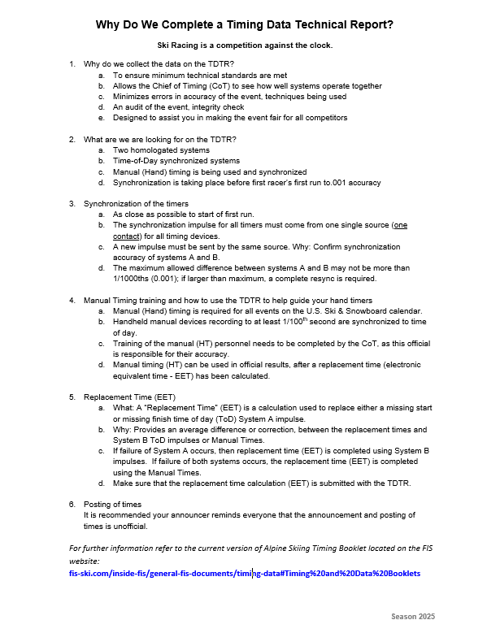
WHY DO WE COMPLETE A TDTR?

Slide 4
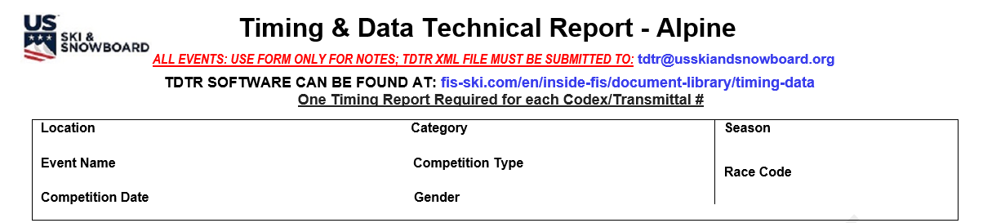
Timing & Data Technical Report - TDTR
A TDTR is required for all events: non-FIS (including non-scored) and FIS
This part of the presentation addresses preparation of a paper copy of the TDTR which is made available in the MPF and may be used to document data which must be keyed into the FIS TDTR software
The paper copy of the TDTR has been redesigned to closely mirror the PDF report generated by the FIS TDTR software

Slide 5
U.S. EVENT IDENTIFIER
U.S. Race Code: Alpha character + 4 numbers assigned by U.S. Ski & Snowboard Competition Services:
U = U.S. scored
N = U.S. non-scored
M = Masters
O = Other (alpha not number)
FIS EVENT IDENTIFIER
FIS Codex: 4 numbers assigned by FIS Office

Slide 6
LOCATION: As listed on U.S. website
CATEGORY: Scored or Non-Scored
SEASON: Current season is 2025
EVENT NAME: As listed on U.S. website
COMPETITION TYPE: Type of race: DH, SL, GS, SG, AC, P
DATE: Actual date of event
  GENDER: Women or Men
RACE CODE: As listed on U.S. website!
All data for a FIS event must be verified against FIS website posting!

Slide 7
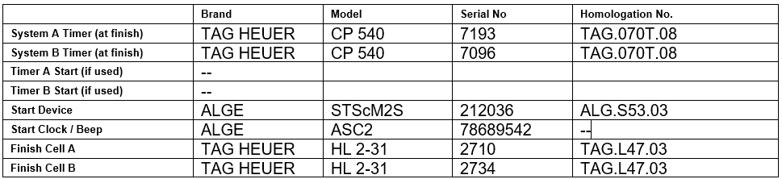
Equipment Identifiers
Information must be accurate; equipment must be currently homologated!
Sys Timer A
Sys Timer B
Start Device
Start Clock / Beep
Finish Cell A
Finish Cell B
Brand Name
Model or Type
Serial Number
Homologation #

Slide 8
RESULT SOFTWARE
Name of Software Company:
Split Second or Vola
Software Name* & Version #:
Version used by both timing & results – verify each system is operating with the same version
* Company Name and Software Name may or may not be the same!

Slide 9
CONNECTIONS
How do we communicate signals/data from Start to Finish?
How is voice communication handled between Start and Finish?
Cable
Radio
Snowmobile
Ski Lift
Skier
??

Slide 10
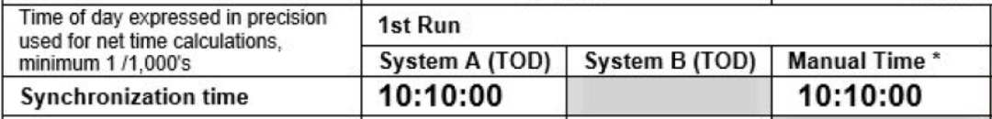
SYNCHRONIZATION
At what time is the run scheduled to start?
  Is there a rule about Synchronization?

Slide 11
Synchronization and CONFIRMATION
Are Systems A and B synchronized?
  How close are they?
  Based on timing ruIes, is the difference acceptable?
What is the maximum difference acceptable?
What about Hand Synchronization (Manual Timekeeping)?

Slide 12
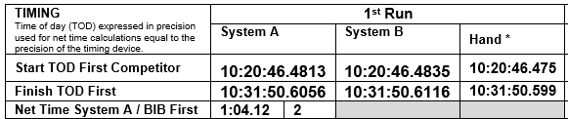
First Competitor Quality Check
What is the System B time-of-day difference?
What about Hand Timing (Manual Timekeeping)?

Slide 13

Last Competitor Quality Check
What is the System B time-of-day difference?
What about Hand Timing (Manual Timekeeping)?
Does net time agree with the Official Results?

Slide 14
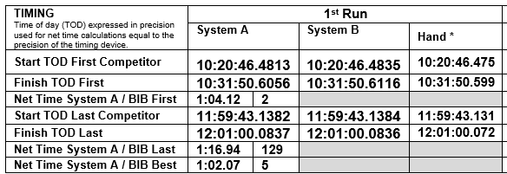
First Run Summary
Why do we show Best run-time?
Why do we show the Bib #?

Slide 15
Second Run / SECOND RACE
RE-SYNCHRONIZATION OF TIMEKEEPING
EQUIPMENT PRIOR TO THE
START OF THE 2ND RUN / 2ND RACE
IS NOT REQUIRED

Slide 16
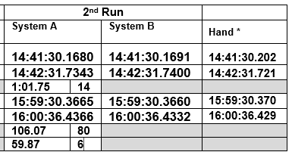
Second Run Summary
Notice First and Last racer data quality!

Slide 17
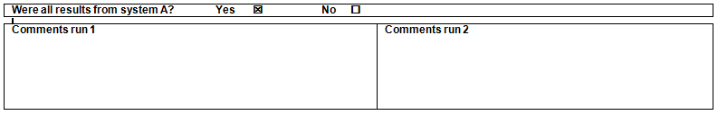
Race Summary
Were all Results from System A? If you answer “NO," you must list any or all bib numbers in the applicable “Comments” section where an assigned time was obtained from any system other than System A
WHY?
List the reason: Batteries Snow obscuration Wire break Photocell alignment Other? (describe)
Data source for replacement System A time (resp. ACR 611.2.1)?
What did you use? System B System C Manual
The “Comments” section is reserved to describe problems that occurred during the timing of a run. It is also used to describe corrective actions that were taken.
NOTE: If Replacement Time (EET) calculated, you must submit calculation worksheet(s) as noted in requirements for “Event Document Packets” in the MPF.

Slide 18
Certification
We certify that the timing and calculations of this event adhered to current ACR rules.

Slide 19
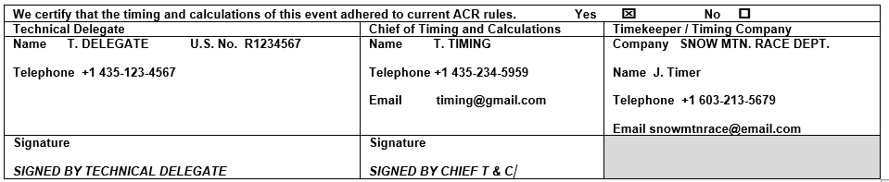
Sign Off
Technical Delegate
  Printed Name
  U.S. #
  Telephone nr.
  SIGNATURE
Chief T & C
  Printed Name
  Telephone nr.
  Email address
  SIGNATURE
Timekeeper / Company
  Name of Company
  Printed Name
  Telephone nr.
  Email address

Slide 20
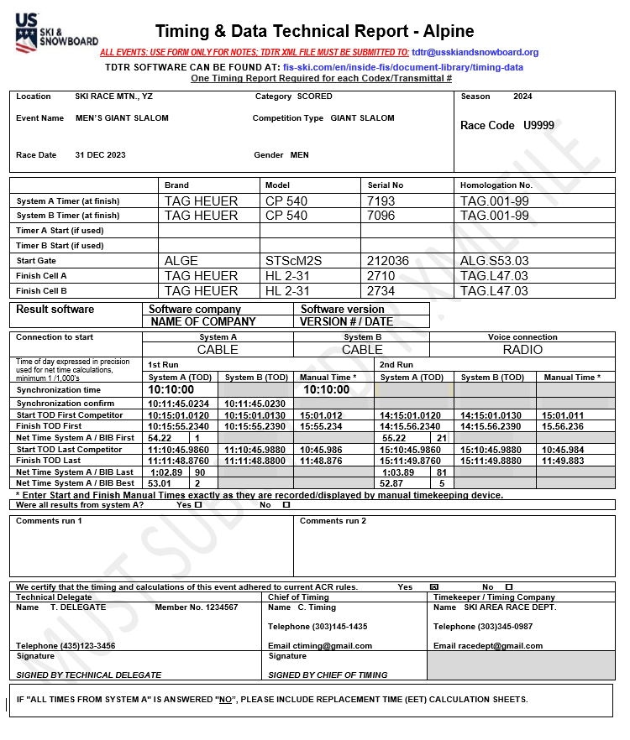
COMPLETED TDTR
This form is used to only to collect data required by the FIS TDTR software
The Chief of Timing & Calculations is responsible for the accuracy of the data contained in this form
The Technical Delegate is responsible for verifying the accuracy of the data
Both officials must sign the PDF copy generated by the TDTR software as their confirmation of the accuracy of the timing for the event
A TDTR is required for ALL events – both scored and non-scored

Slide 21
MISCELLANEOUS INFORMATION
FIS Timing Report software is used to prepare your Timing & Data Technical Report (TDTR) for all events: non-FIS & FIS
Software allows printing of a PDF report and even though the FIS logo will appear on the document, it is acceptable for non-FIS events

Slide 22
TDTR SOFTWARE
FIS TDTR Software prepares an XML file for online filing
Its use is required for all events – both non-FIS (non-scored and scored) and FIS
Software is available for review/download at:
fis-ski.com/en/inside-fis/document-library/timing-data
Available for Windows 10, 11 and macOS 10.14+; will be updated as required
Depending on connection, download time can vary –
DOWNLOAD, INSTALL, AND TEST IN ADVANCE OF YOUR EVENT!
NOTE: For FIS events, the race result XML and TDTR XML files must be submitted prior to filing online FIS TD Report!

Slide 23
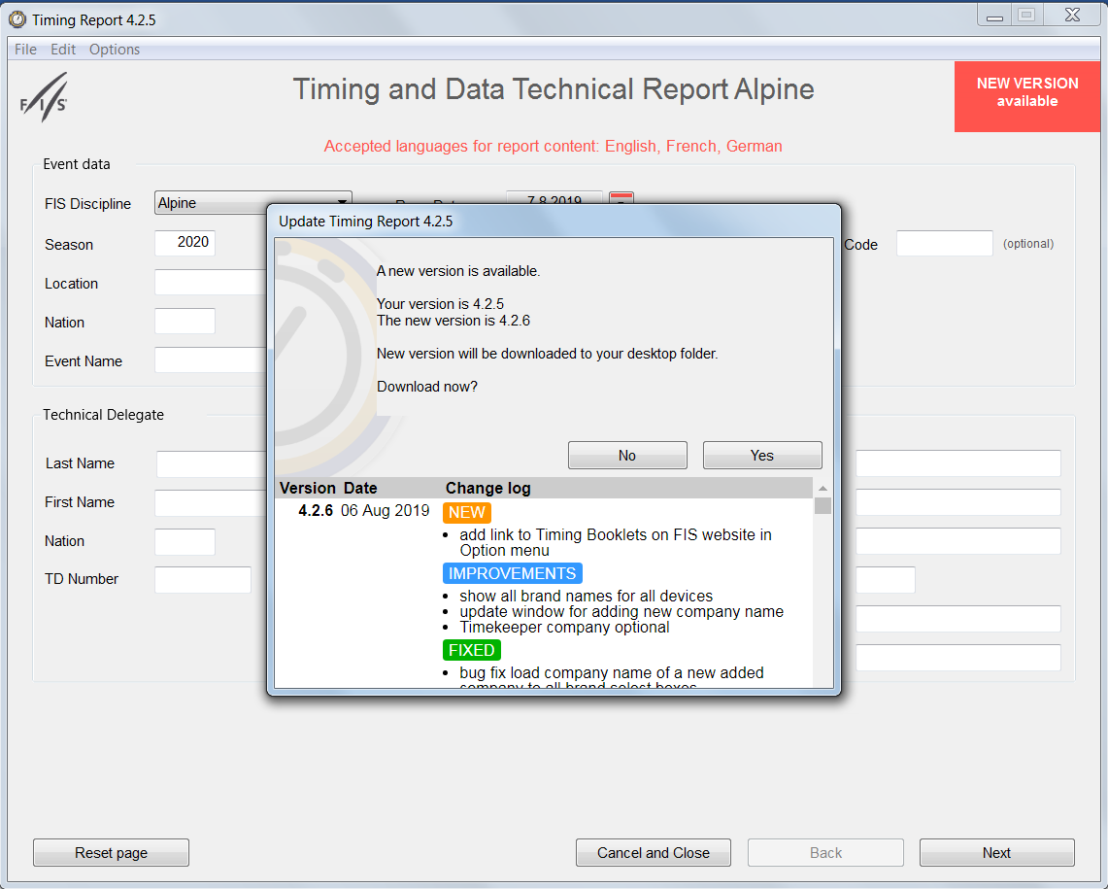
New Version Information
TDTR SOFTWARE ALREADY LOADED!
Select “NEW VERSION available”
Old/New version information
Select “No” or “Yes” to download & install
Note “Change Log”

Slide 24
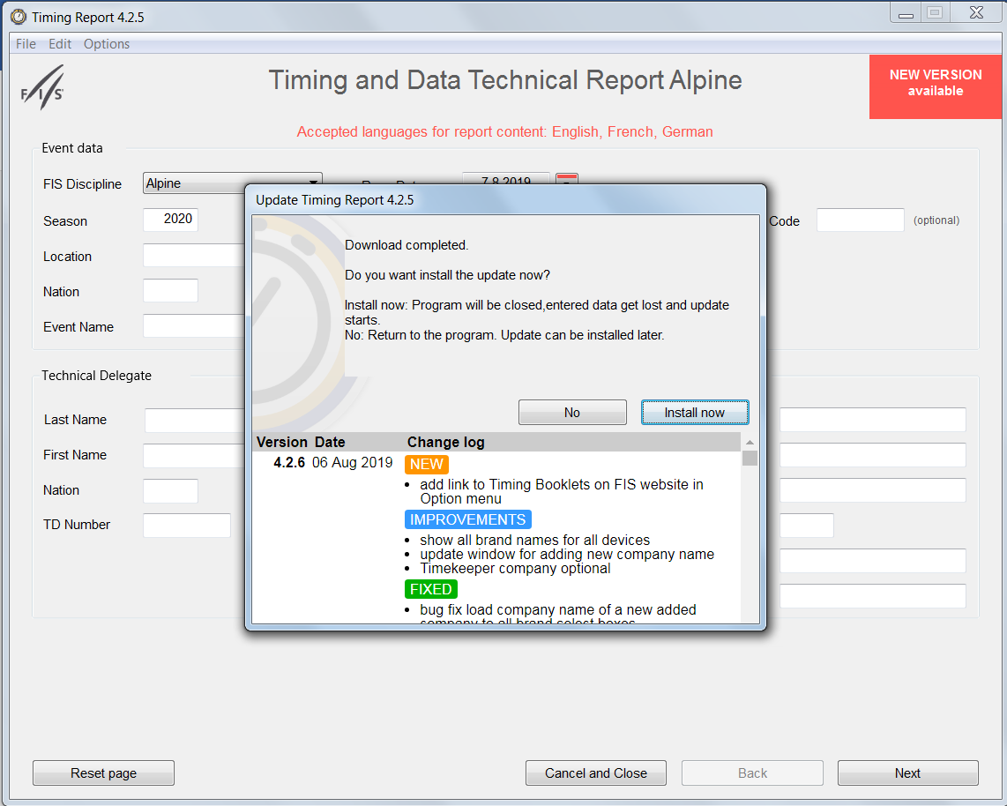
CONTINUING INSTALLATION
Select “No” or
“Install Now”

Slide 25
TIMING & DATA TECHNICAL REPORT SOFTWARE *
Version 6.4.3
*In addition to verifying you are using the most current version of all rule books – including the FIS Timing Booklet, please verify you are using the most current version of the TDTR software!
This software is required for preparing and submitting a FIS-event Timing & Data Technical Report (TDTR).
This software is also required for preparing and submitting a non-FIS event Timing & Data Technical Report (TDTR). Presentation contains instructions for using this software at non-FIS events.
Notes:
TDTR software allows the TDTR to be sent by XML and follows the Results example of sending electronically.
There are two options for this new software to be implemented. The Result software provider can add this to their software and/or it can be used as a stand alone application for the Chief of Timing.

Slide 26
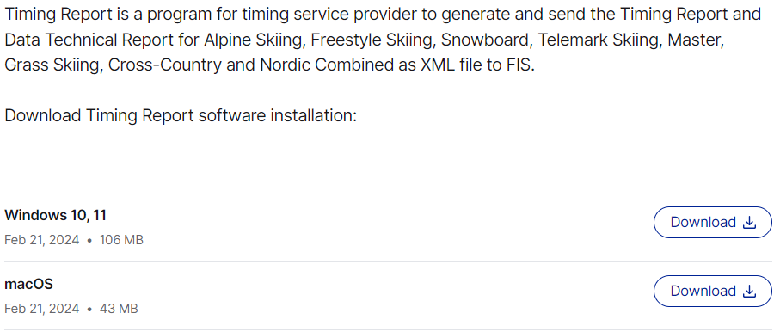
The TDTR software can be found on the FIS website
fis-ski.com/en/inside-fis/document-library/timing-data
Select OS & Download
CURRENT VERSION WILL BE DOWNLOADED!
Notes:
The software program can be downloaded from the FIS FTP website. This program is available for Windows and Mac OS

Slide 27
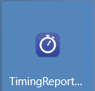
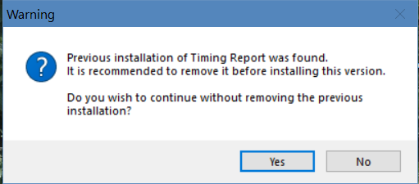
Installing the TDTR software
Click on the icon and allow software to make changes to your computer
Removing previous installations is recommended!

Slide 28
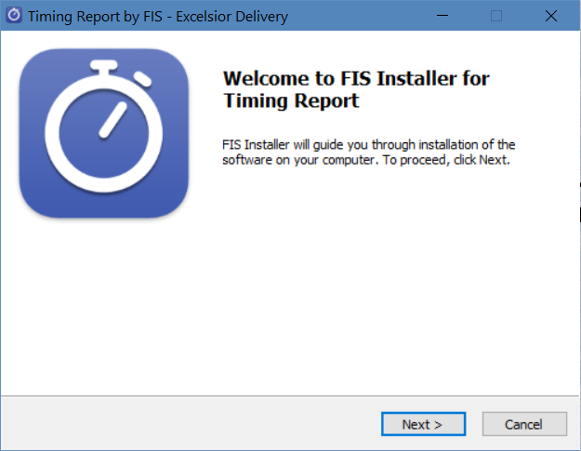
TDTR SOFTWARE, Step 1
Select Option to Continue

Slide 29
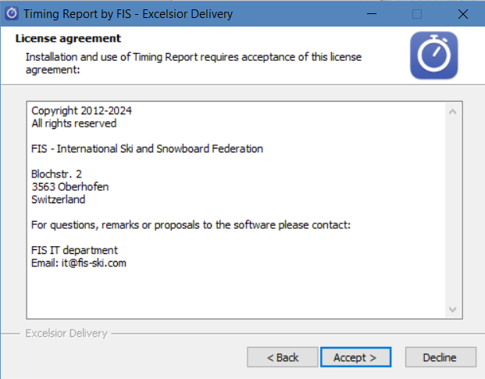
TDTR SOFTWARE, Step 2
Select Option & Continue

Slide 30
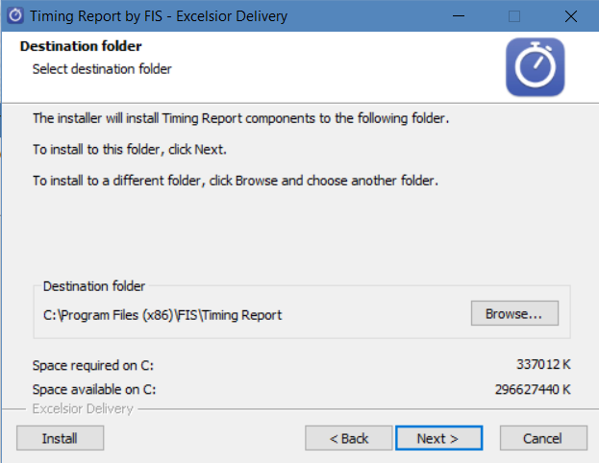
TDTR SOFTWARE, Step 3
Find & Change
or Accept and Continue

Slide 31
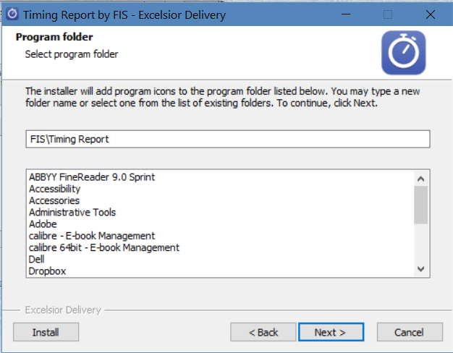
TDTR SOFTWARE, Step 4
Select Storage Location
Continue

Slide 32
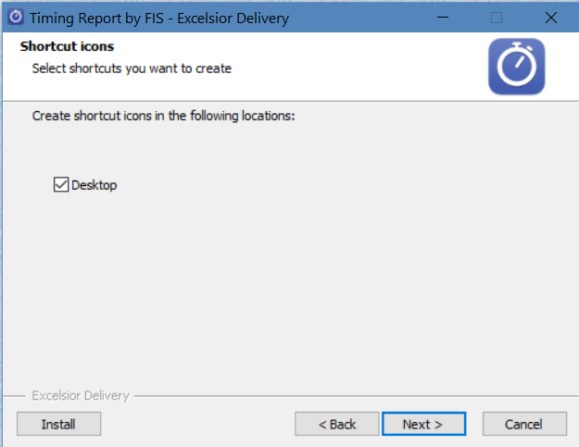
TDTR SOFTWARE, Step 5
Will create shortcut to your default.
Continue

Slide 33
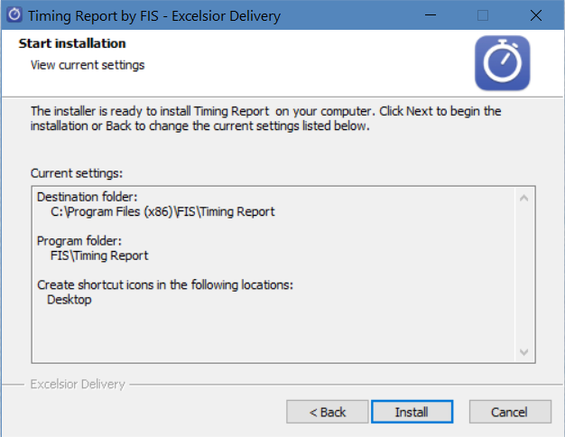
TDTR SOFTWARE, Step 6
SELECT

Slide 34
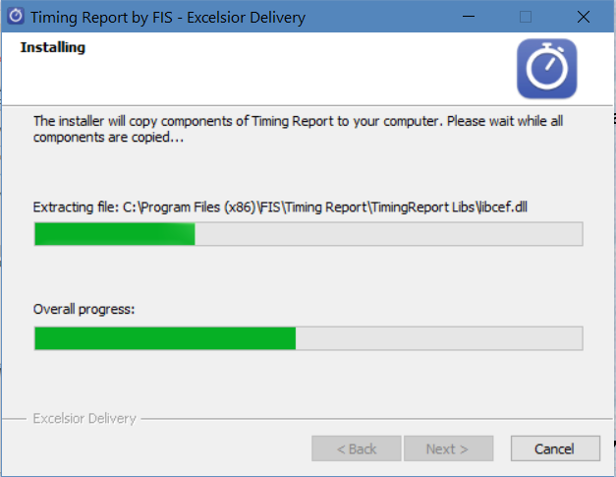
BE PATIENT DURING INSTALLATION!
APPLIES TO BOTH NEW & INSTALLATION UPDATES

Slide 35
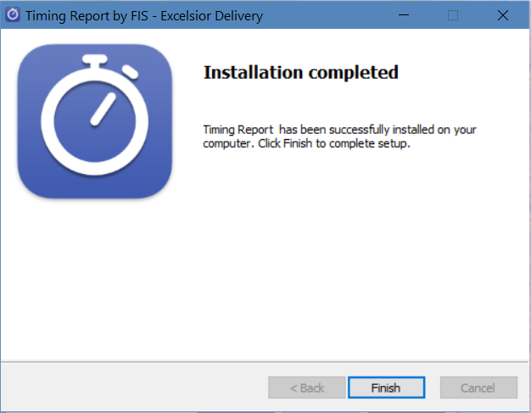
TDTR SOFTWARE, Step 7
Finish Installation & Launch Software

Slide 36

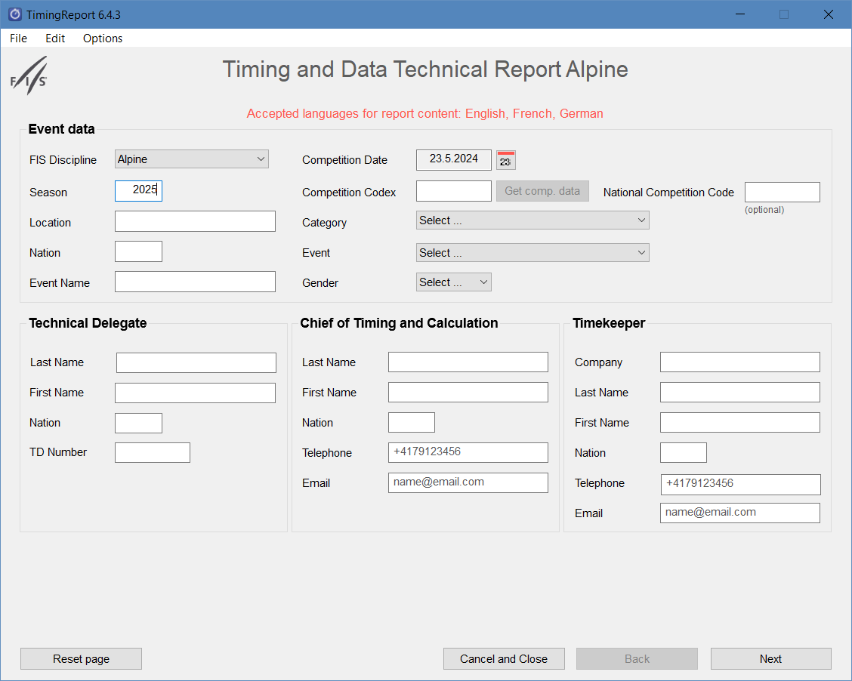

LAUNCH & USE TDTR SOFTWARE
Select the icon
Wait for completion of initialization

Slide 37
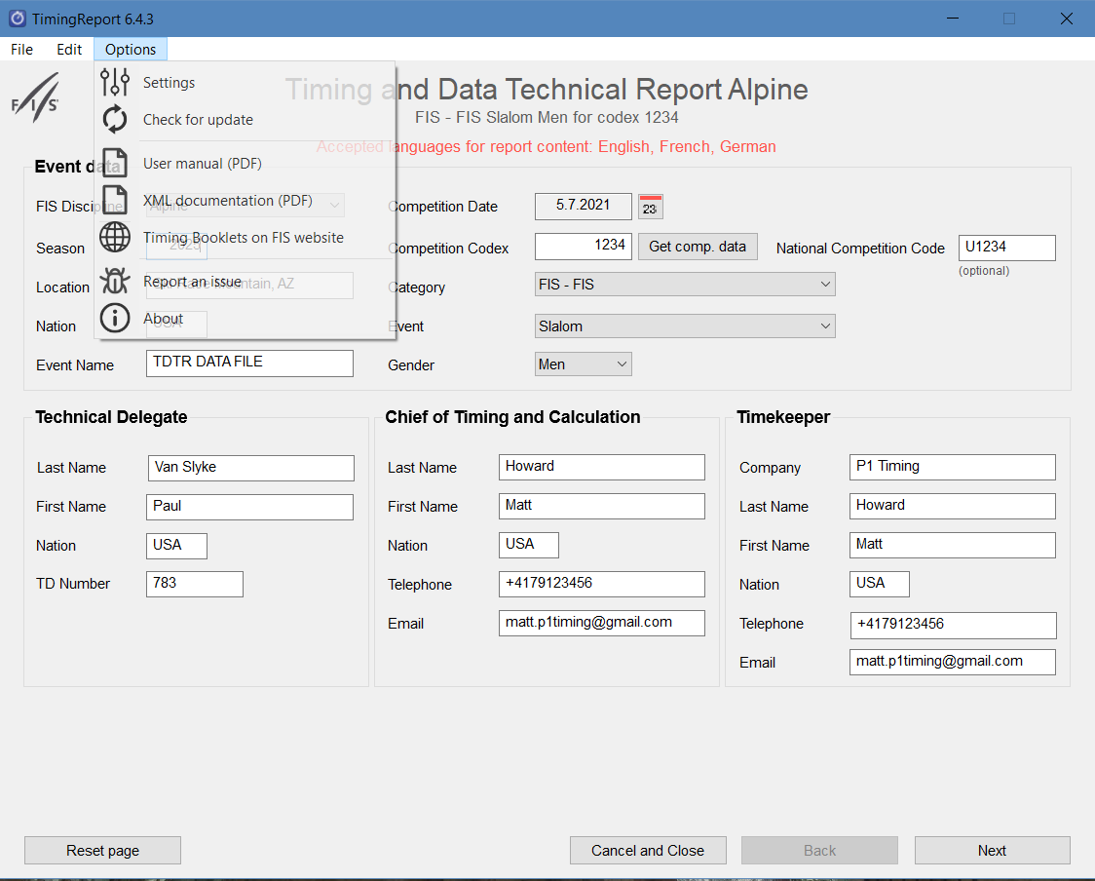
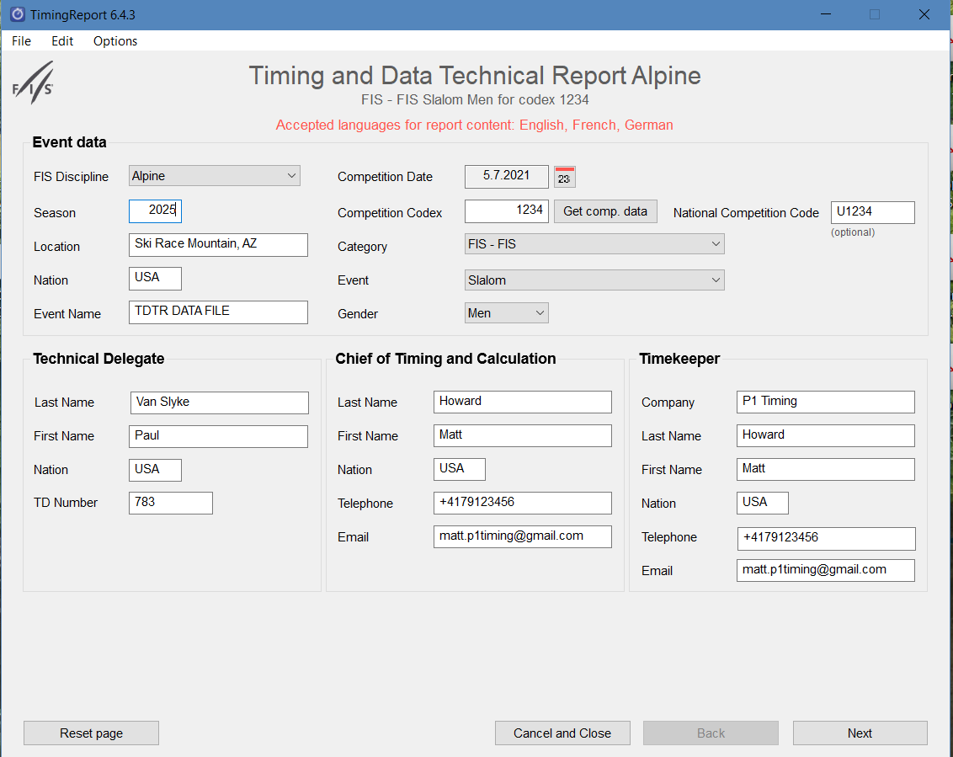
SET DEFAULTS & CHECK FOR UPDATES
Select “Options”
Set “Defaults”
Check for Software “Updates”
Note option to access
Alpine Timing Booklet on FIS website
Verify “Discipline” & “Season ”
Notes:


Slide 38
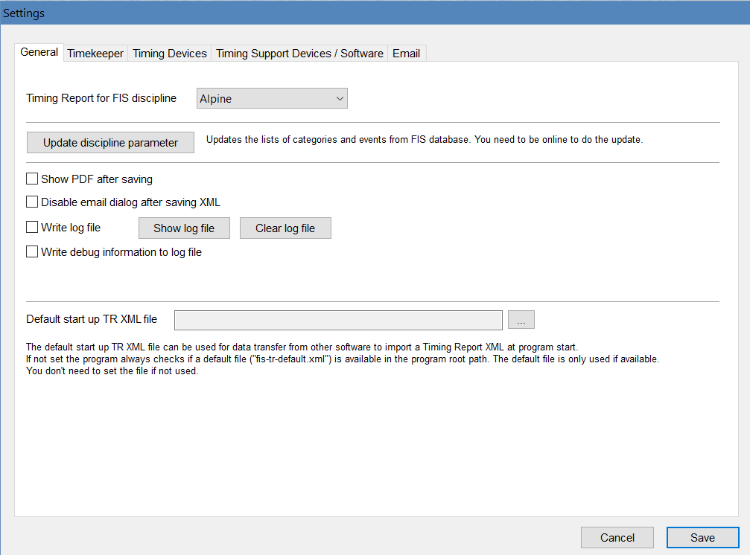
OPTIONS:
Program Options that will not change!

Slide 39
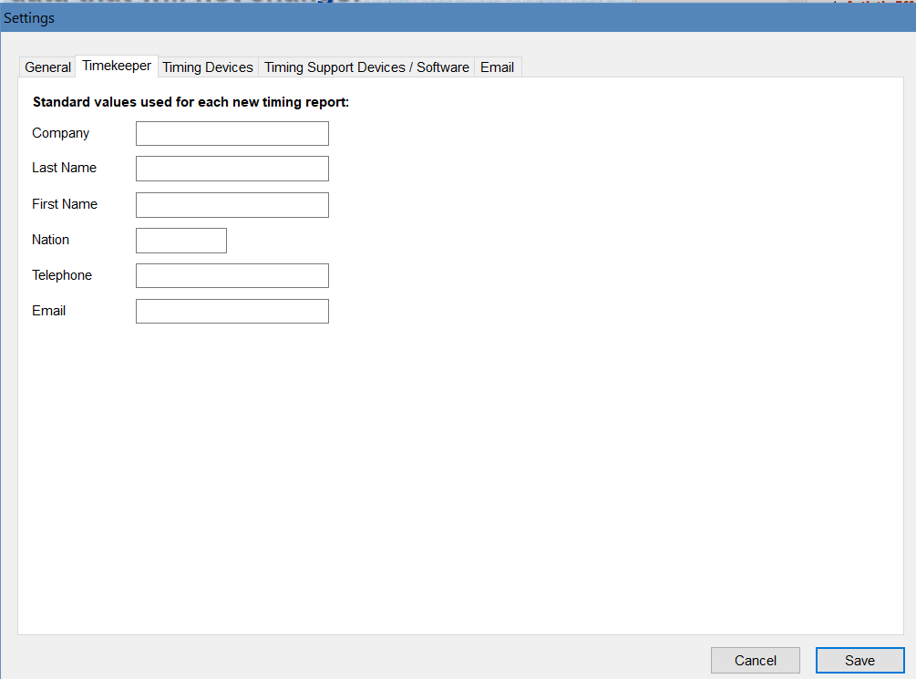
PREFERENCES:
Timekeeper data that will not change!
NOTE: Telephone # must follow international format; e.g., +1

Slide 40
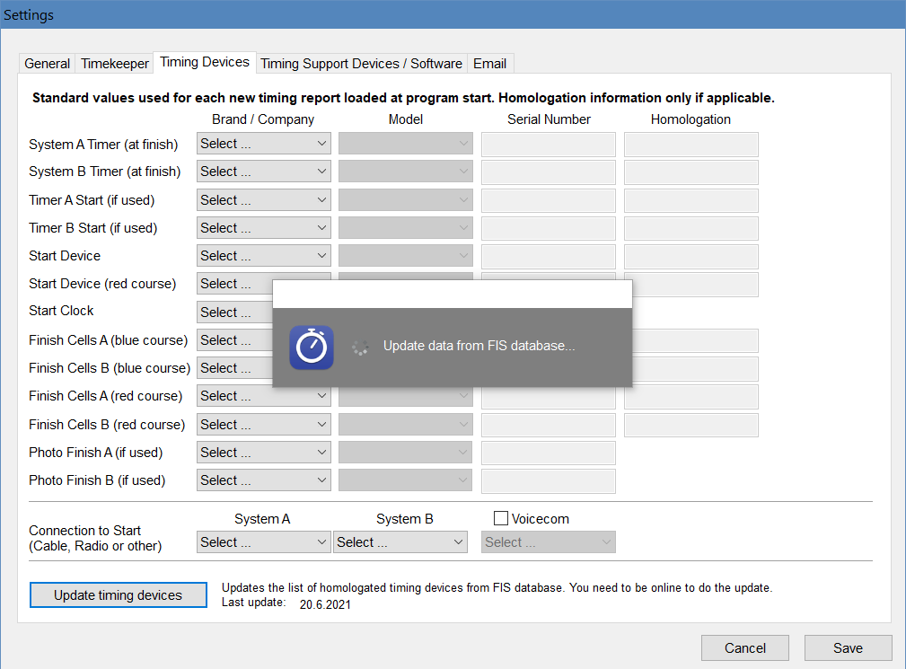
PREFERENCES:
Timing Device data that will not change!
Verify installed timing device data is current

Slide 41
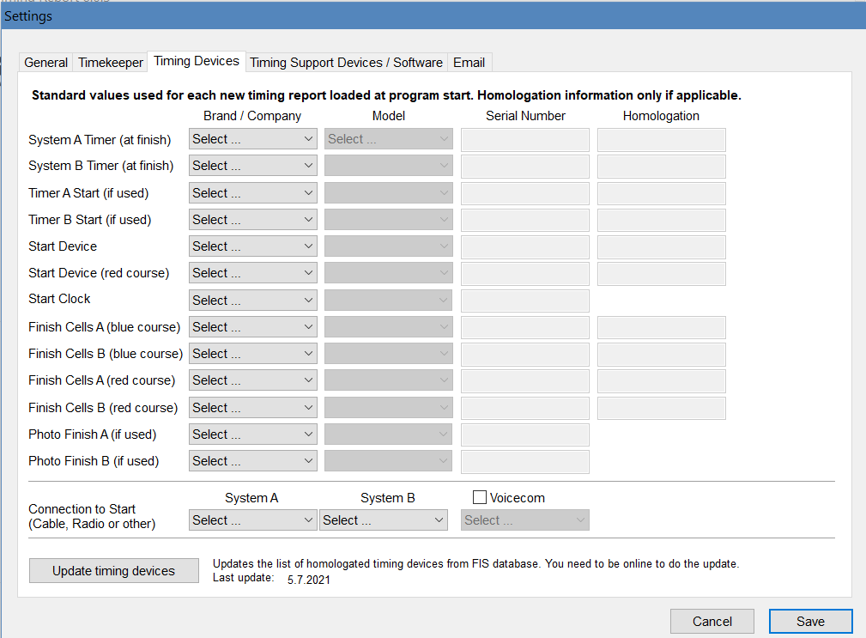
Defaults: Timing Devices
Use Dropdown boxes & insert All Timing Device Data
Select “Save”

Slide 42
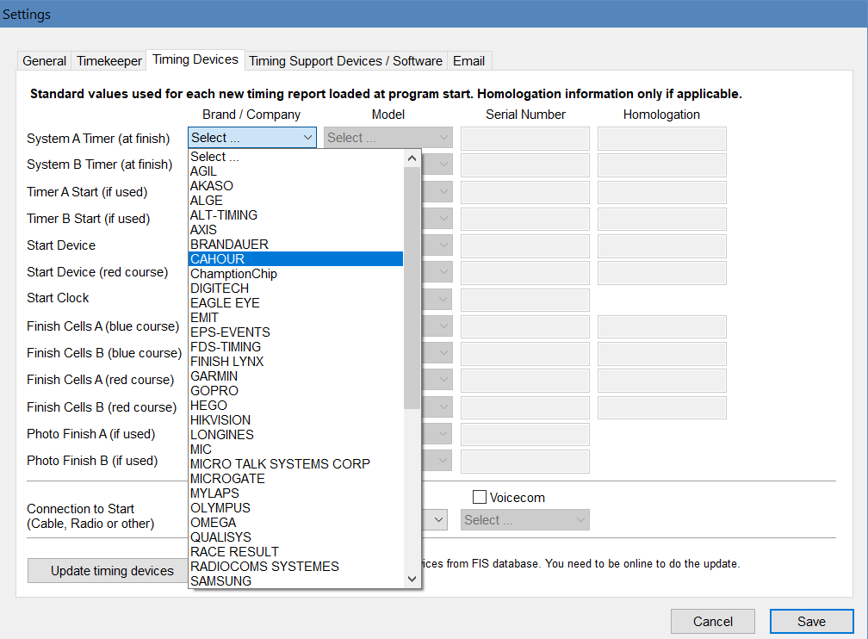
MAKE YOUR EQUIPMENT SELECTIONS
Dropdown boxes allow for easy equipment selections
Select “Save”

Slide 43
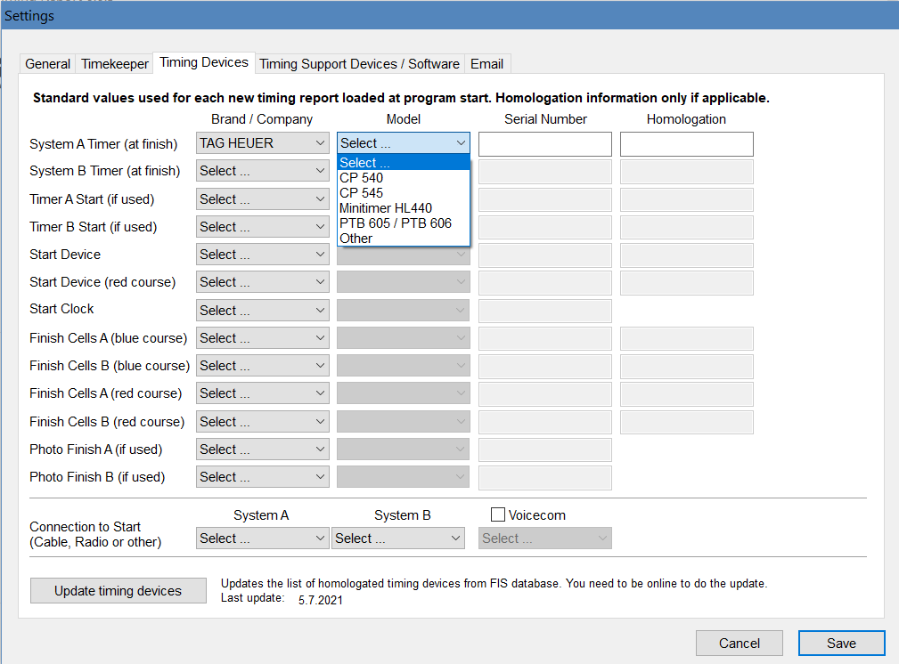
MAKE YOUR MODEL SELECTIONS
Dropdown boxes allow for easy model selections
Select “Save”

Slide 44
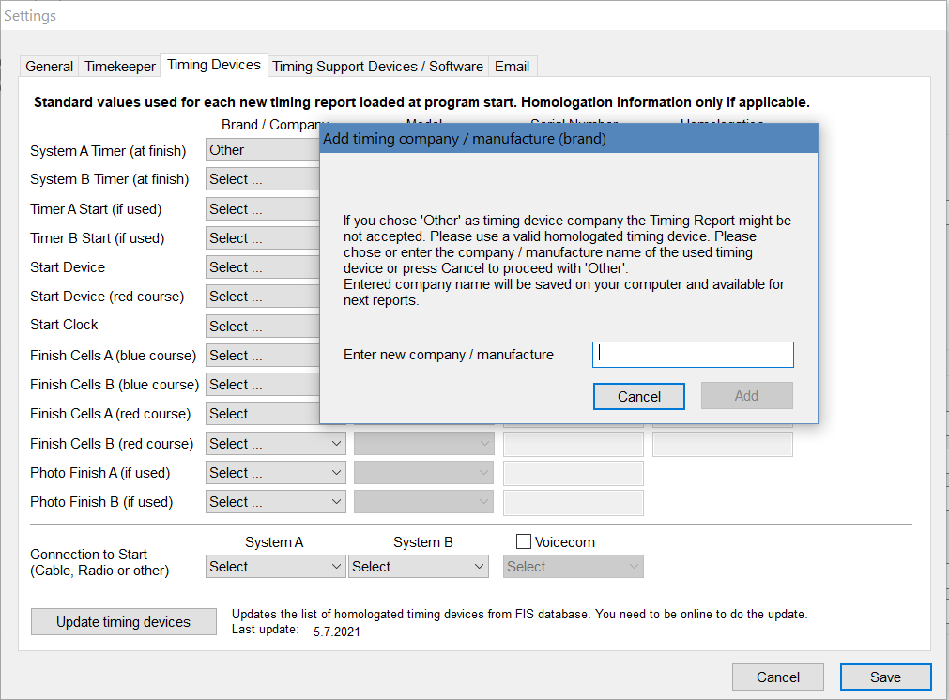
SELECTION WARNING!

Slide 45
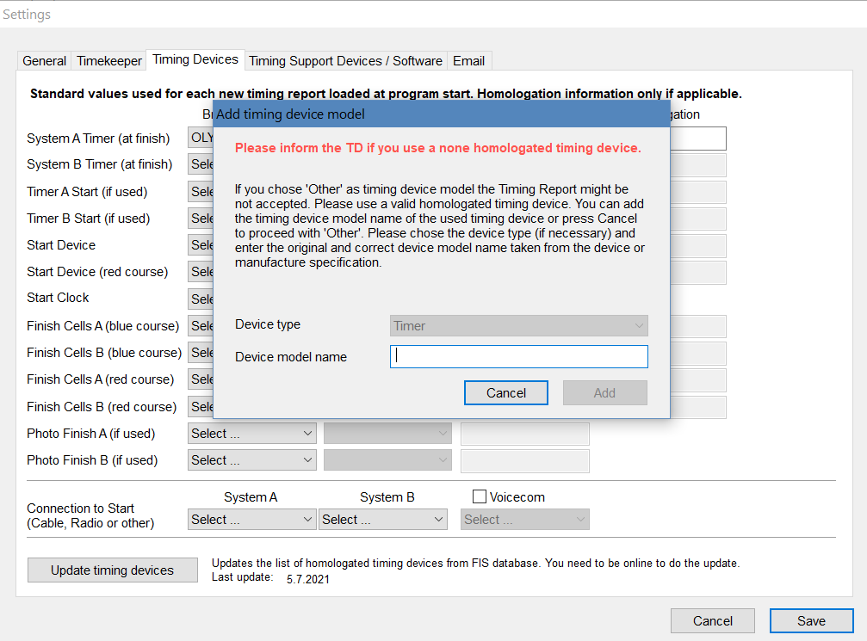
SELECTION WARNING!

Slide 46
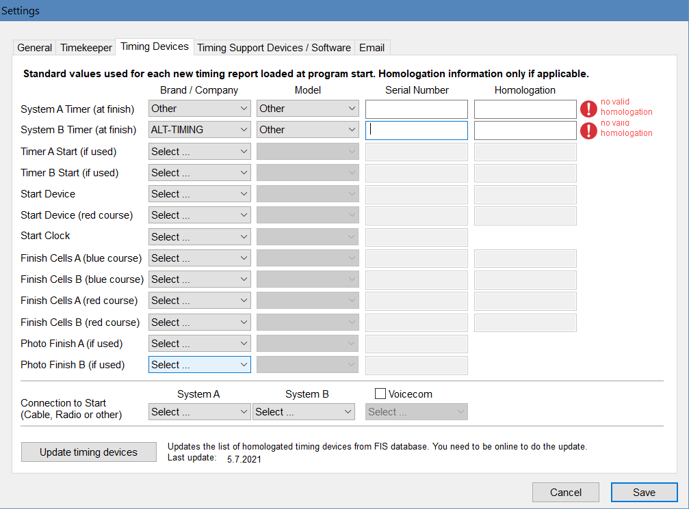
ADDITIONAL SELECTION WARNINGS!

Slide 47
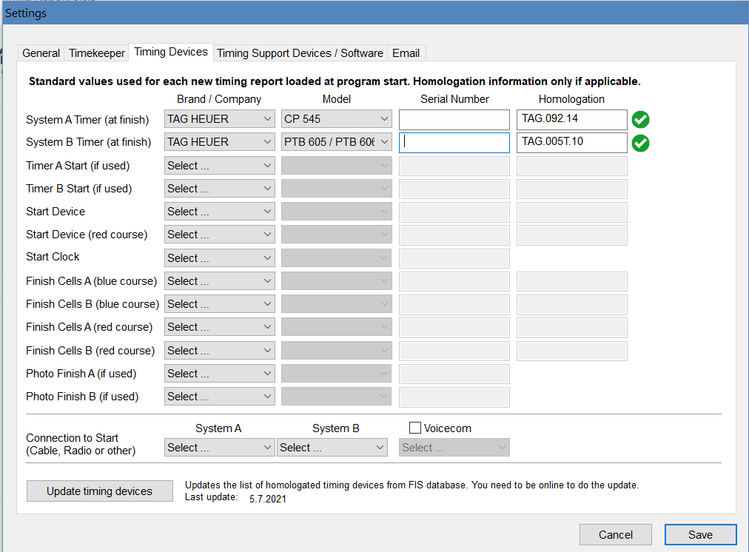
SELECT MODELS:
Homologation #’s are Automatic
“Green Light” = “OK”

Slide 48
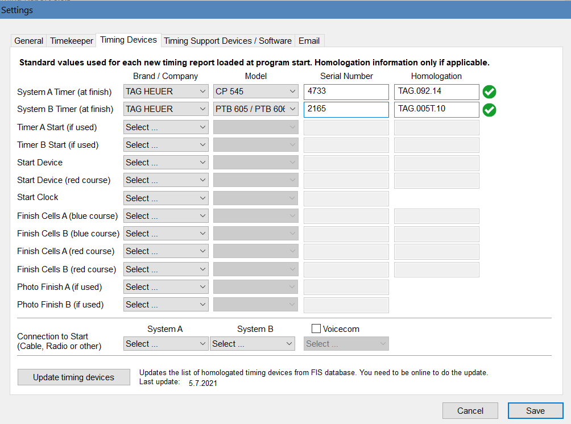
IDENTIFY YOUR EQUIPMENT
Currently Homologated
Key in Serial Numbers

Slide 49
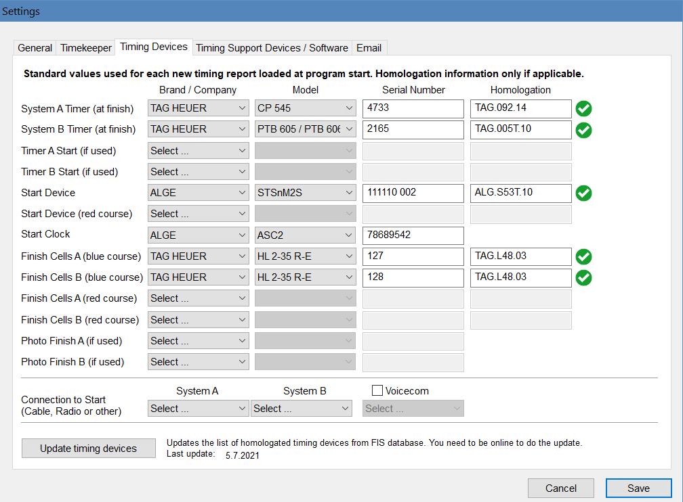
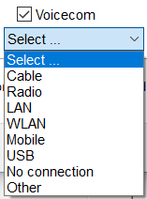
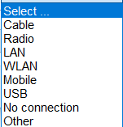
ALL START CONNECTION SELECTIONS
“Voicecom” checked…select your device

Slide 50
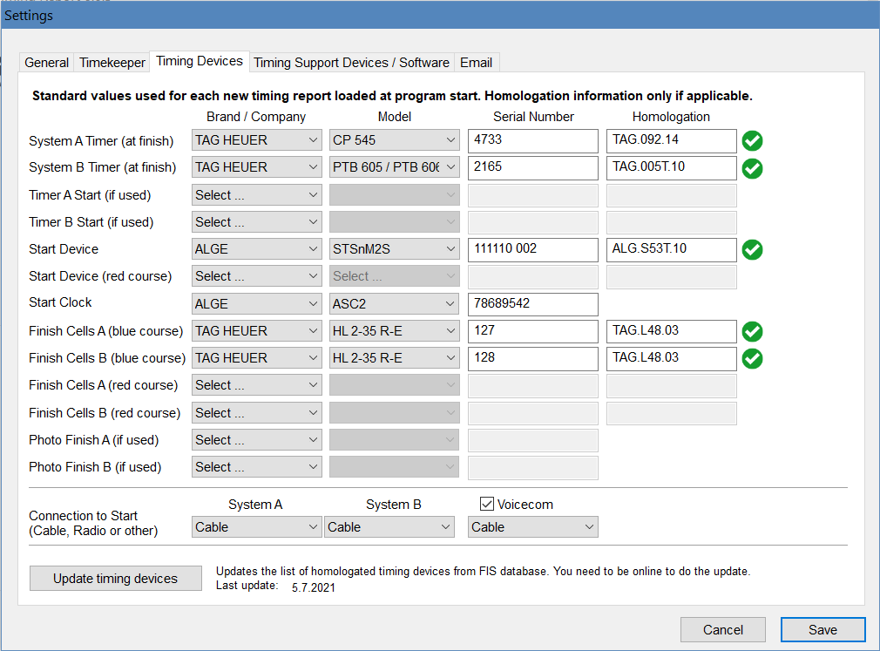
DEFAULT TECHNICAL DATA COMPLETE
DON’T FORGET TO “SAVE”!
Note options for “Photo Finish Timing Systems” & Parallel Events

Slide 51
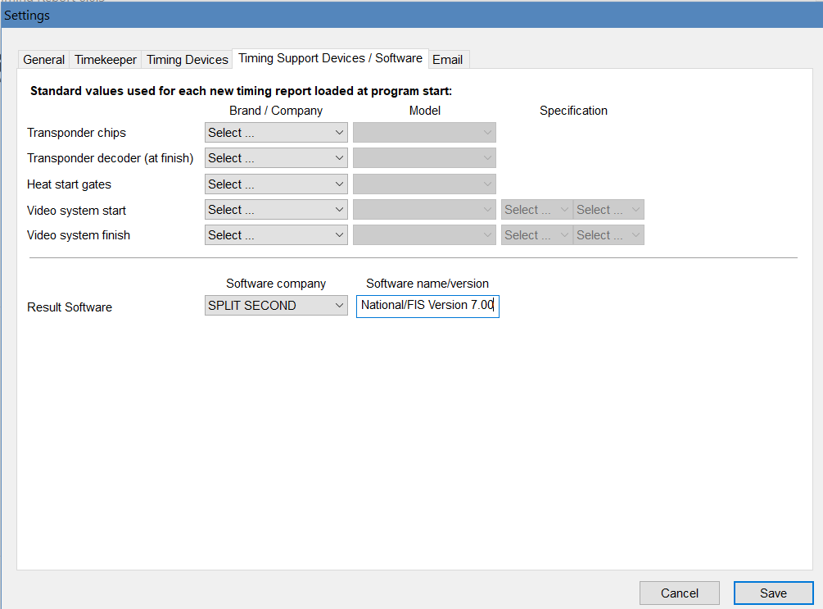
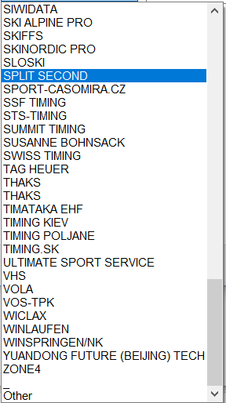
AVAILABLE RESULT SOFTWARE SELECTIONS
Don’t forget: Name & “Version”

Slide 52
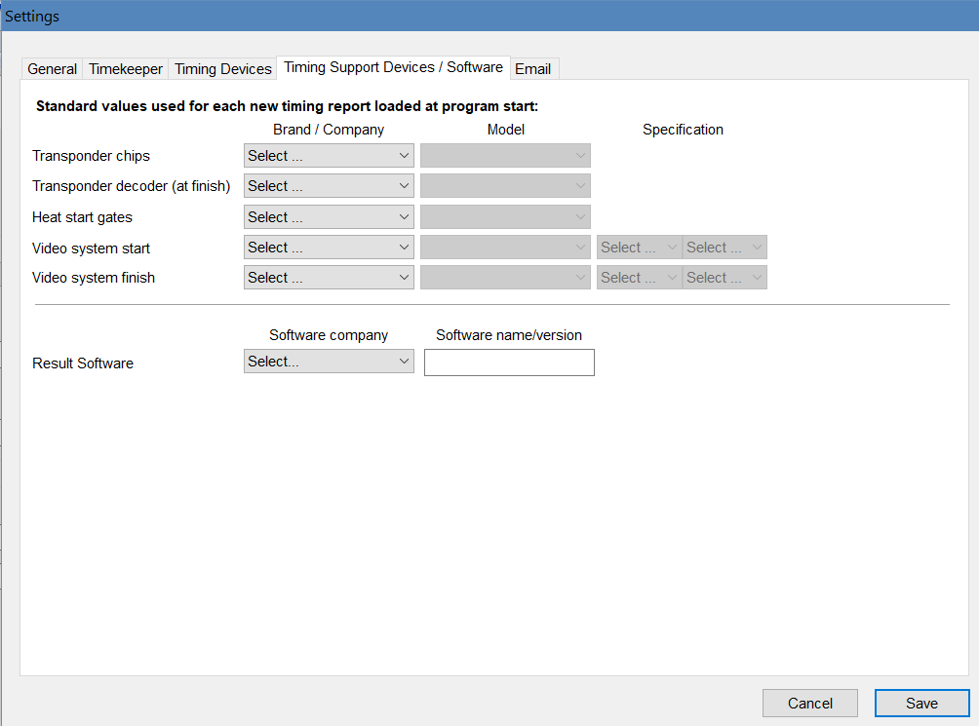
PREFERENCES:
Timing Support Device data that will not change!
This data requirement is not applicable for all events.

Slide 53
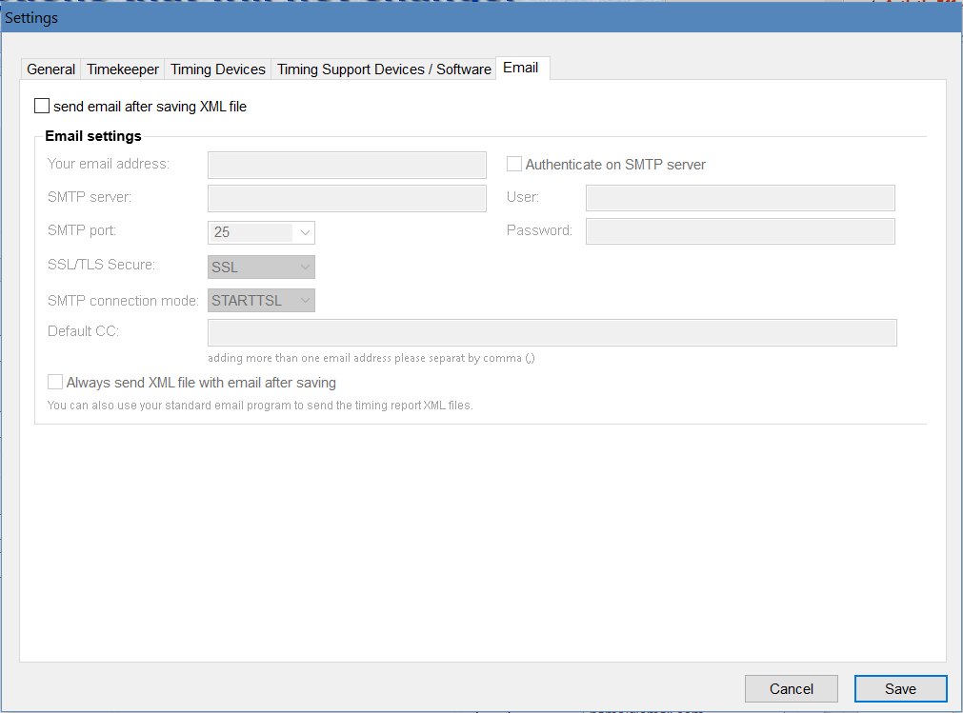
PREFERENCES:
Email Options that will not change!
Although this option is available, the preferred option is to attach the XML file to an email and submit it as required.
The email must only contain one file, and the assigned codex must be used as the email subject.

Slide 54
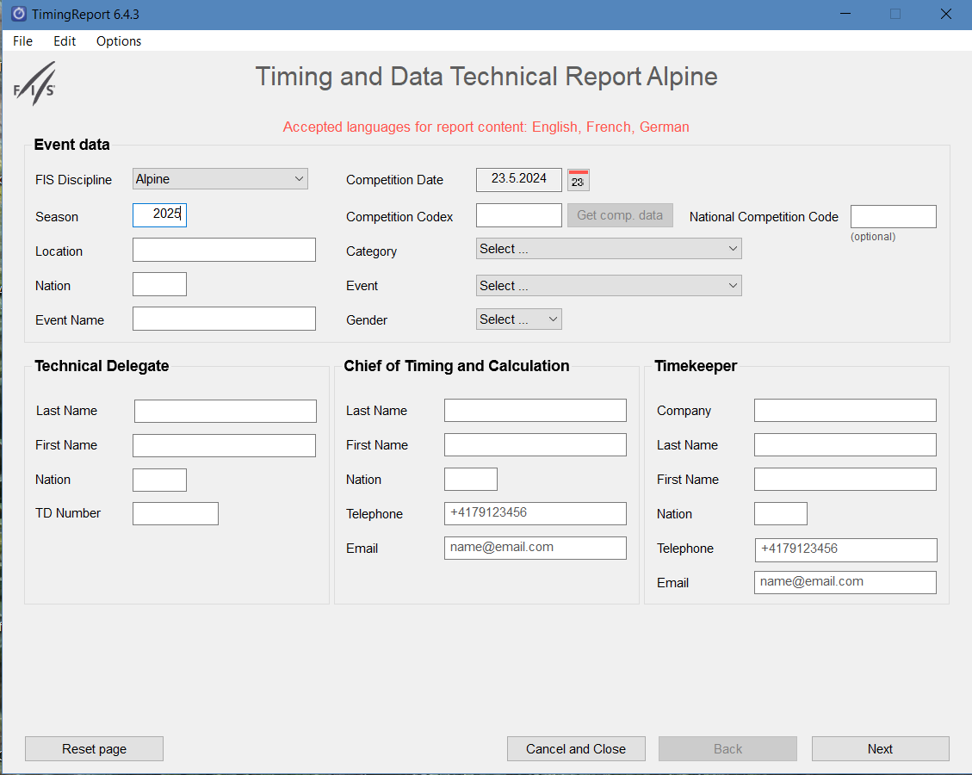
The Software: P1.
Note Season Date
Event Information as listed on applicable website for level of event
Option allowing use at non-FIS events
Officials’ names as listed on applicable website for level of event (name on FIS site may be different than that listed on U.S. site, Daniel A. Chayes on FIS and
Dan Chayes on U.S.!)
Insert timekeeper (timing company) information
Select “Next”

Slide 55
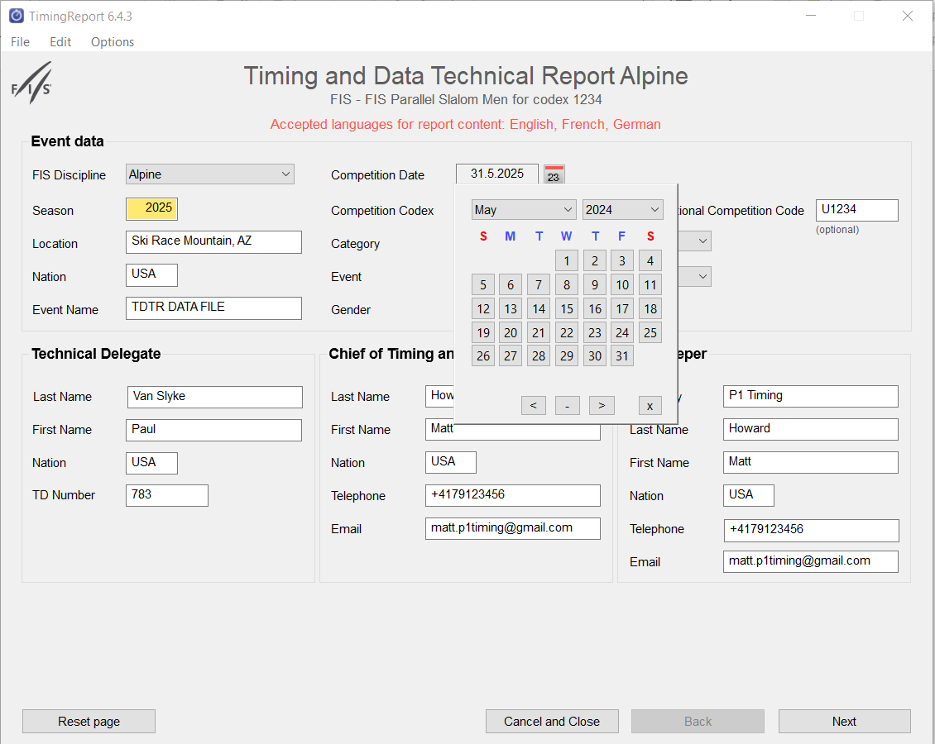
The Software: P1.
Note option to select event date

Slide 56
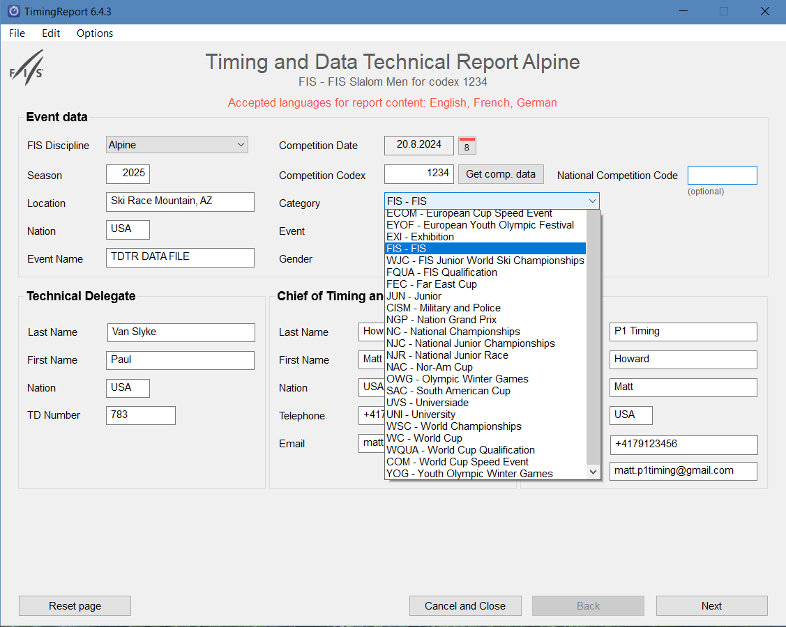
SELECT “CATEGORY”

Slide 57
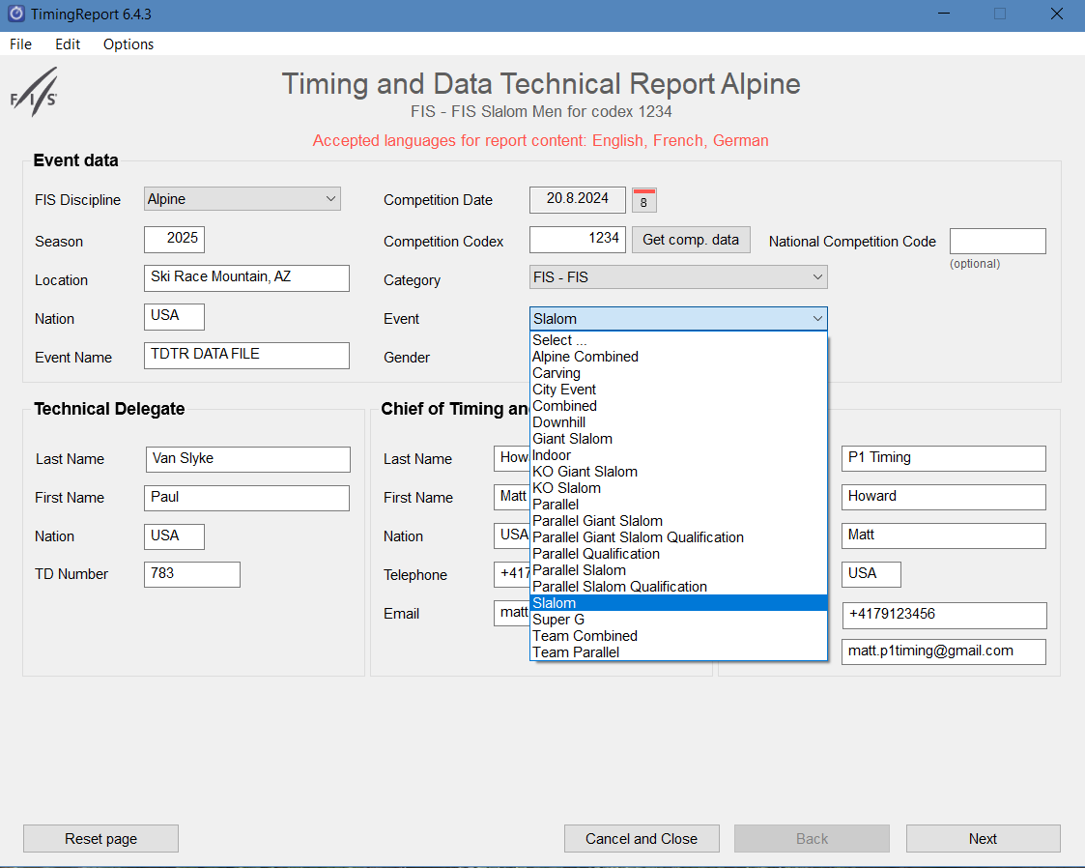
SELECT “EVENT”

Slide 58
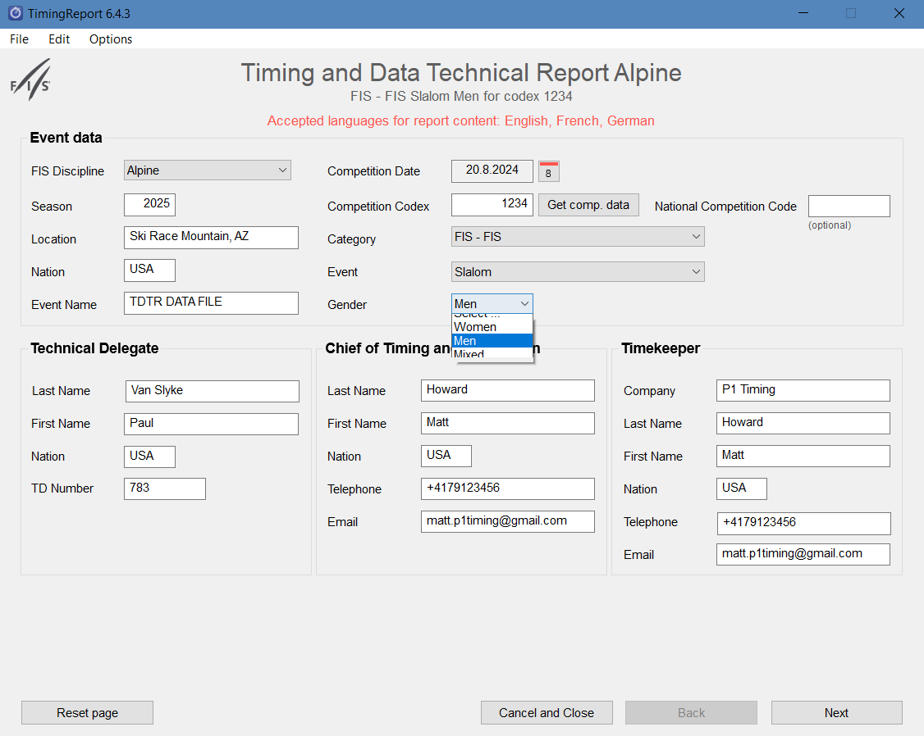
SELECT “GENDER”
Note: Requirement is a separate TDTR per race/per gender

Slide 59

VERIFYING SAVED DATA: Page 1
Explanation required to document failure of either system

Slide 60

VERIFYING SAVED DATA: Page 2

Slide 61

1ST RUN TIMING DATA
Enter “Synchronization times” and
Insert required data for 1st Run
Select “Next”

Slide 62

2ND RUN TIMING DATA
Note option to select
# of runs!
Enter 2nd run time data
Select “Next”

Slide 63

TIMING DATA COMPLETE

Slide 64

FINAL VERIFICATIONS:
All Times from System A?
“Yes” or “No”

Slide 65


Summary of Race:
All Times From System “A”? NO
“NO” is selected; information required.
“Bib” /”Run”/”Reason”
Drop-down selections make it easy!
Notes:
As you can see if a time is missed, there are options to notate detailed information as to what occurred. You can also make any additional comments in the comment section for each Run.
At the bottom you find options to View the xml, go back and check the report or save the XML. The save to PDF is not ready at this time and is not showing in the current version of the software.

Slide 66


Summary of Race:
All Times From System “A”? NO
“Other” allows you to key in a reason.
Select source for replacement time
“Add to List” inserts your keyed data.
“Manual” selected when both System A and System B ToD are missed
Don’t forget to “SAVE”

Slide 67

Certification of Race:
T&C Rules Were Followed!
Rules were followed! ”
Don’t forget to “SAVE”

Slide 68

OOPS!
You want to generate the TDTR XML file and you get this message:
CANCEL & CHECK DATA
This action will be repeated until all required data (yellow highlighted) is entered.

Slide 69

OOPS!
Verify the data in the “yellow” boxes! Is it required?

Slide 70

OOPS – Verified & Fixed!
Notice this is optional for FIS events
Unable to fix Competition Codex; event not in FIS database!

Slide 71

OOPS – WARNING!!
CANCEL & CHECK DATA

Slide 72

OOPS!
All the data in “yellow” boxes is missing!

Slide 73

OOPS - Fixed!

Slide 74

OUTPUTS: SAVE PDF/VIEW XML/SAVE XML/EMAIL
Select “Outputs”
Select your option –
“Save PDF” allows for TD’s review and provides copy for Race Result Document Packets.

Slide 75

Option: SAVE “PDF”
WILL SAVE TO LOCATION OF YOUR CHOOSING
Note PDF File Name:
Season = 2025
Discipline = Alpine
4 Digits = Codex

Slide 76

PRINT “PDF”
Auto-saved as: 2025AL1234
Print for TD’s review, signature and race result document packet requirements
NOTE: Yellow areas = items not fixed
(Season not yet set up; race code not found.)
Must be signed by Technical Delegate & Chief of Timing & Calculations

Slide 77


Option: “VIEW XML”
Notice Season; Category, etc.
Optional for FIS events
“View XML” allows you to see the format of the file required for electronic submittal.
Create email/Subject line =
FIS Codex
Attach & Send to:
results@fisski.ch

Slide 78

Option: SAVE “XML”
WILL SAVE THE TRANSMISSION FILE TO LOCATION OF YOUR CHOOSING OR USE DEFAULT LOCATION

Slide 79


SELECT “SAVE XML & EMAIL”
(If all data is correct, auto-send is an option.)
More data may be required!
This step can be eliminated
by providing required data
in default options!
SAVE XML & EMAIL: will first save to destination of your choice. This option may be preferred because it will allow you to again review the data and verify its accuracy prior to submission.
Notes:
Currently cannot change the results@fisski.com address. Other addresses can be added, but fisski address is locked. Auto send cannot be used for non-FIS events! Refer to slides 83-86 for using this software at non-FIS events.

Slide 80

CLOSING THE TIMING REPORT
Verify you have saved the file before you “Cancel and Close”!

Slide 81

If you choose to not auto-send: “Save XML & Email," use this procedure to send the XML TDTR.
1) Create email with Nat+FIS codex as subject of email: e.g.,USA1234
(as noted in name of file)
2) Attach “saved” file
3) email to: results@fisski.ch
NOTE: All Replacement Time Calculations (EET’s) must be submitted as attachments!
SAVE XML & EMAIL NOT YOUR OPTION

Slide 82
SUBMITTING TDTR XML FILE
The TDTR XML and the RACE RESULT XML files must be submitted before the TD submits their TD Report online.
The Chief of Timing & Calculations is responsible for entering data and transmitting the XML file to FIS, but the Technical Delegate must verify the accuracy!
After all the data is entered in the software:
- TDTR may be viewed as XML
- TDTR must be saved as PDF and printed/signed for result packets
- TDTR must either be auto sent or saved as XML
- Saved XML TDTR must be attached to an email and sent to
results@fisski.com
FIS online Technical Delegate Report allows the Technical Delegate to view what has been transmitted to FIS.
Errors? Corrections can be made and TDTR XML file can be resubmitted
NOTE: FIS results will not be scored to the FIS Points List until the TDTR XML file & FIS TD Report are submitted.

Slide 83
NOTE: REPLACEMENT TIME CALCULATIONS
In addition to a signed PDF copy of the TDTR, the Chief of Timing & Calculations must:
Provide the Race Administrator with a copy of any Replacement Time Calculations (EET’s).
The calculations must be included in required non-FIS and FIS PDF Event Document Packets.
The calculations must also be included with the XML TDTR submitted to tdtr@usskiandsnowboard.org

Slide 84
WHAT ABOUT NON-FIS EVENTS?
  A TDTR is required for all non-FIS events – both scored and non-scored
  The U.S. TDTR in the MPF is used only to collect the data required by the TDTR software
  To use FIS TDTR software for non-FIS events: (FIS logo is a non-issue.)
  - “National Race Code” is used for U.S. Race Code #
  (alpha character + 4-digit number)
  - “Category” must be selected: JUN-Junior
  - FIS “Competition Codex” should remain blank. Data in this area creates flags with the TDTR automated review
  The TDTR XML file is submitted to U.S. Ski & Snowboard; transmittal # is used as email subject
  tdtr@usskiandsnowboard.org
  PDF copy as required for inclusion in Event Document Packet must still be printed
  TDTR for a non-FIS event must never be submitted to FIS!

Slide 85

WHAT ABOUT NON-FIS EVENTS?
This is an example of the error message when the “Competition Codex” (FIS codex) is – as recommended – left blank when preparing a TDTR for a non-FIS event.

Slide 86

The Software:
Used at non-FIS Event
This option allows use at non-FIS events
Select:
“JUN” (Junior)
“Competition Codex” is used for FIS events. Please leave blank as it causes flags in the TDTR automated review.

Slide 87

TDTR FOR NON-FIS EVENT
This area is intended for the 4-digit FIS codex. As noted on previous slide, leave it blank and ignore the yellow box warning.
4-digit U.S. Race Code
Document must be printed/signed and included in scanned/PDF electronic or paper copy non-FIS Race Result Document Packet submitted to U.S. Ski and Snowboard.
“JUN” (Junior) is the only selection that seems to apply for non-FIS events
THIS TDTR IS A SAMPLE AND IS NOT FROM AN ACTUAL EVENT.

Slide 88

INPUT: COMPETITION CODE
FIS Competition Code left blank to eliminate flags with TDTR automated review *
2) U+4-digit U.S. code inserted in National Competition Code
* Missing data will be yellow flagged; this is not an issue with a TDTR for a non-FIS event.
Notes:
The PDF copy will display a 4-digit U.S. code, and the XML file will display the “U” + the 4 digits.

Slide 89

COMPLETING A TDTR FOR A PARALLEL EVENT
Setting to Parallel =
2-runs
2) PGS Qualification or PSL Qualification = 1 run
Make your selection: Qualification or Final (Parallel, GS, or SL)
Notes:
The PDF copy will display a 4-digit U.S. code, and the XML file will display the “U” + the 4 digits.

Slide 90

COMPLETING A TDTR FOR PARALLEL
Use dropdown boxes to make selections
Notes:
The PDF copy will display a 4-digit U.S. code, and the XML file will display the “U” + the 4 digits.

Slide 91

PARALLEL QUALIFICATION
1) Use dropdown to select software
2) Continue to input required information

Slide 92

PARALLEL QUALIFICATION
1) Key in required information
2) Setting to Parallel Qualification = 2-runs
Can be changed to 1 Run
3) PGS Qualification or PSL Qualification = 1 run

Slide 93

PARALLEL QUALIFICATION
Continue input
View/save “Outputs”
Submit XML file for Qualification round(s)

Slide 94

TDTR: Parallel Qualification
TDTR for 2 Run
Parallel Qualifications
Yellow areas indicate “data missing” or “incorrect”

Slide 95

PARALLEL: SL or GS
Qualification over! Return to this page and make your selection for Heats: Parallel, GS, or SL)
Notes:
The PDF copy will display a 4-digit U.S. code, and the XML file will display the “U” + the 4 digits.

Slide 96

PARALLEL: SL or GS
Something different:
Use dropdowns to select Transponder information
Use dropdowns to select system finish
Use dropdowns to select software data
This section is only included for informational purposes. As noted in the slide title, it only applies to Parallel events.
In addition, transponders are rarely, if ever, used in the U.S.

Slide 97

PARALLEL: SL or GS
Key in all required data.

Slide 98
RED COURSE or BLUE COURSE? Which one do you use for data collection?
Most Parallel events in the United States are Net Time Parallels
A Net Time Parallel consists of one athlete triggering one timekeeping system and a second athlete simultaneously triggering a separate timekeeping system
In order to create the best data verification:
Synchronization Confirmation: Both systems should be the same, so it’s your choice – either Red or Blue
Collect all start and finish data (electronic and hand) for the first athlete to trigger a start
Collect all start and finish data (electronic and hand) for the last athlete to trigger a start
NOTE: Procedure is different for Drop Gate Parallel running differential timing. If required, contact a member of Timing Working Group for clarification.
Notes:
The PDF copy will display a 4-digit U.S. code, and the XML file will display the “U” + the 4 digits.

Slide 99

PARALLEL: SL or GS
Continue input
View/save “Outputs”
Submit XML file for your Parallel Event

Slide 100

TDTR: Parallel
TDTR for Event (Heats)
Yellow areas indicate “data missing” or “incorrect”

Slide 101
Thank You For Your Attention!
This is an upgraded presentation. It has taken advantage of the work done by many Alpine Officials and we are grateful for their contributions.
The intention of the presentation is a vehicle that can be used for explaining the intricacies of the TDTR as well as for updating Timing Chiefs and Technical Delegates.
This presentation is dedicated to the memory of Allen Church in recognition of the many years Allen unselfishly volunteered to the U.S. Ski & Snowboard and FIS Alpine Officials’ communities.
Allen “The Pope” Church was a valuable mentor and a valued friend. Allen encouraged us to do our best and helped us to be better than we ever imagined we could possibly be!
MAY HE RIP AND NEVER BE FORGOTTEN

