Slide 1

SEASON 2025
BASIC TIMING & CALCULATIONS
“Clean Hill Initiative Revisited” (Season 2025 release) is a mandatory part of this clinic.
Also available for T&C education are:
“Race Points & Penalty”
“Replacement Time (EET)”
“Preparing a TDTR”
Notes:
Additional TC Education PPT’s may be inserted as deemed appropriate by clinician. If not inserted during this presentation, they should be inserted prior to “Update & Review”.

Slide 2

IMPORTANT NOTICE
Procedures which impact your event operations and programs must be relayed to all event officials, Team Captains, and competitors.
The procedures must – without question – be respected and observed.

Slide 3
ALPINE OFFICIALS’ RESOURCE MATERIALS
Alpine Officials’ resource materials are prepared to be accurate and in compliance with current rules and procedures while maintaining a nationwide outlook.
The content of the material is reviewed by senior Alpine Officials prior to being submitted for acceptance by appropriate U.S. Ski & Snowboard authorities.
If an item included in the resource materials appears to be in conflict with current rules and procedures, please contact U.S. Ski & Snowboard Competition Services for clarification and/or interpretation.

Slide 4
OFFICIALS’ RESPONSIBILITY
It is the responsibility of every official, coach and competitor to know, understand, and abide by the rules for the sport. These rules include, but are not limited to, current editions and “Precisions” of:
U.S. Ski & Snowboard ACR
FIS ICR
Supplemental rules, such as Equipment Specifications, Rules of the FIS Points, Rules for the Alpine Continental Cups, FIS Alpine Timing Guide, etc.
Coaches, Program Directors, and other club officers are encouraged to provide the time and opportunity to instruct their athletes on the rules for the sport.

Slide 5
MINOR ATHLETE ABUSE PREVENTION POLICY (MAAPP)
SAFESPORT CODE
The following slides referring to MAAPP and SafeSport are:
Only a brief summary of information found in many documents
Documents will be updated as required
Please refer to links posted on the U.S. Ski & Snowboard website for access to complete and current information.
usskiandsnowboard.org/safesport-athlete-safety/safesport-resources

Slide 6
MINOR ATHLETE ABUSE PREVENTION POLICY (MAAPP)
MAAPP applies to “In-Program Contact” within the Olympic & Paralympic movement.
Its implementation is required for the U.S. Olympic & Paralympic Committee IUSOPC), National Governing Bodies (NGB), Member Clubs (also known as Local Affiliated Organizations or LAO), and Paralympic Sport Organizations (PSO)
MAAPP applies to all U.S. Ski & Snowboard employees, contractors, athletes, officials, and members
It also applies to participating non-members, e.g., foreign officials, timing companies, volunteers, and any adult participants. MAAPP has three primary components:
- Education & Training
- Required Prevention Policies
- Recommended Prevention Policies
MAAPP should be implemented alongside the SafeSport Code.

Slide 7
SAFESPORT CODE
U.S. Federal Law requires that adults who have frequent contact with, or who are in positions of authority over athletes, must receive consistent education on prevention and reporting of all allegations of sexual misconduct, bullying, hazing, and abuse of all forms
This impacts all U.S. Ski & Snowboard member clubs, coaches, officials, and Club Volunteer members
All members turning 18 years of age and older during the season are required to complete SafeSport training through the U.S. Center for SafeSport (substitutions are not permitted)
U.S. Ski & Snowboard membership status for members who fail to complete required SafeSport Training will be noted as “PENDING”. They must not be issued any venue access that would allow competition arena access until their membership is complete.

Slide 8
ADMINISTRATION PER MAAPP & SAFESPORT: LOCAL ORGANIZING COMMITTEE (LOC)
The Local Organizing Committee (LOC), as well as other individuals and entities as set out in the MAAPP and the SafeSport Code, are responsible for monitoring and enforcing all requirements. These requirements include, but are not limited to:
Events: Any U.S. Ski & Snowboard member club hosting a U.S. Ski & Snowboard sanctioned event must follow the Competition Administration Summary available at usskiandsnowboard.org/safesport-athlete-safety/safesport-resources
to ensure compliance with required athlete safety at at event. There are additional
athlete safety event resources available on this webpage.
Memberships: Using the U.S. Ski & Snowboard website, the Race Administrator must verify that all Jury members, Jury Advisors (Start and Finish Referees), Chief of Course, Course Setters, Coaches, Competitors, Forerunners, Chief of Timing & Calculations, Race Administrator, and medical staff, etc., have current and applicable U.S. Ski & Snowboard memberships.
Individuals whose memberships are “pending”, or whose names appear either on the Centralized Disciplinary Database or the Pending Membership List must not be issued any venue access that would allow competition arena access.

Slide 9
ADMINISTRATION PER MAAPP & SAFESPORT: LOCAL ORGANIZING COMMITTEE (LOC)
Alpine Official Certification Status: Using the U.S. Ski & Snowboard website, the Race Administrator must verify that all Jury members, Jury Advisors, Chief of Course, Course Setters, Chief of Timing & Calculations, and Race Administrator have appropriate certification as required by their position
Alpine Official Continuing Education (Update) Status: Using the U.S. Ski & Snowboard website, the Race Administrator must verify that the Chief of Race, Referee, Assistant Referee (if required), Chief of Course, Course Setters, and Chief of Timing & Calculations have attended a biennial Continuing Education Clinic
For Season 2025, the allowed minimum is Season 2024 attendance.
Unless excused, Technical Delegates and Race Administrators are required to attend a certification-specific Workshop every season
Notes:
Season 2023 attendance was only valid for Season 2023 and Season 2024
Season 2025 requires minimum Season 2024; for TD’s & RA’s Season 2025 attendance

Slide 10
ADDITIONAL REQUIREMENTS
Centralized Disciplinary Database:
List of individuals subject to temporary or permanent restrictions pending investigation of violation of SafeSport Code.
Presence not allowed.
Site allows filtering to sport. However, an individual may not be listed under one sport but may be listed under another; searching by name is the best practice.
If you have a name match and cannot verify if it is the individual attending the event, please reach out to Member Services.

Slide 11
ADDITIONAL REQUIREMENTS
Volunteer Competition Worker Registration: Completion of a current “Volunteer Competition Worker Registration” is required for any workers/volunteers who are over the age of 18, are not U.S. Ski & Snowboard members, properly credentialed FIS officials, coaches and trainers, or regular employees of Organizer or of Ski Area/Landowner acting within the scope of their employment.
“Blocks” of coaches’ tickets must not be made available.
Practice does not allow the OC to make their best effort to comply with SafeSport requirements
Due to circumstances, it may be necessary to allow one coach to pick up all of a team’s coach credentials/lift tickets
In this case, the coach must list all the names to whom the credentials/lift tickets will be issued.
Race Administrator must verify membership status, non-presence on pending lists, and non-presence on Centralized Disciplinary Database for all recipients
Coach must sign for receipt of credentials/lift tickets, thereby confirming recipients’ identity
In order to ensure compliance, all of the above requirements, verifications must be continually monitored and completed for same-day participants, and they must be informed of the SafeSport Code and MAAPP. This can be accomplished by posting the QR Code at registration and asking the same-day participants to scan and read the disclosure.

Slide 12
Please Note:
The responsibility for communication and enforcement of SafeSport and MAAPP policies is:
The responsibility of the Local Organizing Committee as well as other individuals and entities as set out in the Competition Administration Summary, the MAAPP and the SafeSport Code.
All information is available on the U.S. Ski & Snowboard website at usskiandsnowboard.org/safesport-athlete-safety/safesport-resources
The Jury is only responsible for technical matters within the closed competition areas. [601.4]
The closed competition areas are defined as the “race arena” which is accepted as being those areas which the Jury inspects and accepts as being suitable for competitors’ presence:
- start arena
- race course
- finish arena

Slide 13
Please Note:
In addition to stating for “actions within and without the competition area,”
sanctions can be applied and
a penalty can be imposed
223.2.1 includes “conduct within any location connected with the competition.”
These locations include, but are not limited to the following areas that are required for the orderly conduct of an event:
Team Captains’ Meetings,
Jury meeting areas,
timing building,
equipment control area
Neither the “closed competition areas” (within or without the fencing) nor “any location connected with the competition” include lift lines, cafeterias, or parking lots, etc.

Slide 14
TIMING & CALCULATIONS

Slide 15
BASICALLY, THE CHIEF OF TC
Is responsible for supervising, documenting, and enforcing the quality control of actual timing and results [601.3.6]
The Chief of Timing and Calculations should not also be the individual operating the electronic timing equipment or the timing/race result software.
(Exception: U.S. Ski & Snowboard non-scored events, e.g., Youth Ski League (YSL), due to staffing concerns)

Slide 16
Chief of Timing and Calculations
Coordinates officials at the start and finish
Verifies synchronization of the timing
    Manual/hand timekeeping
    Electronic timekeeping
      Is responsible for confirming synchronization of the timekeeping systems is within 0.001 seconds [FIS Alpine Skiing Timing Booklet]
    Is responsible for the accuracy of the timing
    Responsible for the accuracy of the official times
    Completes and signs the Timing & Data Technical Report (TDTR) for all events, both scored and non-scored
    Provides Timing & Data Technical Report for TD’s review and signature
    Oversees preparation and transmission of TDTR XML file
Following officials are under the direction of the Chief of Timing and Calculations:
    Starter
    Assistant Starter
    Start Recorder
    Chief Timekeeper
    Manual/Hand Timekeepers (Assistant Timekeepers)

Slide 17
TIMEKEEPING BASICS:
REQUIREMENTS
CALCULATIONS
SCENARIOS & RULES

Slide 18
What is Time of Day (ToD) Timing?
Time of Day timing is the time a competitor leaves the start and arrives at the finish taken on continuously running, synchronized timekeeping equipment set to local standard time.
When did competitor leave = Start Time
When did competitor arrive = Finish Time
How long was the trip = Run Time

Slide 19
TIMING REQUIREMENTS:
Review timing rules; level of race dictates timing system requirements – 1 or 2 homologated timing devices (Exception for Parallel Levels 2, 3, & 4)
Time-of-Day (ToD) timing is required
Computer software that calculates net times must use the same precision of ToD as used in the timing device
Time of day times must be immediately and automatically sequentially recorded on printed strips at the maximum precision of the timing device according to the requirements for homologation. [611.2.1; FIS Alpine Skiing Timing Booklet]
Final result is calculated by the mathematical comparison of the finish time and start time. Each racer’s run is then expressed to 1/100th (0.01) precision by truncating the calculated net time on course.
Manual timekeeping is required for all levels of U.S. Ski & Snowboard-sanctioned competition and must display to at least 1/100 (0.01) precision
Forerunners are timed…BUT their times are not announced and are not published!

Slide 20
Subtracting ‘Time':
Subtraction begins at the last position and times are truncated
Cross a colon – borrow 60; cross a decimal – borrow 10
REMEMBER: 1 Minute = 60 Seconds
Start Here
3:61
15:04:01.8916
-15:02:59.8715
1:02.0201
Truncate to > 1:02.02
ONLY NUMBERS ARE ROUNDED!
A RACER’S ELECTRONIC TIME IS NEVER ROUNDED OR AVERAGED!
A TIME IS ONLY TRUNCATED!
Notes:
Suggest practicing time math with attendees at this point, using exercises from the TC-1 Study Guide

Slide 21
RULES OF ROUNDING
Necessity to “round” may be encountered when calculating Race Points, an event’s Penalty, or a Replacement Time (EET)
If the next digit in your calculation is less than 5, round the previous digit down (or truncate as required)
e.g., 4.921 = 4.92
If the next digit in your calculation is 5 or more, round the previous digit up
e.g., 10.256 = 10.26

Slide 22
What is Manual/Hand Timekeeping?
Manual/hand times are taken with synchronized, manually-operated timing devices that are independent of the electronic timekeeping.
Start and Finish Manual/Hand Timekeepers are placed in an area where they will not be disturbed.
Device should be held steady using the index finger to activate/depress the button on button-type watches
Timekeepers record the times they see/hear
Timekeepers must record a time for all competitors who leave the start, and cross the finish line, regardless of the competitor’s status
Timekeepers DO NOT make decisions on DSQ or DNF status

Slide 23
START / FINISH FOR
MANUAL TIMEKEEPERS
Start time is taken when the racer’s lower leg crosses the start line
Finish is taken when any part of the competitor’s body crosses the finish line
Manual Timekeepers must be consistent

Slide 24
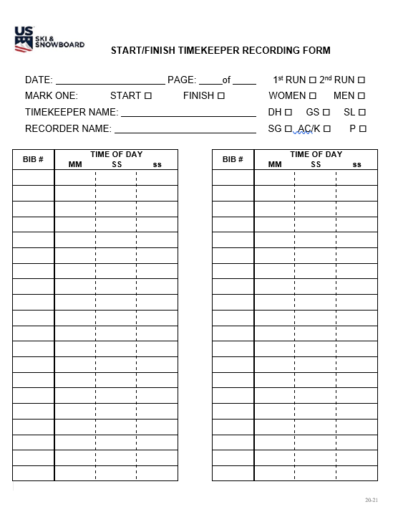
Start/Finish Timekeeper Recording Form
The same form is used by both Start and Finish Manual/Hand Timekeepers / Recorders
Be sure to fill in all information at the top of the form
Important to indicate position: Start or Finish
Form provides a record of an event/starts as they actually occurred
DO NOT PRE-NUMBER FORM!

Slide 25
SUGGESTIONS
Take the time to verify manual devices are still synchronized. A countdown over the radio and a request for the display reading can be done prior to the start. Another option is requesting the manual time for the first forerunner. You will need the manual time for the first athlete, but verification prior to the start of Bib 1 allows time to address any issues.
If electronic systems fail, immediately verify manual times are available for the racer for whom an electronic time is not available. This immediate action will indicate whether or not manual timekeeping has validity so you will either be able to calculate a replacement time or authorize a rerun.
Two suggestions: Neither one will take much effort, but they may be the difference between a race result or a disappointed athlete for whom no time is available.

Slide 26
Replacement Time of Day
(Equivalent Electronic Times - EET)
When the electronic Time of Day is missed on System A (primary system), it will be necessary to calculate a replacement Time of Day from System B (secondary system)
If both the primary and secondary systems fail, you must calculate a replacement Time of Day from the manual/hand timekeeping
A replacement time is a valid time!

Slide 27
REPLACEMENT TIMES
When electronic timing systems fail, calculation of a Replacement Time is required. The purpose of a "Replacement Time (EET)" is to calculate and replace the missing ToD impulse - either start or finish.
The calculation is based on:
  Calculation of a replacement time based on System B Time of Day in lieu of the missing System A electronic Time of Day, or
The calculation is performed by:
  Comparing the 10 Time of Day before the missed electronic Time of Day (If there are not 10 times before, complete the calculation with the remaining times after the missed time.)
  Dividing the sum of the differences by 10 and rounded up or down which supplies the correction value
  Applying correction value to System B Time of Day or manual/hand Time of Day
A replacement time (EET), when required, is an official time and is valid at all levels and types of competition.
FORERUNNER’S TIMES MUST NOT BE USED WHEN CALCULATING A REPLACEMENT TIME!

Slide 28
OTHER TIMING SCENARIOS
If System A times are unavailable for a major portion of the field, System B times must be used for the entire field!
If both System A and System B times are unavailable for a major portion of the field, no correction factor can be calculated, and calculated, and non-adjusted, manual/hand times must be used for the entire field!

Slide 29
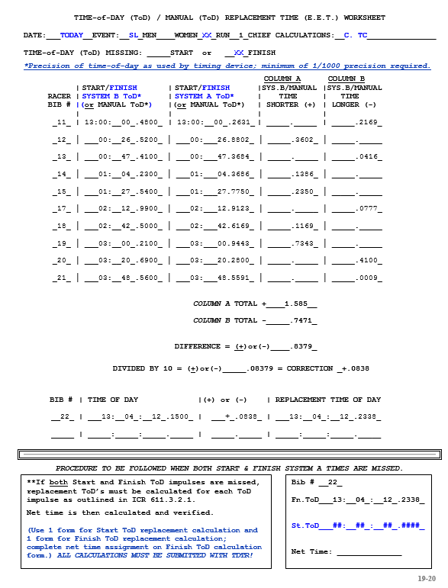
Replacement/Equivalent Electronic Time-of-Day Worksheet:
(Study Guide EET)
If both start and finish impulses are missed, ToD replacements must be calculated for each impulse.

Slide 30
ALTERNATIVE CALCULATION SYSTEMS:
Excel spreadsheet
Excel calculator on FIS website
Race result software
Both Split Second and Vola have options that allow
for calculation of replacement times
HINTS:
      Do NOT use Forerunners’ times
      When times are in close proximity, calculation systems allow for calculation of multiple replacement times
      Systems may require a dedicated computer
      Electronic timekeeping equipment operator should not be responsible for these calculations; Chief of T&C is responsible for this task
      Regardless of the system you prefer, do not wait until race day to learn how to use it!

Slide 31
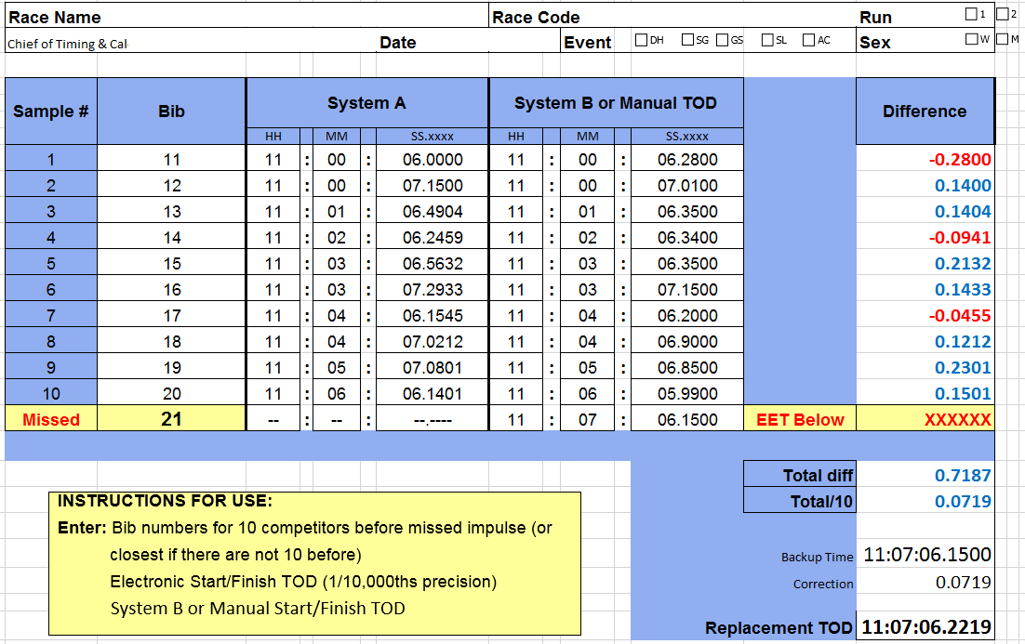
Replacement/Equivalent Electronic Time: Excel
Excel can be used to provide a Replacement (EET) System A Time of Day using either a System B Time of Day or a Manual/Hand Time of Day. (Worksheet available in MPF.)

Slide 32
COMPUTER-GENERATED REPLACEMENT TIMES
Just because a replacement time is calculated by a computer doesn’t mean it is correct. Accuracy of a computer-calculated replacement time must be verified!
Do not wait until the end of a run/race to calculate Replacement Times; calculate them as soon as possible
This would be critical in the event that manual times are inaccurate or incomplete and an accurate Replacement Time cannot be calculated. Waiting until the end of the race/run would deprive the athlete of the opportunity for a rerun.
(In the case of timing system failure(s), a rerun is not considered “provisional.")
Notes:
Suggestion: After discussing this slide, this might be a good place to review the Replacement Time (EET) presentation before continuing with the remainder of this presentation. Alternatively, present all supplemental PowerPoints at the end.

Slide 33
THE POINTS

Slide 34
Seed Points: a numerical indicator of a competitor's individual ranking with all other competitors. Seed Points are used only at scored events.
NOTE: U.S. Ski & Snowboard National Seed Points may only be corrected by U.S., FIS Seed Points may only be corrected by FIS.
Foreign competitors with current FIS inscriptions and without U.S. Points entering non-FIS events are be seeded with their FIS Points. If included in the penalty calculation, their FIS Points are used. Competition Services must be notified when a foreign athlete’s FIS points are used in the calculation of a National penalty.
They must, however, have a U.S. “X” membership.
If these competitors have current U.S. Points, their U.S. Points are used for seeding and required penalty calculation even if their U.S. Points are higher than their FIS Points.

Slide 35
Race Points - a numerical indicator showing the relationship between a competitor and the winner of that specific race; race points are calculated only at scored events.
Penalty - numerical indicator that equalizes competitions of same event, e.g., all Slaloms; a penalty is calculated only at scored events.

Slide 36
What is a “Race Result”?
A racer’s score for a given event is
RACE POINTS
+
PENALTY POINTS
=
RACE RESULT
When a Race Result is equal to current Seed Points, a competitor is skiing their points.
When a Race Result is lower than current Seed Points and averaged with a similar result, a lower seed point value will be earned.
Notes:
Suggestion: After discussing this slide, this might be a good place to review the Race Points & Penalty presentation before continuing with the remainder of this presentation. Alternatively, present all supplemental PowerPoints at the end.

Slide 37
THE BOARDS
&
THE DRAW

Slide 38
Seed and Draw Board - display boards where cards containing competitors’ names, club or team affiliation, and seed points, if applicable, are posted.
Double Draw - simultaneous drawing of the competitor number (the place they hold on the seed board) and the bib number by the Referee(s); a double draw is used only for scored events.

Slide 39
PREPARATION FOR THE DRAW
The starting order is determined by the competitors’ event points. A first group of a maximum of the 15 best competitors present will be drawn. [621.3]
The group may be increased if two or more competitors share the 15th rank.
If in the first 15 competitors, the points difference between one and the following competitor is too great, the Jury will decide the number of competitors who will be drawn in the first group
Adaptive athletes will be seeded in special groups unless their points are more favorable [“Golden Rule” U621.3.1]
In all events, the Jury has the right to change the starting order if they consider the condition of the course warrants it [621.5]

Slide 40
ELECTRONIC BOARDS
Electronic draw/seed boards should have the capability to simultaneously and legibly display the entire competition field.
Simultaneous display of all competitors allows all Team Captains and officials to verify the overall accuracy as well as additions and deletions to the starting order in “real time."
Using race result software to display portions of a competition field is not acceptable.

Slide 41
COMPUTER-GENERATED DRAW
The Jury may allow a computer-generated
draw:
Non-FIS events – at discretion of the Jury
FIS events – signature on entry is acceptance of a computer-generated draw
It is important to remember that computer-generated draws are governed by a random identifier and unless this identifier is changed prior to each draw, results of a Draw involving the same competitors may only have minimal changes.
Only the software writer has the access required to change the random identifier.

Slide 42
Snow Seed - referred to in the rules as a “Start Order in Extraordinary Conditions," is a process whereby 6 competitors are drawn from the last 20% of the field.
- These 6 competitors are shown with an asterisk (*),
- These 6 competitors start prior to start #1 in the
reverse order of their assigned start positions.
- Snow Seed is only valid for DH, GS and SG.
[621.10]
- A snow seed is usually only drawn at scored events.
Snow Seed can be drawn for a non-scored event where start positions are determined by a system other than “age class."

Slide 43
NOT PERMITTED TO START
(NPS)

Slide 44
RECORDING A “NPS” SITUATION:
U.S. and FIS EVENTS
Due to rule(s) violation(s), athlete not permitted to start (NPS)…this could apply to either run of a 2-run event
Athlete’s status is recorded by the Start Referee as “Not Permitted to Start” (NPS); reason must be stated
New Report by Referee form allows entry of required data: Bib/Name/Nation or Club/Notes (Reason)
If old Report by Referee is being used, “NPS” should be clearly noted so it is not confused with “DNS”
Software includes “NPS” designation
Technical Delegate must verify accuracy of Official Results and Penalty posted on U.S./FIS websites

Slide 45
Race Day Scenarios:
The Finish
A racer commits a gate fault
Competitor’s racing speed carries the competitor over the Finish Line
The competitor stops and hikes back over the finish line to complete passage of the missed gate
WHEN WAS THE COMPETITOR’S TIME TAKEN?
WHAT IS THE COMPETITOR’S STATUS?
As a competitor approaches the finish line, a course worker steps in front of the competitor
Competitor’s racing speed carries them over the Finish Line
WHAT IS THE COMPETITOR’S STATUS?
Notes:
611.3.1, 615.3

Slide 46
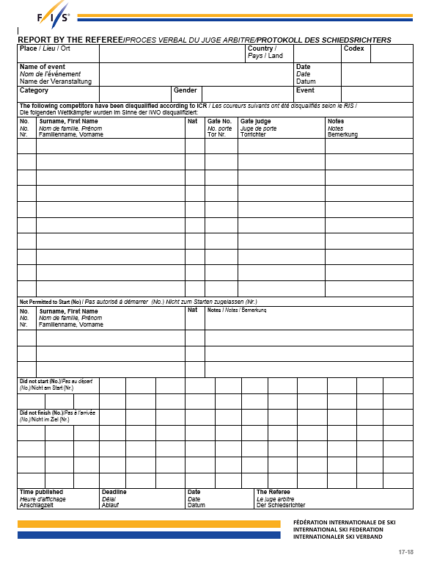
Report by the Referee
Must be completed for each classification gender for each run
Header information should be entered by RA or TC staff
DNS / DNF bib #’s entered by timing crew
DSQ bib #, Name, Nation, Gate #, GJ Name, infraction or rule number entered by RF
NPS bib #, Name, Nation, Notes (reason) entered by RF
Posted on Scoreboard/Official Notice Board with date/time of posting & expiration time
Should be checked by Team Captains regardless of whether or not they feel their competitor(s) may have committed a fault (DSQ)
Announcement of DSQ data can replace actual posting. Procedure must be announced to all Team Captains.
This is the new Report by the Referee form. Older form does not have a separate section for “NPS."

Slide 47
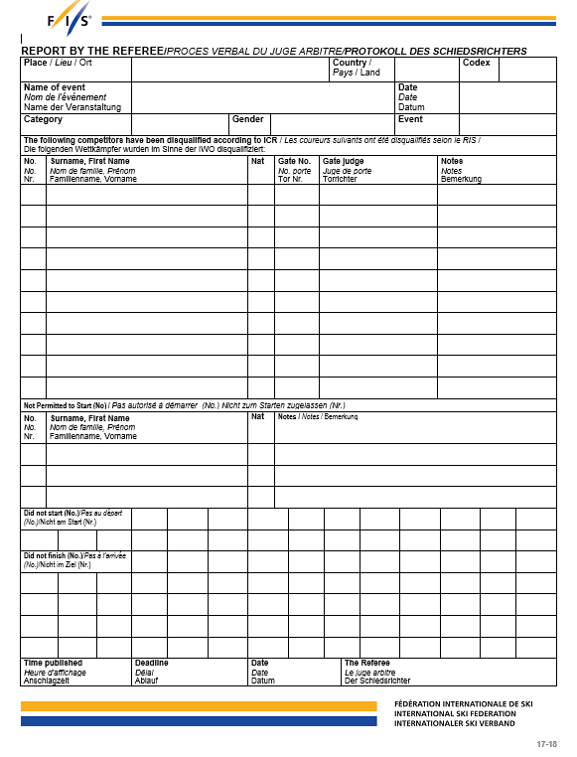
Report by the Referee – must be posted!
Protest period is 15 minutes!
If DSQ information is announced,
protest period begins at time of announcement!
SKI AREA USA ####
YOUR RACE
DATE
LEVEL MEN GS - 2
Online posting is acceptable. If an online platform is being used instead of an actual board or an announcer, the protest period begins at time of posting! Team Captains must be provided with the location of the online platform.
5 McBride, Brett USA 12 J. WILSON STRADDLE
9 Johnson, Walter USA No Helmet Sticker
101
Rules do not specify what procedure is preferred: actual board, announcer, or online platform. Team Captains must be notified which procedure is considered “official”.
2 7 22 34
15:00 15:15 25.12.17 S/REFEREE
Notes:
SIGNATURE

Slide 48
SCORED EVENT:
Tracking 1st Run DNS, NPS, DNF, DSQ athletes in 2nd Run
The U.S. Technical Delegate Report requires documentation of these occurrences, and for events where 1st- run NPS, DNF, DSQ athletes are allowed to start in the 2nd run, this can create a unique challenge
The Chief of Timing & Calculations and the Race Administrator account for all competitors
The Chief of Timing & Calculations should continue recording after all valid 2nd-Run starters have completed their run
Not continuing to record 1st Run NPS, DNS, and DNF competitors will result in incomplete record of the event.
Following procedure is suggested:
1. Start Referee notifies Timing when last valid 2nd-run starter has left
the start, and
2. Chief of Timing & Calculations or assistant makes appropriate
notations in DNS and DNF sections of the Report by the Referee

Slide 49
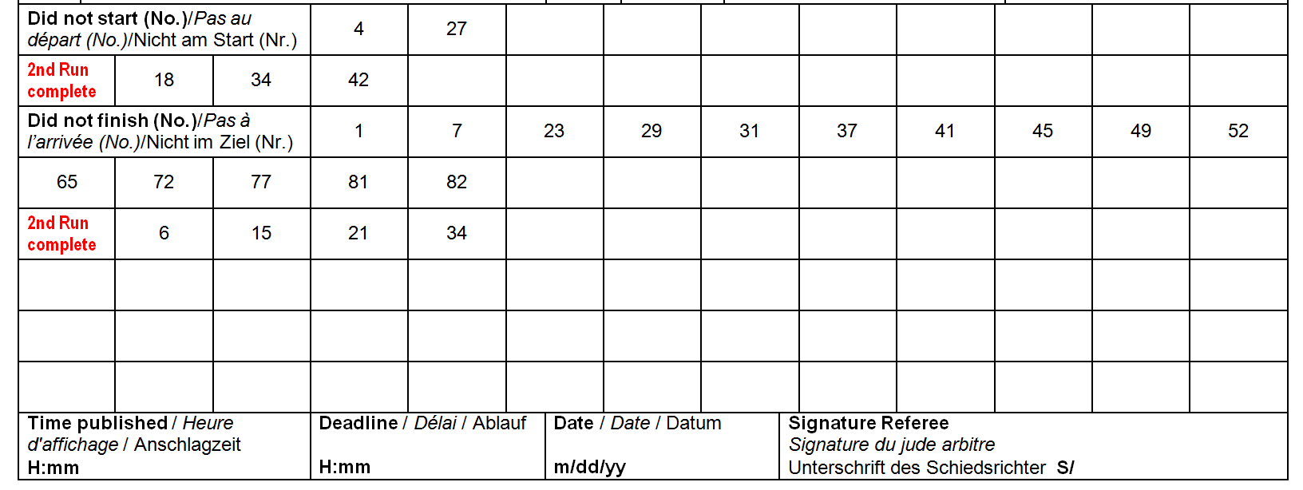
SCORED EVENT:
Tracking 1st Run DNF, DSQ athletes in 2nd Run
The following is only a suggested method. Chief of Timing or assistant may use recording method of their choice; e.g., End 2nd Run, Run 1 Racers, etc.
Report by the Referee will now concisely reflect how many actual 2nd-Run DNS and DNF competitors are to be considered in calculation of “Finishers/Total Ranked on Result."

Slide 50
Miscellaneous Topics
Vertical Drop, Minimum Time and Minimum Penalty in Scoring a U.S. Alpine Race.
1. Races that meet all technical standards:
If all requirements of a competition are met, i.e. vertical drop and minimum time, but
penalty calculates below 40.00, the
minimum penalty of 40.00 will be applied.
This minimum penalty is valid for all events/genders.

Slide 51
2. Races that do not meet vertical drop requirements:
If the minimum vertical drop requirement is not met, but
the minimum time requirement is met,
- greater of the calculated penalty
OR
- the minimum penalty of 60.00 shall be applied.
This minimum penalty is valid for all events/genders.

Slide 52
3. Races that meet neither vertical drop requirements
nor minimum time standards
If the minimum vertical drop requirement and the
minimum time requirement are not met, then
- the greater of the calculated penalty
PLUS
- the additional penalty
OR
- the minimum penalty of 60.00 shall be applied.
NOTE: If the minimum vertical drop requirement is met, the minimum time requirement does not apply.

Slide 53
4. MINIMUM VERTICAL DROP PER RUN,
ALTERNATE MINIMUM TIME STANDARDS AND ADDITIONAL PENALTY:
EVT MIN VD ALT MIN TIME ADD. PENALTY
DH* 400 m 60 sec. combined/max 2 runs 26.00
SL 100 m 50 sec. combined for 2 runs 12.00
GS 200 m 50 sec. combined for 2 runs 17.00
SG 300 m 40 sec. for 1 run 21.00
P 60 m 40 sec combined for 2 runs 10.00
NOTE: DH “combined/max 2 runs” does not eliminate 60-second minimum.

Slide 54
SUGGESTED PROCEDURE: (a/k/a “The Cheat Sheet”)
If an event meets VD: Apply larger of calculated penalty or minimum 40.00
If an event only meets time: Apply larger of calculated penalty or minimum 60.00*
If an event meets neither VD nor time, apply larger of:
- total of calculated penalty + additional penalty
or
- minimum of 60.00*

Slide 55
PENALTY RULES –:
2025 U.S. Ski & Snowboard Alpine Competition Guide
FEWER THAN 10 RACERS FINISH
RACERS IN FIRST 5 HAVE U.S. POINTS IN EXCESS OF EVENT MAXIMUM VALUE
FEWER THAN 5 RACERS FINISH
FEWER THAN 5 RACERS IN FIRST TEN WITH VALID SEED POINTS
TIE FOR 10TH FASTEST TIME / TIE FOR 5TH LOWEST SEED POINTS
PENALTY RULES – FIS: Rules for the FIS Points
FEWER THAN 5 COMPETITORS IN TOP 10 WITH FIS POINTS
HOW MANY HAVE TO BE RANKED
HOW MANY HAVE TO FINISH
TIE FOR 10TH FASTEST TIME / TIE FOR 5TH LOWEST SEED POINTS
For addition information refer to PPT presentation: “RACE POINTS & PENALTY ”

Slide 56
Falls in Finish/Timing Area:
ACR states that a binding release more than 2 gates above the Finish line in SL, GS or SG or
More than 1 gate above the Finish line in DH shall be considered as a clear DSQ
[U628.16, U629.4]
A racer who crosses the finish line after committing a gate fault is DSQ, not DNF (electronic and manual times must be taken)
ONLY THE JURY CAN ASSIGN DSQ STATUS!

Slide 57
COMPETITORS’ START INTERVALS

Slide 58
START CLOCK
&
VERBAL START COMMANDS
U613.4 clarifies the following:
Use of a start clock does not replace the requirement for verbal start commands.
This clarification applies to all U.S. Ski & Snowboard sanctioned events.

Slide 59
REGULAR INTERVAL (Fixed):
DH, GS, and SG competitors leave the start gate at regular/set intervals pre-determined by the Jury
DH Training starts must also be at regular intervals
Intervals apply to all race levels

Slide 60
Start Commands: Regular Intervals
Regular Interval Start Command (DH, SG, GS)
  Starter begins sequence with a warning “10 seconds”
  After a 5 second pause, starter counts down:
  “5, 4 3, 2, 1, Go”
  Racer may start 5 sec before until 5 sec after “Go”
  Failure to start within that 10-second window is an early or late start (false start) and will result in DSQ
Start Referee must record competitor(s) failure to start properly and provide this information to the Jury

Slide 61
MINIMUM INTERVALS
Minimum intervals between consecutive competitor starts in a regular interval event are:
  DH – not less than 40 seconds, includes Downhill
  Training (DHT)
  SG – not less than 40 seconds
  GS – not less than 30 seconds

Slide 62
IRREGULAR INTERVAL (Non-Fixed)
SL competitors leave the start gate at irregular intervals.
Chief of Timing & Calculations or assistant – in agreement with the Jury – tells the Starter when each competitor should start.

Slide 63
START INTERVALS: CHANGES
Start intervals may be longer for the first group in a scored event, and they may also be longer for a pre-determined number of racers at the end of the field. These start intervals, as well as the start intervals for the rest of the field must be published in the race day Program.
The Jury may adjust published start intervals
Force majeure may require changes to start intervals – e.g., events where Start Lists were prepared using random seeding
Team Captains may request that the Start Referee increase the interval between individual competitor’s starts
Depending on circumstances, the Start Referee may skip an interval (or intervals) between individual competitor’s starts; e.g., following the start of a visually impaired Adaptive competitor and their Guide
All changes to start intervals must be communicated via Jury radio, as required; e.g., Jury, timing, Connection Coach(es), course crew, etc.

Slide 64
START COMMAND: Irregular Intervals
Irregular Interval Starts (SL)
  Starter announces “Ready”
  Followed, a few seconds later, by “Go”
  As in regular interval event, racer has 10 seconds to start
  Failure to start within about 10 seconds is a “false start” and results in DSQ

Slide 65
RULES OF THE START
Early/Late Start: In the Gate; DNS within allowed time – disqualified. This applies to all events with regular/fixed start intervals (DH, DHT, SG, GS) as well as to an event with an irregular/non-fixed start interval (SL).
Delayed Start: Not present when called to start – sanction which could include DSQ!

Slide 66
WHY DISQUALIFICATION?
In fixed interval events, course workers know they have a set time frame between competitors
If a competitor leaves the start early or late, this time frame becomes compromised
A compromised time frame = a possible hazard!

Slide 67
EARLY AND LATE STARTS DISQUALIFICATION [613.7]
FOR FIXED INTERVALS STARTING ON THE MINUTE:
CLOCK READS:
10:10:54.9900 = Competitor’s Start / EARLY START?
10:10:55.0000 *
10:10:56.0000 *
10:10:57.0000 *
10:10:58.0000 *
10:10:59.0000 *
10:11:00.0000 * START
10:11:01.0000 *
10:11:02.0000 *
10:11:03.0000 *
10:11:04.0000 *
10:11:05.0000 *
10:11:05.0100 = Competitor’s Start / LATE START?

Slide 68
FIRST RUN
IMPORTANT POINTS

Slide 69
GENERATING A FIRST-RUN START LIST: Double Draw
The Race Administrator is responsible for preparing the Draw/Seed Board. The Chief of Timing & Calculations should attend the Team Captains’ Meeting and review the accuracy of the Draw/Seed Board.
The boards are prepared as follows:
Points used are those that are in effect for the date of the race, not the date of the Team Captains’ Meeting
Draw portion of board is set with names/cards of the 15 lowest point competitors – set in ascending order of points and increased if a tie exists in 15th place
Seed portion of the board is set with names/cards of the remaining competitors – set in ascending order of points
When two or more competitors are tied for points anywhere on the Board:
- For ties in points – National or FIS – all names/cards are alphabetized
- If the group contains foreign competitors, they may be placed first as a courtesy
All ties are marked, brought to the attention of the TD, and their starting positions are drawn.
Although rules state that all competitors without points will be grouped together at the end of the field, if the number without points is too great, the Jury may group them differently. [601.4.6.2, 621.2, 621.3]

Slide 70
Two Sets of Numbers - tags, ping-pong balls, etc., numbered 1 through 19, in case of a tie for 15th position. The first set is for selecting the competitor by drawing their numbered place on the Draw Board. The second set is for selecting the competitor's start position.
Example:
#5 is drawn from 1st set: #1 is drawn from 2nd set:
Competitor in 5th spot on Draw Board - Olson, Matt Starts first
Matt Olson's seed strip removed from 5th spot on Draw Board and placed in 1st spot on Seed Board.
Start Lists for YSL, Age Class, Collegiate, Adaptive, Masters, etc., are prepared according to specific rules relating to type of competition - CHECK CURRENT RULES.
Snow Seed: Downhill, Super G, and Giant Slalom allow for a Start Order in Extraordinary Circumstances – usually bad weather.
This “Snow Seed” is selected by drawing 6 competitors from among the last 20% of the field. These competitors start prior to Start #1, in the reverse order of their assigned start numbers and at the scheduled start time.

Slide 71
GENERATING A FIRST-RUN START LIST: Points to Remember
There are several points that should be reviewed, if required by your event:
Foreign national points, when verified by an official source, e.g., foreign federation’s official points list, are equal to U.S. Ski & Snowboard points for seeding purposes only
Foreign FIS members without valid U.S. Ski & Snowboard Points are seeded with their valid FIS Points at U.S. Ski & Snowboard non-FIS competitions; these points are used in Penalty calculation, if required (IF USED, NOTIFY COMPETITION SERVICES!)
Foreign FIS members with valid U.S. Ski & Snowboard Points are seeded with their U.S. Ski & Snowboard points at U.S. Ski & Snowboard non-FIS competition; these points are used in Penalty calculation, if required.
Check for Special Seeding Rules”
Collegiate (NCAA, USCSA, FIS-U, etc.)
Masters
Continental Cup (Nor-Am Cup)
Golden Rule *for Adaptive Athletes [U621.3.1]
Alternate Seeding Systems (TRS, Turton, etc.)
* Golden Rule seeding is for non-FIS events only; it is not used for FIS events!

Slide 72
WHAT IS THE “GOLDEN RULE”?
The “Golden Rule” is alternative seeding proposed by the late, Adaptive World Champion, Diana Golden. Its intent is to encourage adaptive competitors’ participation in regular-calendared competitions. Adaptive athletes are allowed to compete using the equipment required by their disability.
1st Run: Seeded in special groups (16-20... 36-40... 56-60), or by National Points, whichever is more favorable. (If more than 5 athletes have requested Golden Rule seeding, athletes 1-5 are seeded in group 16-20; athletes 6-10 are seeded in group 36-40, etc.)
2nd Run: Seeded in same special groups or by bibbo, whichever is more favorable. In the case of a “flip-30” 2nd run, the special group starts in the 31st position. In the case of a “flip-15” 2nd run, the special group starts in the 16th/31st, etc., position. Adaptive athletes who have requested special seeding and who are shown as DNS, DNF, DSQ, or NPS in the first run can start in the second run with their original bib immediately after the last qualified competitor has completed his run. It is recommended they be run in bib order. Announcement of this procedure should be made at the team captains’ meeting.
The “Golden Rule” is not valid for FIS events!

Slide 73
WHAT IS TRS a/k/a “BUTTERFLY”?
TRS or “totally random sort” is used for some non-scored and scored events and is actually based on the first initial of the last name of the 3 individuals who developed it. There are many variations of a TRS system; this is an example of one:
Start Lists are prepared as follows:
First event/run: start order is randomly drawn within each gender, class or group, e.g., Year-of-Birth
Second event/run (may be the same day or the following day): start order of first event/run is reversed within each gender, class or group
Third event/run (may be the same day or the following day): begins with the second half of the first event/run order in each gender, class or group, and continues with the second half of the first event/run order in each gender, class or group
Fourth race (may be the same day or the following day): the start order for the third event/run is reversed within each gender, class or group
NOTE: NPS/DNS/DNF/DSQ competitors start subsequent events/runs in their actual start positions.
Example:
Event/Run 1= 1,2,3,4,5,6,7,8,9,10
Event/Run 2= 10,9,8,7,6,5,4,3,2,1
Event/Run 3= 6,7,8,9,10,1,2,3,4,5
Event/Run 4= 5,4,3,2,1,10,9,8,7,6
Notes:
This slide is included for general information. If region/division does not use TRS (Butterfly), please skip.

Slide 74
MORE ABOUT THE “BUTTERFLY”?
INSERTIONS FOR SECOND DAY OF A MULTI-DAY SCORED OR NON-SCORED EVENT (Run 3)
When new athletes need to be inserted in an existing seed, the following procedure shall be followed:
New athletes will be inserted after the racer whose position is 1/2 of the start order for Run 3
The list will be expanded to include all new entries to the first half of the list
The second half of the draw will remain the same
Example: Group is 10 athletes; 3 new athletes will be added at positions 11, 12, and 13.
Event/Run 3= 6,7,8,9,10, 11, 12, 13, 1,2,3,4,5
Event/Run 4= 5,4,3,2,1,13, 12, 11, 10,9,8,7,6
NOTE: If required from an athletic standpoint, Team Captains may request that the Start Referee increase the interval prior to an individual athlete’s start.
(The Start Referee must announce any start interval changes over the Jury
radio channel.)
Notes:
This slide is included for general information; skip if not pertinent to your division.

Slide 75
MORE ABOUT THE “BUTTERFLY”
In events using TRS (Butterfly) seeding, athletes who have requested Golden Rule Seeding will be seeded 16th+ in all runs or races of the same series unless original start list preparation/flip/butterfly affords them a more favorable (earlier) start position.
Not all Regions/Divisions use the TRS Butterfly system
Please verify and understand the Alternate Seeding System used in your Region/Division
Notes:
This slide is included for general information.

Slide 76
INSERTING A COMPETITOR
In the event a competitor must be inserted in the event after a Start List has been generated:
Notify the Technical Delegate/Jury of the situation and request approval for insertion
Upon approval, insert competitor in accordance with Jury instructions (generally earned seed points; if in first seed may be placed 16th)
If bibs have already been distributed, assign an out-of-sequence bib number, assign correct start number, and adjust subsequent start numbers as required
Notify timing personnel of insertion and provide them with an updated race file.
Prepare “Corrected Start List” and distribute – at a minimum – to Jury, Start, Finish, and Timing officials
Example: Competitor inserted at start position 40 wearing bib 101. Competitor wearing bib 40 will now be starting 41, etc. Software’s tie-breaking capability is governed by start number; assigning a start number of 39A or 40A may eliminate that function.

Slide 77
ADDING A COMPETITOR - SPLITSECOND:
Start Number versus Bib Number
SplitSecond breaks a tie in time by defaulting to an athlete’s actual “start number”
Inserting an athlete after the first group and assigning 15A will affect SplitSecond’s tie breaking capability
SplitSecond will not accept the start number + alpha character, so an out-of-sequence bib should be assigned and start numbers must be adjusted (This will result in an offset between Bib and Start Number for the rest of the field.)
617.3.3 If two or more competitors have the same time or the same number of points, the competitor with the higher start number must be listed first on the official list of results.

Slide 78
ADDING A COMPETITOR - VOLA:
Start Number versus Bib Number
Assigning an out-of-sequence high value bib number to replace a missing bib: e.g., Start 16 will wear Bib 106 will affect VOLA’s tie breaking capability should a tie in time occur.
For Example:
Start 16 Bib 106 1:52.06
Start 20 Bib 20 1:52.06
VOLA will default to the Bib number and will rank Bib 106 before Bib 20 regardless of the earlier start by Bib 106.
617.3.3 If two or more competitors have the same time or the same number of points, the competitor with the higher start number must be listed first on the official list of results.
VOLA interprets “start number” as “bib number”.

Slide 79
CRITICAL NOTE WHEN IMPORTING A COMPETITORS’ TIMES
The event data is being managed with SplitSecond, but your Chief of Timing & Calculations is timing with VOLA:
it is possible to transfer data between the systems
it is recommended that only bib #’s and times be imported from VOLA timing to SplitSecond data
If athletes’ names are imported, please verify that any athletes who have double last names: e.g., “VAN HORN, Eric”
transfer back from VOLA in the original format: VAN HORN, Eric and
not VAN, HORN Eric
The misplaced comma will result in FIS and U.S. Ski & Snowboard autoscore systems rejecting the XML file.

Slide 80
SECOND RUN
START ORDERS

Slide 81
SECOND RUN START ORDER
For all scored events, racers who successfully complete the 1st Run are ranked according to their 1st Run Official Time
A pre-determined number of racers is then reversed (flipped): 30 or 15 – this is a “bibbo” – for the 2nd Run start order
- 30 is standard
- Jury may limit to 15 but must announce change 1 hour prior to start of 1st Run)
Non-FIS scored events: 1st Run DNS, NPS, DNF and DSQ racers may be allowed to take a 2nd Run at the end of the 2nd Run field
FIS events: Unless the Jury has allowed a “provisional 2nd-Run start," only racers who successfully complete the 1st Run may start in the 2nd Run
Special rules for 2nd Run Start Order apply for
  U.S. non-scored & scored events using an Alternate Seeding System
  Bibbo with a tie at the pre-determined flip position
  Collegiate events
  “Golden Rule” for adaptive athletes in non-FIS events

Slide 82
BREAKING TIES & CREATING LIST:
Rank all competitors by first run time
Remove DSQ’s unless being granted a provisional 2nd run start
Break all ties by ranking higher start number before lower start number (rationale is higher starter had to have had a cleaner run in order to earn equal time)
Look for ties at flip position (15 or 30)
Include the ties and flip the competitors; e.g., if there is a 2-way tie at the flip position, you will flip 16 or 31; if there is a three-way tie at the flip position, you will flip 17 or 32, etc.

Slide 83
Race-day Scenario – FLIP 30 is Standard
Pl Bib
1 3
2 4
3 15
4 10
5 11
6 1
7 2
8 17
9 5
10 6
11 9
12 7
13 8
14 30
15T 25
15T 19
St Bib
1 19
2 25
30
8
7
9
6
5
17
2
1
11
10
15
4
3
Flip 15 instead of 30
First run tie at flip position.
What do we do?

Slide 84
LIMITATIONS IN SECOND RUN: SL & GS
In U.S. Ski & Snowboard collegiate SL and GS events, the Jury has the right to reduce the number of competitors in the second run to half on the first run start list, provided that notice was given in the invitation, and at the Team Captains’ Meeting before the Draw. [806.2, 906.2]
For FIS Slalom and Giant Slalom events, the Jury has the right to reduce the number of competitors in the second run to half on the first run start list. Decision has to be made (and announced), no later than one hour before the start of the first run. [806.2, 906.2]
Notes:
Consider leading class through 2nd Run Start List exercise from Study Guide

Slide 85
HOW TO PERFORM CALCULATIONS Race Points & Penalty
Replacement Times
How To Prepare A TDTR
Notes:
This is the suggested point for inserting available TC PowerPoints that have not already been viewed: “Race Points & Penalty”; “Replacement Times”; “Preparing a TDTR”

Slide 86

CONTINUING EDUCATION UPDATE
SEASON 2025
U.S. Ski & Snowboard
NON-FIS EVENTS

Slide 87
MEMBERSHIP
All coaches, including part-time coaches and coaches for U12 and younger athletes, must be Coach members of U.S. Ski & Snowboard.
Avalanche Training and Coaching Fundamentals is moving to Sport Education and will be required only for Coach and Junior Coach members.
Athletes who will turn 18 during the competition season must create their own U.S. Ski & Snowboard Membership Account.
Junior Coaches must create their own U.S. Ski & Snowboard Membership Account.
Pursuit of coach certification is required for all coach members, and starting Season 2026, an “active” coach certification will be required in order to register for a U.S. Ski & Snowboard sanctioned competition and be granted race arena/venue access.
For their first season, new coaches who have never been certified, being "in progress" towards their Level 100 certification will meet this requirement.
For additional details, contact sporteducation@usskiandsnowboard.org.
NOTE: Beginning Season 2026, Alpine Officials’ Referee Certification may be required for all Level 200 coaches.

Slide 88
MEMBERSHIP
The Sport Education Academy (SEA) will offer modules for safety training for Alpine Officials.
Access to the training is through the Bronze Tier which does not require a SEA registration fee.
Training topics include Avalanche, Heads Up Concussion Training, First Aid, CPR, and DEI.
This training is only a “recommendation” and is not required in order for an Alpine Official to officiate or be granted race arena/venue access as required by their official duties at any U.S. Ski & Snowboard event.
Completion of the modules, however, is required for Level 100 Coaches.
For additional details, contact: sporteducation@usskiandsnowboard.org.

Slide 89
MEMBERSHIP
Race Administrators must verify that coaches’ membership status; e.g., SafeSport Training and background screening is valid (not pending).
The Race Administrator must also verify the coaches’ non-presence on the Central Disciplinary List.
These verifications are required prior to granting event credentials and race arena/venue access.
Required certification and continuing education (last clinic: Season 2024 or Season 2025) must be current for: Chief of Race, Referee, Assistant Referee, Start Referee, Finish Referee, Course Setters, Chief of Course, and Chief of Timing & Calculations.
Required certification and continuing education (last clinic: Season 2025) must be current for: Technical Delegate and Race Administrator.

Slide 90
FORERUNNERS
U.S. Ski & Snowboard event: Forerunners must hold a current U.S. Ski & Snowboard membership:
- Competitor
- Coach
- Official
- Volunteer
- Master w/Requirements
- Non-Scored Athlete
- Short-Term Athlete
- General
NOTE: Coach, Official, and Volunteer memberships may be accepted in order for an individual to serve as a forerunner. Coaches must take note, however, that forerunning may not be included in the duties outlined in their club employment contract. In addition, regardless of the type of membership, an event’s equipment regulations apply to all forerunners.

Slide 91
FORERUNNERS
FIS events:
Must hold a current U.S. Ski & Snowboard membership
Must hold a current FIS inscription or
Must hold a current membership in a foreign federation recognized by FIS.
In cases of force majeure, where a sufficient number of FIS-inscribed forerunners are not available, an eligible U.S. Ski & Snowboard member may forerun after signing a FIS Athlete’s Declaration. [605.1]
NOTE: FIS Athlete Declaration requires a parent or legal guardian’s signature for an athlete who is not of legal age.

Slide 92
FORERUNNERS
Adult Forerunners – Minor Participants:
Adult (18+) forerunners at events that include minor participants (U18 and younger) are required to be in good standing with a membership that includes SafeSport training and background screening.
The “Alpine Master” and “Short-Term Alpine Master” memberships do not meet this requirement and are not allowed.
Masters Events:
U18 and younger forerunners, including those with General and Short-Term Memberships, at Masters events where competitors may have the “Master” or “Short-Term Alpine Master” memberships that do not include SafeSport Training and background screening must be accompanied by:
- a parent or legal guardian or
- at least two (2) U.S. Ski & Snowboard members with a membership that includes SafeSport training and background screening
(e.g., Coach w/Official, Official, Volunteer, Masters w/requirements).
As with all U18 and younger events, if U18 athletes will be forerunning a Masters event, a communication pertaining to athlete safety policies must be sent to all participants, and the QR code must be posted at the registration area.

Slide 93
LIST OF APPROVED FORERUNNERS
Race Administrator is responsible for verifying Forerunners’ requirements, e.g.:
- membership status: applicable, current, or pending
- within athlete’s vertical drop allowance
- non-presence on Centralized Disciplinary List
A list of approved Forerunners must be provided for the Start Referee – one is generally available on footer of the Start List
Critical if a Condensed Start List is being generated and names of all approved Forerunners are not listed
Critical if the race result software does not provide enough space to list the names of all approved Forerunners
Officials must not allow any individual to start either as a Competitor or a Forerunner if prior approval has not been obtained.

Slide 94
JURY COMPOSITION
U601.4.2.3: The Jury should, where possible, include one person of a different gender.
TIMING
U611.2.1: For all events sanctioned by U.S. Ski & Snowboard, two synchronized electronically isolated systems operating in time-of-day must be used. (All other sections of U611.2.1 remain in effect.)
U611.2.2: Printed records, either automatic, handwritten, or memorized electronically of recorded hand times must be immediately available at the start and at the finish.
MASTERS SUPER G
2-run Super G has been approved for Masters events calendared in the Central Division only.

Slide 95
RANDOM SEEDING – TRS (BUTTERFLY) - UPDATE & CLARIFICATION
TRS (Butterfly) seeding has been approved for scored and non-scored, multi-day races. The approved system is as follows:
Day 1/Run 1: Randomize athletes within gender/age group to create the initial start list.
Run 2: Reverse (flip) Run 1 start order.
Day 2/Run 3: Divide each group by two and move bottom group to top of start order. (Example: 6, 7, 8, 9, 10, 1, 2, 3, 4, 5.)
Run 4: Reverse (flip) Run 3 start order.
NOTES:
DNS, DNF, or DSQ athletes stay in their original position for all runs. (They are not moved to the end of class/field.)
Age Groups are typically started in order of youngest to oldest.
If one of the events is speed (Downhill or Super G), a new randomization is typically done.
If required from an athletic standpoint, Team Captains may request that the Start Referee increase the interval prior to an individual athlete’s start. (Start Referee must announce any start interval changes over the Jury radio channel.)

Slide 96
INSERTIONS FOR SECOND DAY OF A MULTI-DAY SCORED OR NON-SCORED EVENT (Run 3)
When new athletes need to be inserted in an existing seed, the following procedure shall be followed:
New athletes will be inserted after the racer whose position is 1/2 of the start order for Run 3.
The list will be expanded to include all new entries to the first half of the list.
The second half of the draw will remain the same.
Example:
Field is 20 athletes
3 new athletes are entered
New athletes are positioned after the first group of ten: Positions 11, 12, and 13.

Slide 97
GOLDEN RULE - UPDATE & CLARIFICATION
Events using TRS (Butterfly) Seeding:
Athletes who have been granted Golden Rule Seeding will be seeded 16th+ in all runs or races of the same series unless original start list preparation/flip/butterfly affords them a more favorable (earlier) start position.
Events not using TRS (Butterfly) Seeding:
For all events, First Run U621.3.1: Adaptive athletes will be seeded in special groups with start order: 16-20, 36-40, 56-60, etc., or by seed points, whichever is more favorable. (Placement within groups is by national point ranking.)
Second Run with Flip 30 U621.11.3.2: Adaptive athlete groups will start in the 31st position unless first-run time affords a more favorable (earlier) start position. (Placement within groups will be by the results of the first run.)
Second Run with Flip 15: Adaptive athlete groups will start in the 16th position unless first-run time affords a more favorable (earlier) start position. (Placement within groups will be by the results of the first run.)
Adaptive athletes who are shown as DNS, DNF, DSQ, or NPS in the first run can start in the second run with their original bib immediately after the last qualified competitor has completed their run.

Slide 98
GOLDEN RULE: ALL EVENTS
Athletes who have been granted Golden Rule seeding may compete using the equipment appropriate to their disability.
Adaptive athletes who are visually impaired will be accompanied by a guide.
- The guide provides verbal instructions to the athlete
- The guide is accorded the same consideration as the athlete
Start Referee should skip a minimum of one start interval following the start of a visually impaired athlete and their guide.

Slide 99
TIMING & DATA TECHNICAL REPORT (TDTR) –
UPDATE & CLARIFICATION
A Timing Data Technical Report (TDTR) is required for all levels of competition.
FIS TDTR software is used for preparing and submitting the report for all events, both non-FIS and FIS. Software is available for Windows 10, 11, and macOS 10.14+; it is updated as required.
The Chief of Timing & Calculations – not the Race Administrator or other official – is responsible for the preparation and filing of the Timing & Data Technical Report (TDTR) for all events.
PDF copy must still be printed and signed as noted in instructions for preparing event document packets located in the Master Packet of Forms (MPF)
If an event requires calculation of a replacement time (EET), copies of all calculations must be included in the PDF “Event Document Packet.”
The calculations must also be included with the XML copy of the TDTR submitted to: tdtr@usskiandsnowbord.org.
(U.S. TDTR in the MPF is only intended for gathering data for entry into the FIS TDTR software.)

Slide 100
KOMBI - UDPATE & CLARIFICATION
U1259 and the course setting matrix will be expanded to include specifications for GS/SG Kombi. Please refer to current Alpine Competition Guide for complete details.
Kombi events must be set using appropriately homologated/approved hills.
Hills homologated/approved for Giant Slalom may be used for Slalom/Giant Slalom Kombi as well as Giant Slalom/Super G Kombi.
With the exception of specific rules applying to course setting, rules are those that apply to the faster portion of the event: e.g., Slalom/Giant Slalom events are governed by Giant Slalom rules. Giant Slalom/Super G events are governed by Super G rules; e.g., Start commands and start intervals.
U1259.10 clarifies in Kombi competitions, athletes must use the helmets designed for Giant Slalom, Super G, or Downhill. Athletes U14 and older must use helmets that meet the FIS standards.

Slide 101
WAIVED ENTRY/LIFT FEES
The following are entitled to waiver of entry and lift fees at all U.S. Ski & Snowboard events. No head tax will be due for these athletes.
U.S. Ski Team (A, B, C, or D)
U.S. Paralympic National Alpine Skiing Team (A, B, C, or D)
The following should be provided with complimentary entries and lifts. No head tax will be due for these athletes:
Named members of foreign national teams:
- who are properly entered by their national federations and
- who are ranked 200 or better in the world in one of the events being
contested
At pre-determined events (e.g., Nor-Am and U.S. Alpine National Championships), or at the discretion of the OC for other events, regardless of national affiliation or national team status,
Athletes who are ranked 100 or better in the world in one of the events being contested should be provided with complimentary entries and lifts. If applicable to the level of event, head tax will not be due for these athletes.

Slide 102
NAC ONLY:
Named members of foreign national teams who are ranked 350 or better in the world in one of the events being contested are entitled to complimentary entries and lifts.
Regardless of their national team status, foreign athletes enrolled in North American schools, clubs, or universities will be entitled to complimentary entries and lifts if they are ranked 100 or better in the world in one of the events being contested.
(NAC 2.4.2) Previous season’s Continental Cup event winners are also entitled to complimentary entries and lifts. (NAC 2.4.2.1)
NOTE: Some organizers may not be able to provide complimentary lift tickets as they are passing along costs from the host resort.

Slide 103
TWO EVENTS / SAME DAY
U202.2:
A maximum of two scored SL, GS, SG, or DH races per day, per gender, may be calendared per day by an organizer.
U202.2.1:
In cases where more than one SL or GS race, per gender, is conducted in one day and in one place, then the official Program must show the following for both races:
inspection times,
start times,
course reset/redress times and
start intervals

Slide 104
EVENT REGISTRATION and HEAD TAX CALCULATION, VERIFICATION, and PAYMENT
U.S. Ski & Snowboard does not provide an online Event Registration platform.
Race Organizers are encouraged to use systems currently being provided by private vendors; (e. g., skireg.com or adminskiracing.com).
Regardless of whether or not the registration system of choice calculates and submits required Head Tax, the Organizing Committee is responsible for calculation, verification, and payment of all National, Regional, and Divisional Head Taxes.
If the registration system of choice does not calculate and submit required Head Tax, the calculation forms and required payments must be submitted to Competition Services; copies should be retained in the Organizing Committee’s event file.
If the system does calculate and submit the required Head tax, the calculation forms should be retained in the Organizing Committee’s event file.
Applicable head taxes must be submitted in a timely manner. Organizers who fail to submit head taxes risk loss of Club Certification and the ability to host other competitions until coming into compliance.

Slide 105
FIS EVENT ENTRY AUTHORIZATION LETTERS (TRAVEL LETTERS)
Only National Ski Associations (Federations) are entitled to make entries for international competitions.
Some foreign federations may issue an entry authorization (travel) letter which allows foreign athletes training with U.S. Ski & Snowboard clubs or attending USA schools/colleges/universities to be entered by their coaches.
Several nations, e.g., Austria, Canada, Great Britain, and Spain currently do not issue authorization (travel) letters; entries for competitors from these nations must originate from the respective Federation; cover email should be retained in the Organizing Committee’s event file.
Entries submitted by a foreign Federation must list the names of all personnel accompanying the athlete(s) and for whom race arena/venue access is requested; e.g., coach, trainer, ski technician, etc.

Slide 106
Due to issues controlling the entry of some non-USA athletes into USA FIS events, U.S. Ski & Snowboard adopted the following policy regarding entry authorization (travel) letters.
  U.S. Ski & Snowboard will only manage authorization letters for foreign athletes who are also competitor members of U.S. Ski & Snowboard.
  Authorization letter must be sent to U.S. Ski & Snowboard: chip.knight@usskiandsnowboard.org
  Authorization letter must also be sent to the Regional Manager for the Region where the athlete is training.
Authorization letters must be submitted directly by the respective National Ski Association.
A list of U.S. Ski & Snowboard foreign athlete members (X membership) for whom authorization letters have been received is available at usskiandsnowboard.org/competition/points/alpine-points.
This site will provide a link to the google doc which is updated as information is received.

Slide 107
U.S. Ski & Snowboard’s policy regarding entry authorization (travel) letters for foreign athletes who are not competitor members of U.S. Ski & Snowboard is as follows:
Authorization letter provided by the foreign federation allowing a club/school/university coach to enter an athlete must accompany the official FIS entry.
Official FIS entry must include the names of all personnel accompanying the athlete(s) and for whom race arena/venue access is requested; e.g., coach, trainer, ski technician, etc.
Authorization letter must be accompanied by the cover letter from the foreign Federation.
Accuracy of the following information in the authorization letter must be verified.
Date of letter
Name, gender, nation, FIS inscription code for athlete
Date of applicable season
Authorization letters will only be recognized for FIS category and below.
Entries for World Cup, Nor-Am Cup, and National Championships must be submitted directly by the respective National Ski Associations.

Slide 108
NOTES:
Foreign entries not submitted by actual National Ski Association and for whom no authorization letter has been submitted to U.S. Ski & Snowboard must not be accepted.
There is a possibility that small groups of foreign athletes may be training in North America and may seek entry into U.S. Ski & Snowboard FIS events.
These athletes will be represented by coaches from their National Ski Associations and,
because they are not members of U.S. Ski & Snowboard and training with USA clubs/schools/colleges/universities,
authorization letters will not be on file with U.S. Ski & Snowboard.
Contact U.S. Ski & Snowboard Competition Services prior to refusing any FIS entry.

Slide 109
RESULT PROCESSING – XML FILE and
EVENT DOCUMENT PACKETS
Individual event XML race result files are uploaded at: race-results.usskiandsnowboard.org/.
Following successful uploading of the XML race result file, if the PDF “Event Document Packet” has been completed, it may be uploaded during the same access window as the corresponding XML race result file.
If the PDF “Event Document Packet” is:
- not completed until after the XML race result file is uploaded, or
- you are unable to successfully utilize the upload function,
the PDF “Event Document Packet” must be emailed to: resultpackets@ussa.org.
The U.S. Ski & Snowboard transmittal number must be used as the email’s subject.
PLEASE NOTE: Login for clubs hosting sanctioned events or a previously-approved login for individuals who do not have access to the club login will be required in order to access the upload platform. If an official is unable to log in, contact Competition Services for assistance.

Slide 110
ALPINE OFFICIALS’ CERTIFICATION MATRIX CHANGES
Technical Delegate: In addition to other requirements, in order to advance from Level 2 to Level 3:
a minimum of one of the required work days should be outside of Division/Region
or at an event assigned by the respective Alpine Officials Chair.
Recommendations for advancement must be submitted from two Level 4 or FIS Technical Delegates.
Submitted recommendations for advancement must be current: Technical events should be within two (2) seasons of submittal; Speed events should be within three (3) seasons of submittal.
Race Administrator: In addition to other requirements, recommendations for advancement from Level 1 to Level 2 must be submitted by two (2):
higher level Race Administrators,
Level 3 or Level 4 Technical Delegates,
or FIS Technical Delegates.
Referee: There has been no change for the requirement that a minimum of one (1) shadow assignment must be successfully completed under the supervision of a U.S. Ski & Snowboard Level 3 Alpine RF or TD (minimum Level 2 RF/TD), or FIS TD. AO recommendation forms must be submitted to the respective Divisional AO chair in order to verify fulfillment of this requirement.

Slide 111
START NUMBER or BIB NUMBER
617.3.3 If two or more competitors have the same time or the same number of points, the competitor with the higher start number must be listed first on the official list of results.
SplitSecond breaks a tie in time by defaulting to an athlete’s actual “start number.”
VOLA interprets the “start number” to be the “bib number” and breaks a tie in time by defaulting to an athlete’s actual “bib number.”
Refer to these defaults when inserting an athlete in a start order or assigning an out-of-sequence bib:
SplitSecond: inserting an athlete after the first group and assigning 15A will affect SplitSecond's tie breaking capability because SplitSecond will not accept the start number + alpha character.
VOLA: assigning an out-of-sequence high value bib number to replace a missing bib; e.g., Start 6 wearing Bib 106 will affect VOLA’s tie breaking capability should a tie in time occur, for example, between Start 6 Bib 106 and Start 20 Bib 20; (Bib 106 will be ranked before Bib 20 regardless of the earlier start.)

Slide 112
CONTINUING EDUCATION UPDATE
SEASON 2025
FIS EVENTS

Slide 113
COMPOSITION OF THE JURY
ICR 601.4.1.4: The Jury must include at least one person of a different gender (applicable at OWG and WSC).
ICR 601.4.2.3: For international races, the Jury should include one person of a different gender.
TIMING
ICR 611.2.2: Printed records, either automatic, handwritten, or memorized electronically of recorded hand times must be immediately available at the start and at the finish.
If an event requires calculation of a Replacement Time (EET), copies of all calculations must be submitted as an attachment to the Timing & Data Technical Report (TDTR).

Slide 114
FIS REPORTS: TD Report and Injury Report (ISS)
FIS Alpine events require that the Report of the Technical Delegate be filed online. The FIS Injury Report (ISS) has been incorporated into the online report, so paper copy filing of this document is no longer required for most FIS events.
A paper copy of the FIS Report of the Technical Delegate will be required for:
FIS Masters
FIS PARA
FIS Children
Some canceled FIS events (as requested by FIS)
A paper copy of FIS Injury Report (ISS) is also required If an injury occurs at any of the following:
FIS Masters
FIS PARA
FIS Children
FIS Alpine event that is terminated or canceled (e.g., Downhill event canceled, but an injury occurred in DH Training). There is no result XML file submitted for terminated or canceled events, so an online Report of the Technical Delegate incorporating the FIS Injury Report (ISS) is not available.

Slide 115
If the previous documents* are required, using the FIS-assigned codex number as the email subject, please submit in scanned/PDF format to:
flere@fis-ski.com
jeff.weinman@usskiandsnowboard.com
NOTE: Additional documents (e.g., Jury Minutes, etc.), may also need to be submitted.
(* Forms are available in the MPF – Additional FIS Documents.)
NOTE: FIS Technical Delegates, regardless of their national affiliation, are only responsible for the accuracy and submittal of FIS documents.
The accuracy and submittal of any additional documentation required by the NGB, e.g., Results/Penalty based on National Points, U.S. First Report of Injury, etc., are the sole responsibility of the Race Administrator and/or the Organizing Committee.

Slide 116
CARRY or WEAR START NUMBERS (BIBS) [614.3.2]
Discussion at FIS meetings resulted in the following clarification:
“Carry” means the athletes only need to have the bibs with them;
there is no need for the athletes to wear the bibs during course inspection.
This interpretation is also valid for non-FIS events.

Slide 117
GENERAL REVIEW
CLARIFICATIONS
RULES AND PROCEDURES

Slide 118
MINOR ATHLETE ABUSE PREVENTION POLICY (MAAPP)
SAFESPORT CODE
MAAPP should be implemented alongside the SafeSport Code.
Administration applies – but is not limited to – events, participation requirements, membership requirements, officials’ certification and continuing education, race arena access, volunteers, etc.
In order to ensure compliance, all requirements must be continually monitored and completed for same-day participants, and they must be informed of the provisions of MAAPP and the SafeSport Code.
Required distribution can be accomplished by posting a QR code which, when scanned, provides required information.

Slide 119
The responsibility for communication and enforcement of MAAPP and SafeSport policies is the responsibility of the Local Organizing Committee (LOC) as well as other individuals and entities as set out in the Competition Administration Summary, the MAAPP, and the SafeSport Code.
Administration of MAAPP and the SafeSport Code applies – but is not limited to – events, participation requirements, membership requirements, officials’ certification and continuing education requirements, race arena access, volunteers, etc.
In order to ensure compliance, all requirements must be continually monitored and completed for same-day participants, and they must be informed of the provisions of MAAPP and the SafeSport Code. This can be accomplished by posting a QR code which, when scanned, provides required information.
At least one non-FIS competition will be audited by the Center for SafeSport during the 2025 season. U.S. Ski & Snowboard may receive only minimal advance notice of the audit, so it is imperative that organizers know, understand, and follow the MAAPP and SafeSport documentation available on the U.S. Ski & Snowboard website.
Please refer to links posted on the U.S. Ski & Snowboard website for access to current information and links:
usskiandsnowboard.org/safesport-athlete-safety/safesport-resources

Slide 120
RACE ARENA vs RACE VENUE
The Jury is responsible for technical matters within the closed competition areas. [601.4] The closed competition areas are defined as the “race arena” which is accepted as being those areas which the Jury inspects and accepts as being suitable for competitors’ presence:
within (the side-to-side fencing) and
without (start area and finish arena) the confines of the competition area and
any location connected with the competition [223.2.1]
The Jury does inspect and accept:
the start and finish areas as well as the ingress and egress to these areas
the racecourse
the type and placement of the on-hill competitor security
the ingress and egress to areas where media meets with athletes, coaches (upper-level events)
The Jury does not inspect or accept:
lift areas
parking lots
cafeterias
terrain parks, public trails, team meeting rooms, etc.

Slide 121
Please Note:
In addition to stating for “actions within and without the competition area,”
sanctions can be applied and
a penalty can be imposed
223.2.1 includes “conduct within “any location connected with the competition.”
These locations include, but are not limited to the following areas that are required for the orderly conduct of an event:
Team Captains’ Meetings,
Jury meeting areas,
timing building,
equipment control area
Neither the “closed competition areas” (within or without the fencing) nor “any location connected with the competition” include lift lines, cafeterias, or parking lots, etc.

Slide 122
SPLITSECOND / VOLA INTERFACE
If the event data is being managed with SplitSecond, but your Chief of Timing & Calculations is timing with VOLA:
It is possible to transfer data between the systems.
Itis recommended that only bib #’s and times be imported from VOLA timing to SplitSecond data.
If athletes’ names are imported, please verify that any athletes who have double last names:
- e.g., “VAN HORN, Eric” transfer back from VOLA in the original format: VAN HORN, Eric not VAN, HORN Eric.
The misplaced comma will result in FIS and U.S. Ski & Snowboard autoscore systems rejecting the XML file.

Slide 123
U.S. SKI & SNOWBOARD FIRST REPORT OF ACCIDENT
Lockton Companies is the insurance carrier for U.S. Ski & Snowboard; the actual insurers are SiriusPoint America Insurance Company and Zurich.
All injury reporting forms and procedures can be found at usskiandsnowboard.org/sport-development/club-development/club-insurance under Participant Accident.
Online filing is preferred, and a copy of the completed First Report of Accident can be printed for inclusion in the required PDF Event Document Packet.
If online filing is not an option, the site also includes a 2-page First Report of Accident in PDF format. (The First Report of Accident in PDF fill-in format is available in the Master Packet of Forms).
The PDF First Report of Accident requires a name and contact information for the “Technical Director.” Please note this information should be for an individual who is on site and who has access to all injury-related documents; e.g., OC Representative or Chief of Race.
If a First Report of Accident is required for named U.S. Ski Team members, it will be filed by U.S. Ski & Snowboard staff; a copy should be provided for the OC’s files.

Slide 124
SKILLSQUEST
The Jury members for a sanctioned SkillsQuest Tournament are: Technical Delegate, Referee, and Chief of Race. (The Chief of Race may also be serving as the SkillsQuest Tournament Director.)
A SkillsQuest Technical Delegate’s Checklist for U.S. Ski & Snowboard sanctioned SkillsQuest events is available in the Master Packet of Forms.
A Roster of SkillsQuest Participants and the SkillsQuest Score Card (usskiandsnowboard.org/index.php/sport-programs/skillsquest) must be submitted to: jeff.weinman@usskiandsnowboard.org.
SKI CROSS
Ski Cross was approved to move from Freeski to Alpine.
Coordination for events is the responsibility of USASA and the Hole Shot Freeski Tour.

Slide 125
WIRELESS TIMING
Wireless timing has been approved for U.S. Ski & Snowboard non-championship events.
FIS further restricts its use to FIS Level 3 and FIS Level 4 only.
An application for the use of wireless timing at U.S. Ski & Snowboard events has been drafted, and a link to the application is available in the Master Packet of Forms (MPF).
Please contact John Jett (jjett@cjtiming.com) or Matt Howard (matt.p1timing@gmail.com) for complete details.

Slide 126
MANUAL TIMEKEEPING VERIFICATION SUGGESTIONS
Two suggestions: Neither one will take much effort, but they may be the difference between a race result or a disappointed athlete for whom no time is available.
Take the time to verify manual devices are still synchronized. A countdown over the radio and a request for the display reading can be done prior to the start.
Another option is requesting the manual time for the first forerunner.
Completion of the TDTR requires the hand time for the first athlete, but verification prior to the start of Bib 1 allows time to address any issues.
If electronic timekeeping systems fail, immediately verify hand times are available for the racer for whom an electronic time is not available.
This immediate action will indicate whether or not manual timekeeping has validity so you will either be able to calculate a replacement time or authorize a rerun.

Slide 127
fis ALPINE SKIING timing booklet
a new FIS Alpine Skiing Timing Booklet has been published. Please refer to current edition of the FIS Alpine Skiing Timing Booklet.
COMPETITOR TIES IN PARALLEL EVENTS
In case of a tie in both runs, the competitor with the lower bib will advance to the next round. [1232.4]
If both competitors are tied after the second run in the Final and/or the Small Final:
- competitors will be ranked equally (tied)
- competitors will be ordered by descending bib number. [1232.5]

Slide 128
HOMOLOGATION FILES
Homologations for Giant Slalom and Slalom courses are valid for 10 seasons. Homologations for Super G and Downhill courses are valid for 5 seasons. New homologations will expire on July 1 of the 10th/5th season of homologation.
Note: The only accurate sources for course homologation data verification are the U.S. Ski & Snowboard and FIS websites.
A new inspection of an existing course (FIS or National) voids the previous homologation of an existing course.
Homologation files may be accessed at: media.usskiandsnowboard.org/CompServices/Homologation/. (Login is required: User ID = homologation; Password = Allout2022!)
Files may also be accessed at:
fis-ski.com/DB/alpine-skiing/homologations.html
Maps, photos, reports, etc., are not available at this site.

Slide 129
SUPPLEMENTARY REPORT or an
ADDITIONAL REPORT OF THE TECHNICAL DELEGATE
A Supplementary Report is filed by the Technical Delegate to document event anomalies. Under some circumstances, the Referee may also be required to file a Supplementary Report.
An Additional Report of the Technical Delegate is used to address issues that may or may not require re-homologation of a racecourse.

Slide 130
NO ADVANTAGE – NO DSQ!
Art. 223 addresses offences for which a sanction – not necessarily a disqualification – may apply.
Art. 223.3.3 states: “Competitors shall only be disqualified if their mistake would result in an advantage for them with regard to the end result; unless the Rules state otherwise in an individual case.”
Rules that address grounds for disqualification are:
Art. 629.2 – jeopardizes the security of persons or property or causes actual injury or damage;
Art. 629.3 – does not pass through a gate correctly in accordance with Art.661.4;
Art. 629.3 – does not start within the time limits defined by Art. 613.7
Please note unsportsmanlike behavior is subject to sanction which may or may not include disqualification. [Art. 223.1.1; Art. 223.3.2]

Slide 131
DUE PROCESS – ACR/ICR Art. 224.7
Prior to the imposition of a penalty (except in cases of verbal reprimands and withdrawal of accreditation), the person accused of an offense shall be given opportunity to present a defense at a hearing, verbally or in writing.
Defense can include, but is not limited to the following:
Calling witnesses, e.g., Athlete, Coach, Gate Judge
Questioning witnesses upon whose testimony the Jury relies
Considering information from a witness who is unavailable for questioning by the accused would create a serious issue. It is also unwise for Jury members to discuss a situation and consider possible penalties prior to hearing all testimony.

Slide 132
POLICY FOR DUE PROCESS
The Jury must adhere to this policy:
    Consider infraction
    Hear and consider all testimony and other evidence
    Allow accused person the opportunity to present a defense and review all evidence (question all witnesses, etc.)
    Deliberate
    Make a fair decision
    Review, vote, and sign prepared Jury Minutes of decision
    Notify affected parties

Slide 133
STARTS – Early/Late Starts & Delayed Starts
VALID & FALSE STARTS [613.7, 805.4]
Early/late start violation occurs when a competitor is in the start gate and does not start within the required period with respect to the start command – “GO”!
Course workers and officials must have a reasonable expectation of when a competitor may be approaching their position.
Competitors who either start early or late can minimize this expectation and potentially create an environment that is not secure.
For these reasons, early/late start violations require DSQ.
DELAYED STARTS [613.6, 805.3.1]
A “delayed” competitor is one who is not present in the start area or who is not ready to start when called
In cases of force majeure a provisional start may be allowed by the Start Referee
In cases of doubt, a provisional start may be allowed by the Jury
Athletes who are given delayed starts are subject to SANCTION, which may or may not include DSQ.

Slide 134
PROVISIONAL STARTS – IMPORTANT POINTS
An athlete who is granted a provisional start that is later found to be unjustified is subject to “sanction”
Depending on circumstances, the sanction may include DSQ
Prior to imposing DSQ, Jury must decide whether or not the later start provided an unfair advantage, e.g., improved weather conditions, etc.
A competitor shall only be disqualified if his mistake would result in an advantage for him with regard to the end result, unless the Rules state otherwise in an individual case. e.g., gate fault; early/late starts. [223.3.3]
If a provisional start is not approved, the competitor’s status must not be changed to DNS

Slide 135
PROVISIONAL RERUNS
When making a determination on validity of a provisional rerun, Jury must evaluate the following, many of which are included in the very clear provisions of 623:
Did the competitor cross the finish line? Unless the claimed obstruction occurred in close proximity to the finish line and the competitor’s racing speed did not allow sufficient time for the competitor to avoid crossing the finish line, the Jury may consider the run is over.
When interference did not occur in immediate proximity to the finish line, did the competitor stop immediately after the obstruction or interference occurred and report the incident to the nearest Gate Judge, Jury Advisor, or Jury member?
Does the claimed obstruction/interference meet the requirements of 623.1.2 (Technical Failure), 623.1.3 (Yellow Flag) or 623.2 (Grounds for Interference)?
Did a “similar incident” occur that caused significant loss of speed or lengthening of the racing line and consequently affect the competitor’s time? [623.2.6]

Slide 136
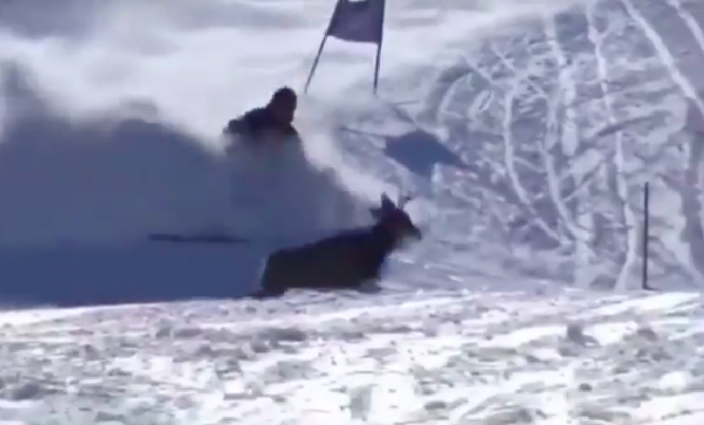
PROVISIONAL or RERUN?
Notes:
Witnessed by the Jury! Do you grant a “provisional” or do you grant an automatic “rerun” which will require no further Jury action?

Slide 137
COLLECTIVE OFFENSES [224.3]
In accordance with Art. 224.3, a “collective offense” occurs when several persons:
Commit the same offense
At the same time
Under the same circumstances
When addressing sanctions related to collective offenses:
Jury’s decision as to one offender may be considered binding upon all offenders
Written decision shall include:
    Names of all offenders concerned
    Scope of the penalty to be assessed upon each of them
Decision will be delivered to each offender.

Slide 138
GATE JUDGES
The Jury along with the support of the Organizing Committee may opt to not use Gate Judges for:
Downhill
Downhill Training
Super G
Super G Training
Giant Slalom
Measures MUST be taken to cover the entire course with sufficient:
Jury members
Jury Advisors
Eyes of the Jury
Connection Coaches [U669.3]
Slalom requires regular assignment of Gate Judges.
Please note U669.3 is a non-FIS rule. FIS rules require that Gate Judges be present for all events.
Notes:
This rule also does not prohibit an Organizing Committee from assigning Gate Judges to race arenas where, for example, the topography of the hill may result in limited visibility.

Slide 139
TEAM CAPTAINS’ MEETING & THE DRAW
An actual meeting, attended in person or online by Team Captains, Jury, and race officials
is an inseparable part of the competition and
is important for communication of Jury instructions,
support of the OC,
OC requests, and
information as well as
a critical element for risk management and liability related matters.
Art. 216 and 217 apply in all cases. [604.3]
Definition of a Team Captains’ Meeting also applies to non-FIS events. Race Announcement must include TCM date/time/format. For online meetings, log-in information must be made available to registered Team Captains.
Notes:
It is an accepted fact that not all areas of the nation have adequate internet connectivity/bandwidth, and online meetings are not possible (some still have rotary-type phones! Really, they do!).
Depending on the type of event, Team Captains’ Meetings may be held either the night before an event, the morning before the event, or at the end of the day for the next day’s event.
IT IS RECOMMENDED THAT TCM FOR EVENTS WITH SPECIAL SEEDING (Continental Cup, Championships, etc.), BE IN-PERSON MEETINGS.

Slide 140
LESS THAN 5 COMPETITORS:
FIS PENALTY - MAX VALUE
If there are less than five competitors with FIS points among the first ten of the result list,
or there are not five competitors who started with FIS points,
then those competitors without FIS points will receive the maximum value as noted in Rules of the FIS Points.
If less than three competitors with FIS points are ranked within the five
or at least three competitors without FIS points are classified,
the competition will be considered for FIS points with a double of the maximum value (of the respective event) as minimum penalty.
[4.4.4 Rules of the FIS Points]

Slide 141
MINIMUM PENALTY: NON-FIS EVENTS
if an event does not meet required minimum vertical drop (MVD), the following shall be applied:
the greater of the calculated penalty
calculated penalty plus addition (doesn’t meet time requirement), or
the minimum penalty of 60.00
If an event does meet required minimum vertical drop (MVD), the following shall be applied:
the greater of the calculated penalty, or
the minimum penalty of 40.00

Slide 142
DOCUMENTS & SIGNATURES
The list of documents that must be submitted to U.S. Ski & Snowboard and the FIS Office has been reduced, but rules still require signatures on many documents including, but not limited to TD Report, TDTR, Jury Minutes, Team Captains’ Meeting Minutes, Report by the Referee, Protests, etc.
Signatures confirm rules and procedures were followed, and original, signed documents may be required in a legal review.
If the Technical Delegate agrees to the use of electronic signatures on certain documents, h/she must verify availability of legally-acceptable document signing software, e.g., DocuSign, eSign, etc., which “certify” signatures with time and date, etc.
Copying and pasting a facsimile of a signature is not a legally acceptable electronic signature
It is strongly suggested that Technical Delegates request copies – either paper or electronic – of all event-related documents.
Notes:
Refer to U202.2, 601.4.5.5, 601.4.9.3, 601.4.10, 611.3.3, 617.3.4, 646.3. All of these rules refer to a requirement for a signature.
In addition, TCM Minutes form and Protest form have a signature line.
If you, as the Technical Delegate, do not have copies of all event-related documents, you are eliminating your ability to prove 1) How the event was conducted, and 2) What you actually approved.

Slide 143
WHAT IS “FORCE MAJEURE”?
In Alpine competitions, "force majeure" describes those uncontrollable/unexpected events (such as extreme weather, extreme surface conditions) that are not the fault of any party and that make it difficult or impossible to carry out an event.
An unexpected weather occurrence that requires a program/course/assignment change
A last-minute ski area management decree
Force majeure is “uncontrollable and unexpected”; force majeure is not “planned”.
Notes:
Your team playing in the Super Bowl does not constitute force majeure!

Slide 144
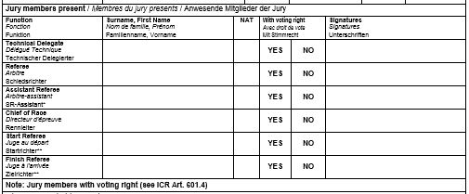
JURY MEMBER SECTION:
TD’s Name
USA
Must be SIGNED!
RF’s Name
USA
Must be SIGNED!
NAME/NAT
Must be SIGNED! DH/SG/WC SL & GS
CR’s Name
USA
Must be SIGNED!
Only OWG, WSC
Only OWG, WSC
Notice that form requests: SURNAME / FIRST NAME
VOTES MUST BE RECORDED!
“YES” or “NO”
PLEASE NOTE: “Jury members with voting right”
Listing Start & Finish Referee and marking “NO” means the official voted: “NO”; it does not mean the official does not have voting rights.

Slide 145
EVENT RELATED DOCUMENTS
For events with no issues (injuries or accidents), it is recommended all event-related documents be kept on file for one (1) year.
In the case of an event with serious injury/accident as defined by the “Guidelines for Serious Accidents” as posted in the MPF, the Technical Delegate must immediately contact Jeff Weinman, U.S. Ski & Snowboard Competition Services for instructions.

Slide 146
IMPORTANT UPDATE: VOLA
NOTE:
VOLA will now require use of a “new generation dongle.”
The old dongle will no longer be updated.
Technical support will not be available.
Users who returned the old dongle to Jeff Weinman prior to 31 October 2024 received a replacement free of charge.
Users who did not return the old dongle prior to that date, will have to pay an CHF 89 fee in order to receive a new one.
Complete information is available at:
vola-racing.ch/en/timing/logiciels/utilitaires/vola-board

Slide 147
IMPORTANT CLARIFICATIONS: Timing
Calculation of Missed Impulses
If both the Start impulse and the Finish impulse from System A are missed:
Replacement ToD’s must be calculated for each missing impulse as outlined in ICR 611.3.2.1
Net time is then calculated & applied
(Use 1 form for Start ToD and 1 form for Finish ToD.)
Synchronization of Timekeeping Systems
Synchronization of timing systems must occur as close as possible to scheduled start for the first run
After synchronization is done, a new impulse must sent by the same source to check the synchronization accuracy on Systems A and B
Synchronization of all systems must be maintained and must not be re-synchronized for the second run
FIS Base Points
Points posted in the Season 2025 FIS Base Points List must not be used for event seeding or penalty calculation purposes.

Slide 148
CHIEF OF TIMING AND CALCULATIONS: This official supervises, documents and enforces quality control of timing operations. With exception of lower-level events (e.g., YSL), where staffing might require it, Chief of Timing and Calculations should not be operating the timekeeping equipment or the timing/race result software.
RACE ADMINISTRATOR: Due to requirements for preparation of accurate event documentation (these are documents that may be required in a legal review), it is strongly recommended that the Race Administrator not also assume the duties and critical event responsibilities of the Chief of Timing and Calculations.
This becomes even more critical with the additional duties required in order to be in compliance with MAAPP and SafeSport Code.

Slide 149

For additional information, refer to current editions of:
U.S. Ski & Snowboard Alpine Competition Guide
FIS ICR
FIS Alpine Skiing Timing Booklet
Rules for the FIS Points
Remember:
Without accurate timing, you don’t have an event!

