Slide 1
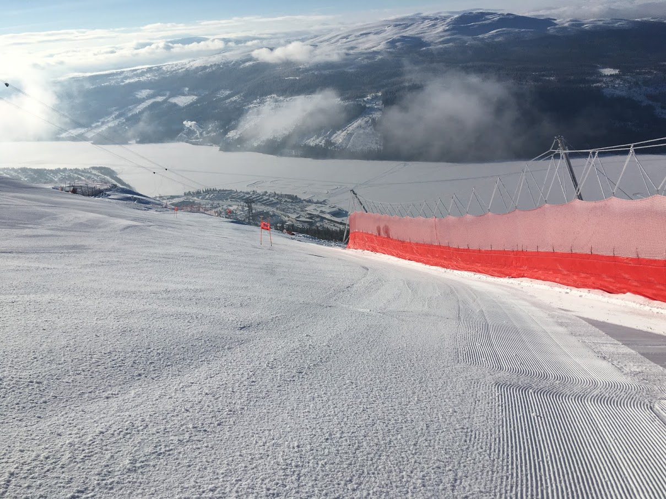
COURSES
©PVS Consulting 2019
Paul Van Slyke, USA
Notes:
Welcome and Introduction
All U.S. Ski & Snowboard competition courses must be homologated or registered by the U.S. Ski & Snowboard Alpine Courses Working Group inspectors

Slide 2
Notes:
This is what the certificate looks like
Is this the entire certification?
What else may be in the file?
We will find out.

Slide 3
Notes:
The inspection report
Contains a variety of information regarding the site, the slope, the general area.

Slide 4
Notes:
Map -Location, directions, nearby intersections.

Slide 5
Notes:
Contains – Place, contact, specifics of vertical drop, length & gradient.

Slide 6
Safety Information & Protection Plans
Recommended protection installations: Jacopie has a surface lift and chair lift towers on skiers right and snow guns on skiers left. For SL there should be a minimum of 25 (20m) rolls of B-net available to the Jury. Crowd control devices should be used where appropriate to separate the race area from the general public skiing areas. For GS, it is recommended that B-net be placed on both sides of the trail from just below the start to the finish. Final B-net placement will depend on conditions, course set and Jury instructions.
Notes:
Safety Plan recommendations – read slide

Slide 7
Safety Information & Protection Plans
Emergency evacuation and medical services: A member of the Labrador Mtn. Ski Patrol, with a toboggan, will be positioned at the top of the race hill during all USSA events. Patrol buildings are located at the top of the triple chair lift (about 150 ft away from the GS start) and at the bottom of the hill. Smith Ambulance out of DeRuyter NY is available by phone 315-852-3393. Local hospitals are located in Cortland, Ithaca, and Syracuse. Mercy flight “Life Flight” is available. Major trauma unit is located in Syracuse at the Upstate Medical Center.
Notes:
Emergency Evacuation and medical services on site – Read Slide.

Slide 8
Other Inspector Report content
12. Communication start - finish (telephone, electrical timing cable etc.): Hard wired timing and communications top to bottom.
13. Have the necessary documents been submitted? yes:
14. Uphill facilities (Lifts etc.): Triple Chair lift and T-bar surface lift.
15. Hourly capacity / persons: 1800 PPH
16: The inspector was assisted by: Robert Okoniewski (Race Club), Sue Wilson (Owner), Mike Browne
17. General remarks:
18. Conclusions: Approval recommended
Notes:
Other info that may be useful.

Slide 9
Other Inspector Report content
Notes:
Registered GS and Homologated Slalom.
A registered course is one that does not meet minimum standards and possible penalties may apply – see current Alpine Competition Rules.
Specifically a GS requires 250 meters minimum vertical drop and in this case Jacopie has only 134 vertical drop.
Slalom requires 100 meters and thus conforms to homologation requirement.

Slide 10
Notes:
Trail Map – to identify you reviewing the correct slope and provides bearing to which lift you will use to access the slope.

Slide 11
Notes:
Overhead Image – provides a realistic visual of the resort and homologated trail.

Slide 12
Notes:
Topographic Map – (not very good one here)
Raise your hand if you understand how to read a topographic map and understand the meaning of the lines?

Slide 13
Notes:
Gradient – Note legend top right – Elevations, Vertical Drop, Length, Average Gradient, Minimum and Maximum Gradient.

Slide 14
Notes:
Protection Plan requirements for Slalom - Note that only crowd control fencing is required and trail closure.
In the fine print – Final B-net placement will depend on course set, conditions and jury instructions.
Considerations should be made by the jury to consider b-net installations based on their inspections and any obstacles present on the competition day.

Slide 15
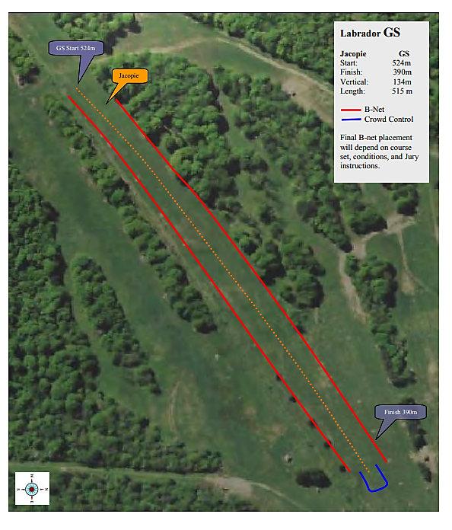
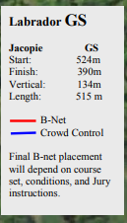
Notes:
Protection Plan – This is the minimum required to run this GS. The Jury may ask for additional safety installations dependent on course set and snow conditions.
Protection Plans and Homologations/Registrations are not only meant for competition days. It is Best Practice to train your athletes as they would compete.
Safety installations for Training should be reflective of same concerns as on competition days.
TD’s, Jury’s and Organizers should always plan ahead, review the homologation in this planning and be prepared for all Protection Plan requirements.
They should also plan to have additional materials in the event the jury should request additional installations.

Slide 16
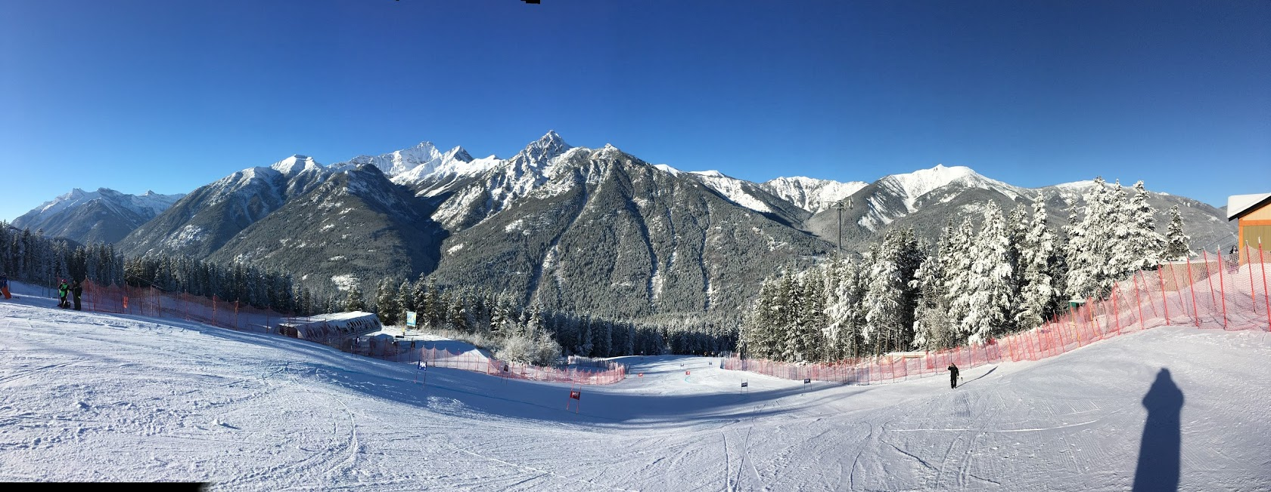
This is THE OFFICIAL Location to find the
most Recent, Valid Homologations
Where to find this information:
media.ussa.org/Public/Athletics/CompServices/Homologation/
Username = homologation
PW = Allout2018!
Notes:
The Username and Password for U.S. Ski & Snowboard homologations is published in the Annual Review and Update on U.S. Ski & Snowboard website.
ONLY Current Homologations are published here.
Do not rely on a paper copy unless you print it yourself from the U.S. Ski & Snowboard Site or you may not have the most accurate info!
Valid FIS Homologations are also contained in the database.

Slide 17
Notes:
Log in and you will find a State by State Directory.

Slide 18
Notes:
Click on your State of interest and you will find all homologations/registrations available.

Slide 19
Notes:
Search for your resort and find the homologation you intend to use or study.
In our case, you fill find the course reviewed in this presentations – NY Labrador Mountain Jacopie GS & SL
This is your official resource for homologations/certifications. If you can’t find a homologation, it is VERY likely it doesn’t exist or has expired.
Super G & Downhill MUST be run on tracks that are homologated for the discipline. (DH on DH, SG on SG) NO EXCEPTIONS.

Slide 20
601.4.9.1 Before the race
The TD
• reviews the homologation file and consults the organizer about the possible existence of a special authorization. If he establishes that no homologation exists, the Jury must cancel the race (see 650).
Notes:
Know the rules about the requirements of using homologated courses.
601.4.9.1 – Responsibility of the TD Before the Race.

Slide 21
601.4.9.1 Before the race
The TD
has the right, if a SL or GS cannot be carried out on the homologated course because of “force majeure”, to move the race to a “substitute course” proposed by the organizer. This is on the explicit condition that the necessary homologation measures can be fulfilled. For DH and SG there is only the possibility of shortening the run on a homologated course. The minimum prescribed vertical drops must, however, be observed in any case.
Note – Force Majeure can not be planned prior to an event by the organizing committee with intent to use a non homologated slope. An event must be calendared on a homologated slope to be on the competition calendar. If due to weather, or some other change of the conditions of the homologated slope, causes the homologated slope to be unusable, force majeure may apply and the jury could make a decision to use another slope. Jury Minutes with details about the change of course along with votes and signatures of voting Jury members are required.
Notes:
Force Majeure can’t be decided in advance of a competition.
To calendar an event, a valid homologation is required.
Example – on the day before the competition a snowmaking pipe broke and the ensuing water washed out the homologated trail.
There is no chance to repair the slope. The TD was present and worked with the OC to look at other slopes that may be suitable as a force majeure site.
COR & TD agreed on another slope that met the standards and agreed on a Protection plan for the substitute slope.
Before the TCM, the referee was appointed and the jury formally confirmed the change to the substitute slope unanimously.

Slide 22
650 Rules about the Homologation of the Courses
U650.1 General
All sanctioned events (DH, SG, GS, and SL) both scored and non-scored, including Masters, must be run on courses that have been approved by U.S. Ski & Snowboard or by FIS. Courses not meeting the minimum vertical drops requirements will be registered, and an inspection certificate provided. Registered courses are subject to all rules pertaining to homologated courses. U650.1.1 All FIS-homologated trails are automatically accepted as meeting national course approval standards.
Notes:
Rules of Homologation – all courses must be run on courses that have been approved!

Slide 23
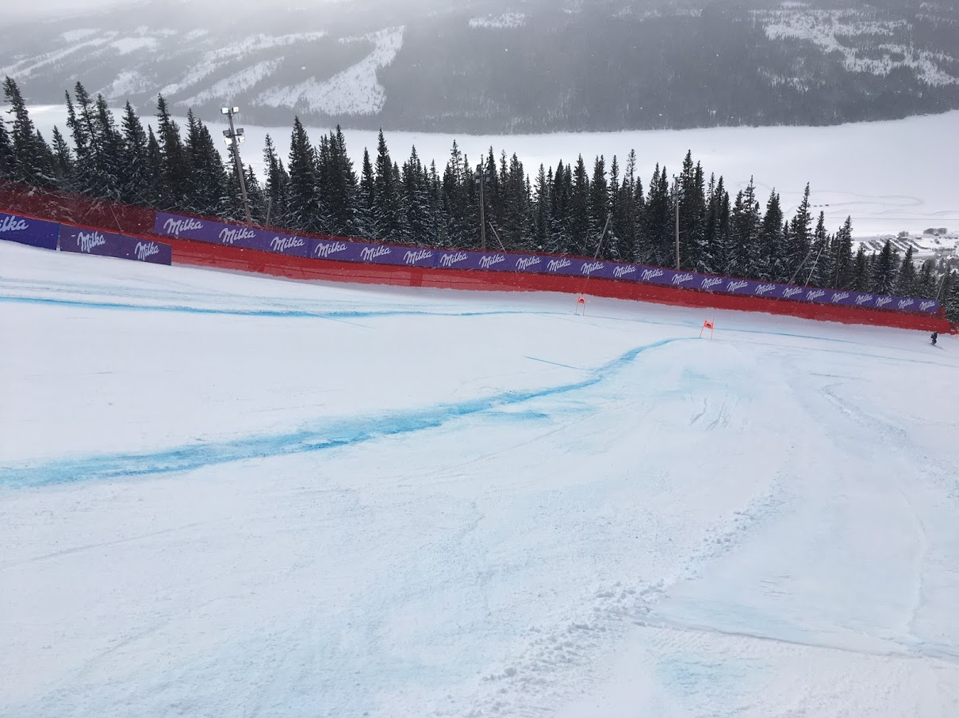
Know your Courses, Plan and be Prepared!
Thank you!
This presentation outlines manufacturers recommendations and suggested safety applications. This presentation may not be altered or edited in any fashion unless with author’s permission.
©PVS Consulting 2019
Paul Van Slyke, USA
Notes:
Thank you! Questions?

